Slide 1

Frequency Isolation Using Cascaded KHN Biquad Filter
Team name: Peak-Velocity
Team members
SIVA SUBRAMANYAN R M
SUJITH KUMAR V
UDHAYAN C H B
VISHNUVARDHAN M

Slide 2
Abstract
To isolate the 6 kHz usable signal from a composite analog input containing drift, interference, and noise.
To implement cascaded KHN Biquad filter for selective frequency extraction.
To enable smooth manual tuning and ensure stable, repeatable signal conditioning validated through FFT analysis.
To demonstrate frequency selectivity using cascaded KHN Biquad filter stages implemented with op-amps and RC networks.
To verify effective suppression of unwanted frequency components and noise through FFT analysis for different tuning conditions.

Slide 3
Problem Statement
Design and simulate a pure analog signal-conditioning circuit that extracts and amplifies the 6 kHz usable signal from a composite input containing low-frequency drift, structured interference, high-frequency interference, and broadband noise.
The circuit must suppress unwanted components, ensure stable output, allow smooth manual tuning during operation, and demonstrate repeatable performance using transient and FFT analysis.

Slide 4
Proposed Solution
An analog signal-conditioning circuit using cascaded KHN Biquad filter, is designed to extract the 6 kHz usable signal from a composite input.
A high-pass stage suppresses 600 Hz drift, a tunable band-pass filter isolates the desired signal, and a low-pass stage attenuates high-frequency interference.
A potentiometer enables smooth manual tuning for stable, repeatable operation.

Slide 5
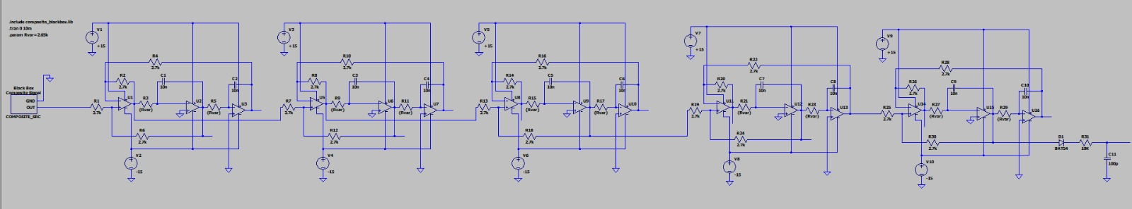
System Architecture
Cascaded KHN Biquad Filter

Slide 6
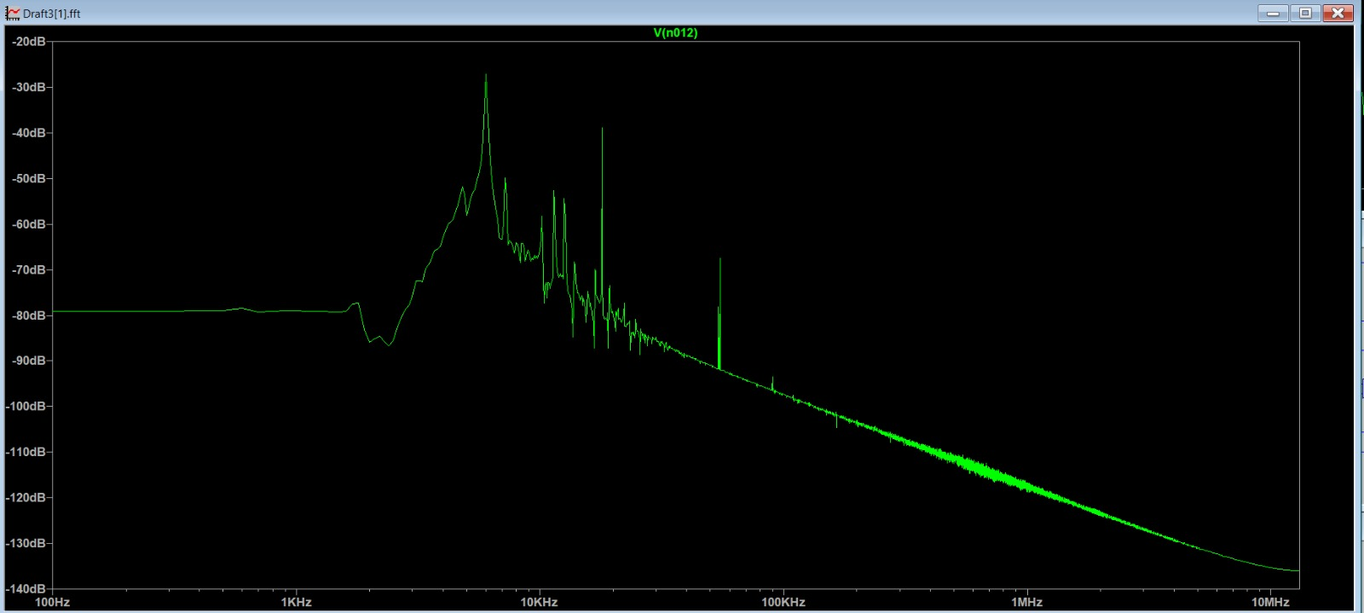
FFT Analysis of Output Signal
FFT Analysis of 6khz from Composite Signal

Slide 7
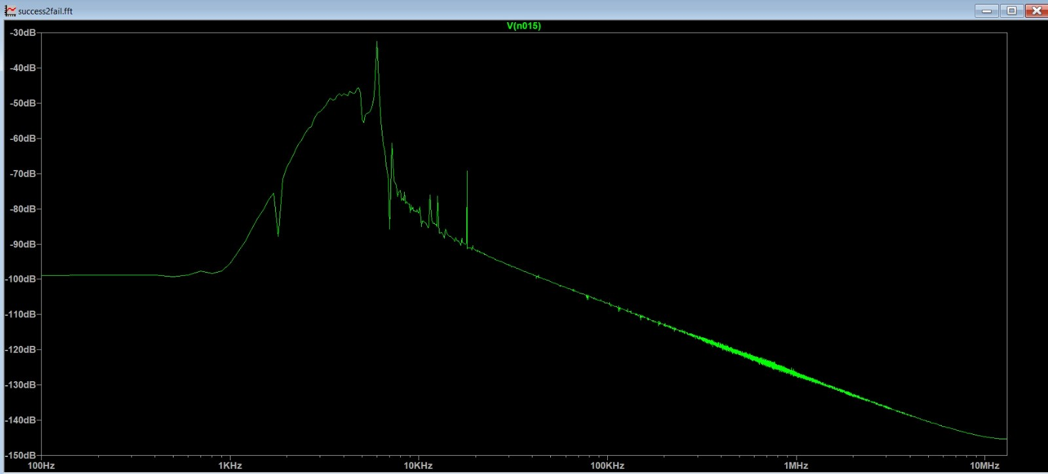
FFT Analysis of Output Signal
FFT Analysis of 4khz from Composite Signal

Slide 8
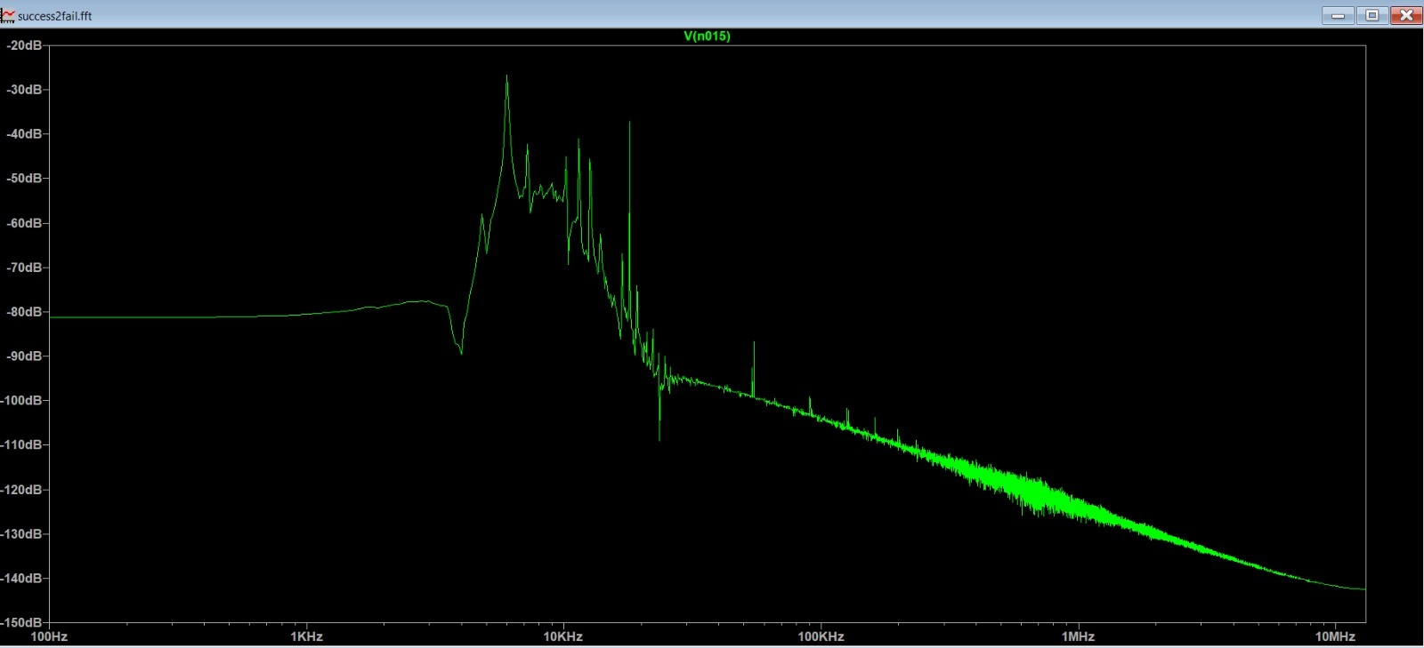
FFT Analysis of Output Signal
FFT Analysis of 8khz from Composite Signal

Slide 9
Results
Cascaded KHN Biquad filters effectively isolate the 6 kHz usable signal from the composite input. FFT analysis shows strong attenuation of 600 Hz drift, 18 kHz square interference, and 55 kHz noise.

