Slide 1

FIRST PARK THEN PAY
Udhayarajan J (2202561) MCA – I
Guided by : Nidhi Damle
( Assistant Professor, MCA Department )

Slide 2
Objectives
To provide a smooth and efficient parking system
To reduce waiting time and avoid long queues
To offer real-time tracking of available parking slots
To ensure accurate billing and improve parking management

Slide 3





Technologies Used
Java (Spring Boot)
– For building the backend API and business logic.
Angular
– For developing the frontend user interface.
MySQL
– For storing parking, user, and payment data.
Key Cloak
– For secure authentication and authorization.
Docker
– For containerizing the application and easy deployment.

Slide 4
Modules
Dashboard & Reporting
First Pay Then Park
User Management
Vehicle Management
Billing & Payment Management

Slide 5
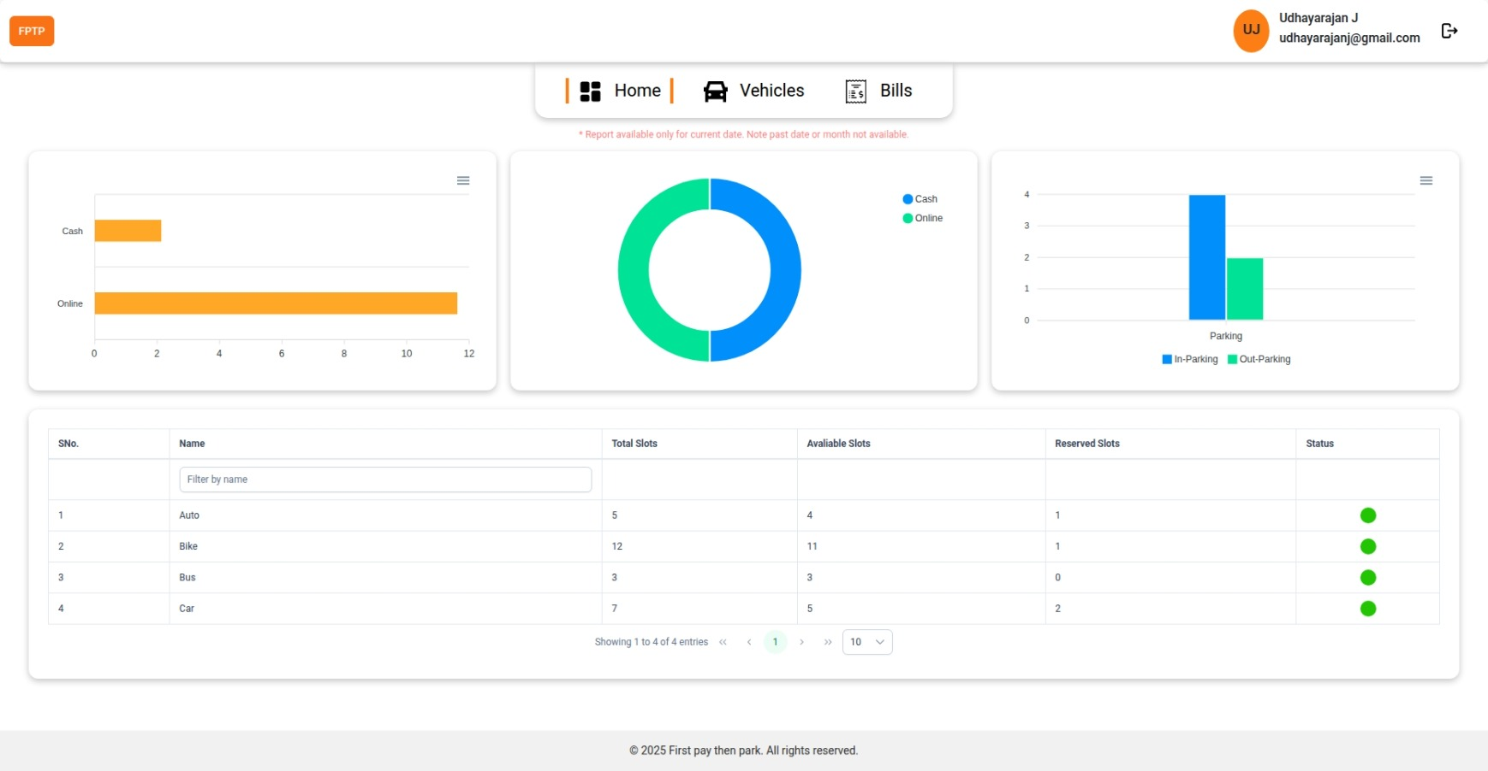
Dashboard & Reporting
Displays today’s collection split by cash and online payments for quick revenue insight.
Shows total in-parking and out-parking vehicles to monitor real-time occupancy.
Summarizes total, available, and reserved slots by vehicle type (auto, bike, bus, car) to support allocation decisions.

Slide 6
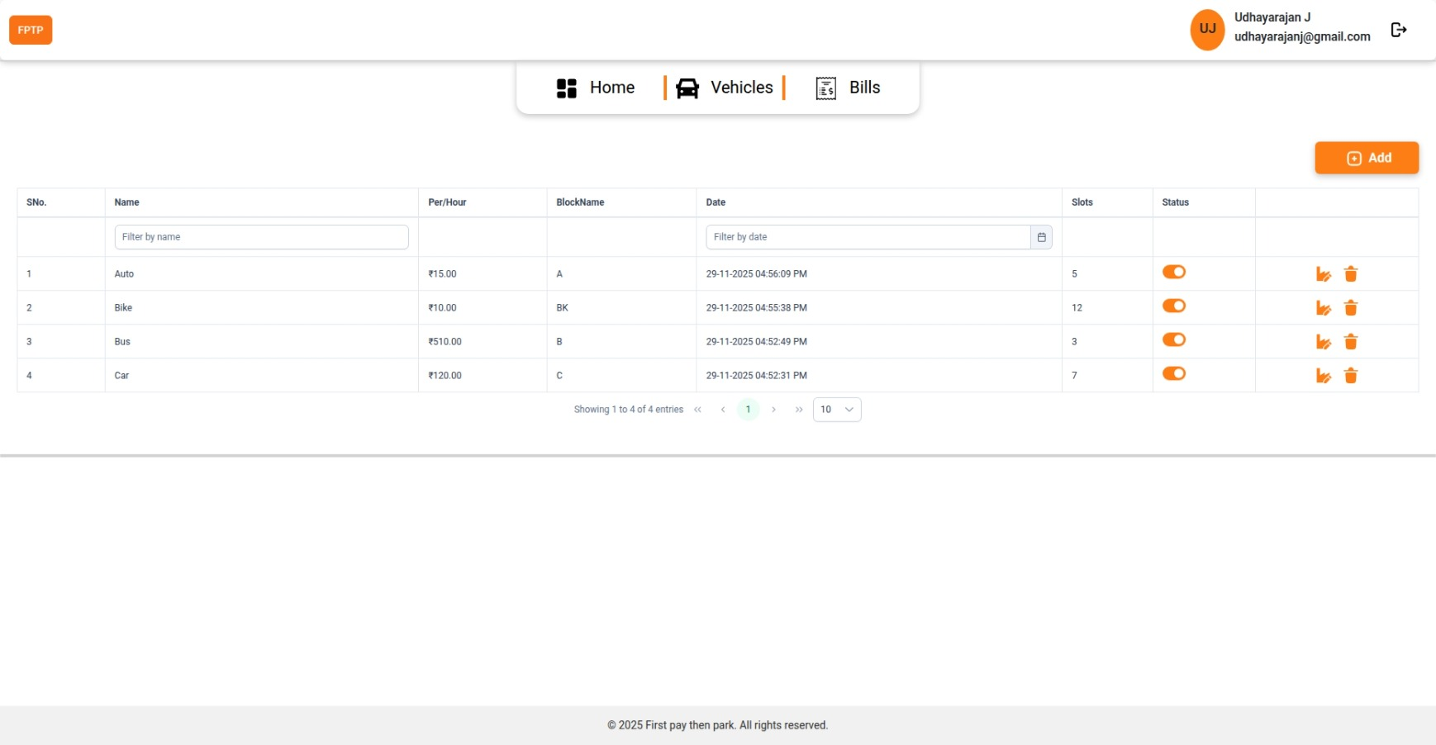
Vehicle Management
Lists all vehicle types with their hourly rate, block assignment, total slots, and status to manage parking configuration efficiently.

Slide 7
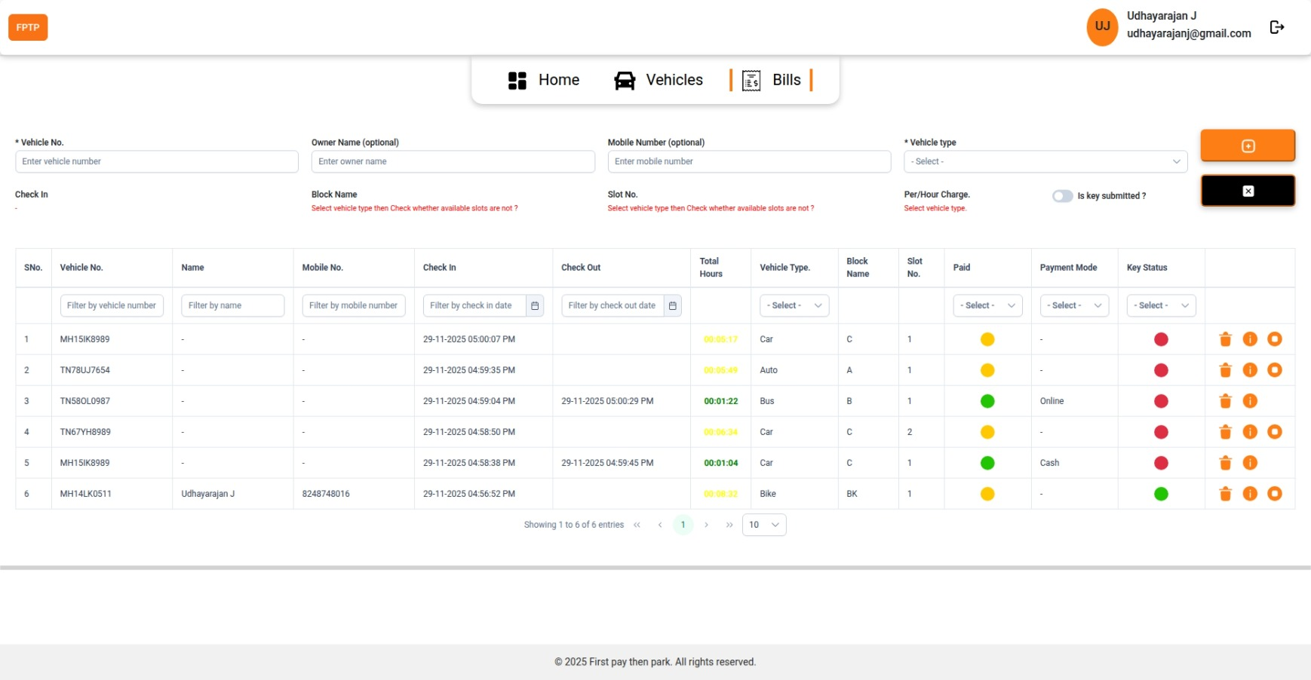
Billing & Payment Management
Captures all active parking sessions with vehicle, slot, time in/out, and total hours for precise tracking and billing.

Slide 8
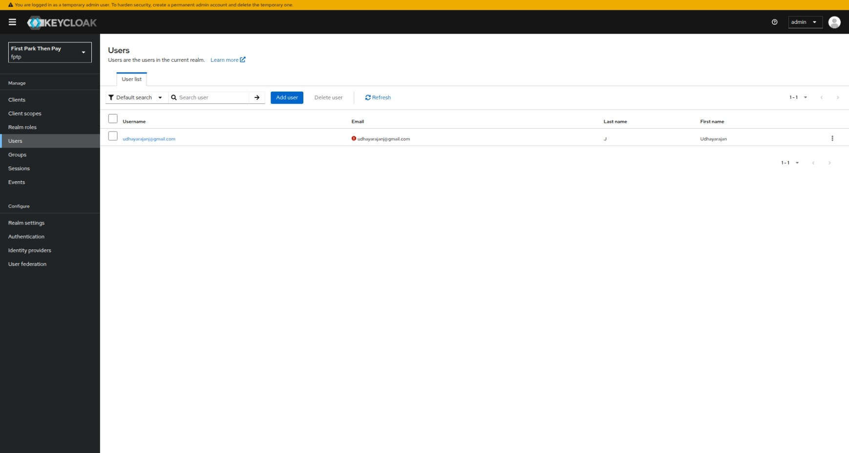
User Management
Manage Users
Efficient user management is crucial for maintaining secure and organized access within the system.
Administrators can create, update, and delete user accounts, assign roles, and control authentication settings.
This ensures that only authorized individuals can access specific resources, enhancing both security and operational clarity.

Slide 9
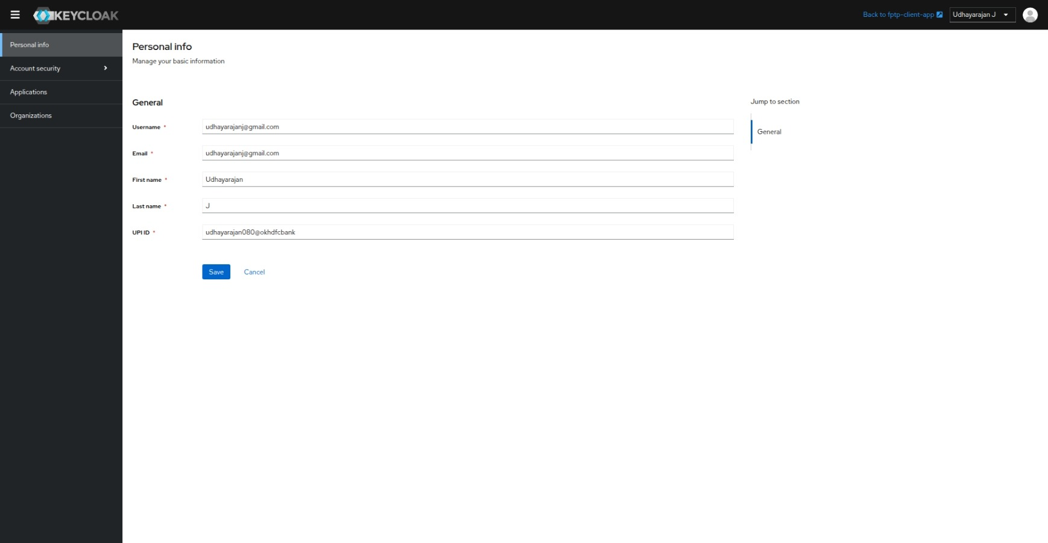
User Management
Personal Info Management
Users can view and update their basic profile details such as username, email, name, and UPI ID.
This ensures accurate identity representation and supports seamless integration with payment systems and communication channels.
Keeping personal info up to date enhances user experience and system reliability.

Slide 10


