Slide 1
NextStop - Online Travel Booking System
SPM PROJECT
‹#›

Slide 2
Contents
Meet Our Team | 3
NextStop-Online Ticket Booking System | 4
Scope | 5
Architecture Diagram | 6
Tools | 7
Tech Stack | 8
Future Works | 9
‹#›

Slide 3
Meet our Team
Name | Register Number | Role
Malarvannan M | 2022503011 | Project Manager Frontend / UI developer
Udhya Kumar K | 2022503051 | Technical Lead / Developer
Bose B | 2022503061 | Database / Backend Specialist
Shreya Sankaran | 2022503071 | Quality Assurance(QA) Lead
Vedalakshmi K | 2022503301 | Documentation & Knowledge Manager
Akash S | 2022503041 | Monitoring & Reporting Lead
Guru Aravindan V | 2022503001 | Collaboration & Communication Coordinator
‹#›

Slide 4

NextStop - Online Travel Booking System
A web-based platform for reserving bus tickets online.
Eliminates the need for physical booking counters.
Provides real-time seat availability and booking confirmation
Offer secure payment options for convenience.
Enhances the traditional booking process with AI-powered features and personalized experience.
‹#›

Slide 5
Scope
User Features:
AI-powered seat recommendation
Booking fairness system for certain buses
Wallet and loyalty points
Multilingual support
Payment gateway integration
Notifications and alerts
‹#›

Slide 6
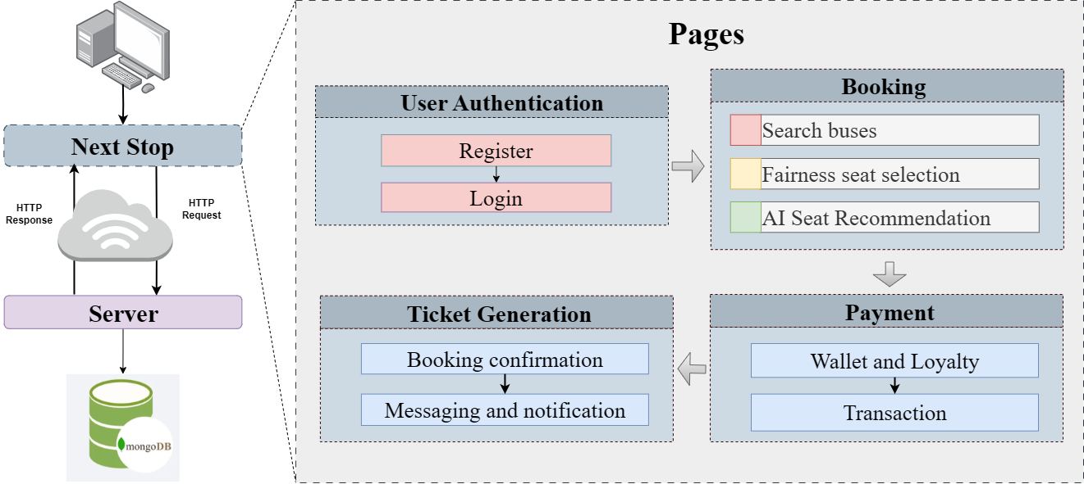
Architecture Diagram
‹#›

Slide 7




Tools
‹#›

Slide 8








Tech Stack
‹#›

Slide 9
Future Works
Development of a Landing Page with user-friendly navigation
Database design and integration (schema, user, booking, bus, and transaction tables)
Implementation of Ticket Summary & Payment Pages for complete booking flow
‹#›

Slide 10
THANK YOU !
‹#›

