Slide 1

FuseLens Attention-Guided Chimera Classification
Udi Bahat

Slide 2
Overview
Background
Motivation
Methodology
Results
Comparative Analysis
Summary
Future Work
Q&A

Slide 3
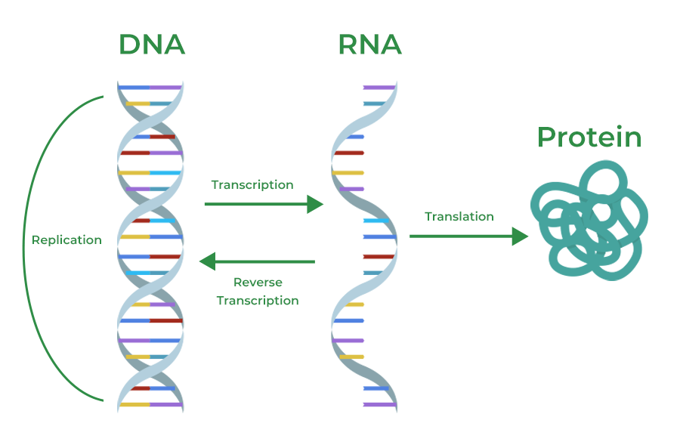
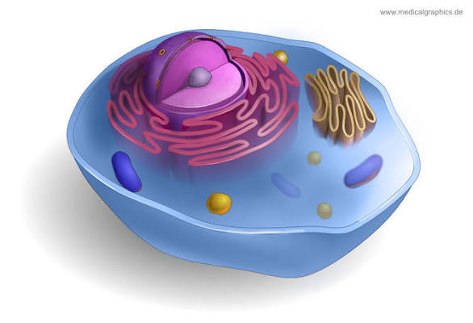
Background - The Central Dogma
The Core Process:
Transcription: The information stored in a cell's DNA is copied into a portable messenger molecule called mRNA (messenger RNA).
Translation: This mRNA travels to the ribosome, where its code is "read" and used to assemble a specific chain of amino acids, which folds into a functional protein.

Slide 4
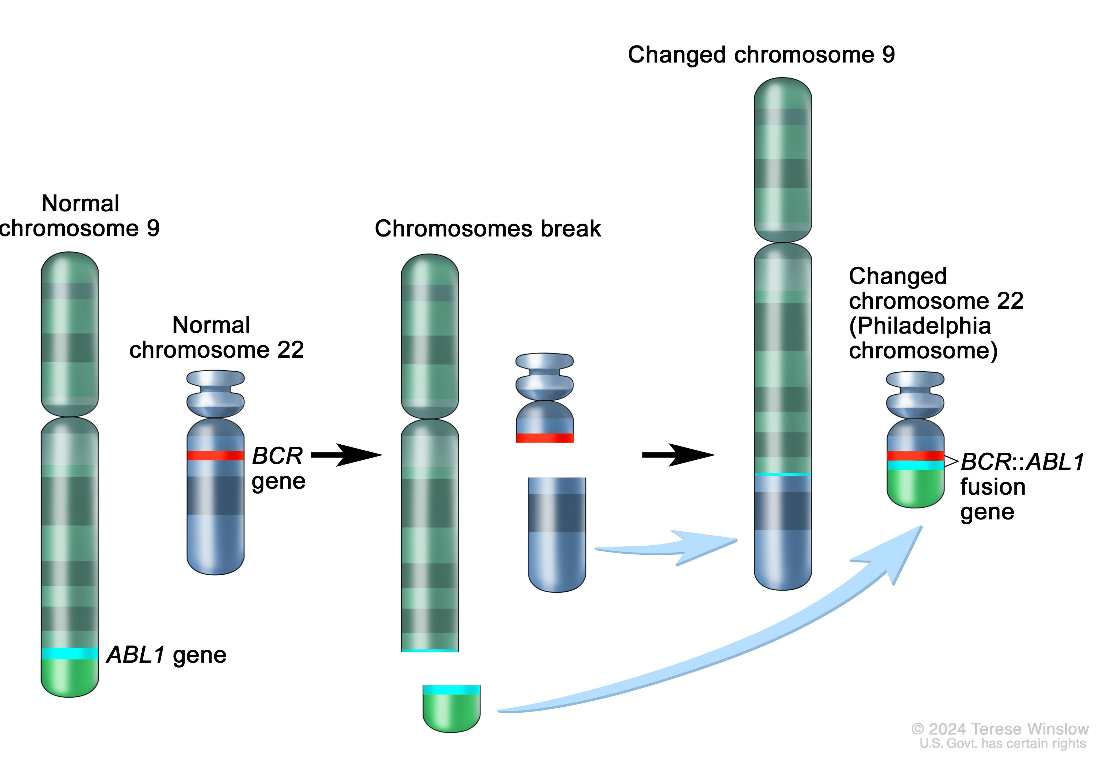
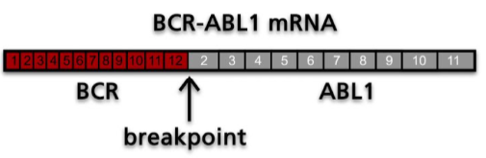
FuseLens -Motivation
Gene Fusions - 2 Genes combined to together to create 1 RNA strand, they originate in DNA, but functional danger comes from Chimeric RNA
Chimeric RNA drive ~20% of all human cancers
BCR-ABL1

Slide 5
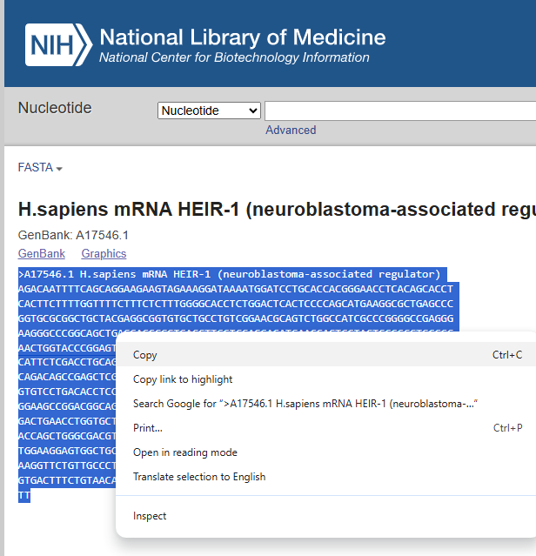
FuseLens - Motivation
Alignment-first pipelines rely on hand-engineered rules and have high false positives rates
Every false positive is a potential misdiagnosis + wasted resources (PCR/Sanger).
Existing Models have short context (up to 20k bp) while Long-context models are computationally heavy.
The median human gene length is approx 26 kb, but oncogenes can span over 60 kb
The Gap: There is a need for an efficient tool with Long Context + high speed clinical screening for both classification and coordinate matching.
Notes:
Average Gene Size (Including Introns): Roughly 10 kbp – 30 kbp (10,000 to 30,000 base pairs). Some studies suggest an average of 27,000 bp or even up to 62,000 bp depending on whether all regulatory regions are included.

Slide 6
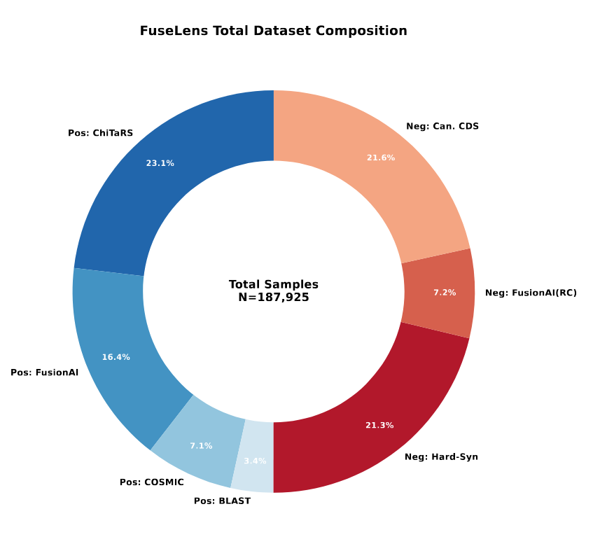
FuseLens – Methodology (Data)
Positives – ChiTaRS 8.0, FusionAI, COSMIC, BLAST-validated chimeras
Negatives – canonical CDS (UniProt Swiss-Prot) + 5,000 paralog pairs (Ensembl Compara)
+ adversarial decoys that maximize loss:
RC – Reverse Complement (canonical CDS only; flipping a fusion is still a fusion)
D_shuf – Dinucleotide Shuffle (preserves k-mer stats, breaks grammar)
J – Shift-Invariant Junction (decoy breakpoint inside one gene)
Strict group-level partitioning (gene-pair / gene-identity) prevents leakage between train, validation, and test.
Notes:
Why Chimera? Clinical datasets lack precise breakpoint labels.
Dataset: Synthetic fusions with ground-truth coordinates.
Hard Negatives: We trained on 'spliced' non-fusions to force the model to learn abnormal junctions, not just splicing.

Slide 7
FuseLens – Negative Operators
Force the model to learn fusion grammar, not gene identity.
RC – Reverse Complement
Flips the DNA strand. Applied only to canonical genes — never to true fusions (a flipped fusion is still a fusion).
D_shuf – Dinucleotide Shuffle
Scrambles the sequence but preserves base-pair statistics. Forces the model to learn structure, not k-mer frequency.
J – Shift-Invariant Junction
Cuts a single gene and re-glues it. Creates a fake breakpoint inside one gene — model must verify the two halves come from different genes.
Paralog Pairs (n = 5,000)
Sister genes from Ensembl Compara — the #1 false-positive failure mode of alignment-based callers like STAR-Fusion.

Slide 8
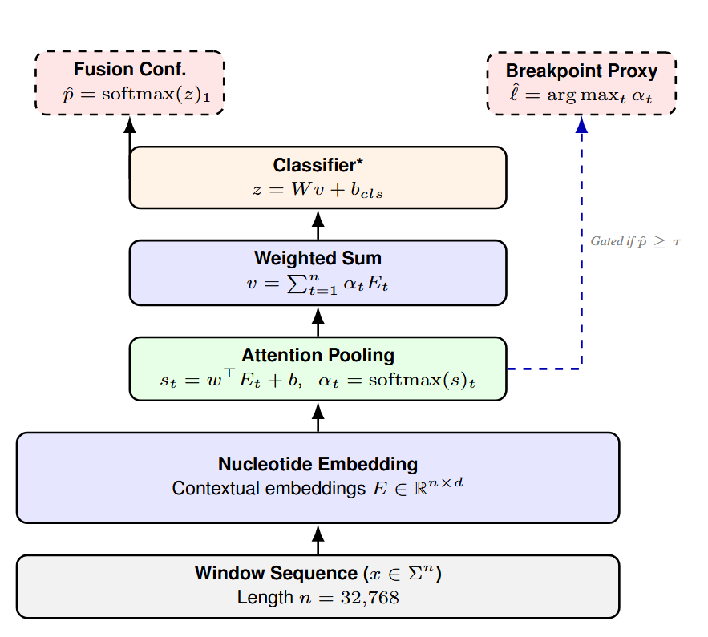
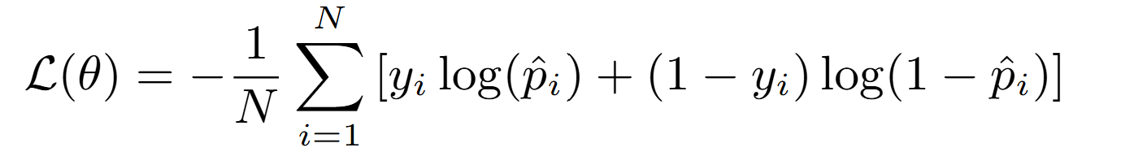



FuseLens – Methodology (Model)
Backbone: Nucleotide Embedding using HyenaDNA
Custom Attention Pooling Head
The model learns to assign high "importance" $\left(α\right)$only to nucleotides near the fusion boundary
Training Objective
BCE
Output:
Fusion confidence $\hat{p}$ + Breakpoint Area Pointer $\hat{ℓ}$
Motivation for Architecture:
Global context without the quadratic cost
Notes:
We adapted a pretrained HyenaDNA backbone and added specialized 'Lens’—
our custom attention pooling head.
Instead of just outputting a 'Yes/No' classification, our head learns a weighting parameter $\alpha$ for every nucleotide.
This allows the model to not only detect the fusion but to point to exactly where the breakpoint is.
Standard Transformers use Attention, FuseLens relies on the Hyena architecture, which takes a completely different approach. Instead of a massive Q,K,V comparison matrix, it uses Long Convolutions computed via the Fast Fourier Transform (FFT).
By moving the sequence into the frequency domain, we can perform global processing with a complexity of just $O(N \log N)$. This mathematical trick allows us to capture the entire 32k context essentially as fast as a linear scan, breaking the memory bottleneck that holds back standard Transformers.“
$y_i$ (Ground Truth Label): This is the binary target for the $i$-th sequence window.
$y_i = 1$: The sequence is a True Positive (a validated fusion transcript from ChiTaRS/COSMIC).
$y_i = 0$: The sequence is a Negative (either a canonical gene, a Reverse Complement decoy, or a Shift-Invariant Junction decoy).
Mechanism:
When $y_i=1$, the first term $\log(\hat{p}_i)$ is active, penalizing the model if it predicts a low probability for a fusion.
When $y_i=0$, the second term $\log(1 - \hat{p}_i)$ is active, penalizing the model if it is "fooled" by a hard negative decoy.

Slide 9
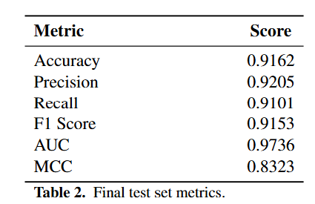
FuseLens – Results
Strong discriminative results on the test set, achieving an Accuracy of 91.62%.
The model effectively separates true fusions from the negative space, maintaining a balanced performance profile even against hard adversarial negatives
Notes:
FuseLens demonstrates strong discriminative capacity on the testset, achieving an Accuracy of 0.9162. The model effectivelyseparates true fusions from the negative space, maintaininga balanced performance profile even against hard adversarialnegatives

Slide 10
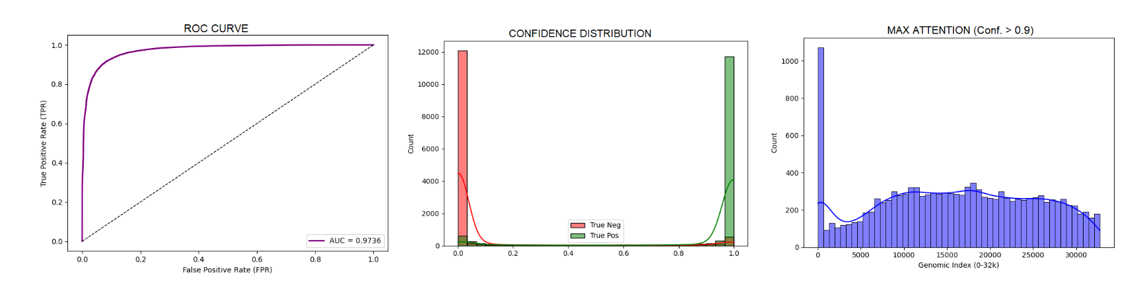
FuseLens – Results
There is a disproportionate accumulation of attention peaks at the start of the sequence window (Index 0).

Slide 11
Ablation: Do Hard Negatives Matter?
Stress test: n = 10,000 sequences with swapped gene order (Gene B → Gene A). Same genes, glued back-to-front.
95.63%
failure rate without adversarial training (canonical CDS only)
8.4%
failure rate with full FuseLens 1.0 adversarial pipeline
Without the negative operators, the model memorizes gene identity — not fusion grammar.

Slide 12
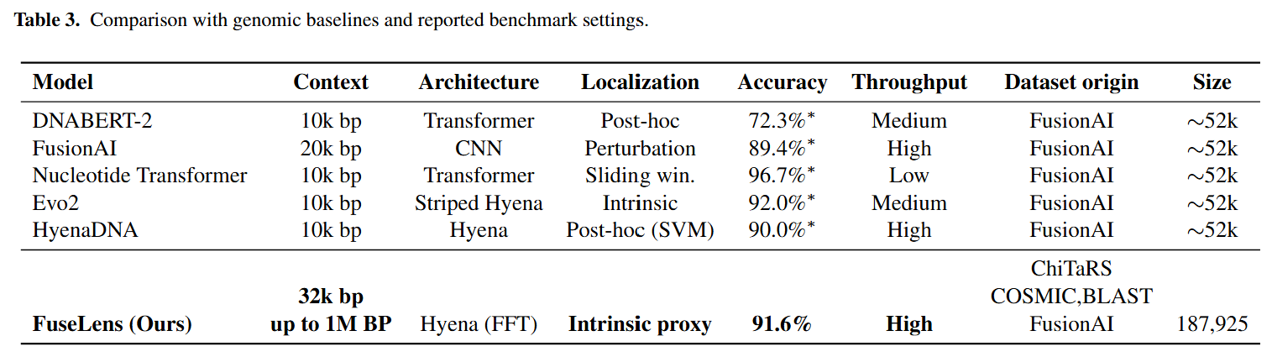
FuseLens – Comparative Analysis
Notes:
Sharp Localization: In 35.4% of cases (n = 4, 511), theattention mechanism collapses into a narrow peak (width≤ 500 bp). This occurs in high-confidence scenarios, suchas distinct exon-exon boundaries, effectively pinpointing thejunction

Slide 13
FuseLens – Results
Sharp Localization: In 35.4% of cases (n = 4, 511), the attention mechanism shows a narrow peak (width≤ 500 bp).
Regional Localization : For sequences with high repetitive content, the model attends to a broader region (width > 500 bp), aggregating evidence across the genes.
Notes:
Sharp Localization: In 35.4% of cases (n = 4, 511), theattention mechanism collapses into a narrow peak (width≤ 500 bp). This occurs in high-confidence scenarios, suchas distinct exon-exon boundaries, effectively pinpointing thejunction

Slide 14
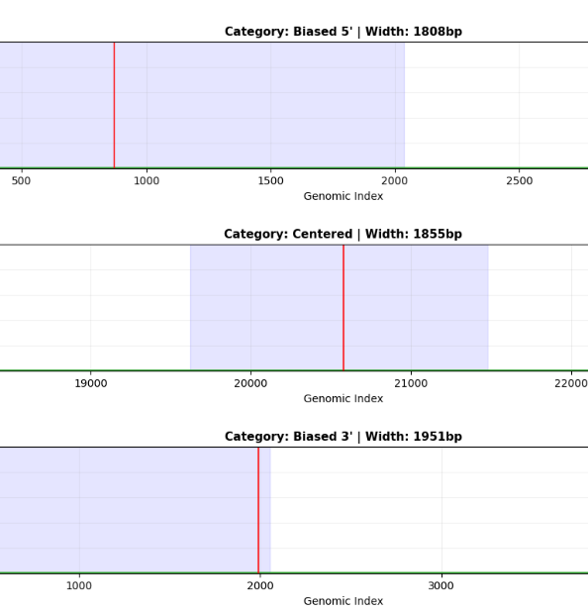
FuseLens – Results
Sharp Localization: In 35.4% of cases (n = 4, 511), the attention mechanism shows a narrow peak (width≤ 500 bp).
Regional Localization : For sequences with high repetitive content, the model attends to a broader region (width > 500 bp), aggregating evidence across the genes.
Notes:
Sharp Localization: In 35.4% of cases (n = 4, 511), theattention mechanism collapses into a narrow peak (width≤ 500 bp). This occurs in high-confidence scenarios, suchas distinct exon-exon boundaries, effectively pinpointing thejunction

Slide 15
FuseLens 1.0 → 2.0: The Localization Gap
Strong classifier ≠ useful pointer
FuseLens 1.0 — discrimination is excellent:
• Accuracy 0.916 AUC 0.973 F1 0.915
…but localization is not:
MAE = 5,501 bp
≈ 17% of the 32 kb window — too coarse for any clinical use.
Why? Attention pooling was supervised only by the classification loss. With no signal pointing it at the breakpoint, attention spreads as a diffuse smear.
The Update: tell the model where the breakpoint is during training.

Slide 16
FuseLens 2.0: Multi-Task Learning
Same backbone (HyenaDNA), now with two heads sharing the same attention distribution.
Classification head
Same as 1.0: pooled vector → linear → BCE loss.
Localization head — soft-argmax
p̂_coord = Σ t · α_t
Expected position under the attention distribution. Differentiable — gradients flow through α_t back into the encoder. (Standard arg-max wouldn't work: zero gradient almost everywhere.)
Combined objective
ℒ_MTL = ℒ_cls + λ · ℒ_loc λ = 0.1 (validation-selected)
ℒ_loc is masked: only applied when the sample is a true fusion and the breakpoint survives random cropping.

Slide 17
FuseLens 2.0: 89× Better Localization
λ sweep (validation set)
λ = 0 (1.0 baseline) MAE 5,501 bp
λ = 0.01 MAE 850 bp
λ = 0.1 ★ selected MAE 61 bp
λ = 1.0 MAE 68 bp (classification collapses)
Test set (τ = 0.21, validation-calibrated)
MAE = 61.3 bp
≈ 89× reduction vs FuseLens 1.0
Recall 0.920 ↑ from 0.910 AUC 0.944 Accuracy 0.860
Per-percentile error
Median 22 bp | 75th 85 bp | 90th 145 bp | 95th 210 bp | 99th 1,850 bp

Slide 18
Science Discovery: Attention Learned Real Biology
Once supervised by coordinates, attention anchors itself to real biological landmarks — without us telling it what those are.
82%
of high-confidence predictions land within 50 bp of a canonical GT/AG splice site (random null: 18%).
In the same scale as biological microhomology
BCR-ABL1 (K562): 5 bp · KIAA1549-BRAF: 1.78 bp · TMPRSS2-ERG: single-digit bp
FuseLens 2.0 median error = 22 bp (vs FusionAI's 70 nt median, 99.5 nt mean)
Validated on canonical fusions
BCR-ABL1 t(9;22): predicted within 14 bp of the annotated M-bcr hotspot.
Control: model needs real biology
Real genomic flanks → MAE 68 bp. Fake junction inside one gene → MAE > 4,000 bp.

Slide 19
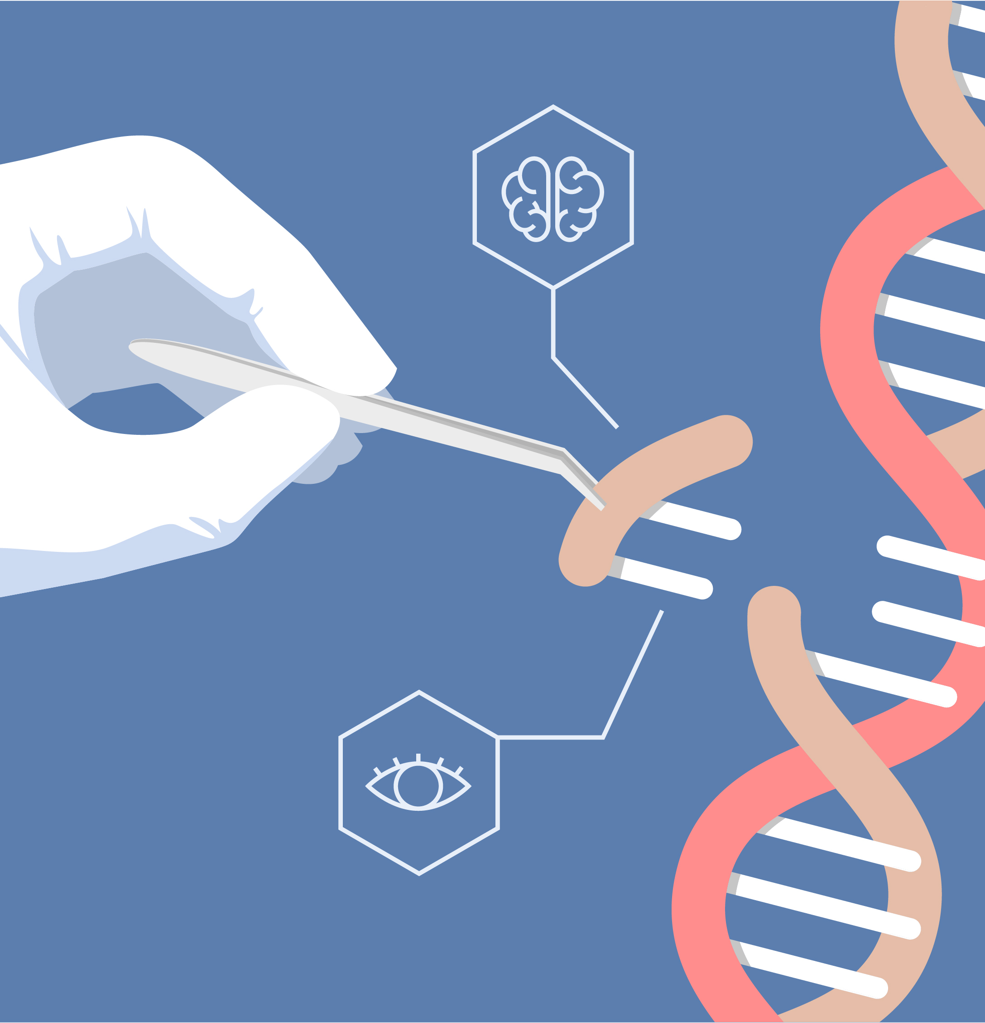
FuseLens – Summary
Long-context classification – 32 kb window (scalable to 1 M bp) at single-nucleotide resolution.
Adversarial negatives – RC, D_shuf, J + paralog pairs disentangle gene identity from fusion grammar (95.6% → 8.4% failure on swap test).
FuseLens 1.0 – Acc 0.916, AUC 0.973, but 5,501 bp localization error.
FuseLens 2.0 (MTL) – soft-argmax under coordinate supervision: MAE 61.3 bp (89× better), Recall ↑ to 0.920.
Biological discovery – 82% of predictions land within 50 bp of canonical splice sites; attention behaves as a true biological pointer.
Notes:
High-Fidelity Classification

Slide 20
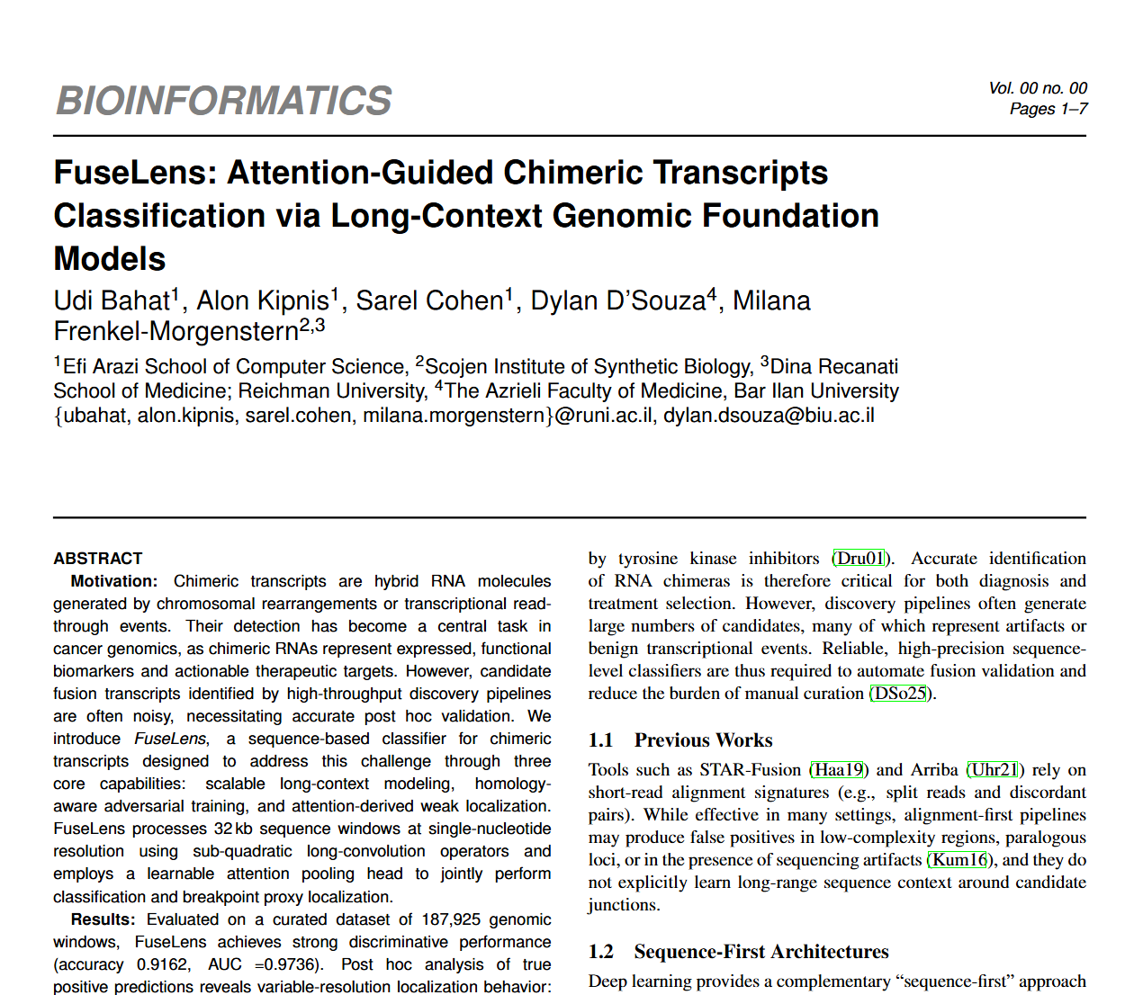
FuseLens – Article
Notes:
High-Fidelity Classification

Slide 21
FuseLens – Future Work
Hard-negative realism – add/update our decoys with real negatives RNA-seq debris
Clinical Testing - ‘Wet Lab’ Tests integrating Oxford Nanopore
Benchmark FuseLens Datasets on the other methods described in the benchmarks
Improved localization objectives - Add supervised or semi-supervised for breakpoint coordinates.
Notes:
High-Fidelity Classification

Slide 22
Thank you !
Q & A

Slide 23
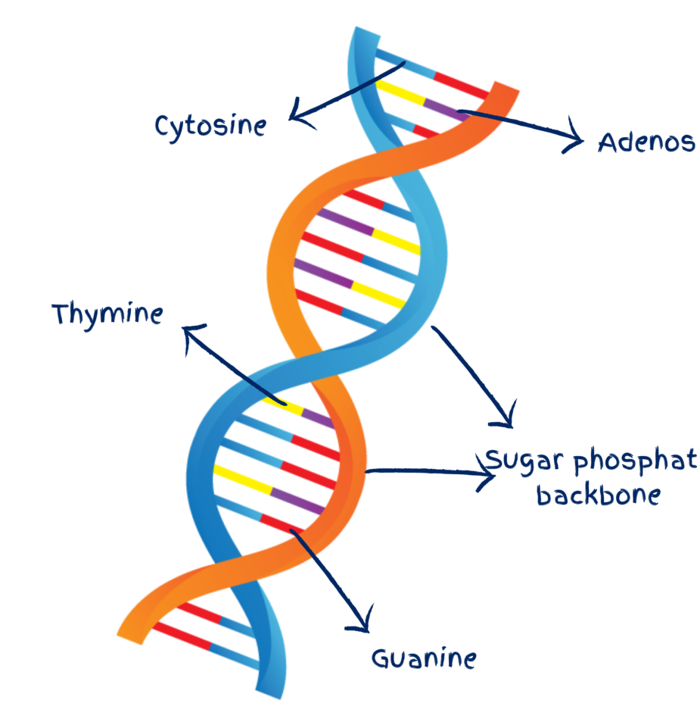

Background – DNA 101
DNA Base pairs: The human genome has about 3.2 Billion Base Pairs → $10^{9}×3.2$
~2 meters compressed in each cell of our body.
Each bp size is = 2nn ,for reference - latest Nvidia GPU transistor size = 3nn
Human Genome Project :
Mapped all 20K Genes arranged in chromosomes (only ~5% of total Genome)
Rest is noncoding DNA , but has biological importance

