Slide 1
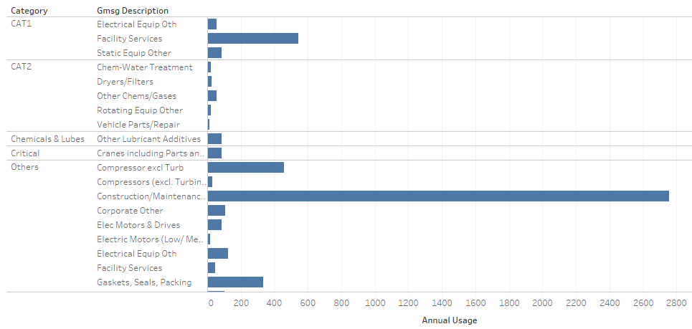
Material Usage By Category

Slide 2


Most Used and Least Used Materials

Slide 3
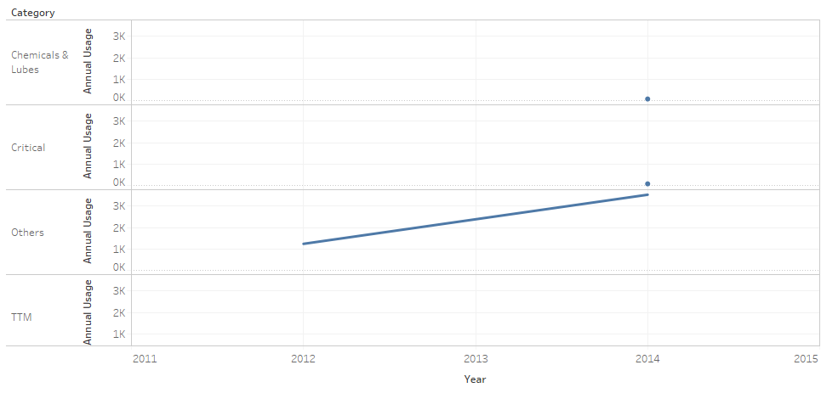
Material Consumption By Year

Slide 4
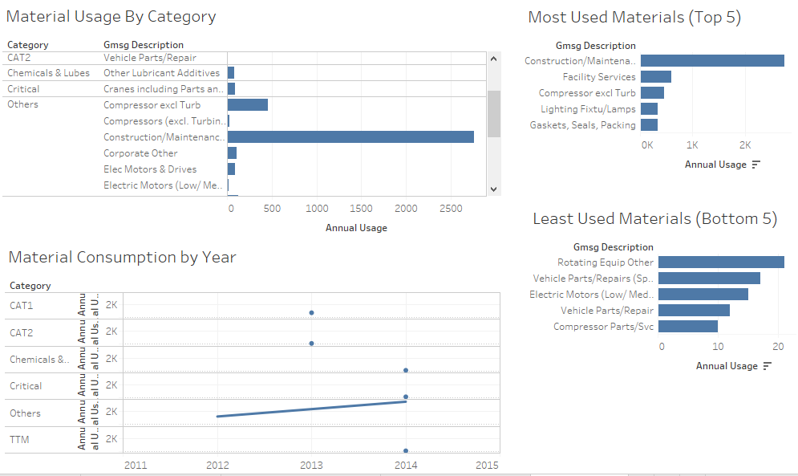
XPN Dashboard

