Slide 1

SMART MEDICINE REMINDER ALARM SYSTEM
Under the supervision of
PALLABI DAS (GUIDE)
DEPARTMENT of ELECTRONICS AND TELECOMMUNICATION ENGINEERING
KAMRUP POLYTECHNIC, BAIHATA CHARIALI
JULY 2023
(Submitted in partial fulfillment for the requirement of the award of Diploma in Electronics and Telecommunication Engineering, Under State Council for Technical Education, Assam)
BEDANTA SUBADAR
RHYTHOM GOGOI
UDIPTA NATH
TANMOI RAJKONWAR
BISHWAJIT BARUAH
KAM/20/ET/012
KAM/20/ET/042
KAM/20/ET/036
KAM/20/ET/026
KAM/20/ET/041

Slide 2
TABLE OF CONTENTS
Introduction
Block diagram
Working principle
Circuit diagram
Hardware requirements
Result & conclusion
Future uses

Slide 3
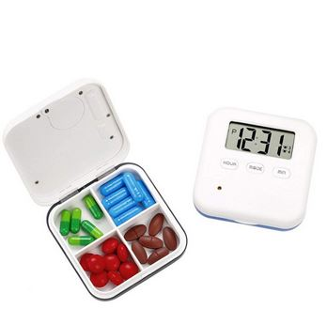
INTRODUCTION:
Now a days in this developing world , most of the people are actually busy in their daily lifestyle. Some of them with their personal life , some are with their professional life and some of are with their social life it is necessary for their upliftment of lifestyle according to todays scenario of the world in this process of upliftment of lifestyle , most of the people are fails to maintain a certain routine of some basic things to maintain a healthy lifestyle. Such as taking food timely , proper 7-8 hours of sleeping and regular exercise . When ever they are unable to meet this basic activities in their lifestyle, either they get physically ill or mentally disturbed. Sometimes people get some diseases and even meet some kind of accident, for that they need to visit to doctors for checkup. After the checkup , the doctor prescribed the medicines that need to be taken in time or even in some accidental case the patient need to be admit in medical for treatment. The people get forget about this kind of little things to take medicines timely. In such kind of scenario The medicine reminder help patients or any person in disease by reminding time to time for taking medicine.

Slide 4


Slide 5
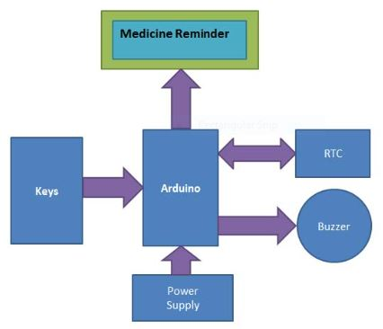
BLOCK DIAGRAM:

Slide 6
WORKING PRINCIPLE
This system works on Arduino Uno and RTC module. Arduino Uno becomes a major component for receiving and sending commands to operate the circuit precisely. The programme already uploaded on the Arduino board for proper work of this project.
After connecting all the components of attendance system, we give the the power supply to switch on the circuit. Then LCD will display." SMART MEDICINE REMINDER SYSTEM". Then date and time will be shown on the display to set a alarm. When a person set a alarm using switch button LCD will show the time which has been set for alarm. After the alarm setup by the person the command will go to the Arduino as a input and arduino set the alarm using RTC module. After that LCD will display that alarm has been set.
And Buzzer will beep when the Arduino send the signal to buzzer that the set time has arrived. And LED will turned on when medicine has to take by the palient. By using this system, the patient can get reminded everytime to take medicine in time.

Slide 7
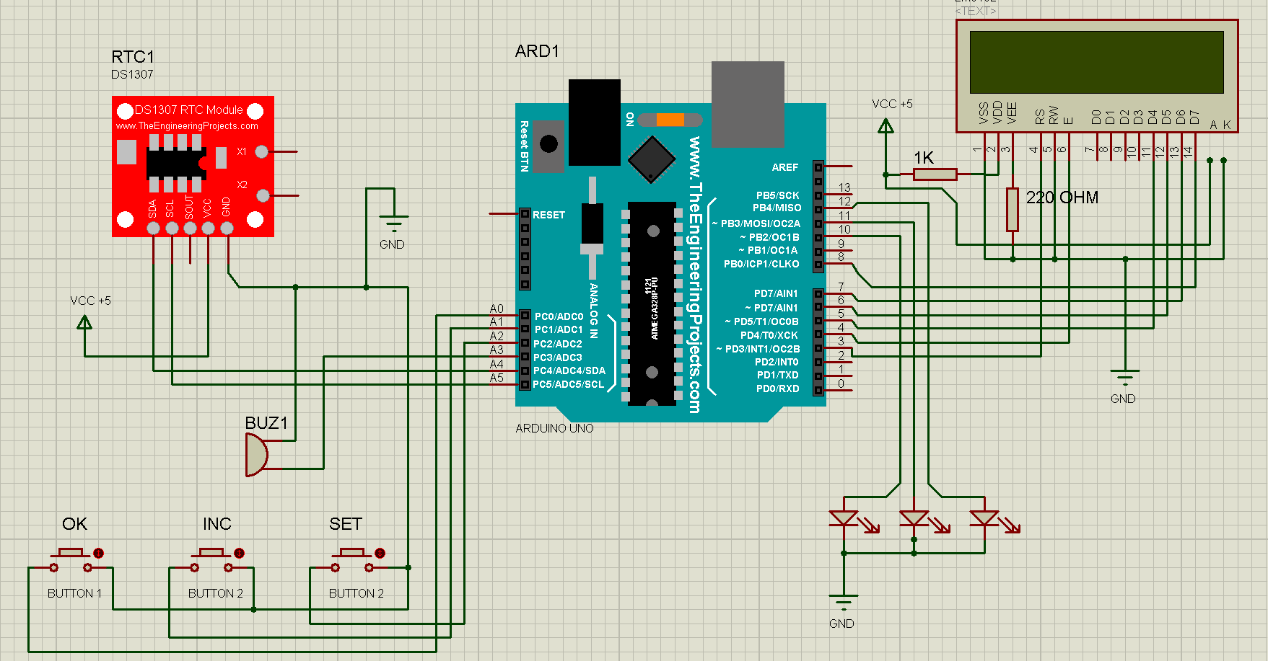
CIRCUIT DIAGRAM

Slide 8
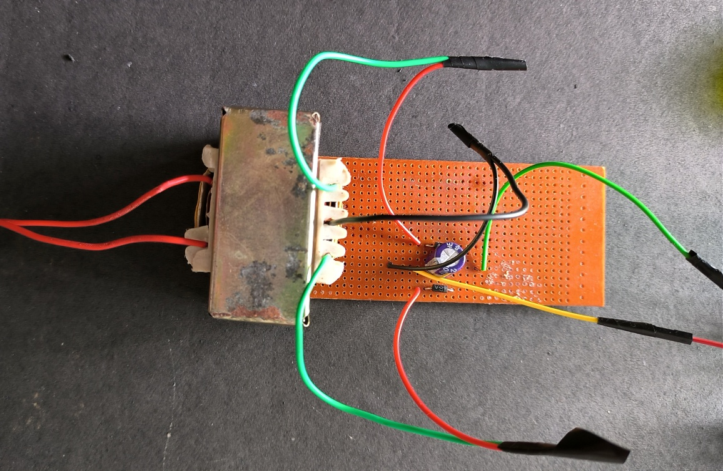
HARDWARE REQUIREMETS
Power supply:
A power supply takes the AC from the wall outlet, converts it to unregulated DC, and reduces the voltage using an input power transformer, typically stepping it down to the voltage required by the load. For safety reasons, the transformer also separates the output power supply from the mains input.
COMPONENTS USED IN POWER SUPPLY ARE:-
Transformer
Capacitor
Diode

Slide 9
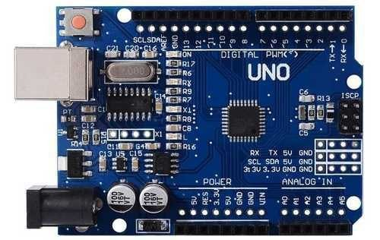
ARDUINO UNO
Arduino UNO is a microcontroller board based on the ATmega328P. It has 14 digital input/output pins (of which 6 can be used as PWM outputs), 6 analog inputs, a 16 MHz ceramic resonator, a USB connection, a power jack, an ICSP header and a reset button. It contains everything needed to support the microcontroller; simply connect it to a computer with a USB cable or power it with a AC-to-DC adapter or battery to get started.Arduino is an open-source electronics platform based on easy-to-use hardware and software. Arduino boards are able to read inputs - light on a sensor, a finger on a button, or a Twitter message - and turn it into an output - activating a motor, turning on an LED, publishing something online.

Slide 10
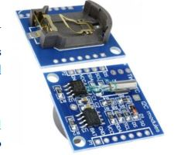
RTC MODULE
We all know that most MCUs we use for our projects are time-diagnostic; simply put they are unaware of the time around them. It’s OK for most of our projects but once in a while when you come across an idea where keeping time is a prime concern, DS3231 RTC module is a saviour. It’s perfect for projects containing data-logging, clock-building, time stamping, timers and alarms. At the heart of the module is a low-cost, quite accurate RTC chip from Maxim – DS3231. It manages all timekeeping functions and features a simple two-wire I2C interface which can be easily interfaced with any microcontroller of your choice.

Slide 11
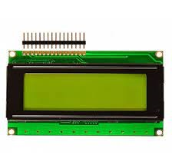
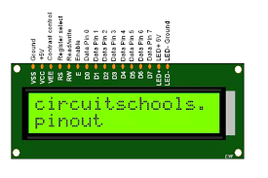
LCD DISPLAY
The term LCD stands for liquid crystal display. It is one kind of electronic display module used in an extensive range of applications like various circuits & devices. The main benefits of using this module are inexpensive; simply programmable, animations, and there are no limitations for displaying custom characters, special and even animations, etc. A 20x4 LCD means it can display 20 characters per line and there are 4 such lines. In this LCD each character is displayed in 5x7 pixel matrix. This LCD has two registers, namely, Command and Data. This is standard HD44780 controller LCD.

Slide 12
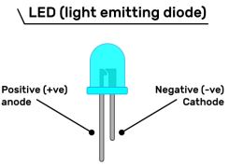
LED:
LEDs work on the principle of Electroluminescence. On passing a current through the diode, minority charge carriers and majority charge carriers recombine at the junction. On recombination, energy is released in the form of photons.

Slide 13
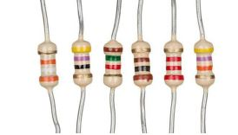
RESISTOR
A resistor is a passive two-terminal electrical component that implements electrical resistance as a circuit element. In electronic circuits, resistors are used to reduce current flow, adjust signal levels, to divide voltages, bias active elements, and terminate transmission lines, among other uses

Slide 14
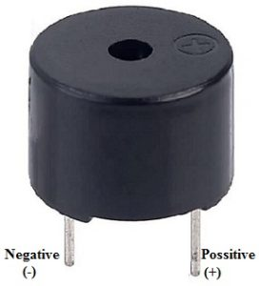
BUZZER:
An audio signaling device like a beeper or buzzer may be electromechanical or piezoelectric or mechanical type. The main function of this is to convert the signal from audio to sound. Generally, it is powered through DC voltage and used in timers, alarm devices, printers, alarms, computers, etc. Based on the various designs, it can generate different sounds like alarm, music, bell & siren.

Slide 15
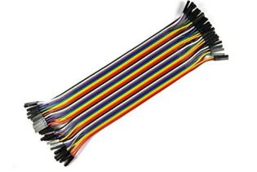
CONNECTING WIRE
Electrical wires operate by offering a path of low resistance to the flow of current through them. When an electric wire comes in contact with a power source, there is a movement or flow of electric charge or electrons in the wire

Slide 16
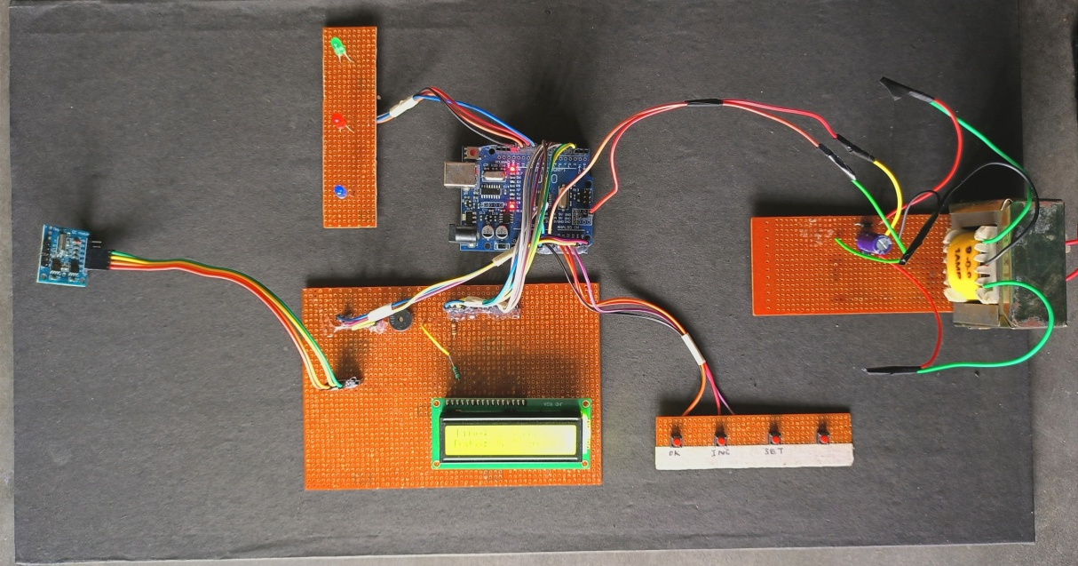
RESULT & CONCLUSION
In this project we have made one smart medicine reminder system. It will helps to avoid problem of forgetting things like taking medicine on time at right amount. This system will remind us when to take medicine and when not to. Because here we can set the timing of our medicines as prescribed by the doctor. When time will come to take the medicines it will remind us by an beep sound alarm and by popping up on the screen with the medicine name. This project will helps to normalize all the parameters required before any type of surgery or treatment .

Slide 17
FUTURE WORK OF THE PROJECT
In future, the project can be upgraded in Bluetooth connectivity based.
Android application can be added.
System data can be stored on smartphone application.
The project can also be made to work on internet connection.
The project can also upgraded using GSM modules to get SMS alert on cellphone.

Slide 18

THANK YOU FOR YOUR ATTENTION.

