Slide 1
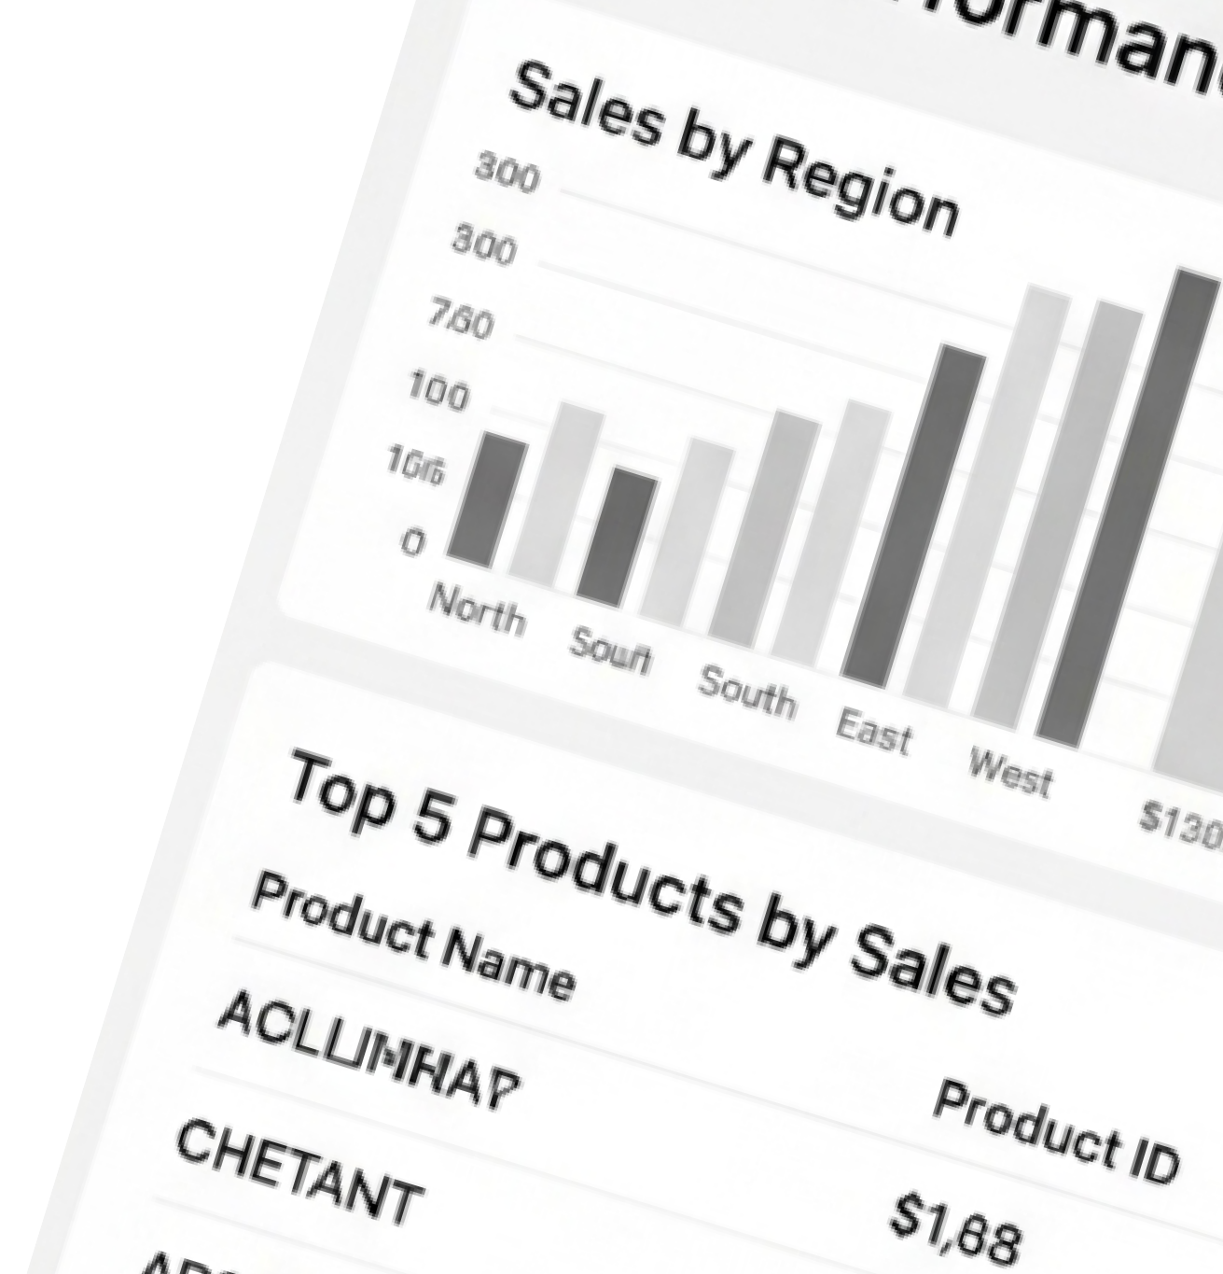
Sales Dashboard Using SQL
Turning data into decisions through interactive dashboards
Presented by:
Udit Sharma

Slide 2


Problem Statement
Business Challenges
Raw sales data was messy & inconsistent
Hard to analyze trends directly from spreadsheets No clear visuals for decision-making
Solutions in This Project
Cleaned & standardized dataset using Python
Queried key insights with SQL (sales, regions, top products) Built an interactive dashboard for easy tracking

Slide 3


Tools & Technologies
Python
SQL
Power BI
Cleaned & preprocessed raw data
Queried insights (sales, regions, trends)
Built interactive dashboard

Slide 4
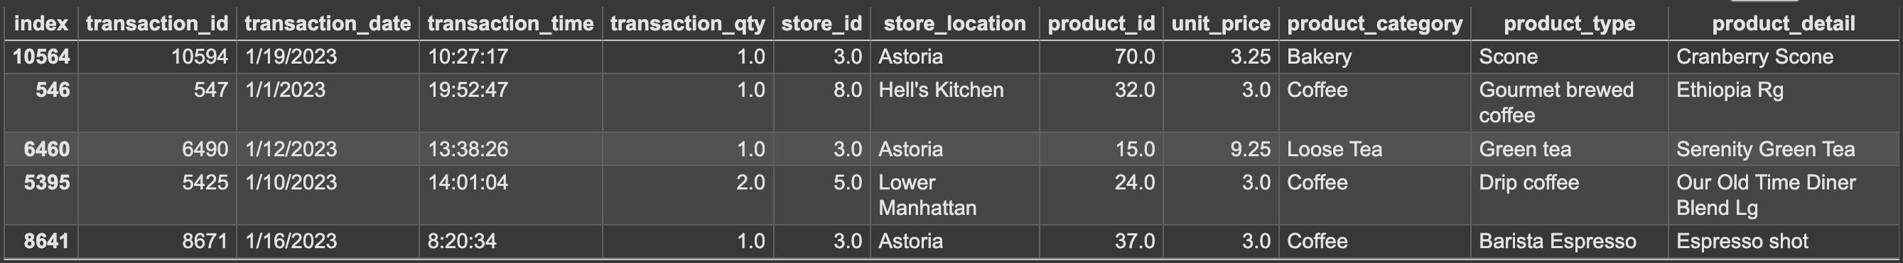
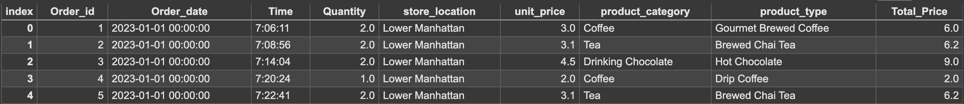
Data Cleaning (Python)
Removed missing & duplicate values
Fixed data types (dates, numbers)
Standardized product & region names
Final dataset ready for SQL

Slide 5
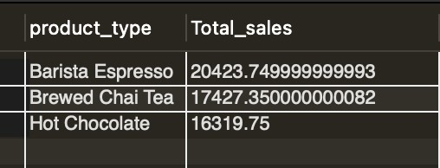
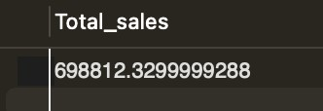
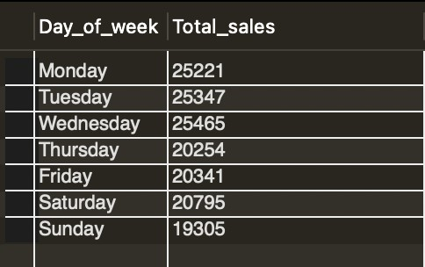
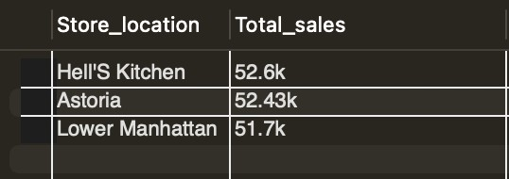
SQL Queries & Insights
Total sales calculation
Top-selling products
Sales by Store Location
Sales by Day Of Week

Slide 6
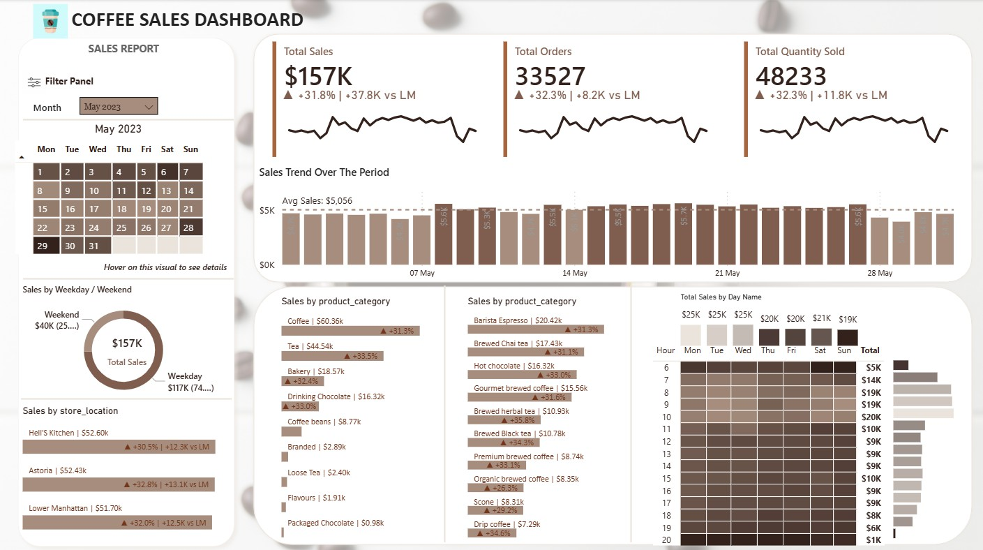
Dashboard (Power BI)
Interactive dashboard with multiple visualizations.

Slide 7






Recommendations
Increase marketing efforts where sales are already high
Run campaigns & expand availability of top seller
Launch discounts/promotions during peak season
Use dashboard filters to identify & improve weak regions

