Slide 1
Lending Club Case Study
BY: UDIT NARAYAN MISHRA

Slide 2
The problem
Company
Context
Problem statement
Lending Club is the largest online loan marketplace, facilitating personal loans, business loans, and financing of medical procedures.
Borrowers can easily access lower interest rate loans through a fast online interface.
Lending Club wants to understand the driving factors behind loan default,
i.e. the driver variables
which are strong indicators of default.
The company can utilise this knowledge for its portfolio and risk assessment.
As a data scientist working for Lending Club analyze the dataset containing information about past loan applicants using EDA to understand how consumer attributes and loan attributes influence the tendency of default

Slide 3


Analysis Approach
Drop columns with null values, all random values or single
Analyze variables against segments of other variables
Create derived variables
category value
Convert values to proper int, float, date representations
Publish insights and observations
Univariate Analysis
Segmented Univariate Analysis
Bivariate Analysis
Summarize Results
Clean Data
Check distributions and frequencies of various numerical and categorical variables
Create derived variables
Do correlation analysis Check how two variables affect each other or a third variable
Analyze joint distributions

Slide 4
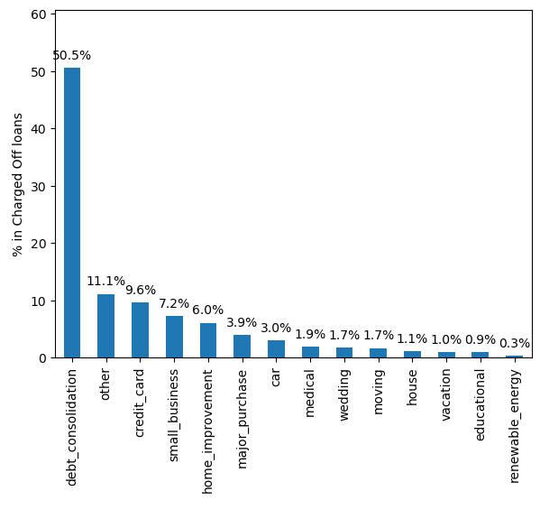
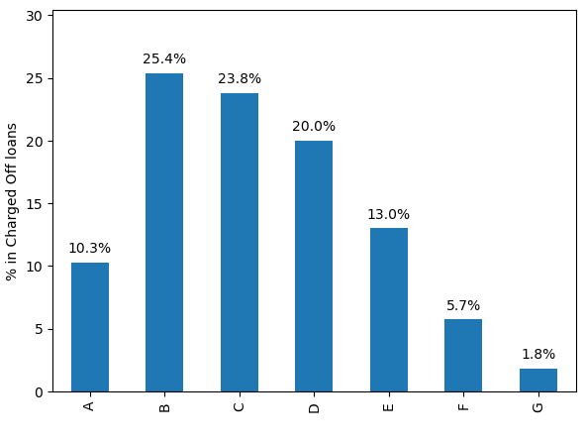
Analysis - Understanding Loans
Most loans are high quality, with a grade of A or B
Maximum number of loans are for debt consolidation, followed by credit card

Slide 5
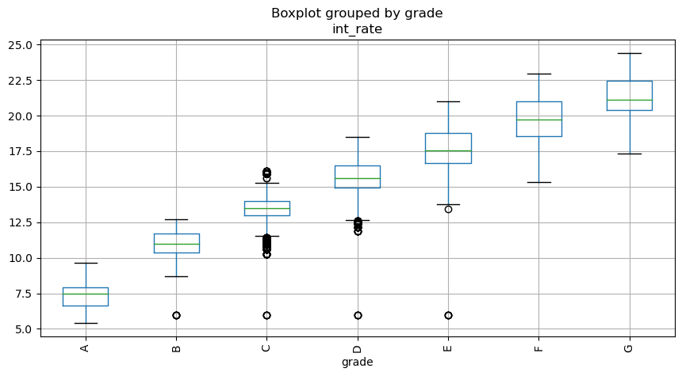
Analysis - Understanding Loans Continued
Lower grades have higher incidence of defaults on loans. The grading system is working!
Lending Club charges higher interest rates as the grade of loan becomes worse.
However, as we will see on next slide - the driving variable for defaults is the higher interest rate.

Slide 6
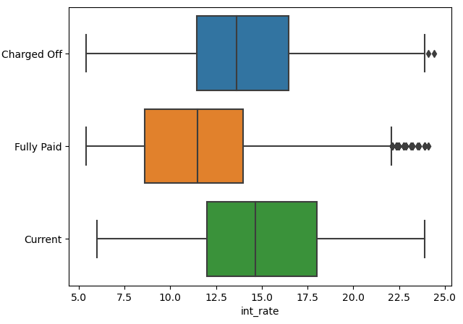
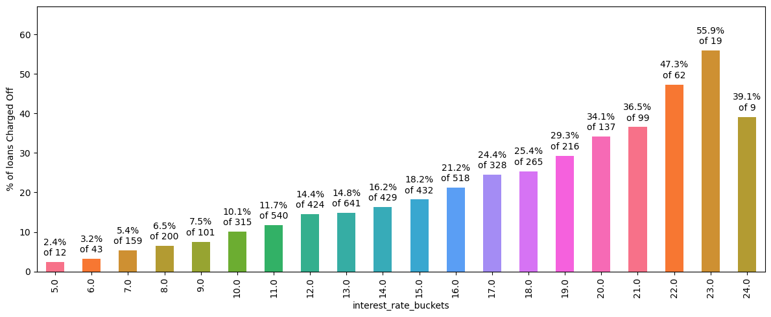
Analysis - Defaults by Interest Rate
Percentage of Defaults increases monotonically with higher interest rates. At rates of 19% and above, more than 33% of loans are Charged Off.

Slide 7
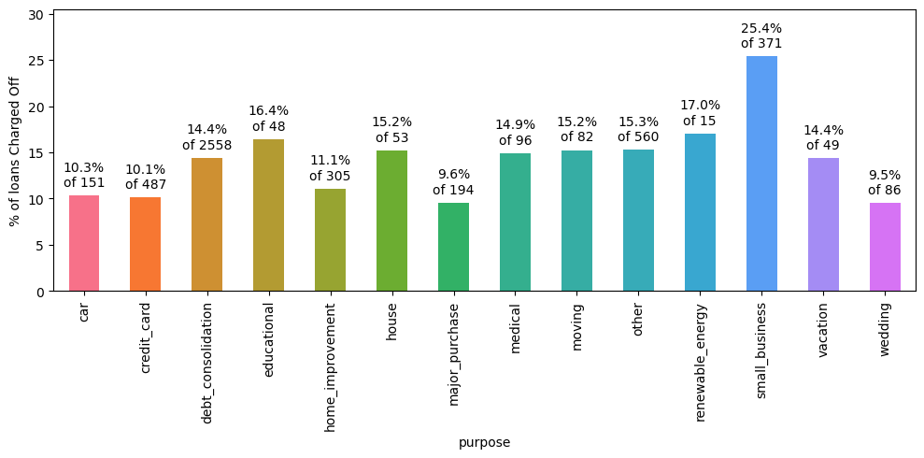
Analysis - Defaults by Loan Purpose
More than a quarter of loans taken for the purpose of running a small business see defaults.

Slide 8
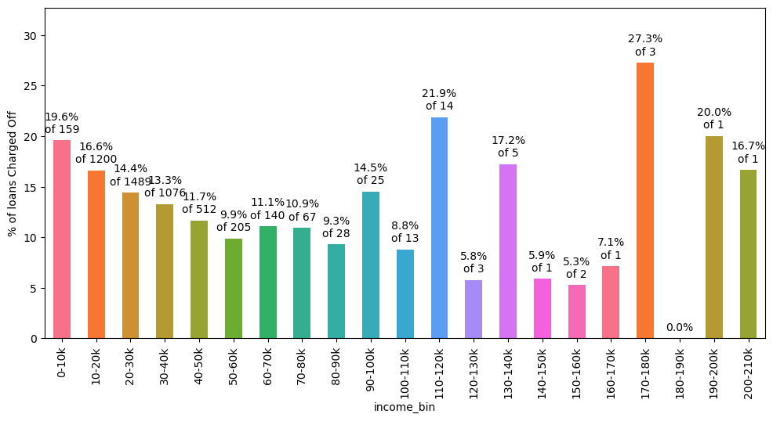
Analysis - Defaults by Borrower’s Income
Borrowers having annual income less than 20000 default on their loans at much higher rates. Loan default decreases with higher annual income.
As we will see on next slide – the ratio of amount to income is more important.

Slide 9
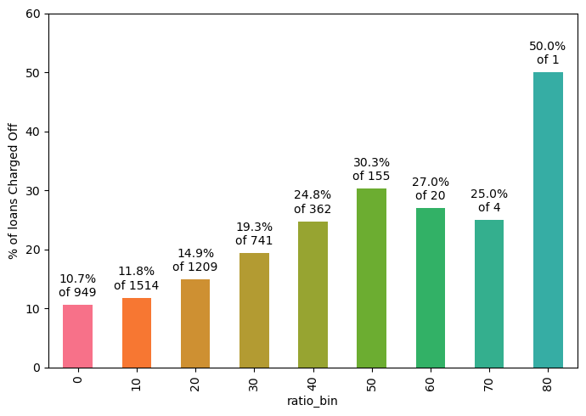
Analysis - Defaults by ratio of amount to income
As long as loan amount is less than 20% of annual income, defaults are low.
Loan amounts of 30% of annual
income or higher see a high rate of
default.
X-axis is the % of loan amount versus annual income

Slide 10
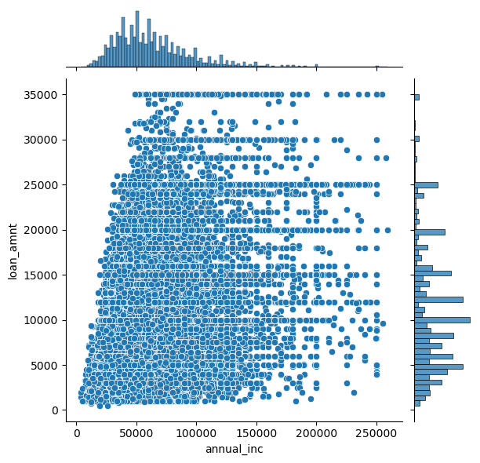
Analysis - Defaults by ratio Continued
We see here that Lending Club has extended high-value loans to people with low income.
There are many cases of people with income 50000 or less getting loans of 25000 or more.
This practice should be curtailed.

Slide 11
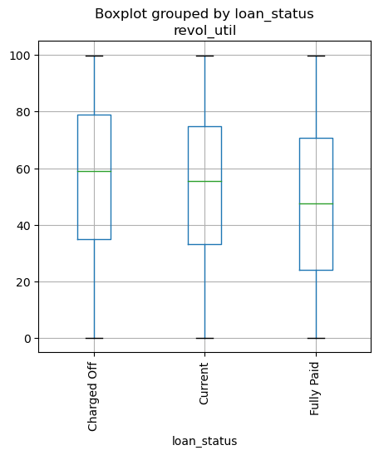
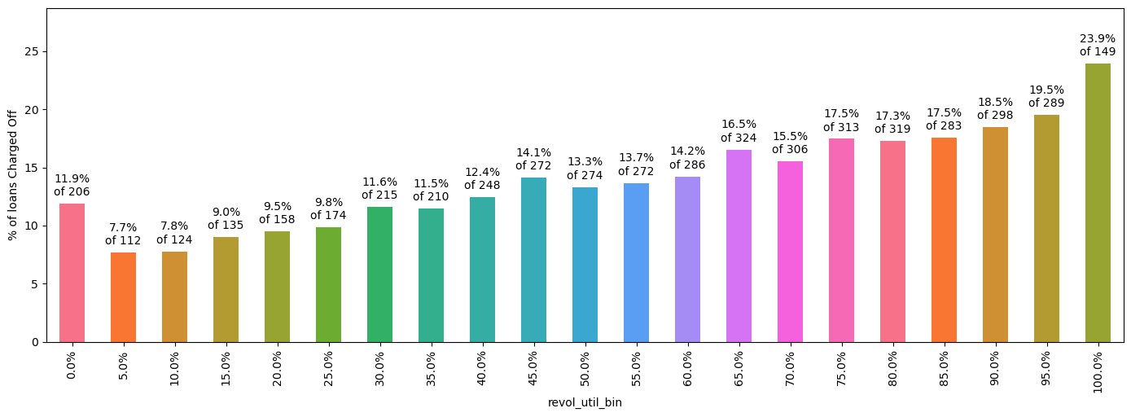
Analysis - Defaults by Revolving Line Util Rate
People with high utilization of Revolving Line of Credit at the time of taking loan default more.
Loans with utilization > 75% are risky.

Slide 12
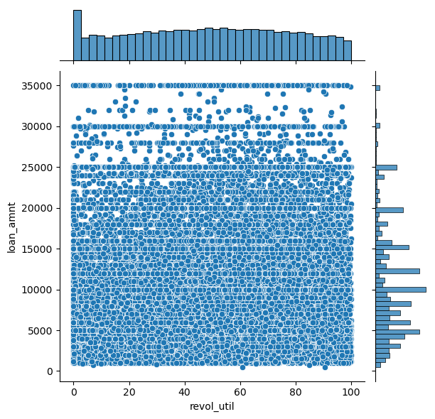
Analysis - Defaults by Rev Util Continued
There have been some high value loans extended to borrowers with revolving line utilization rate of higher than 75%.
This practice should be stopped.
Density of low value loans is also high. They should be approved less often.

Slide 13
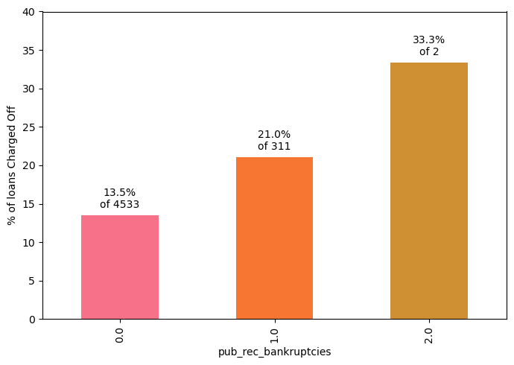
Analysis - Defaults by prior bad record
96% have no bankruptcy record.
Having even 1 bankruptcy record
increases the chances of Charge Off significantly.
Public Derogatory Record and Public Bankruptcy records have 83% correlation. We can use any one.
94% have no Public derogatory records.
Having even 1 derogatory record increases the chances of Charge Off significantly.

Slide 14
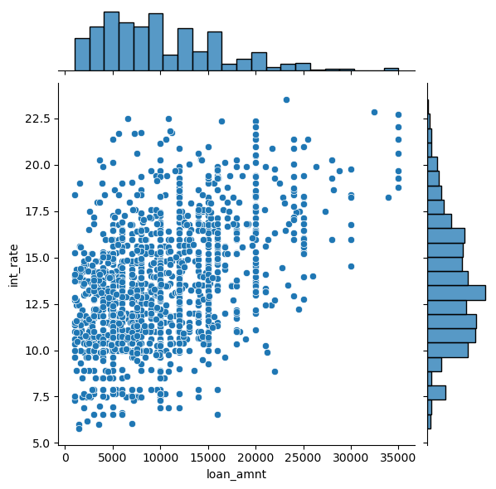
Analysis by prior bad record - Continued
High value loans, as well as low interest loans have been extended to those with prior public derogatory records.
This practice can be stopped to improve business metrics.
Data of people with >0 bad records

Slide 15
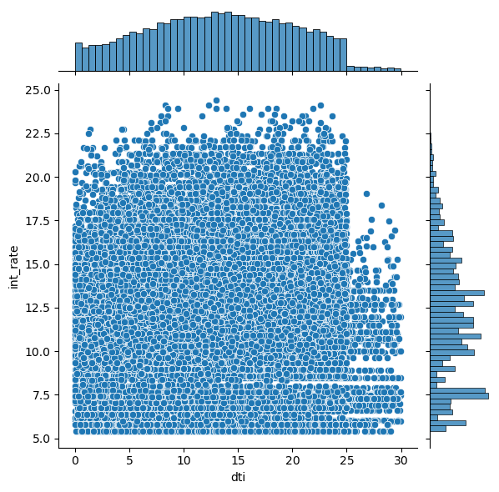
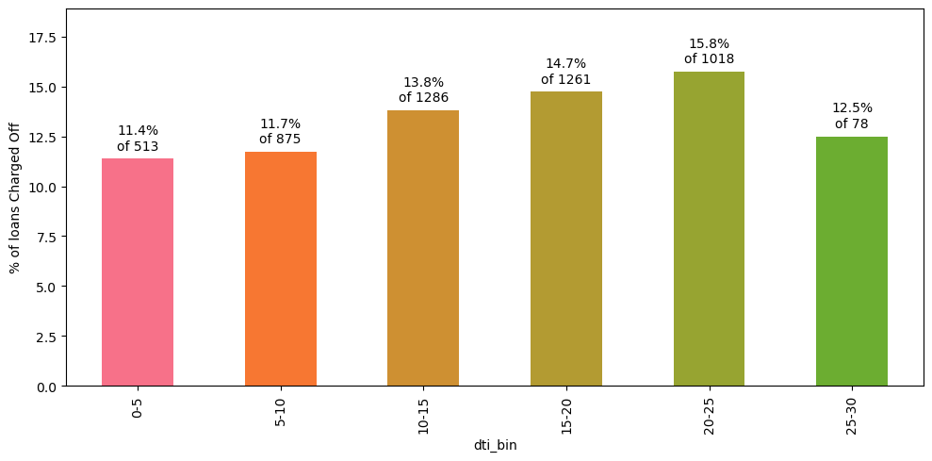
Analysis – Defaults by Debt to Income Ratio
Higher interest rates should be
Percentage of default rises with dti ratio.
charged for higher dti, but we see spread across all values
As the dti ratio rises above 20, the loans become risky.

Slide 16
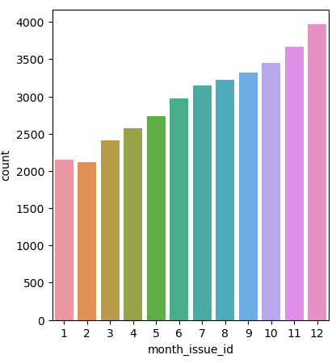
Appendix: Interesting tidbits
Loan numbers increase as months get closer to year-end. Are people trying to meet targets?
Maximum loans are in populous states, California, New York, Florida and Texas

Slide 17
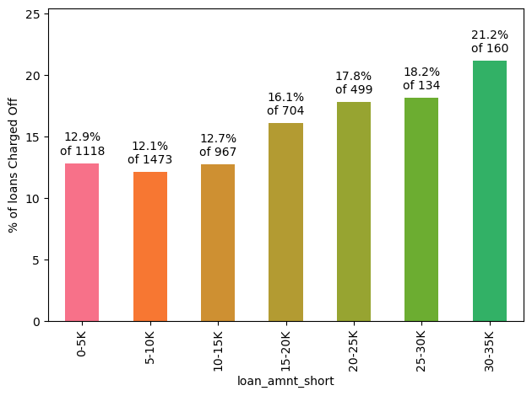
Appendix: Interesting tidbits
As the loan amount increases, the chance of default also increases.
High value loans are being extended to questionable quality borrowers?

Slide 18
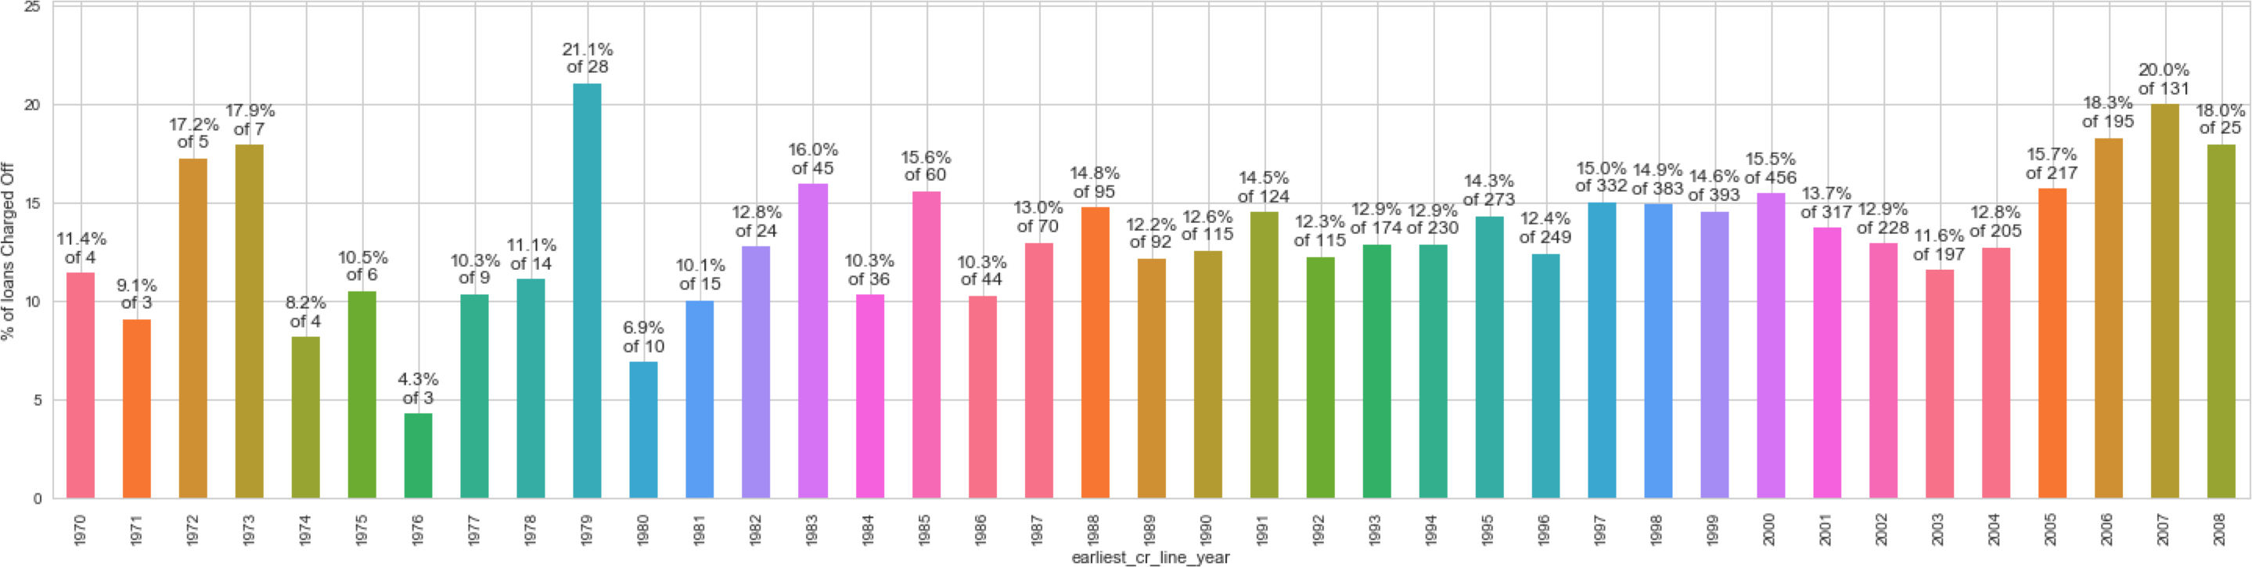
Appendix: Interesting tidbits
People who took their first loans just before an economic crisis, like the one in 1980 and the subprime crisis in 2008, have higher rates of default.
Presumably, these are young people who were affected by the economic conditions of their early career.

Slide 19
Stop – approving loans where amount/income is higher than 30%
Reduce – number of approvals where purpose is small business
3. Stop – approving high-value loans
when revolving line utilization rate greater than 75%
Recommendations
Better Quality Borrowers
4. Stop – approving loans to people with
prior bad record. Or at least stop approving high-value loans
5. Start – charging higher interest rates for loans with dti greater than 20

