Slide 1



Sass concepts with files structure
First things first, it’s Sass not SASS. Sass doesn’t stand for anything, except maybe making your CSS more Sassy…? Sass makes CSS more Sassy because it’s a preprocessor. Preprocessors make writing code easier.
If it helps, you can think of Sass making CSS more like a real programming language. If that doesn’t help, just think of it as a way to write CSS that’s more cleverer.
Presented By: Udit Chandra Sahu

Slide 2
What is Sass?
SASS (Syntactically awesome style sheets) is an extension of the CSS which adds syntactic power to the basic CSS language making it easier for developers to write CSS. It is just a CSS preprocessor, so that you can write CSS in an easy and convenient way.
“Sass is a meta-language on top of CSS that's used to describe the style of a document cleanly and structurally, with more power than flat CSS allows. Sass both provides a simpler, more elegant syntax for CSS and implements various features that are useful for creating manageable style sheets.”
“Sass is an extension of CSS3, adding nested rules, Variables, mixins, selector inheritance, and more. It’s translated to well-formatted, standard CSS using the command line tool or a web-framework plugin.”

Slide 3
A little history…..
Sass was first given life by Hampton Catlin in 2006, later supported by Natalie weizembaum and chris eppstein
Sass started life in ruby community
Sass supports two syntaxes
–Indentation syntax with file ext .sass
–Css compatible syntax with file ext .scss
Sass is free to use, require no license.

Slide 4
Why use it?
Modularize (@import)
Variables for maintainability
Mixins improves reusability
Reduces redundant rules (keep it DRY)
Scalable and Maintainable
Sass is completely compatible with all versions of CSS
Sass reduces repetition of CSS and therefore saves time
It provides the document style in a good, structured format, better than vanilla CSS
It uses re-usable methods, logic statements and some of the built-in functions such as color manipulation, mathematics and parameter lists

Slide 5
SASS and SCSS
Two available syntaxes
SASS
SCSS
HAML-style indentation
No brackets or semi-colons, based on indentation
Less characters to type
Enforced conventions/neatness
Semi-colon and bracket syntax
Superset of normal CSS
Normal CSS is also valid SCSS
Newer and recommended

Slide 6
How do I install sass on my computer…
Install Live Sass Compiler Extension In VS Code
Select the Extensions tab from the sidebar. Click on the Extensions tab from the sidebar
Search for Live Server in the search box
Search for “Live Sass Compiler” from the search box
Click on the Install button
It is now in Nodejs package also
First install nodejs
then Enter npm install –g sass

Slide 7
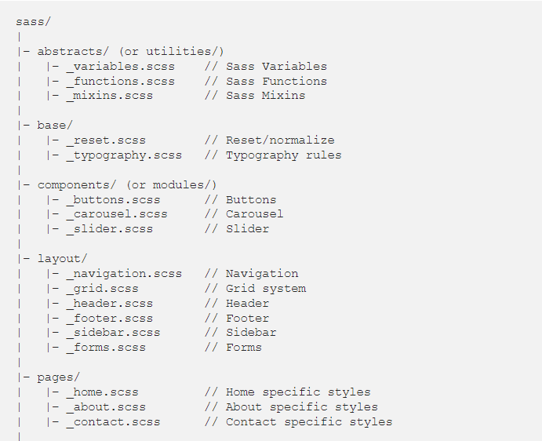
The Sass File structure pattern

Slide 8
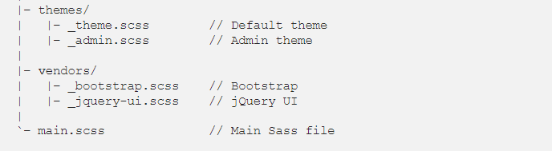
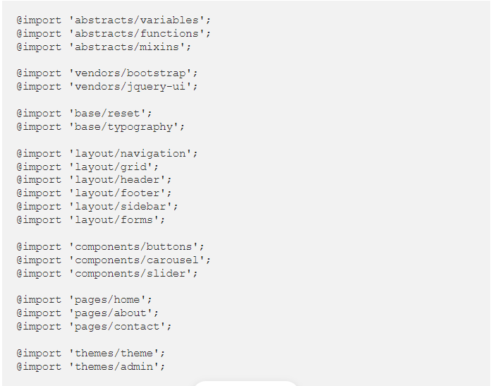

Slide 9
Our folders would typically contain the following:
Abstracts contains tools, helpers, variables, mixins etc.
Base contains boilerplate code for the project. This includes styles such as resets, typography etc.
Components contains all the smaller page components like separated into multiple smaller files like slider, carousel etc.
Layout contains the layout styles, separated into several smaller files like header, footer etc.
Pages contains page-specific styles. For example, the home page and search results page typically looks very different.
Themes contains files that are theme specific, like alternate color schemes (if any).
Vendors contains third party code from external frameworks and libraries like jQueryUi, Bootstrap etc.
Our main file is only used to import all the other files.

Slide 10

Reasons we love
Variables
Mixins
Nesting
Imports
Operator and functions

Slide 11
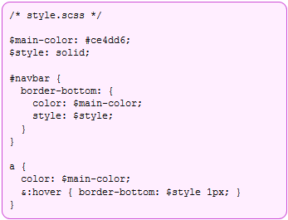
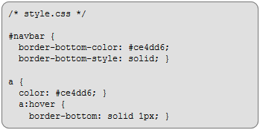
Variables
Sass allows to declare variables that can be used throughout the stylesheet
Variables begin with $ and are declared like properties
They can have any value that’s allowed for a CSS property, such as colors, numbers, or text

Slide 12
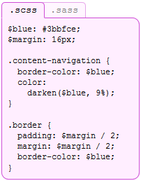
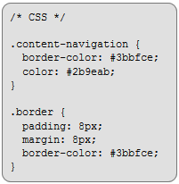
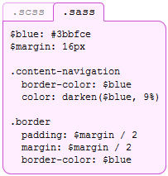
Variables: Sass vs. Scss

Slide 13
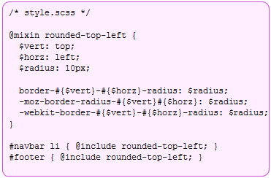
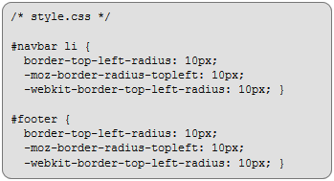
Mixins
Mixins allow to re-use whole chunks of CSS, properties or selectors
Mixins are defined using the “@mixin” directive, which takes a block of styles that can then be included in another selector using the “@include” directive

Slide 14
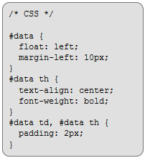
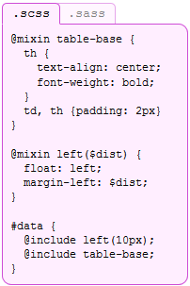
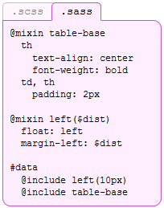
Mixins: Sass vs. Scss

Slide 15


Nesting
Often in CSS there are several selectors that begin in the same way
Sass avoids repetition by nesting selectors within one another
CSS3 Saas
.center {
text-align: center;
}
.center h1 {
margin-bottom: 10px;
}
.center {
text-align: center; h1 {
margin-bottom: 10px;
}
}

Slide 16
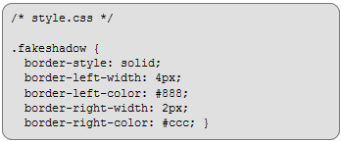
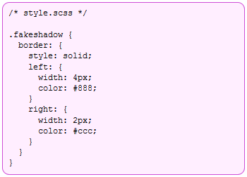
Nesting
Properties can be nested too

Slide 17
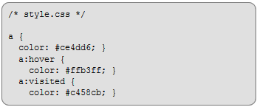
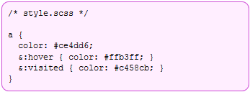
Nesting
Pseudoclasses can be nested too (e.g. :hover)
Sass special character &
in a selector & is replaced with the parent selector

Slide 18
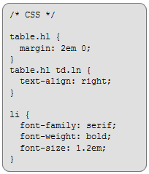
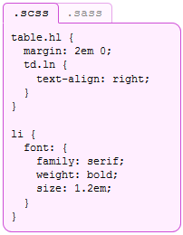
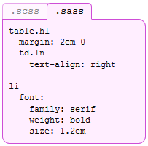
Nesting: Sass vs. Scss

Slide 19
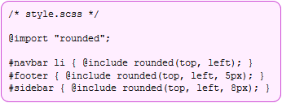
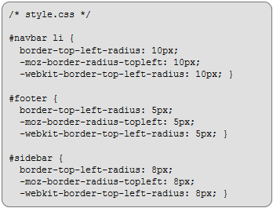
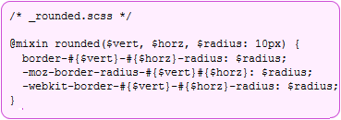
@import
Stylesheets can be big: the @import directive that allows to break styles up into multiple stylesheets

Slide 20
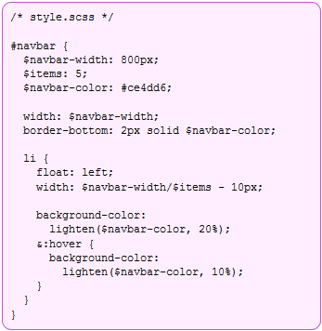
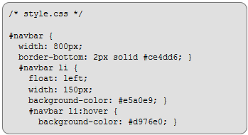
Operator and functions
Saas supports basic math operations and many useful functions
http://sass-lang.com/docs/yardoc/Sass/Script/Functions.html
The standard math
operations
(+, -, *, /, and %) are supported for numbers
There are many useful functions for colors, e.g. to change lightness, hue, saturation, …

Slide 21
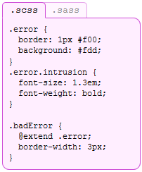
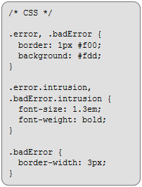
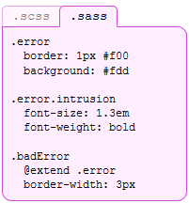
Selector inheritance
Sass can tell one selector to inherit all the styles of another without duplicating the CSS properties

Slide 22
References
Sass {style with attitude}
http://sass-lang.com/
CSS to Sass online converter
http://css2sass.heroku.com/

Slide 23

Any Questions?

Slide 24


