Slide 1
ADDING AND MODIFYING FF BLOCK OBJECTS

Slide 2


Using Foundation Fieldbus Terms
Adding FF Variables – wrong
Adding FF Parameters – better
Adding FF Block Object – best!

Slide 3
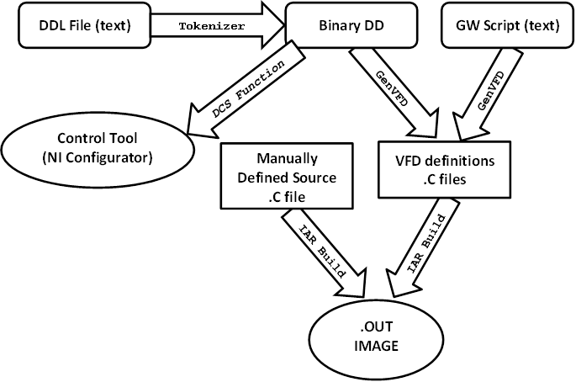
Process of Building FF Firmware

Slide 4
FILES TO MODIFY
Files which we need to modify when working on insertion of new and modification of old parameters.
File Type | Extension | Present Implementation | Belongs to:
DDL file | .ddl | svi_positioner.ddl | DD side (SSDC)
Firmware DD script | .gw | SVI_Positioner_APP.gw | FF firmware script (Softing)
FW source code | .c | appl_ptb.c | FF firmware (Softing)

Slide 5
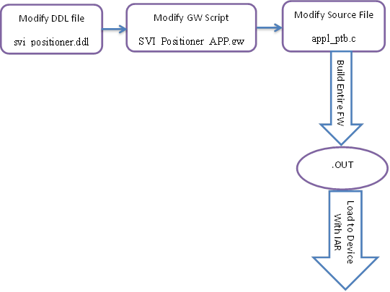
Parameter Modification Work Flow

Slide 6
TYPES OF PARAMETERS
By Periodicity of Addressing
- Cyclic high priority
- Cyclic low priority
- Non-cyclic
Structural Types
- Simple = VARIABLE
- Structure = RECORD

Slide 7
DDL File Modifications
BLOCK PTB
{
CHARACTERISTICS ptb_character ;
LABEL LBL_POSITIONER_TRANSDUCER_BLOCK ;
HELP HLP_POSITIONER_TRANSDUCER_BLOCK ;
PARAMETERS
{
/* standard parameters */
ST_REV, __st_rev ;
TAG_DESC, __tag_desc ;
FINAL_VALUE, __final_value;
FINAL_POSITION_VALUE, __final_position_value;
.....other standard parameters....
...................................
/* non-standard parameters */
/* most likely here we are inserting new parameters */
CONTROL_PARAMETERS, svi_control_parameters_record;
FIND_STOPS, svi_find_stops;
SUPPLY_PRESSURE, svi_supply_pressure;
ACTUATOR_PRESSURE, svi_actuator_pressure;
RAMP_RATE, ramp_rate;
SLEEP, little_nap;
..........other non-standard parameters.... .....

Slide 8
(continue from previous)
......................................
}
....other block components: vies, etc......
PARAMETER_LISTS
{
VIEW_1, ptb_view_1 ;
VIEW_2, ptb_view_2 ;
VIEW_3, ptb_view_3 ;
VIEW_4, ptb_view_4 ;
}
..............................................
..............................................
} /* end block definition */

Slide 9
DD ITEMS
VARIABLE – simple
RECORD – structure, several components
Standard DD Item(with double underscore __)
Standard – do not define, but import files with definitions.
May be REDEFINE’d
Custom DD Item – needs to be defined

Slide 10
Custom DD Items
Simple DD Item
VARIABLE ramp_rate
{
LABEL LBL_RAMP_RATE ;
HELP HLP_RAMP_RATE ;
CLASS CONTAINED ;
TYPE FLOAT ;
HANDLING READ & WRITE ;
}

Slide 11
Custom DD Items (continued 1)
RECORD Type DD Item (Standard Members)
RECORD svi_supply_pressure
{
LABEL "svi_supply_pressure";
HELP "svi supply pressure";
MEMBERS
{
STATUS, __status_contained_nd ;
VALUE, __float_contained_nd ;
}
}

Slide 12
Custom DD Items (continued 2)
Standard Members Definitions
Defined in file “std_parm.ddl”
Example:
VARIABLE __float_contained_nd
{
LABEL [value_label] ;
HELP [float_contained_help] ;
CLASS CONTAINED & OPERATE ;
TYPE FLOAT ;
HANDLING READ & WRITE ;
/* RESPONSE_CODES xxx ; */
}

Slide 13
Custom DD Items (continued 2)
RECORD Type DD Item (Custom Members)
/**********************************************************************
little_nap
**********************************************************************
*/
VARIABLE time
{
LABEL "Sleep length" ;
HELP "Duration of snooze during this presentation in min." ;
CLASS CONTAINED ;
TYPE FLOAT ;
HANDLING READ & WRITE ;
}
VARIABLE uninterrupted
{
LABEL "Is uninterrupted" ;
HELP "True if your sleep uninterrupted all the way through" ;
CLASS CONTAINED ;
TYPE BOOLEAN ;
HANDLING READ & WRITE ;
}

Slide 14
(continued from previous)
RECORD little_nap
{
LABEL "Nap quality" ;
HELP "Quality of your sleep during this meeting" ;
MEMBERS
{
LENGTH, time ;
QUALITY, uninterrupted;
}
}
/**********************************************************************/
Define all VARIABLEs (simple)
Define RECORD with these VARIABLEs

Slide 15
VIEWs
VIEW_1
VIEW_2
VIEW_3
VIEW_4
Used for presentation of groups of parameters.
Grouping Principle: Dynamic vs. Static.
Creating VIEWs in DDL
VARIABLE_LIST ptb_view_1
{
LABEL LBL_PTB_VIEW_1 ;
HELP HLP_PTB_VIEW_1 ;
MEMBERS
{
VL_ST_REV, PARAM.ST_REV ;
VL_MODE_BLK, PARAM.MODE_BLK ;
VL_BLOCK_ERR, PARAM.BLOCK_ERR ;
..............................
}
}

Slide 16
Object Redefinition
IMPORT MANUFACTURER __FF,
DEVICE_TYPE __STD_PARM,
DEVICE_REVISION SFT_STD_PARM_dev_rev,
DD_REVISION SFT_STD_PARM_dd_rev
{
EVERYTHING ;
REDEFINITIONS
{
REDEFINE VARIABLE __manufac_id
{
LABEL [manufac_id_label] ;
HELP [manufac_id_help] ;
CLASS CONTAINED ;
TYPE ENUMERATED (4)
{
{0x445644, "|en|Dresser Valve Division", [mfr_id_help]}
}
CONSTANT_UNIT [blank] ;
HANDLING READ ;
}
REDEFINE VARIABLE __dev_type
……………………………………………………………………….
Import standard object using the word “IMPORT”
Redefine it to you own need with the word “REDEFINE”.
For greater details reference DDL files

Slide 17
Firmware DD Script
Most of our changes are to the file: <SVI_Positioner_APP.gw> in the
Softing codebase.
GW files define parameters of FF Blocks to help generating corresponding VFD blocks. VFD blocks are used in source code as regular C structures.
SCRIPT DEFINITION SEQUENCE (Parameter Descriptions)
Name same as in DDL file
Flags (such as Read/Write)
Length in bytes
Structure or simple variable type
(examples: Simple INTEGER32; Record FLOAT_S)
Number of components (such as number of Record members)
Initial values of all components
(denoted with the pound sign # and delimited by semicolon)
SubIndexAccess, bit-coded write-access authorization for individual components. Zero for write-authorization for all components.

Slide 18
GW Script -- example
//--------------------------------------------
// Transducer Block 0
// Analog Input Transducer Block
//--------------------------------------------
BLOCK_INFORMATION Block=TB0 Tag=POSITIONER_TB BlockType=PTB ExecutionTime=0 DD_Rev=1 Profile_Rev=1 Start_index=START_INDEX_TR_BLK0 StartIndVIEWS=START_INDEX_VIEWS_TBLK0 NrVIEW3=1 NrVIEW4=1
#include "positioner_tb.gw"
// index = 14
STANDARD_PARAM FINAL_VALUE RW 5 Record FLOAT_S 2 #0;0.0 SubIndexAccess=0
// index = 15
STANDARD_PARAM FINAL_POSITION_VALUE RW 5 Record FLOAT_S 2 #0;0.0 SubIndexAccess=0
.........................................
// index = 18
PARAM FIND_STOPS RW 4 Simple INTEGER32 1 #0
.........................................
// index = 20
PARAM SUPPLY_PRESSURE R 5 Record FLOAT_S 2 #0;0.0 SubIndexAccess=0
// index = 21
PARAM ACTUATOR_PRESSURE R 5 Record FLOAT_S 2 #0;0.0 SubIndexAccess=0
END_BLOCK

Slide 19
FW Source Code Changes
File for modifications:
<...\FD-SW\target\appl\fdev\src\appl_ptb.c>
4 spots in the file to modify:
The function < Appl_handle_HART_cmd()>;
The function < Write_handler_PTB() >;
Two lists: /* Cyclic commands */ and /* Regular commands */
Definition segment with “pound-defined”
- command numbers
- macros like CMD_..._FINAL_VALUE_OFFSET
Each HART command is a “case” statement of the “switch”, which makes the body of the funtion appl_handle_HART_cmd()
Each FF parameter is a macro in the “case”:
WRITE_HART_CMD and READ_HART_CMD

Slide 20
Cyclic and Non-cyclic Parameters (commands)
Cyclic Parameters:
/* Cyclic commands */ --
high priority (frequent)
/* Regular commands */ --
low priority (less frequent)
Non-cyclic Parameters:
Write_handler_PTB() – explicit calls to:
appl_send_acyc_HART_cmd()

Slide 21
FW Source Code Changes (sample)
case CMD_154_READ_SETPOINT:
{
if ( access == RECEIVE )
{
/* read FINAL_VALUE from HART */
READ_HART_CMD(CMD_154_FINAL_VALUE_OFFSET, p_PTB->final_value.value , FLOAT);
p_PTB->final_value.status = SQ_GOOD_CAS | SUB_NON_SPECIFIC;
}
else if ( access == SEND )
{
*send_length = HART_READ_CMD_REQ_LEN ;
}
break;
} /* end case CMD_154_READ_SETPOINT */

Slide 22
FW Source Code Changes (sample continued)
case CMD_155_WRITE_SETPOINT:
{
if ( access == RECEIVE )
{
/* read FINAL_VALUE from HART */
/* there is no data to read */
}
else if ( access == SEND )
{
WRITE_HART_CMD(CMD_155_FINAL_VALUE_OFFSET, SPSubCmd, USIGN8);
WRITE_HART_CMD(CMD_155_FINAL_VALUE_OFFSET + 1, p_PTB->final_value.value, FLOAT);
WRITE_HART_CMD(CMD_155_FINAL_VALUE_OFFSET + 5, SPmode, USIGN8);
*send_length = CMD_155_REQUEST_LENGTH ;
}
break;
} /* end case CMD_155_WRITE_SETPOINT */

