Slide 1
November 2024 Financial Review

Slide 2
Agenda
• Key Financial Metrics
• Variance Analysis
• Challenges and Risks
• Action Items and Next Steps

Slide 3
PnL Comparison
Category | Current Month | Previous Month | Variance
Revenue | 100000 | 90000 | 10000
Cost of Goods Sold | 50000 | 45000 | 5000
Gross Profit | 50000 | 45000 | 5000
Operating Expenses | 20000 | 18000 | 2000
Operating Income | 30000 | 27000 | 3000
Net Income | 25000 | 22500 | 2500

Slide 4
PnL Comparison
Category | Current Quarter | Last Year Same Quarter | Variance
Revenue | 100000 | 90000 | 10000
Cost of Goods Sold | 60000 | 50000 | 10000
Gross Profit | 40000 | 40000 | 0
Operating Expenses | 15000 | 10000 | 5000
Operating Income | 25000 | 30000 | -5000
Net Income | 20000 | 25000 | -5000

Slide 5
Highlights: Achievements, Challenges, and Opportunities
• Increased market share by 15%
• Launched 3 new products
• Improved customer satisfaction scores by 10%
• Supply chain disruptions
• Increased competition
• Need for skilled workforce

Slide 6
Revenue Highlights
Category | Value | Trend
Stream 1 | 10000 | Up
Stream 2 | 8000 | Down
Stream 3 | 6000 | Up

Slide 7
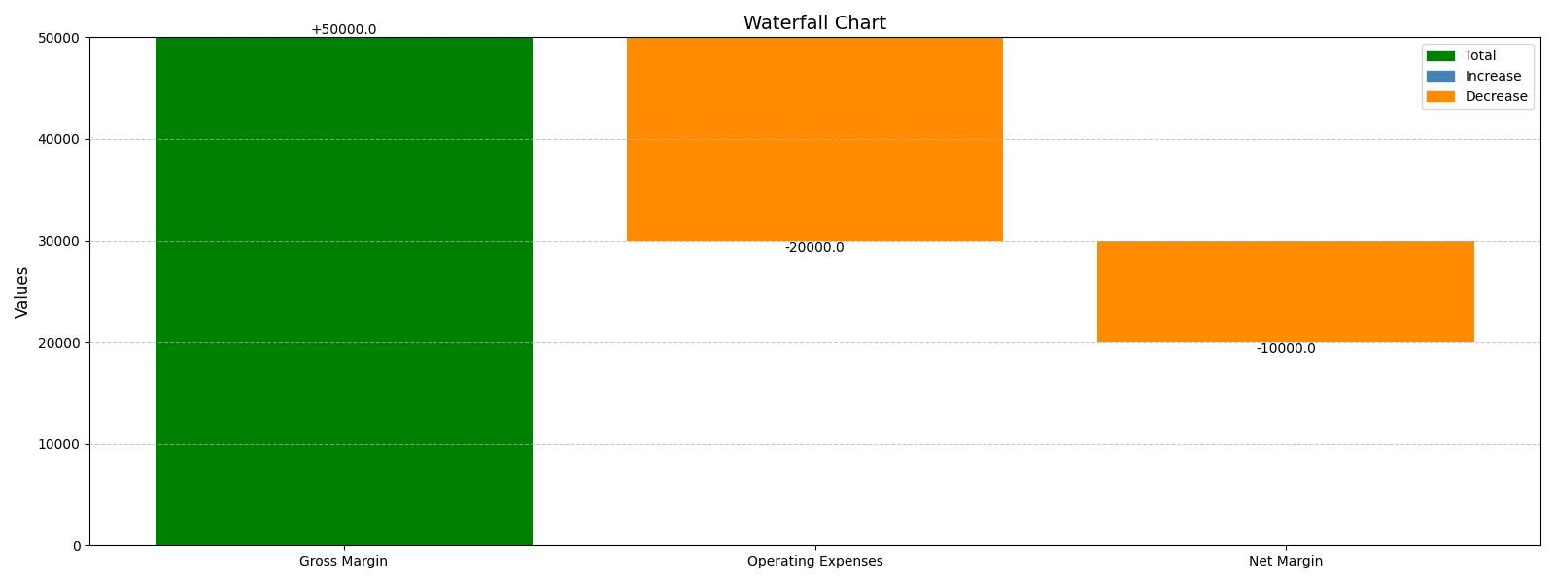
Margin Waterfall Chart

Slide 8
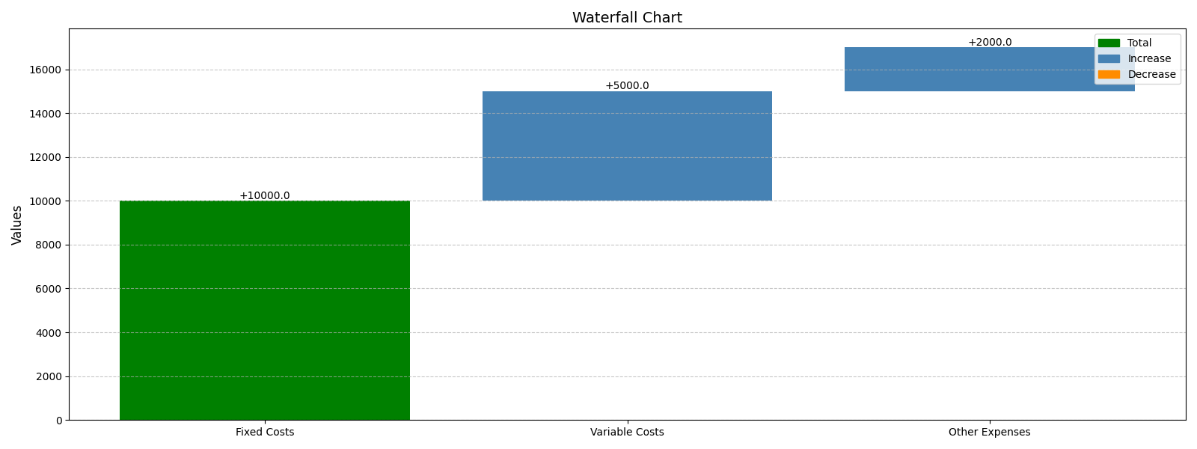
Operating Expenses Waterfall Chart

Slide 9
Key Risks and Challenges
• Increased competition
• Supply chain disruptions
• Regulatory changes
• Economic downturn
• Talent acquisition difficulties

Slide 10
Action Items
• Complete project proposal
• Finalize design mockups
• Conduct user testing
• Prepare presentation materials
• Submit project report

