Slide 1
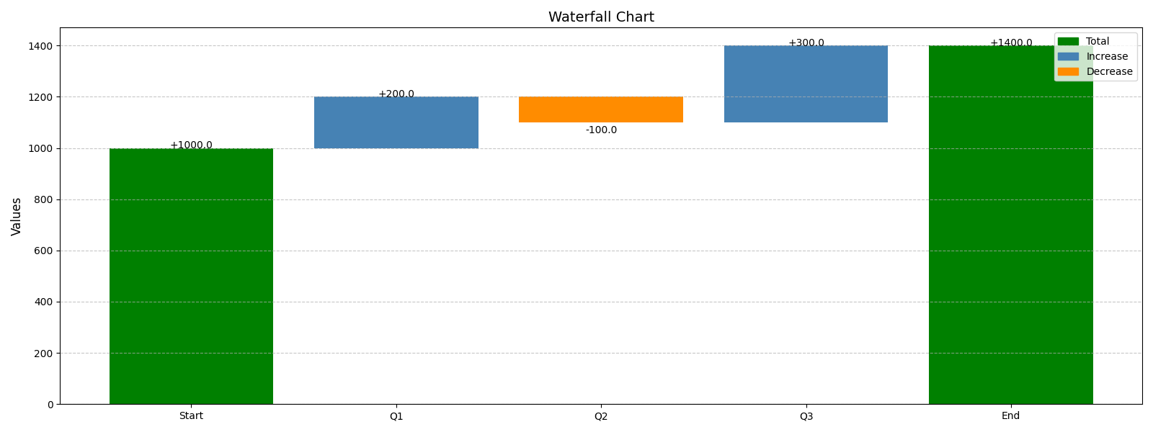
Waterfall Chart Example

Slide 2
Quarterly Sales

Slide 3
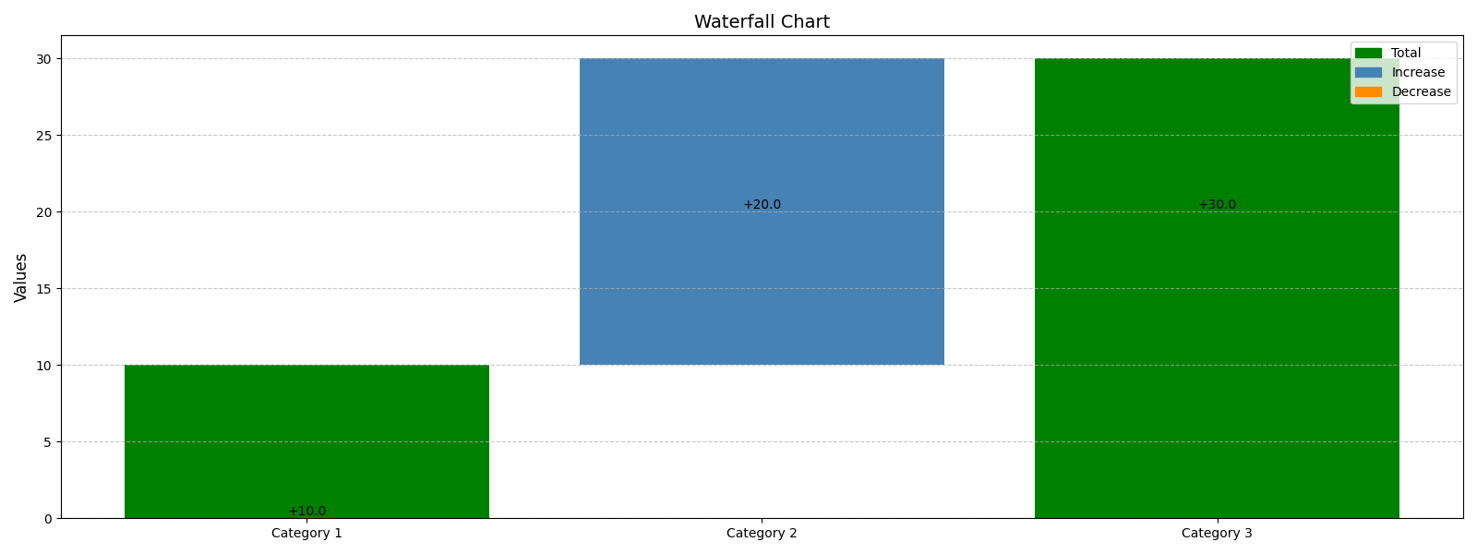
Waterfall Chart

Slide 4
Q1-Q4 Sales Comparison

Slide 5
Q1-Q4 Sales Comparison

Slide 6
Quarterly Sales

Slide 7
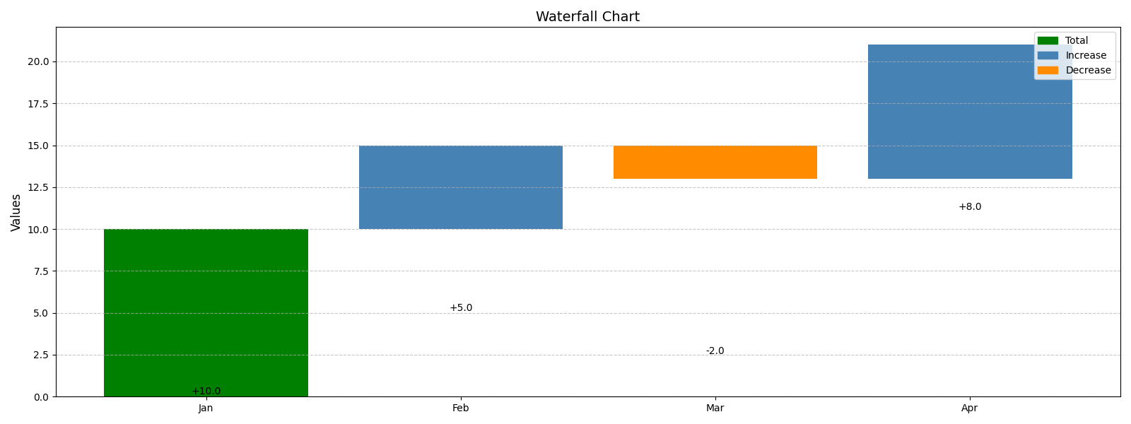
Margin Waterfall

Slide 8
Sales and Profit Correlation

