Slide 1
TEAM : Data Diggers HACKFEST 2019 Sound Recognition System for deaf people
Team members:
Udit Singh Tomar
Neelesh Kumar Yadav
Rohit Saha
Ranjeet Kumar Pandey

Slide 2
Our Idea:
We plan to develop a sound recognition and communication system for the deaf people or the patients of other diseases unable to process voices.
We have seen deaf people communicate via sign language. But, this requires both the communicating parties to know the sign language.
Our project removes this drawback.
Voices received will be converted to sequence of vibrations which can be received by the user using a vibratory device attached to his hand.
LSTM Encoder Decoder architectute is used for this sequence to sequence modelling.
For any natural language the model can be trained to generate the corresponding sequence of vibrations in vibration language.

Slide 3


The Complete Model:
We obtain the data of English sentences, and the corresponding set of sequence of bits acting as input to a set of 5 piezoelectric sensors to generate the vibratory language.
This data is used to train a LSTM model based on encoder decoder architecture.
Thus given a text sentence our neural network generates corresponding bit sequence.

Slide 4
For each input sentence the corresponding seqence of bits translated is fed to Arduino which activates the piezoelectric sensors, by introducing a short time delay between each five bit sub bitstring.
This short time delay helps in distinguishing between words of vibrating language.
Thus the user who is trained to recognize the vibration language, understands what the second person wants to say.

Slide 5
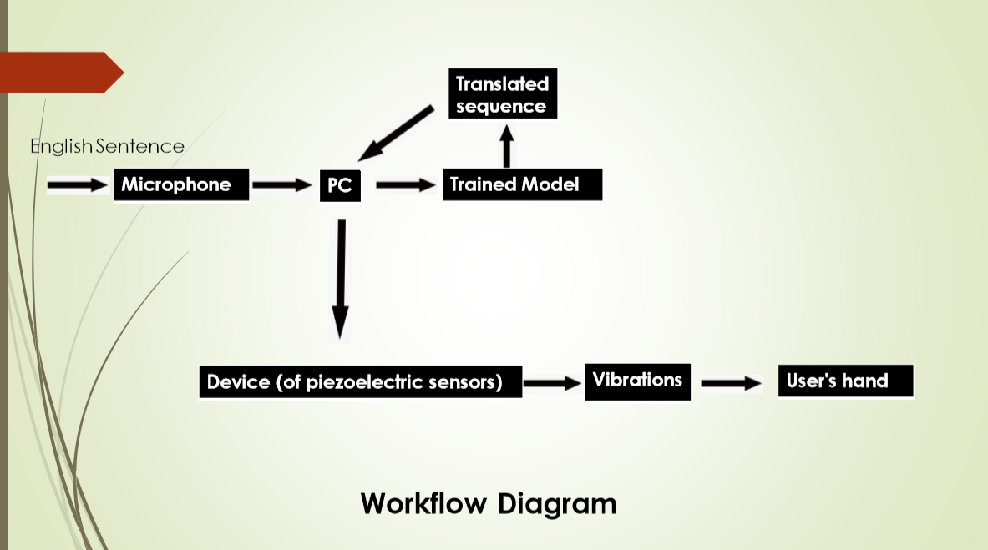

Arduino
Flow Diagram

Slide 6
LSTM ENCODER DECODER ARCHITECTURE MODEL
Recurrent neural networks or better the modified ones called LSTMs (Long Short Term memory networks) work well with sequential data.
A typical sequence to sequence model has two parts – an encoder and a decoder. Both the parts are practically two different neural network models combined into one giant network.
Broadly, the task of an encoder network is to understand the input sequence, and create a smaller dimensional representation of it. This representation is then forwarded to a decoder network which gives a sequence that represents the output.

Slide 7
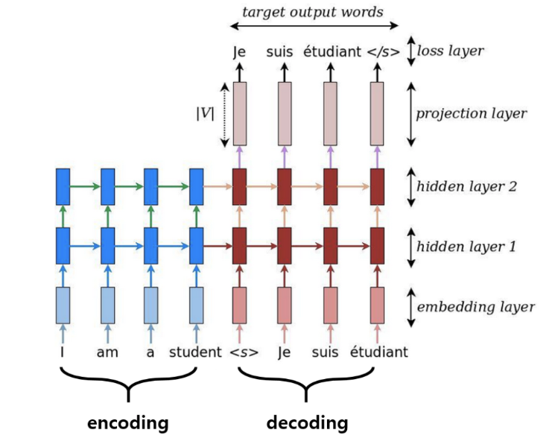

0000 1111 0000 ….

Slide 8
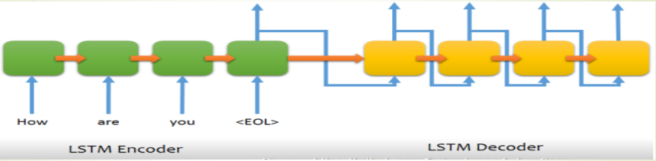
00001 11100 11001....
In the image given above, the input sequence is “How are you”. So when such an input sequence is passed though the encoder-decoder network consisting of LSTM blocks, the decoder gives vibration sets one by one in each time step of the decoder’s iteration. Also many times, the hidden state for a pair of languages works good for some other pairs.

Slide 9
Further Future Improvements:
With more data available the model is destined to produce good results like other sequence to sequence models working on big amounts of data.
The system can be worked upon to reduce the cost of production, and put into market on low cost.
Trained model later can also be embedded along with the vibrating piezoelectric sensors into a single device which can be put into the market.
The device can be connected to cloud services and can be made to fine tune itself for the users.

Slide 10
Github repository link: https://github.com/UditSTomar/Hackfest_DATA_DIGGERS
REFERENCES:
1. On the Properties of Neural Machine Translation: Encoder Decoder Approaches
Kyunghyun Cho, Bart van Merrienboer, Dzmitry Bahdanau, Yoshua Bengio
2. https://machinelearningmastery.com/how-does-attention-work-in-encoder-decoder-recurrent-neural-networks/

Slide 11


Slide 12
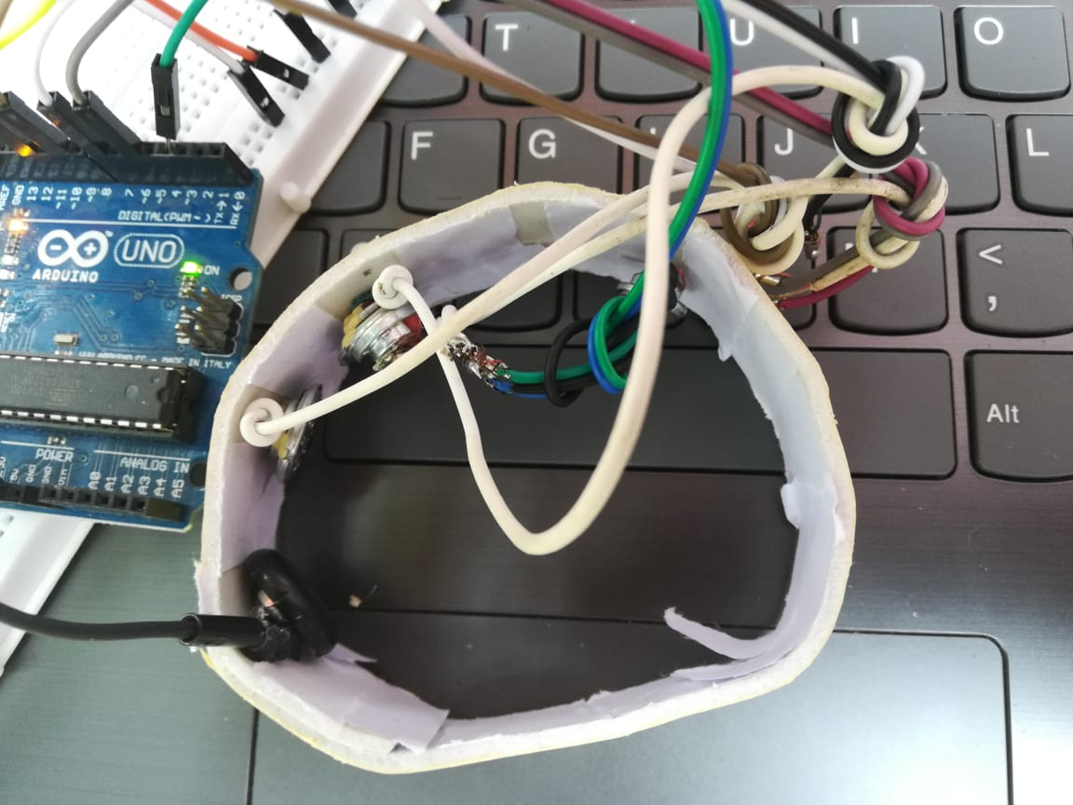
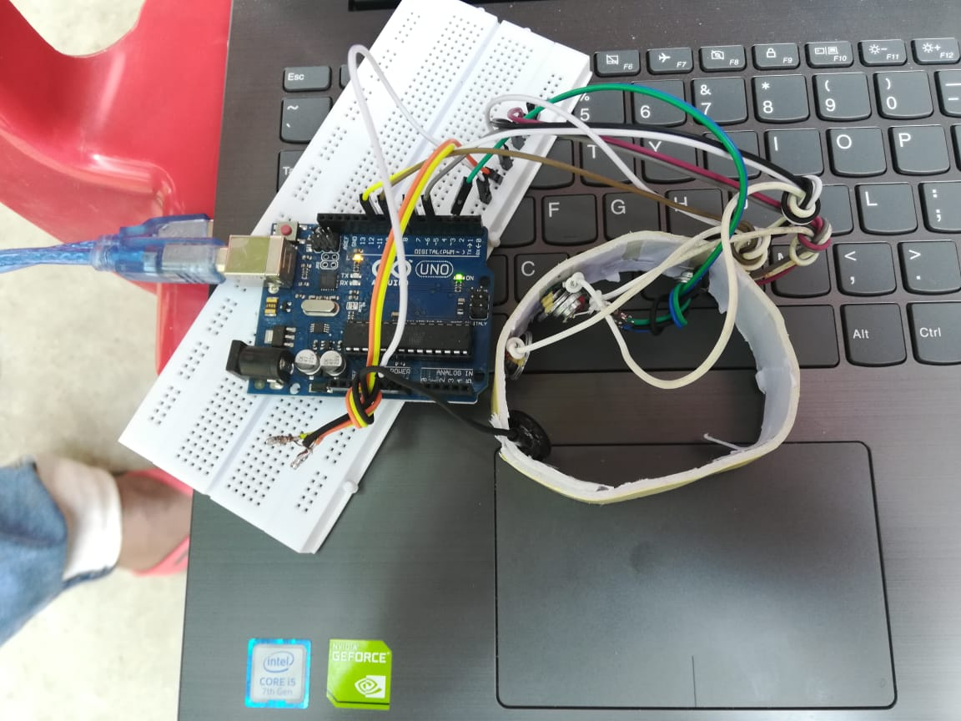
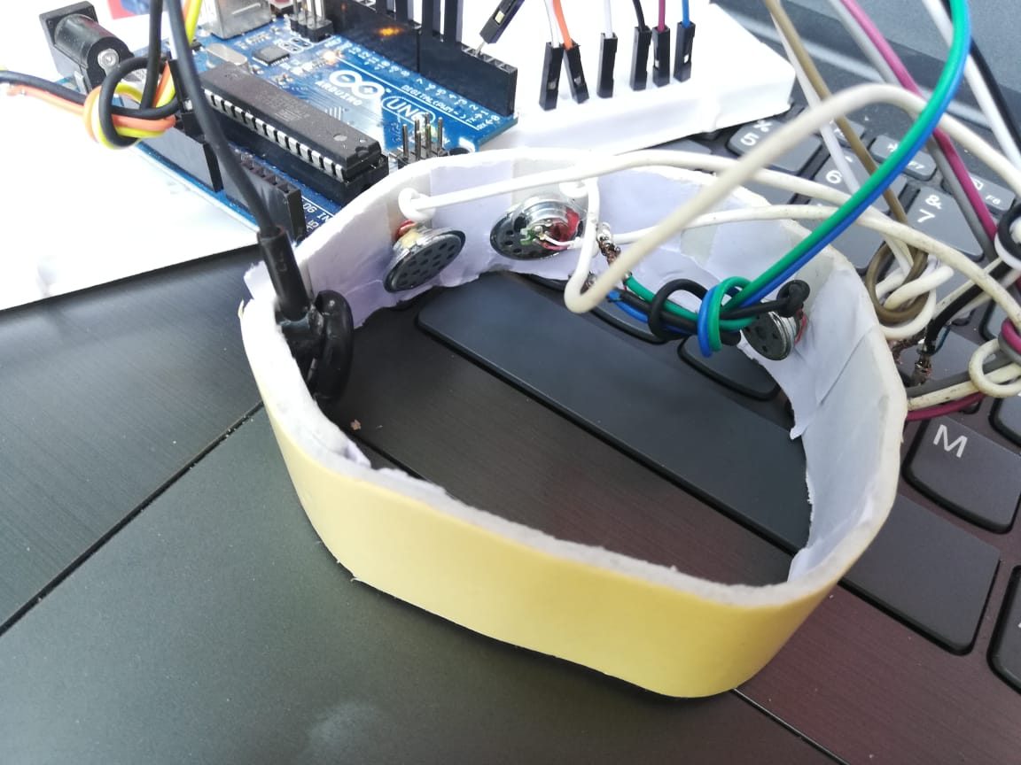
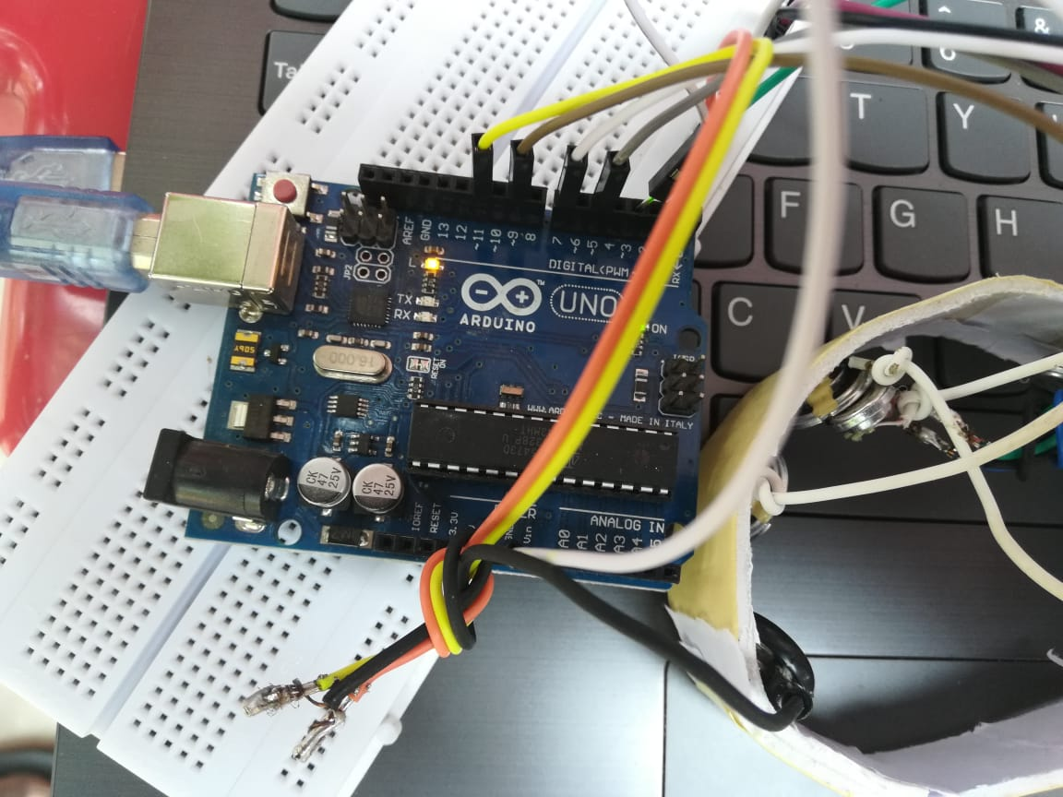

Slide 13
Thank You

