Slide 1
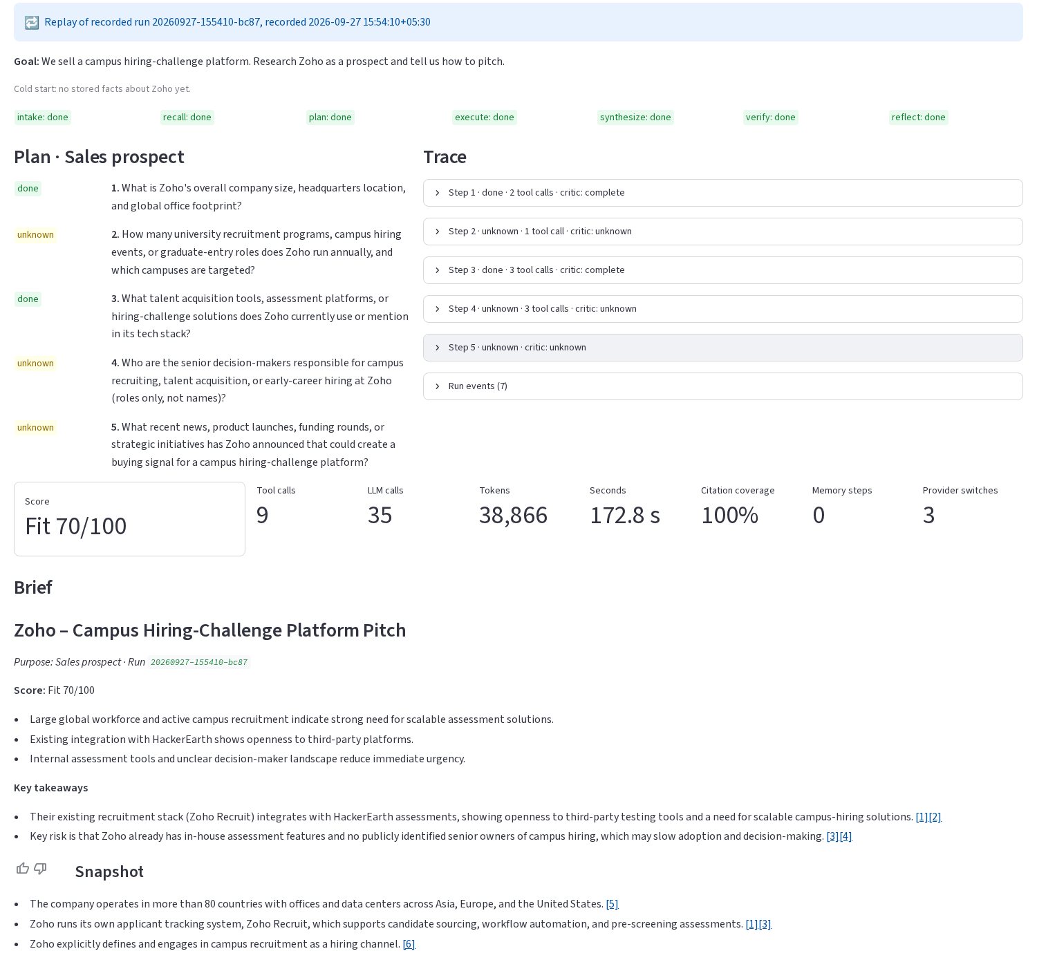

Scout
A purpose-aware company intelligence agent
Give it a company and a reason. It plans research around that reason, cites every claim, checks its own work, and gets faster with every run.
Udit Singh Chauhan
AI Agentic System Challenge · September 2026
github.com/UditSinghChauhan/scout-agent
Live UI: plan, trace, metrics and a cited brief

Slide 2



Why you ask changes what you need
Same company — Zoho — three people, three different research jobs
Sales rep
Competitor analyst
Interview candidate
“We sell a campus hiring platform. How do we pitch Zoho?”
“How does Freshworks compete with us?”
“Prep me for an SDE intern interview at Zoho.”
Needs: Size, hiring programs, current tools, buyer roles, buying signals
Needs: Products, pricing, positioning, recent moves, threat level
Needs: Tech stack, engineering culture, interview formats, recent news
Most research agents run one generic prompt and return one generic summary. Scout turns the purpose into the plan.
Scout · github.com/UditSinghChauhan/scout-agent
2

Slide 3

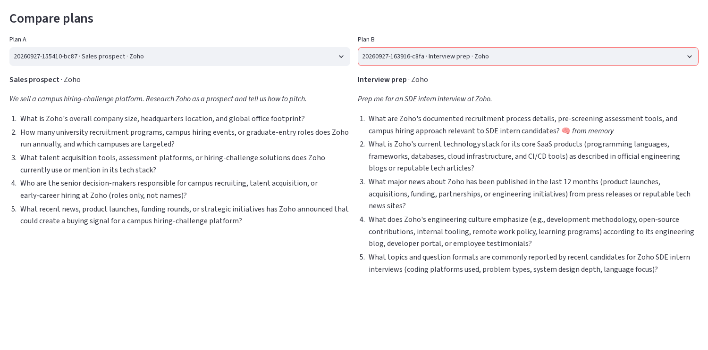



What Scout does
Four promises, each enforced in code — not just asked for in a prompt
Plans around the purpose
Intake classifies the goal (sales, competitor, interview prep); a playbook + past lessons shape a ≤5-step plan.
Cites every claim
Every brief claim must point to evidence the agent actually collected with its tools.
Checks its own work
A critic grades each step (retry / follow-up / unknown); a deterministic verifier checks citations and numbers.
Same company, two purposes → two different plans (recorded runs 1 and 2). Run 2's first step was answered from memory.
Learns with use
Verified facts, source reliability scores and strategy lessons carry into the next run.
Scout · github.com/UditSinghChauhan/scout-agent
3

Slide 4




Architecture: an explicit state machine
Hand-written, no agent framework. The orchestrator is a Python generator of events.
⟲ verify → one revision → Unknowns
Intake
goal → task
Recall
memory
Plan
playbook
Execute
ReAct + tools
Critique
verdict
Synthesize
cited brief
Verify
citations, numbers
Reflect
lessons
⟲ critic loop: next step · retry with a new approach · follow-up step (replan) · unknown
LLM + router
Tools
JSON calls validated by Pydantic, one repair; tiered router over 3 Groq models + Gemini, failover on quota/401/404
web_search (Tavily → DuckDuckGo), fetch_page (SSRF-guarded, trafilatura), recall_memory
Memory
Interfaces
SQLite: runs, facts (7-day / 2-day freshness), source scores, lessons, feedback
Rich CLI, Streamlit UI and trace.jsonl all consume the same event stream → free replay
Scout · github.com/UditSinghChauhan/scout-agent
4

Slide 5








Agentic patterns, mapped to code
Every pattern lives in a small, tested module
Plan-and-Execute
ReAct
Tool use
Critic routing
planner.py writes the plan; orchestrator.py runs it
executor.py: think → search / fetch / recall → observe
tools/registry.py: name, description, JSON schema per tool
critic.py: complete · retry · follow-up · unknown
Self-verification
Reflexion lessons
Human feedback
Provider failover
verifier.py: deterministic checks + one revision
reflector.py writes and votes; top 3 go into the next plan
👍/👎 per section updates source scores and lesson votes
router.py: ordered candidates, cooldowns, traced switches
Scout · github.com/UditSinghChauhan/scout-agent
5

Slide 6
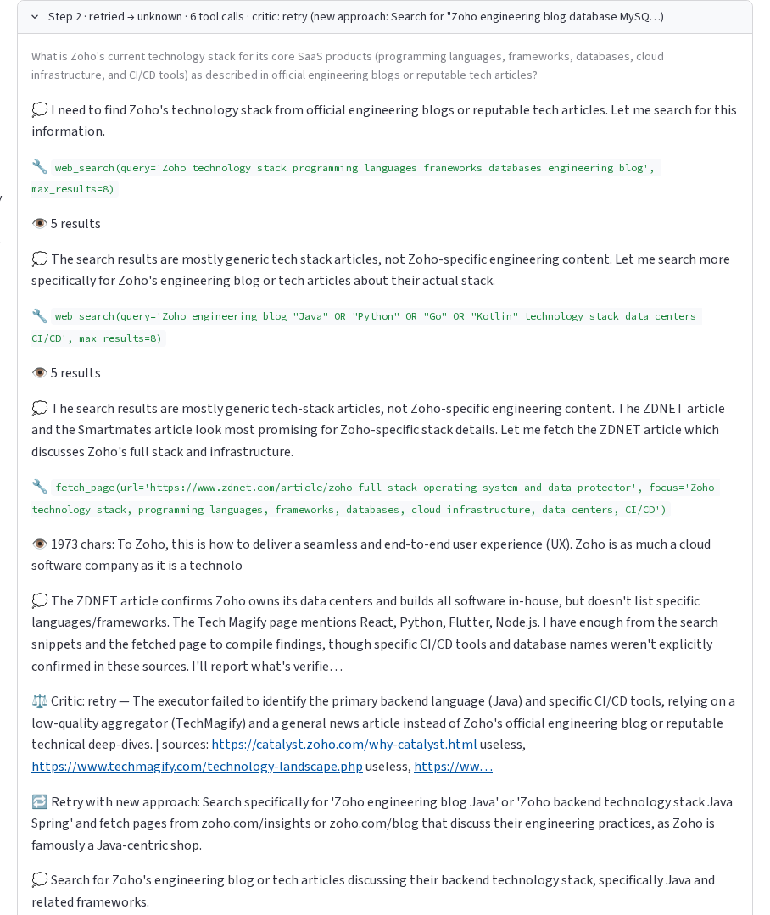
It checks its own work
A critic after every step, a deterministic verifier before anything is published
Critic (LLM, per step)
Rates each step and every source it saw. On weak evidence it orders a retry with a concrete new approach — e.g. “search the Zoho engineering blog for Java” instead of an aggregator.
Verifier (code, per brief)
Every claim must cite existing evidence, and every number in a claim must appear in a cited snippet. One LLM revision; what still fails moves to Unknowns.
100%
24
7
citation coverage
claims flagged by the verifier
moved to Unknowns, not published
Across 13 recorded runs (evals/results.md)
Scout · github.com/UditSinghChauhan/scout-agent
6

Slide 7



It gets faster with use
Same question asked twice — “Prep me for an SDE intern interview at Zoho.” — run 2 vs run 4
−33%
−29%
−24%
−51%
2×
tool calls
LLM calls
tokens
time
facts reused
12 → 8
31 → 22
40,040 → 30,478
203.7 s → 99.1 s
6 → 12
Fact memory
Source reliability
Strategy lessons
Verified facts per company, with source URL and freshness (7 days stable, 2 days news). Steps memory answers skip research but keep citations.
Critic + 👍/👎 ratings per domain: (useful+1)/(useful+useless+2). Search results are gently re-ranked.
The reflector writes 1–3 lessons per run; the top 3 per purpose shape the next plan and get voted on.
Scout · github.com/UditSinghChauhan/scout-agent
7

Slide 8
What carries over between runs
Four live runs recorded after a memory reset — committed in examples/
1
2
3
4
Run 1
Run 2
Run 3
Run 4
Zoho · sales
Zoho · interview
Freshworks · sales
Zoho · interview again
Cold start. Researches size, campus programs, hiring tools, buyer roles. Writes lessons for sales prospects.
Recalls 8 facts from run 1: memory answers step 1; research goes to new questions (stack, culture, formats).
No stored facts, but 2 lessons from run 1 shape the plan (news + investor-relations sources).
Reuses 12 facts and run 2's 3 lessons: 8 tool calls instead of 12, half the time.
Lesson injected into run 3: “Combine Google News with press-release aggregators and the company’s investor-relations page to capture funding rounds or strategic initiatives that signal buying intent.”
Scout · github.com/UditSinghChauhan/scout-agent
8

Slide 9
Evals from real runs
python -m scout eval --from-runs · 13 recorded development runs, not a curated benchmark
Purpose | Runs | Median sec | Coverage | Budget stops
Competitor | 1 | 148.2 | 100% | 0
Interview prep | 5 | 99.1 | 100% | 2
Sales prospect | 7 | 155.3 | 100% | 1
All | 13 | 137.0 | 100% | 3
19k–58k tokens per full run on free tiers
Budget stops end in a partial brief that says so — never a crash
Live task set: evals/tasks.yaml (one task per purpose)
Scout · github.com/UditSinghChauhan/scout-agent
9

Slide 10





Reliability and safety
Built for the open web and free-tier APIs
Hard budgets
SSRF guard
Untrusted content
5 steps (8 with follow-up), 30 tool calls, 60 LLM calls, 480 s. Two LLM calls reserved so a brief always gets written.
fetch_page allows http/https only, blocks private, loopback and link-local addresses, re-checks every redirect.
All web text wrapped in <untrusted_content>; prompts treat it as data, never instructions.
Roles, not people
Provider failover
258 offline tests
No personal profiles fetched or cited; emails and phone numbers scrubbed from briefs.
Cooldowns on quota errors, failover on 401/403/404, every switch traced; rate-limit waits shown live.
Fake LLM and fake search, no network — including a Streamlit AppTest of the UI.
Scout · github.com/UditSinghChauhan/scout-agent
10

Slide 11
Design decisions and trade-offs
What we chose, why, and what it costs
Decision | Why | Cost
Hand-written state machine, no framework | Every edge, budget and failure is visible and unit-tested; replay falls out of the event stream | More code to own
JSON action protocol, not native tool calls | Portable across OpenAI-compatible providers; Pydantic-validated, one repair | Must also accept native-call shapes some models emit
SQLite memory | Zero setup after clone; transactional; inspectable | Single-user; no fuzzy (vector) recall
Deterministic checks behind the LLM | Citations, numbers, personal data and memory reuse don’t depend on model quality | Exact-match numeric check can be strict
Free-tier multi-model router | Runs without paid keys | Rate limits slow runs; quality varies by model
Replay-first UI | Judging and demos cost no quota and are reproducible | Replays must be labelled (the UI does)
Scout · github.com/UditSinghChauhan/scout-agent
11

Slide 12

Honest limits, and what’s next
Limitations
Next
Free-tier quotas cap live runs at a handful per day
Planner quality varies by model
Numeric check is exact-match after normalisation
Lessons are not always fully company-neutral yet
Scheduled competitor tracking
Vector memory for fuzzy fact recall
Parallel execution of independent steps
Scout as an MCP server
Try it in minutes — no API key needed to replay the example runs
github.com/UditSinghChauhan/scout-agent
git clone https://github.com/UditSinghChauhan/scout-agent.git && cd scout-agent
python3 -m venv .venv && source .venv/bin/activate && pip install -r requirements.txt
cp .env.example .env && python -m scout ui
Scout · github.com/UditSinghChauhan/scout-agent
12

