Slide 1
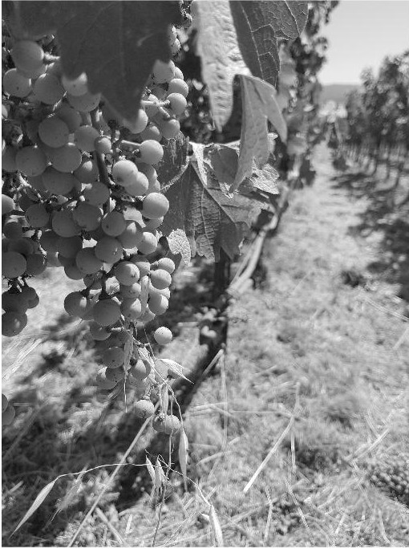
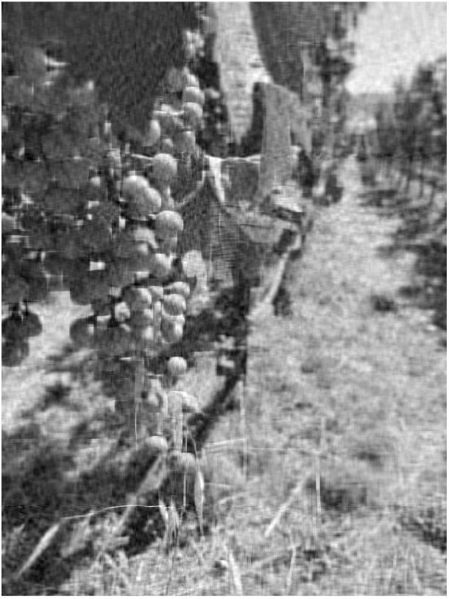

IMAGE COMPRESSION USING CUDA
Udit Singh Parihar
2018701024
Team Id: 24

Slide 2
PCA
1. Image = [c₁, c₂, ..., c_{n}]
2. mean = (c₁+c₂+ ... + c_{n})/n
3. Image = [c₁-mean, c₂-mean, ..., c_{n}-mean]
4. Cov = Image’ * Image
5. [V, D] = eigen_decomposition(Cov)
6. [V, D] = sort(V, D)
7. V^{k} = V[1:k]
8. Red_image = I*V^{k}

Slide 3
EIGEN DECOMPOSITION
Eigenvalues, Eigenvectors
QR Algorithm
QR Decomposition
Householder

Slide 4
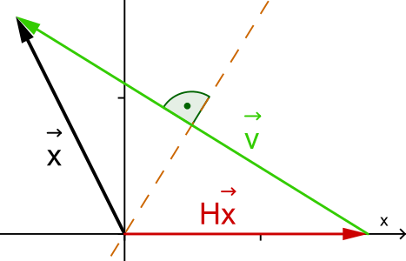
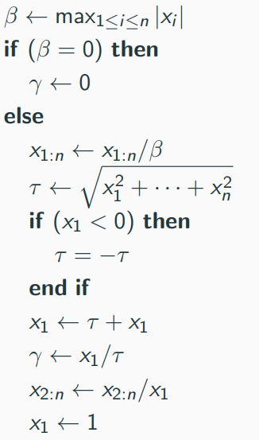
HOUSEHOLDER MATRIX
1. x = [x₁, x₂, ..., x_{n} ]^{T} -> y = [||x||₂, 0, ..., 0]^{T}
2. y = H*x ; where H = I – y*u*u’
3. H is symmetric and preserve length
4. Householder Algorithm

Slide 5
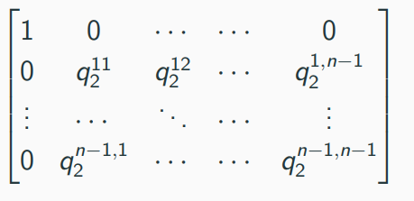
QR DECOMPOSITION
1. R₁ = H₁*X
2. R₂ = H₂*R₁
.
.
.
3. R = H_{n}R_{n-1}
4. Q = H₁*H₂*...*H_{n}
5. Q = Orthogonal, R = Upper Triangular

Slide 6
QR ALGORITHM FOR EIGENVALUES
1. for i = 1 : n
2. Q_{i} * R_{i} = qr(A_{i})
3. A_{i+1} = R_{i} * Q_{i}
4. end
5. Eigen values, D = A_{inf}
6. Eigen vectors, V = Q₁*Q₂*...*Q_{n}
7. return [V, D]

Slide 7
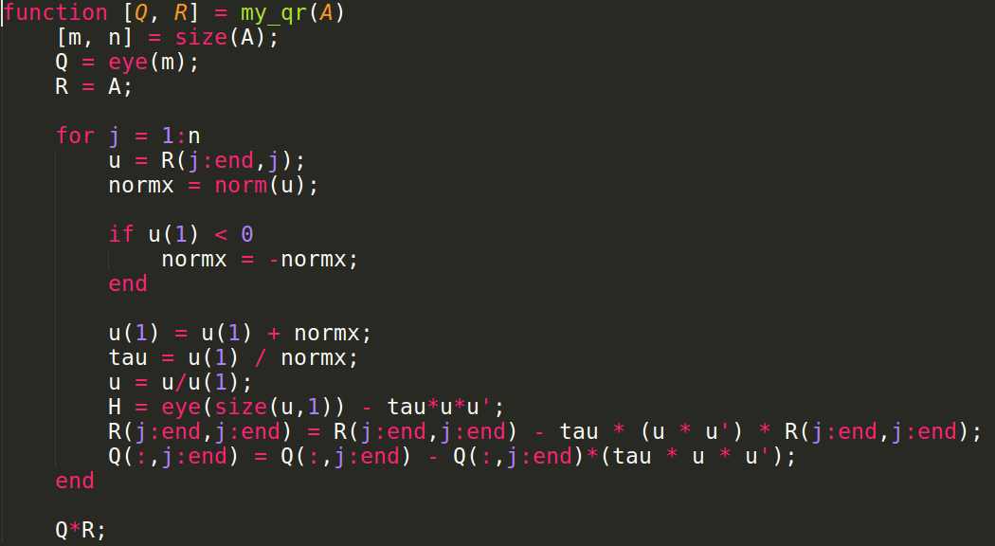
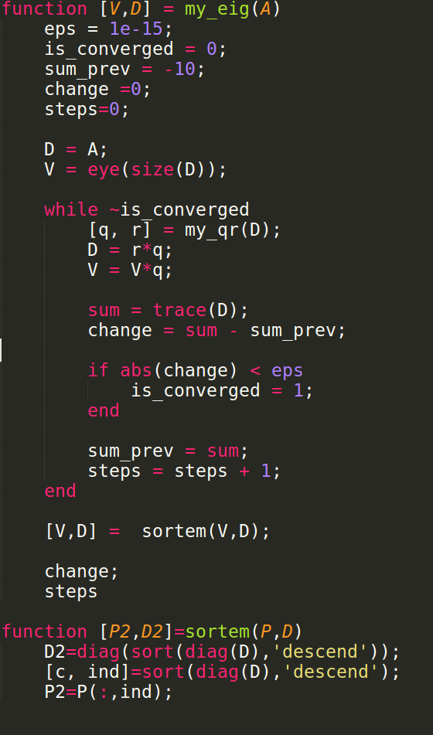
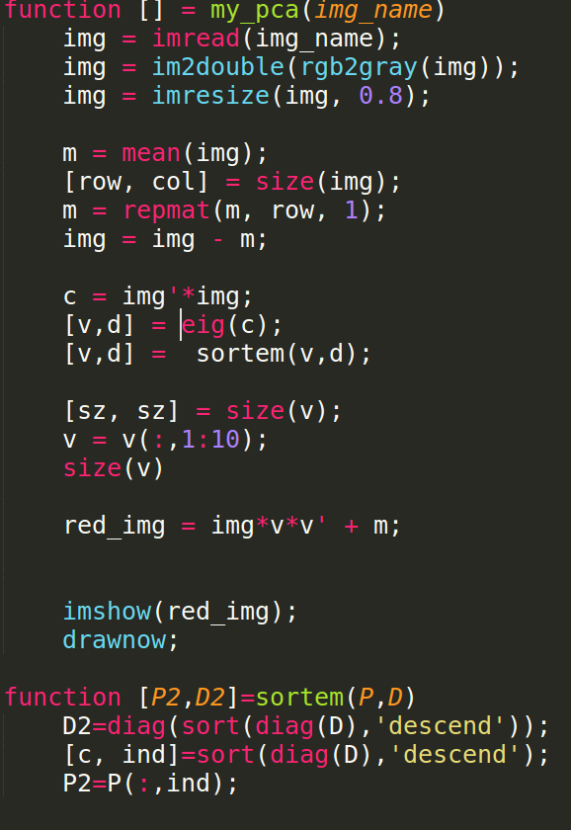
MATLAB IMPLEMENTATION
1. QR
2. Eigens
3. PCA

Slide 8
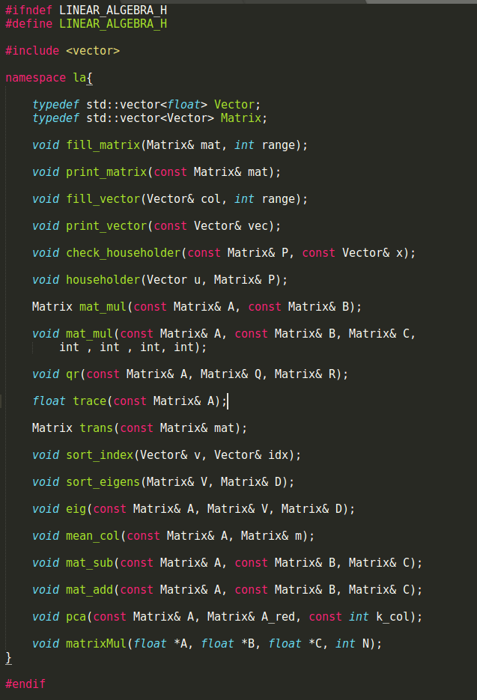
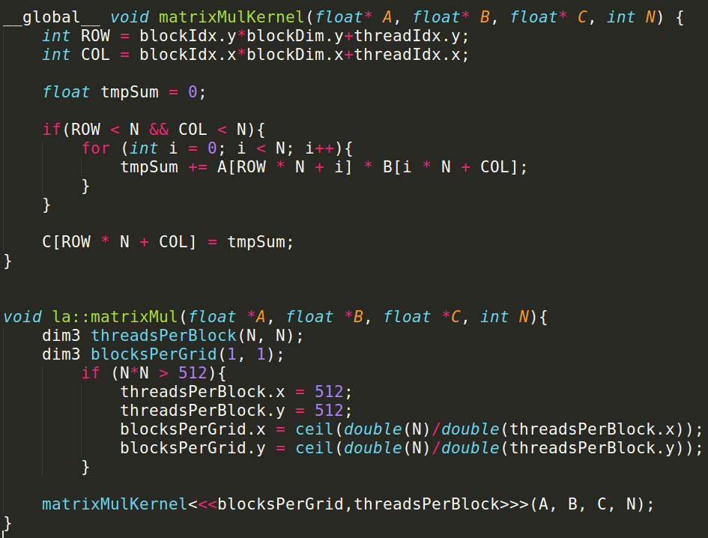
C++/Cuda IMPLEMENTATION
2. Parallel matrix multiplication
1. Matrix operations

Slide 9
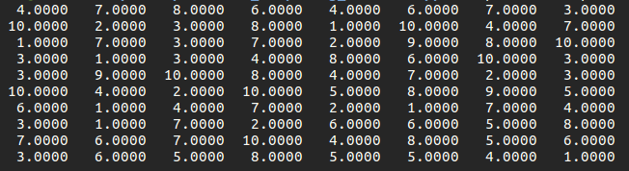
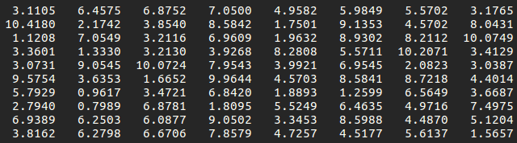
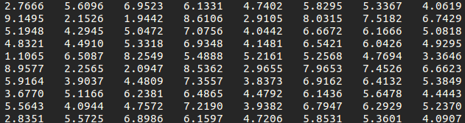
K-APPROXIMATION USING PCA
1. Red_Mat = Mat * V * V’ + Mean
2. V = EigenMatrix(Cov)
1. Original Matrix
2. Mat = 10X8
3. V = 8X8
1. k = 5 approx
2. V_red = 8X5
1. k = 1 approx
2. V_red = 8X1

Slide 10
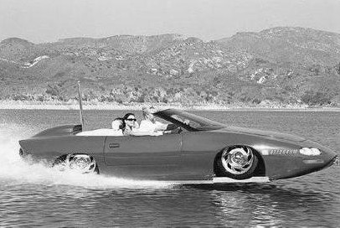
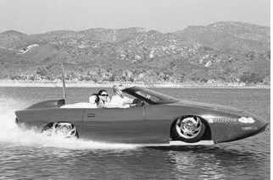
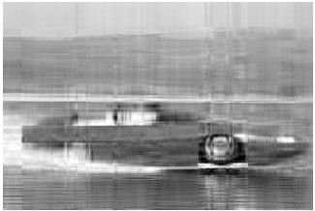
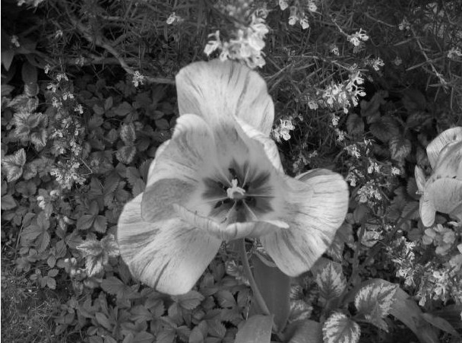
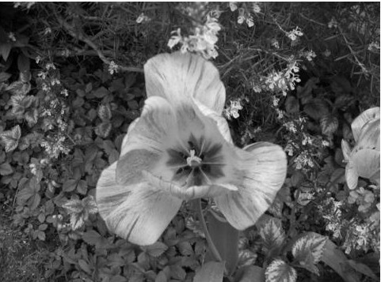
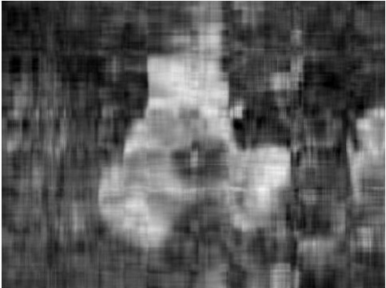
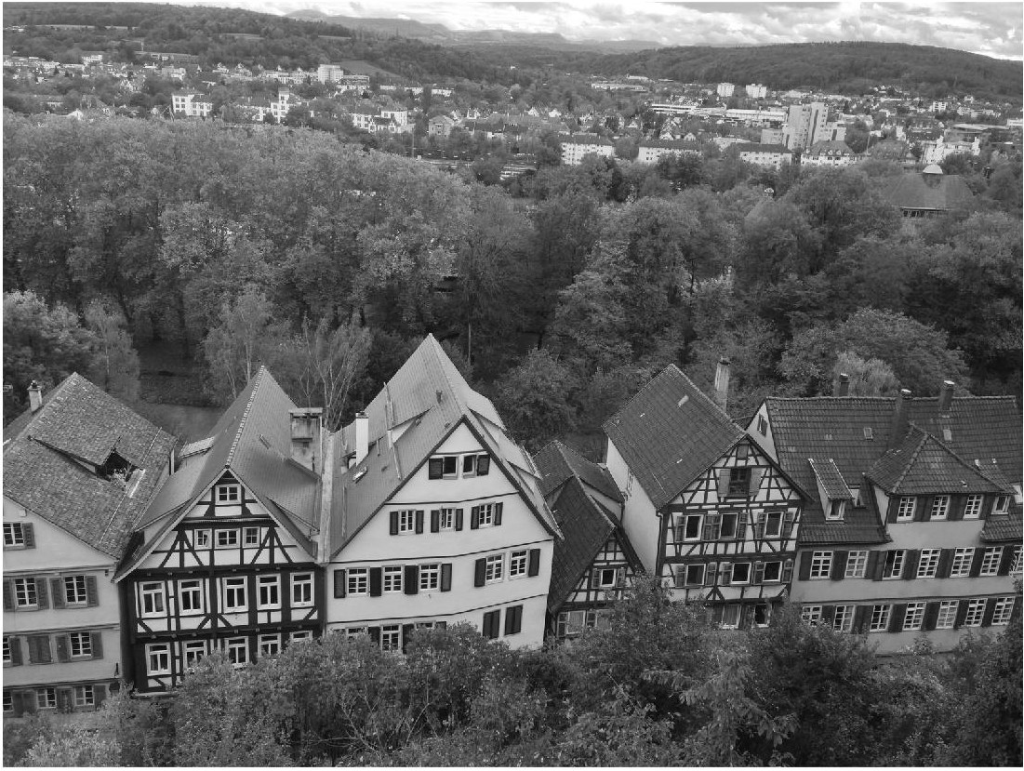

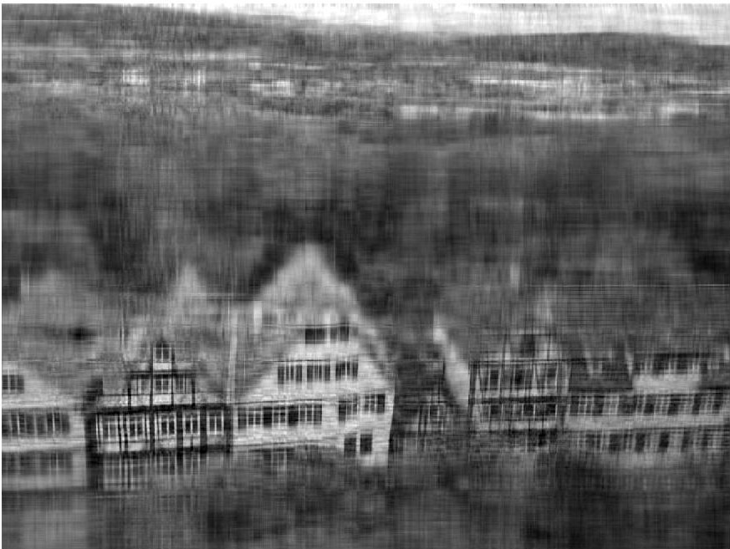
K-APPROXIMATION IMAGES
Original Image
k = size/2 approx
K = 10 approx
Original Image
k = size/2 approx
K = 10 approx
Original Image
k = size/2 approx
K = 20 approx

Slide 11
CONCLUSION
1. Speed using Hetergenous parallel programming
2. Using OpenMP to avoid copying back and forth from device to host.

