Slide 1
MINOR PROJECT · 2026–27
An HR agent that
1
Screens resumes against a versioned, job-anchored rubric
JASIPA
2
Assesses skills with generated questions and sandboxed code
Job Applicant Screening and Interview Panel Agent
3
Convenes a panel of three independent agents
4
Checks for bias on every merged decision
[Team member names]
Guide: [Guide name]
Dept. of CSE (Artificial Intelligence)
5
Leaves the decision to a human, with a verifiable audit trail

Slide 2
PROBLEM
Screening is slow, inconsistent and hard to audit
Recruitment AI is classed as high-risk under the EU AI Act; NYC Local Law 144 requires bias audits.
Inconsistent evaluation
Unchecked disparity
Opaque automation
Different reviewers weigh the same resume differently; criteria drift between rounds and roles.
Small applicant pools make adverse-impact checks easy to misread: no data is often reported as no bias.
Automated rejection without human review or an audit trail is unacceptable for hiring decisions.
Problem statement
Build an HR agent that takes a candidate from resume screening through skill assessment to an interview-panel recommendation, using resume_screen, skill_assess and bias_check tools, a JD-anchored rubric, stage memory, an MCP connector to an ATS database and a swarm of evaluator agents — where no candidate is rejected without human review and every panel decision carries a logged bias check.
JASIPA · Job Applicant Screening and Interview Panel Agent
2

Slide 3
OBJECTIVES
Objectives and status
# | Objective | Status
O1 | Screen PDF, DOCX and dataset resumes against a versioned rubric | Done
O2 | Generate MCQ, coding, scenario and STAR assessments; regenerate | Done
O3 | Score code against hidden tests in an isolated sandbox | Done
O4 | Swarm of three evaluators + Panel Coordinator (LangGraph) | Done
O5 | Bias check on every panel decision, small-sample aware | Done · no real cohort data
O6 | Human decisions, two-reviewer escalation, auditable log | Done
O7 | MCP connector to the ATS database | Done
O8 | Kaggle Resume Dataset as candidate data | Done · 6 categories
O9 | Agents that learn from decisions and outcomes | Not implemented
JASIPA · Job Applicant Screening and Interview Panel Agent
3

Slide 4
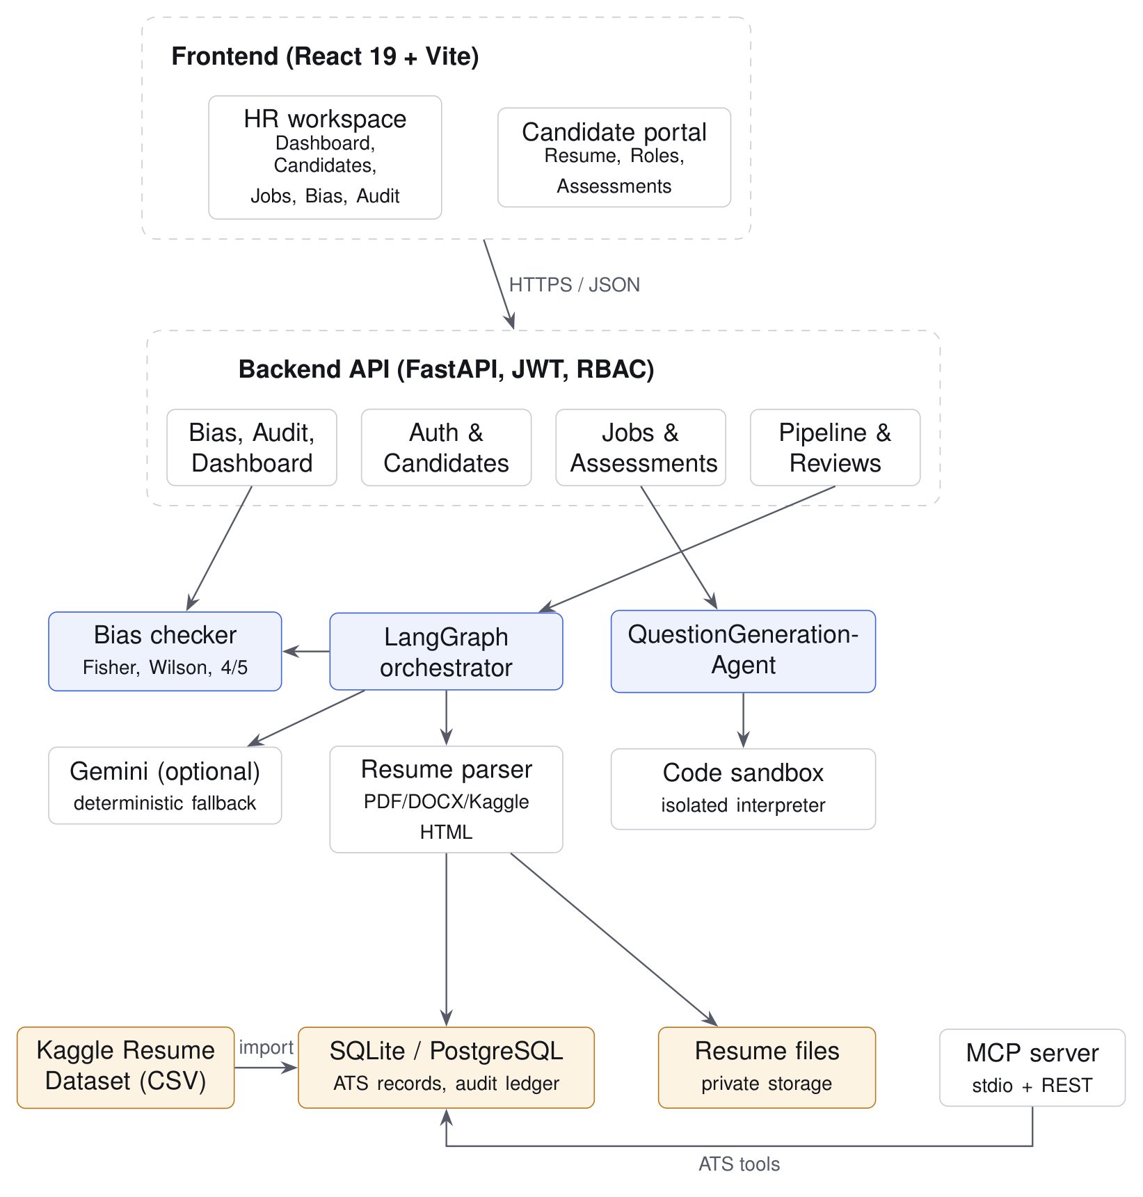
DESIGN
System architecture
React SPA → FastAPI → agents, sandbox and bias services → SQL database; MCP connector for agents.
• Frontend: React 19 + Vite; HR workspace and candidate portal; light, minimal design system.
• API: FastAPI with JWT, bcrypt and role-based access (HR / candidate).
• Agents: LangGraph state graph; each agent is a chain of strategies — LLM → rules → human expert.
• Services: resume parser, question generator, code sandbox, fairness statistics, audit chain.
• Data: SQLAlchemy over SQLite / PostgreSQL; versioned rubrics; candidate stage memory.
• Connector: MCP stdio JSON-RPC + REST facade over ATS records — no decision tool exposed.
JASIPA · Job Applicant Screening and Interview Panel Agent
4

Slide 5
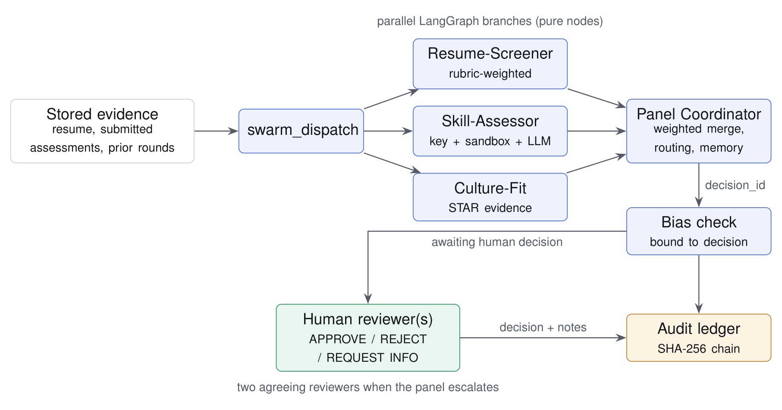
ORCHESTRATION
Agentic workflow
Three evaluators run in parallel on separate evidence and never see each other's output.
• Resume-Screener — resume vs. rubric (redacted, injection-screened)
• Skill-Assessor — answer keys, sandbox pass rate, open answers
• Culture-Fit — STAR evidence per competency
• Panel Coordinator — weighted merge (0.4 / 0.4 / 0.2), routes only
• Bias check — bound to the panel decision
• Human reviewer — records the decision; 2 reviewers if agents diverge ≥ 30 pts
JASIPA · Job Applicant Screening and Interview Panel Agent
5

Slide 6
IMPLEMENTATION
Agentic AI components
Component | Implementation in JASIPA
Tools | resume_screen · skill_assess (with code sandbox) · bias_check · MCP ATS tools
Skill | Versioned JD-anchored rubric: resume 50/15/20/15, technical 30/40/30, competencies = 100
Memory | Candidate stage machine, panel history across rounds, cached question sets, audit history
Connector | MCP (initialize, tools/list, tools/call) over stdio, plus REST facade
Orchestration | LangGraph StateGraph: dispatch → 3 parallel evaluators → panel → bias
Model | Optional Gemini 2.5 Flash, JSON output, temperature 0.2 — deterministic fallbacks offline
Governance | Routing-only labels · human decision endpoint · two-reviewer rule · hash-chained log
JASIPA · Job Applicant Screening and Interview Panel Agent
6

Slide 7
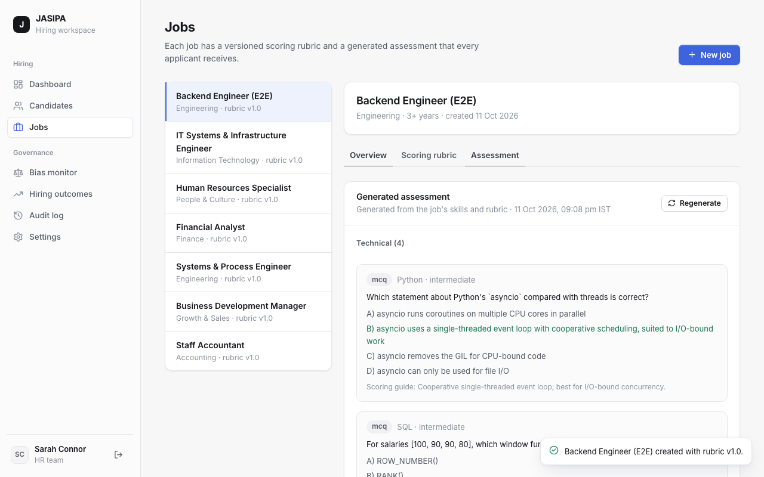
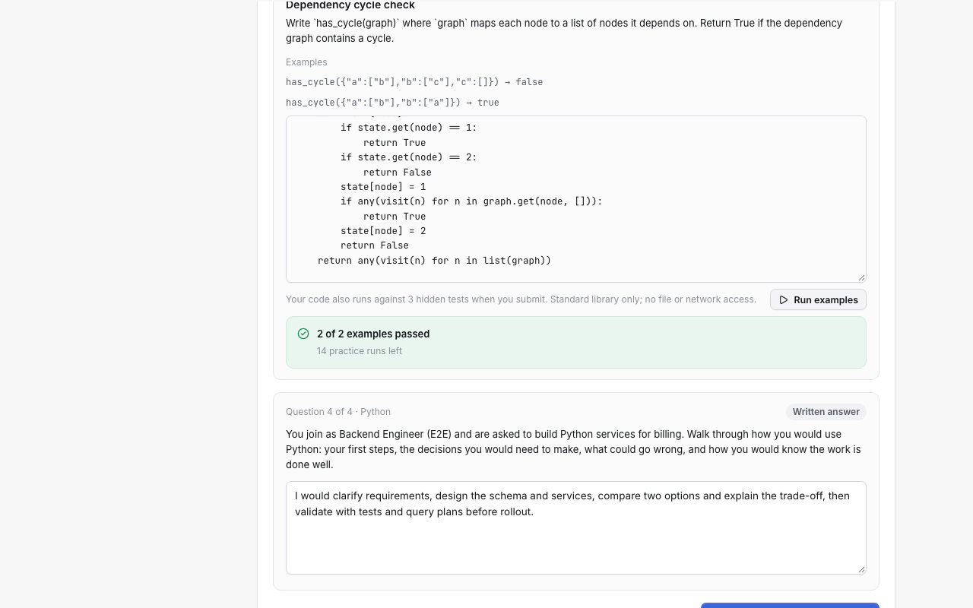
QUESTIONGENERATIONAGENT
Role-specific assessments and sandboxed code
Generation MCQ, coding (programming roles only), scenario and STAR questions from the JD and rubric; cached per rubric version. Regenerate saves only a set that differs, and reports how many questions changed.
Sandbox Fresh isolated interpreter, CPU / memory / file / process limits, audit hook blocks network, files and subprocesses. Judging happens outside the sandbox, so forged output cannot pass.
JASIPA · Job Applicant Screening and Interview Panel Agent
7

Slide 8
FAIRNESS
Bias check: three honest states
Cohort = HR-recorded monitoring label; never inferred from resumes, never shown to agents.
Disparity detected
No indicator detected
Insufficient data
Impact ratio < 0.80 (four-fifths screen) with n ≥ 5 in each cohort. Fisher p shown as significant / not significant.
Screen not triggered. A significant rate difference alone is a note, not a warning. Under n = 30: low-power caution.
Cohort below 5, fewer than two eligible cohorts, or no selections. Never presented as fairness.
• Per decision: AI recommendation, final human decision, post-hire outcome, score-threshold gap and rationale language.
• Uncertainty: Wilson 95% intervals; fragility flag when one outcome would flip the screen; Fisher test verified against SciPy.
• Separation: the bias check never changes scores or routing — it informs the human reviewer.
JASIPA · Job Applicant Screening and Interview Panel Agent
8

Slide 9
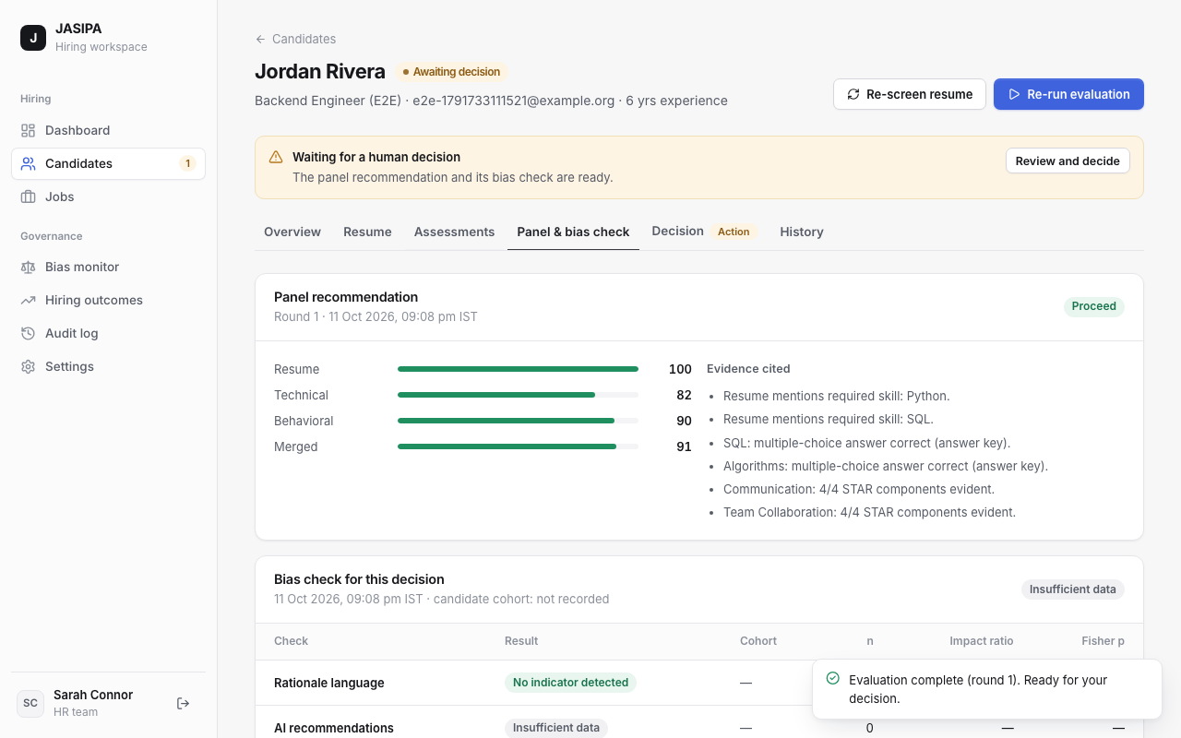
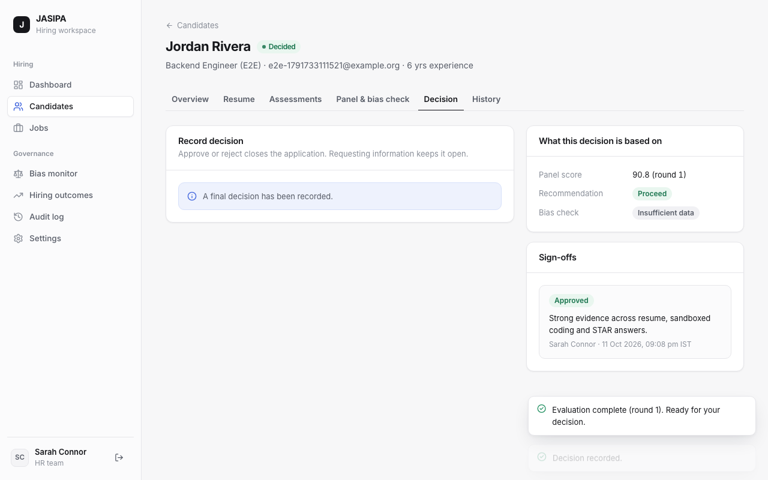
HUMAN OVERSIGHT
Panel, bias check and human decision
• A decision is accepted only for the latest panel decision with a bias check, and binds both IDs to the review.
• Every action is appended to a SHA-256 hash chain; Audit log → Verify integrity recomputes it.
JASIPA · Job Applicant Screening and Interview Panel Agent
9

Slide 10
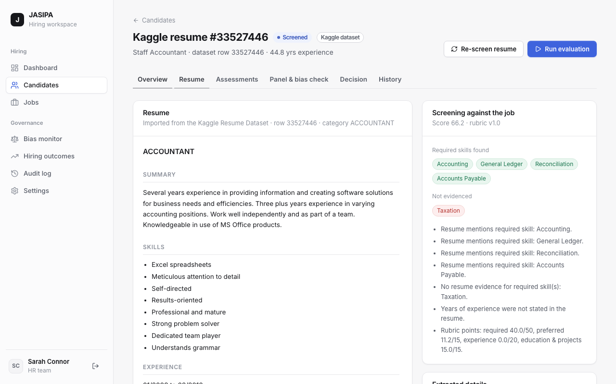
DATASET
Data: Kaggle Resume Dataset
Seeded synthetic candidates were replaced by real resumes; nothing is invented.
2,484
24
6
48
resumes in Resume.csv
job categories
categories with authored JDs
records imported by default
• Categories: IT, Engineering, HR, Finance, Accountant, Business Development.
• Structure: sections rebuilt from Resume_html, so the resume reads like the original.
• Provenance: source = dataset_import, external ID, category; badge in the UI; separate from real applicants.
• Honest gaps: no names, cohorts, answers or outcomes — so dataset runs report incomplete evidence and insufficient data.
JASIPA · Job Applicant Screening and Interview Panel Agent
10

Slide 11
VALIDATION
Testing: 149 / 149 passed
Generated from the runners' result files by scripts/run_all_tests.py — not written by hand.
Suite | Total | Pass | Fail
Backend (pytest) | 110 | 110 | 0
Frontend (Vitest) | 30 | 30 | 0
End-to-end (Playwright) | 9 | 9 | 0
All | 149 | 149 | 0
• Unit: agents, sandbox escapes, question generation, Fisher / Wilson values, resume parsing.
• API: RBAC, uploads, regeneration, decisions, two reviewers, audit chain, MCP.
• Component: IST formatting, bias labels, resume rendering, regeneration feedback.
• End-to-end: 9 Playwright journeys — job → application → sandboxed code → panel → bias → decision → audit.
• Defects found: 'C' matched inside 'C++'; regeneration reported false success; error-check ordering; sticky sidebar.
JASIPA · Job Applicant Screening and Interview Panel Agent
11

Slide 12
HONEST ASSESSMENT
Does the agent learn? No — by design
Mechanism | Present | What it does
Rubric / rule-based scoring | Yes | Default for every agent; deterministic and inspectable
LLM inference | Optional | Scoring open answers, drafting questions, summaries — cannot override objective scores
Stored history | Yes | Screenings, assessments, panels, bias checks, reviews, outcomes, audit
Round memory | Context only | Previous panel rounds are reported to the coordinator; scores unchanged
Retrieval | No | No vector store or case retrieval
Training / feedback loop | No | Hiring outcomes are descriptive analytics; rubric changes are manual
Why: learning from historical hiring outcomes can encode historical bias. Any feedback loop needs a validated, audited, human-approved process — stored outcomes are the foundation for it.
JASIPA · Job Applicant Screening and Interview Panel Agent
12

Slide 13
CONCLUSION
Limitations and future scope
Limitations
Future scope
• No learning loop from decisions or outcomes
• No real cohort data — bias paths validated on controlled tests
• Dataset has no outcomes, so accuracy vs. hiring ground truth is not measured
• LLM paths tested with mocks; output quality not evaluated
• Subprocess sandbox is defence in depth; Docker recommended
• Low statistical power under 30 candidates per cohort
• Audited, human-approved rubric updates from outcomes
• Retrieval over past evaluations for reviewer consistency
• Agreement metrics against expert ratings on a labelled sample
• More dataset categories and sandbox languages
• Container / VM sandbox by default; production ATS over MCP
• Intersectional cohorts and power analysis
JASIPA · Job Applicant Screening and Interview Panel Agent
13

Slide 14
Thank you
Questions and live demo
github.com/UditaB20/jasipa

