Slide 1
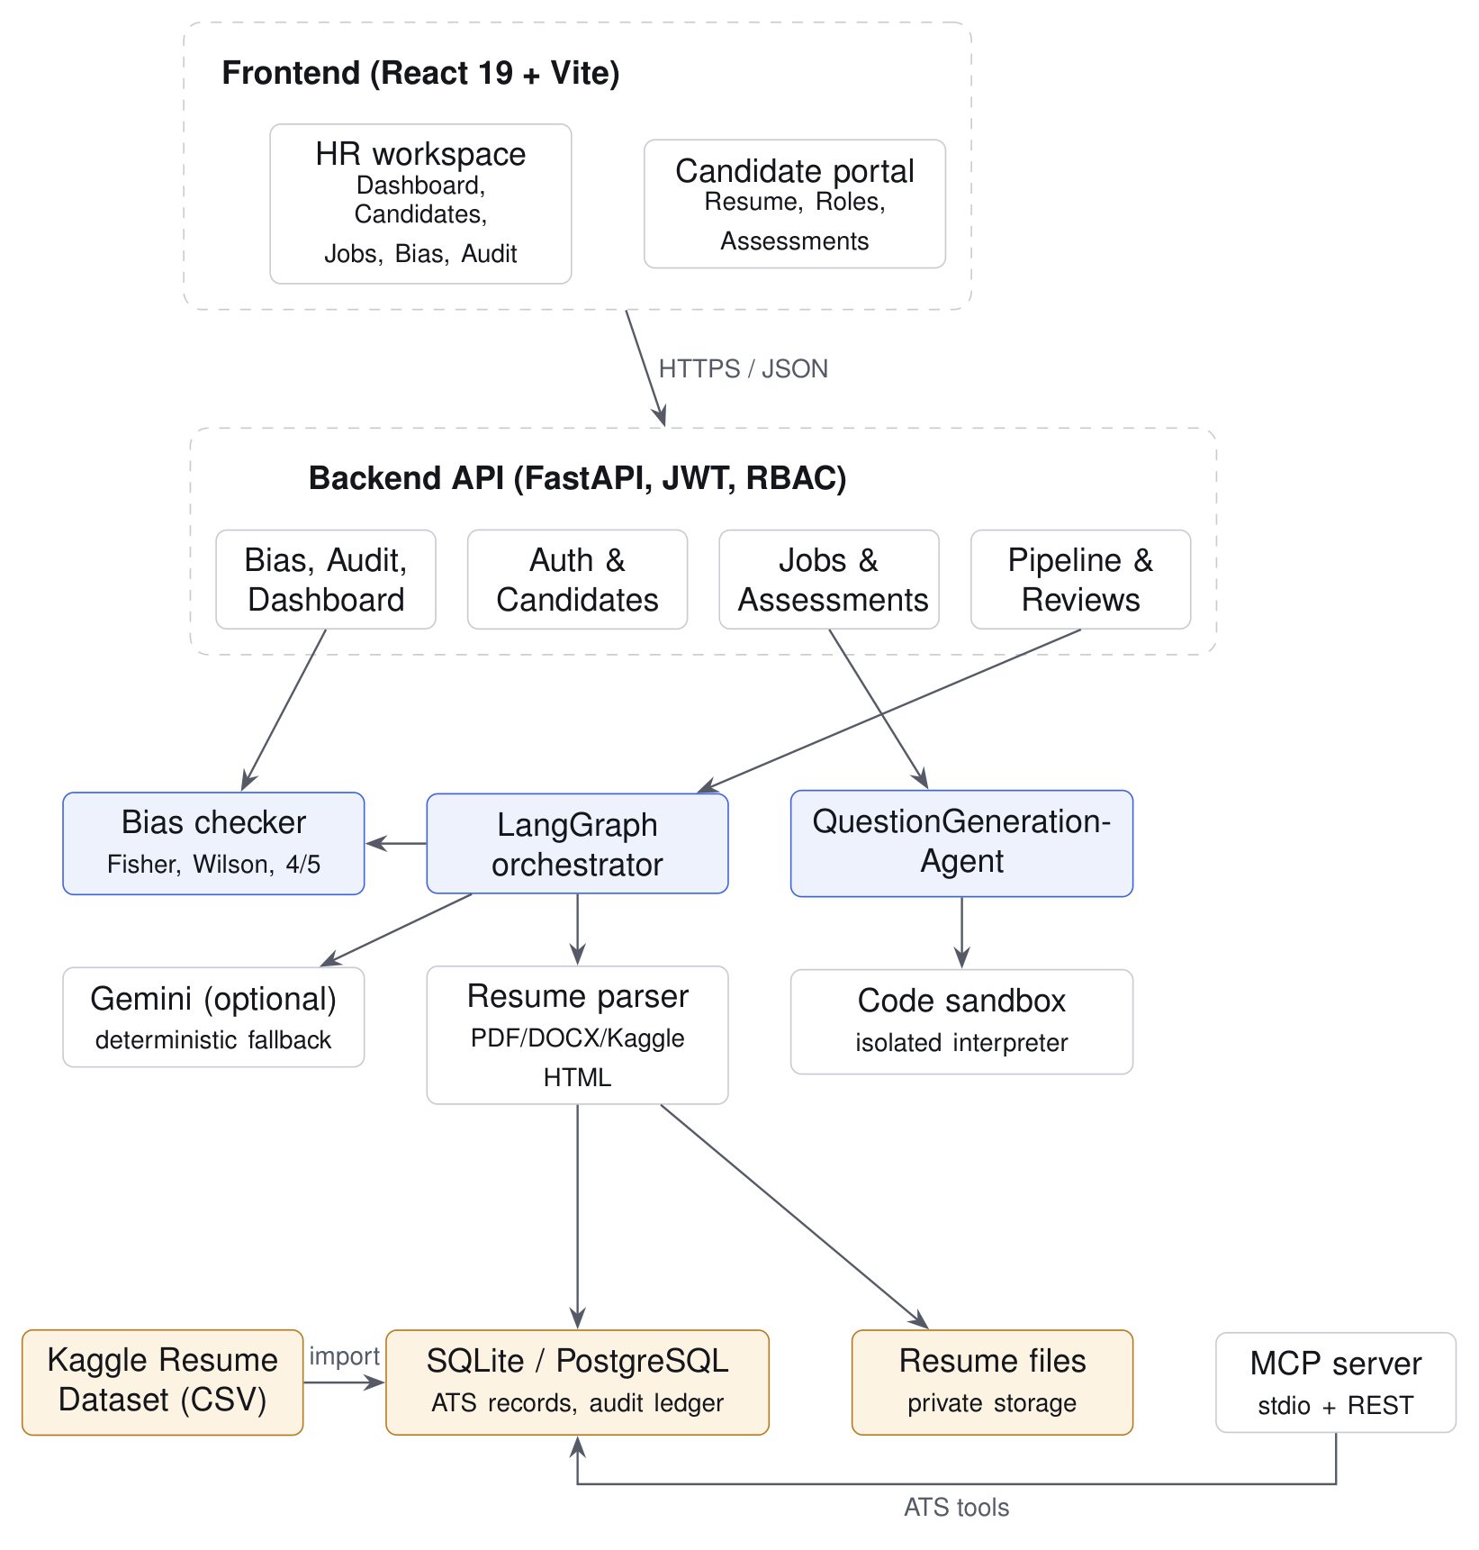
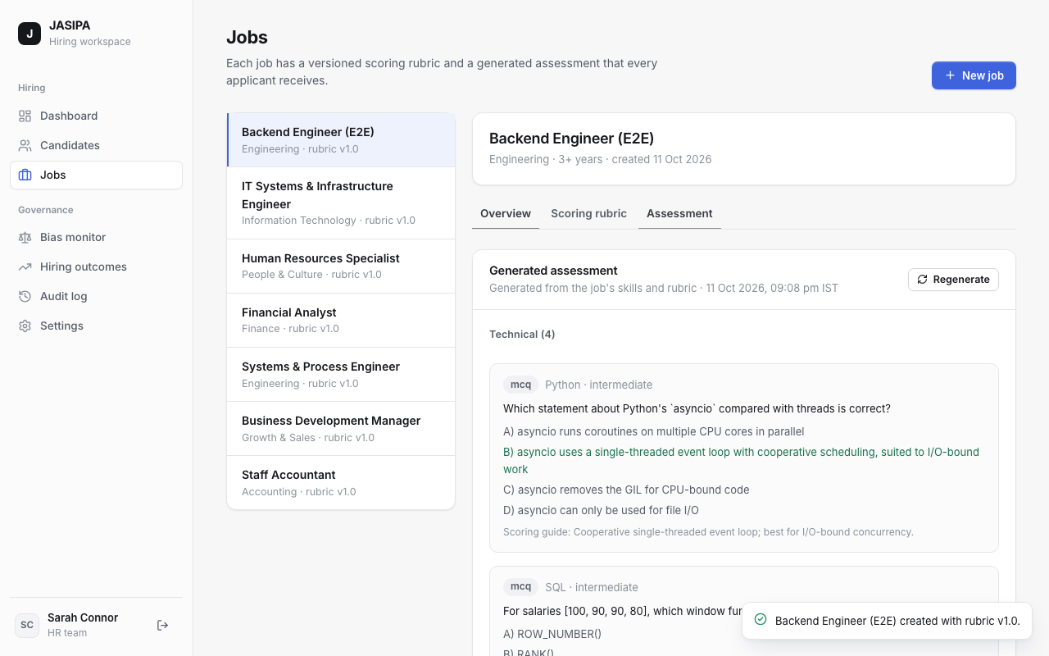
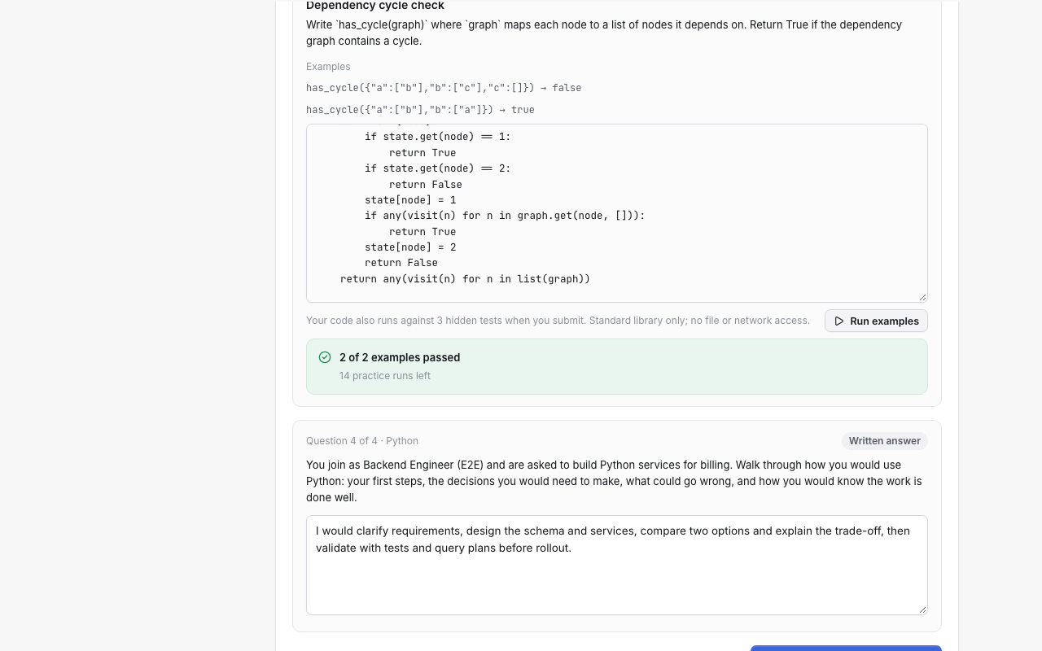
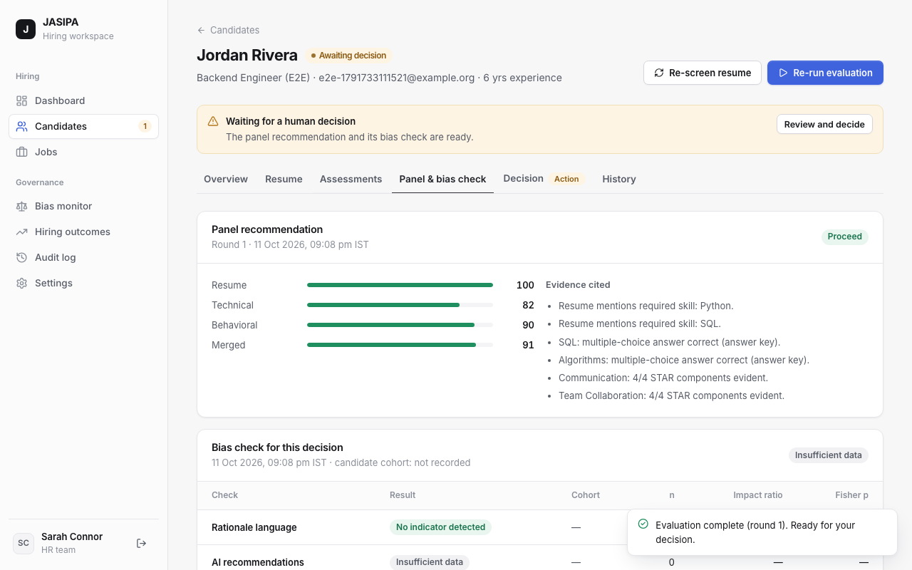
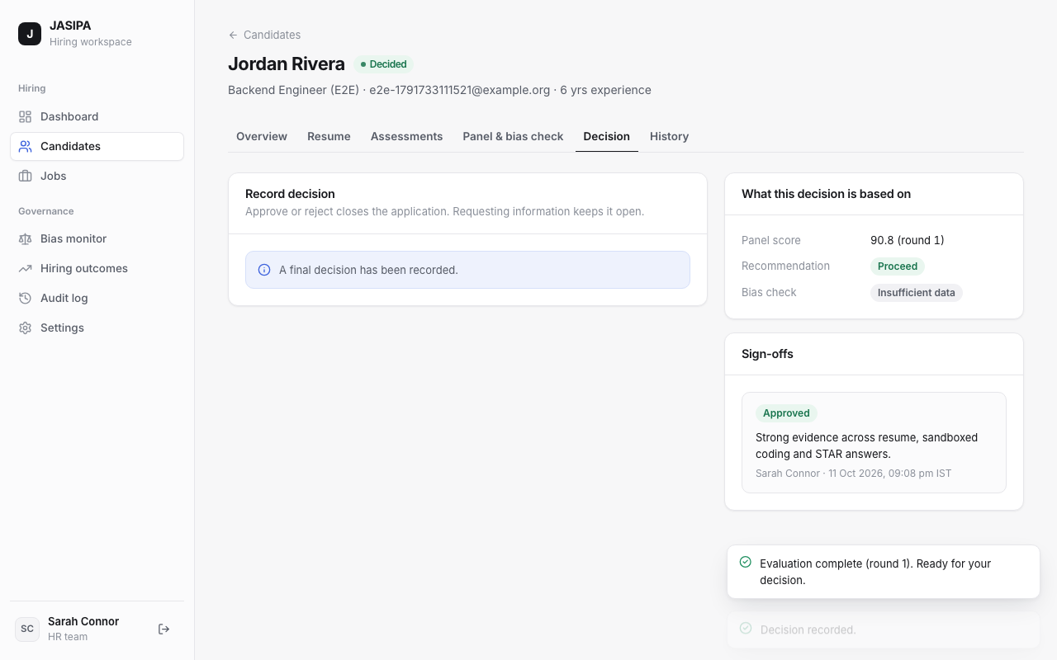
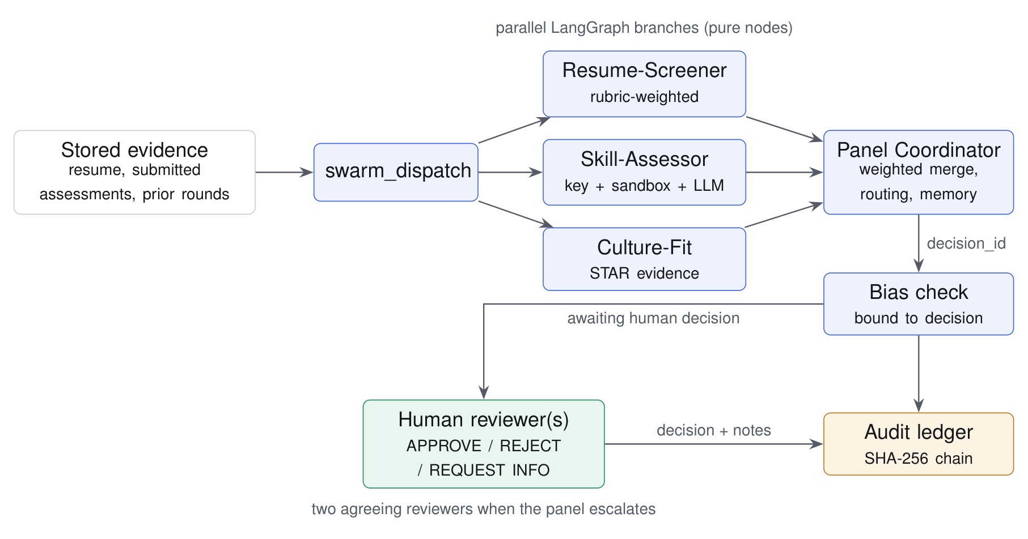
MINOR PROJECT 2026–27 · DEPARTMENT OF CSE (ARTIFICIAL INTELLIGENCE)
JASIPA
Job Applicant Screening and Interview Panel Agent
[Team member names] · Guide: [Guide name]
Three independent agents screen, assess and evaluate each candidate; a coordinator merges their evidence; every recommendation carries a bias check and goes to a human, who records the decision in a verifiable audit trail.
Problem
Bias check: three honest states
• Manual screening is slow and inconsistent between reviewers and rounds.
• Small applicant pools make adverse-impact checks easy to misread — no data is often reported as no bias.
• Recruitment AI is high-risk under the EU AI Act; automated rejection without human review is unacceptable.
Disparity detected
No indicator detected
Insufficient data
Impact ratio < 0.80 with n ≥ 5 per cohort
Screen not triggered; significance is a note
Too few candidates — never shown as fair
Fisher's exact test and Wilson 95% intervals quantify uncertainty. Cohorts are HR-recorded labels, never inferred and never shown to agents. The check informs the reviewer; it never changes scores or routing.
Architecture
System in use
Generated assessment · sandboxed coding · panel with bias check · human decision
Agentic workflow
Data and validation
2,484
48
149/149
Kaggle resumes
imported (6 roles)
tests passed
Suite | Total | Pass | Fail
Backend (pytest) | 110 | 110 | 0
Frontend (Vitest) | 30 | 30 | 0
End-to-end (Playwright) | 9 | 9 | 0
• Tools: resume_screen · skill_assess (sandboxed code) · bias_check · MCP ATS tools
• Skill: versioned, JD-anchored rubric with stage weights 0.4 / 0.4 / 0.2
• Escalation: two reviewers when agents diverge by ≥ 30 points
• Real Kaggle resumes replace synthetic seed data; dataset records are labelled and kept apart from applicants.
• Test tables are generated from the runners' result files — unit, API, component and 9 end-to-end journeys.
Does it learn?
Limitations · next steps
No. Scoring is rubric-based and inspectable; an optional LLM helps with open answers, questions and summaries. Outcomes are stored for analytics only — learning from past hiring risks encoding past bias.
No real cohort data or hiring outcomes; LLM output quality not evaluated; subprocess sandbox is defence in depth. Next: audited rubric updates, expert-agreement validation, container sandbox by default.
github.com/UditaB20/jasipa

