Slide 1
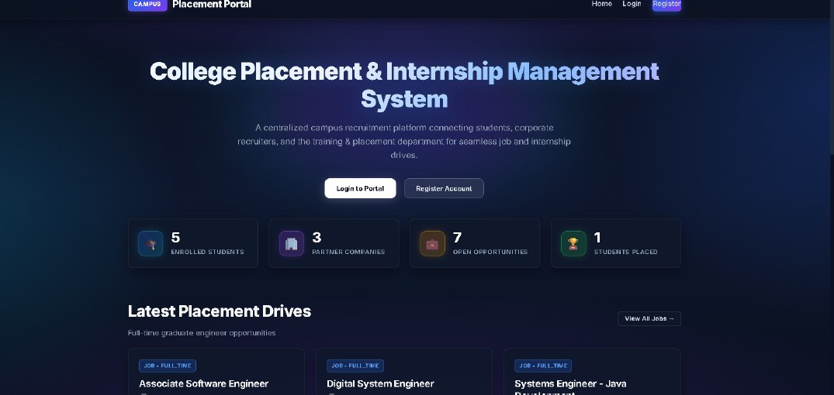
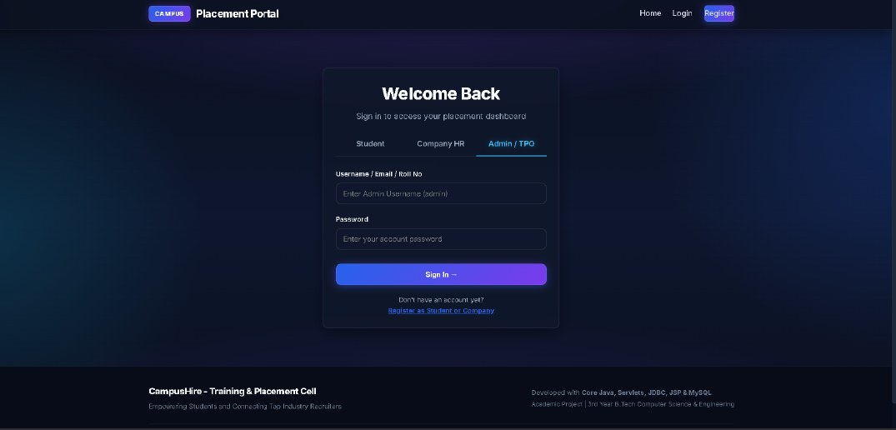
CampusHire
College Placement & Internship Management System
A secure, zero-framework, three-tier web architecture for role-separated campus recruitment
Presented by
Yash Kumar
Virender Singh
Udit Bhardwaj
Vaibhav Charan
Rahul Tailor
Guided by Er. Ram Babu Buri | Dept. of AI & Data Science, Arya College of Engineering & I.T., Jaipur
Notes:
Namaste. Hum apna project CampusHire present kar rahe hain - ek college placement aur internship management system, jo Core Java, Servlets, JSP, JDBC aur MySQL par bana hai.

Slide 2




The Problem with Manual Placement
Fragmented records
Manual eligibility screening
Spreadsheets, e-mail circulars and notice boards give inconsistent data and unverified CGPA claims.
Matching students to cut-offs by hand is slow for the placement officer and error-prone.
No status visibility
Weak data separation
Candidates cannot see where their application stands or the recruiter's remarks.
A shared file has no role-based separation of confidential student data.
Notes:
Ye chaar main problems hain jo humne identify kiye: records alag alag copies mein, eligibility manual, status ki visibility nahi, aur confidential data ka role-based separation nahi.

Slide 3



Proposed Solution: Three Self-Service Roles
Student
Company Recruiter
Placement Officer (TPO)
Maintain profile & CGPA
See only eligible postings
Apply once per posting
Track status & remarks
Register, wait for TPO approval
Post jobs & internships
Review applicants
Update status with remarks
Approve or reject companies
Manage users
View placement statistics
Oversee the full lifecycle
What makes it different
Recruiter self-service
Server-side eligibility
Auditable status lifecycle
Framework-free stack
Notes:
Ye teen actors hain: student, company recruiter aur TPO. Existing systems mein aksar sirf student aur admin hote hain. Humara contribution ye combination hai - recruiter self-service, server-side eligibility, formal lifecycle aur framework-free deployment. Hum koi naya algorithm claim nahi karte.

Slide 4






Technology Stack
Core Java
Servlets 6.0 & JSP
JDBC + DAO
MySQL 8.0 / TiDB Cloud
Models, validation, server-side rules
Request handling and dynamic views
Prepared statements, no ORM
Six tables, ACID, local or cloud TLS
HTML5, CSS3, JS
Apache Tomcat 10.1
Maven
Docker + Render
Responsive forms and role tabs
Servlet container
Builds one 2.45 MB WAR
Multi-stage image, cloud hosting
Zero-framework: no Spring or Hibernate. Only the Servlet API, a container, a JDBC driver and the Java standard library.
Notes:
Hum ne jaan-boojhkar koi bada framework use nahi kiya. Isse stack halka, inspect karne mein aasaan aur sasta host hota hai. Build Maven se hota hai aur Docker image Tomcat 10.1 par Render par chalti hai.

Slide 5
Three-Tier Architecture
Tier 1 · Presentation
Build & Deploy
JSP views /WEB-INF/views/
HTML5 · CSS3 · vanilla JS
Maven builds one 2.45 MB WAR
Multi-stage Docker image
Apache Tomcat 10.1
Hosted on Render
TiDB Cloud Serverless database
Same code runs on local MySQL or cloud TLS via DBConnection
Tier 2 · Business logic (Jakarta Servlets 6.0 on Tomcat 10.1)
AuthFilter: session role vs. path prefix (/student/*, /company/*, /admin/*)
AuthServlet
StudentServlet
CompanyServlet
AdminServlet
Tier 3 · Persistence (pure JDBC)
DAO classes
DBConnection
MySQL / TiDB Cloud
Notes:
Teeno tiers clear separated hain. Sabse important cheez AuthFilter hai jo har request ko servlet ya database tak pahunchne se pehle check karta hai. DBConnection configuration se local MySQL ya cloud database choose karta hai.

Slide 6
Role-Based Access Control
Browser request
AuthFilter checks session role
Role matches path prefix?
Servlet → DAO (prepared SQL)
Unauthorised requests are redirected to login. View templates sit under /WEB-INF/, so the container never serves them directly.
Data item | Student | Company | Admin (TPO)
Own profile and CGPA | Yes | No | Yes
Other students' profiles | No | Applicants to own postings only | Yes
Postings | Eligible ones | Own | Yes
Applications and status | Own | Applicants to own postings | Yes
Company approval | No | Own status | Yes
Credential hashes | No | No | Database-level only
Notes:
Role check do mechanisms se hota hai: WEB-INF mein views aur AuthFilter. Table intended data visibility dikhati hai. Admin aur database operator ka access ek residual risk hai jo application level se remove nahi hota.

Slide 7
Database Design: Six Tables
users
id (PK)
username, email (UNIQUE)
password_hash CHAR(64)
role: ADMIN / STUDENT / COMPANY
status
students
companies
id (PK)
user_id (FK → users)
roll_no (UNIQUE)
department, cgpa
passing_year, resume_url
applications reaches a job or internship through posting_type + posting_id (no foreign key)
id (PK)
user_id (FK → users)
company_name, industry
contact_person
approval_status: PENDING / APPROVED / REJECTED
applications
jobs
internships
id (PK)
student_id (FK → students)
posting_type (JOB / INTERNSHIP), posting_id
status, applied_date, remarks
UNIQUE: student + posting
id (PK), company_id (FK)
title, package_lpa
min_cgpa, allowed_branches
openings, deadline, status
id (PK), company_id (FK)
title, stipend_per_month
duration_months, min_cgpa
deadline, status
Notes:
Schema campus_hire_db mein chhe tables hain. applications table posting_type aur posting_id se job ya internship ko refer karti hai, aur student plus posting par UNIQUE constraint duplicate application rokta hai.

Slide 8

Application Lifecycle
Student applies
Recruiter
Recruiter
ACCEPTED
PENDING
SHORTLISTED
INTERVIEW_SCHEDULED
REJECTED
Student
Recruiter
Final decision
Applies once per posting. Sees the current status and remarks on the next page load.
Owns the posting. Moves each candidate forward and records remarks at every step.
Interview ends in ACCEPTED or REJECTED. Interview remarks are stored with the application.
Transitions are specified as one forward path; enforcement is by the UI today, with a server-side transition table planned.
Notes:
Application lifecycle ek hi forward path hai: PENDING, SHORTLISTED, INTERVIEW_SCHEDULED aur phir ACCEPTED ya REJECTED. Honest note: abhi ye transitions UI se enforce hote hain, server-side transition table future work hai.

Slide 9
Server-Side Eligibility and Applying
Eligibility rule
Submit application
Student.CGPA ≥ Job.min_cgpa
AND
branch is allowed (or "All Branches")
1
Load student profile and posting
2
Apply eligibility check; reject if ineligible
Checked when postings are listed
Checked again at submission, so a client-side bypass cannot create an ineligible application
Eligibility is only as accurate as the entered CGPA; TPO verification is the real control
3
Insert with status PENDING via prepared statement
4
UNIQUE constraint rejects duplicates, even concurrent ones
Notes:
Eligibility rule server par do baar check hoti hai - listing ke time aur application submit ke time. Duplicate application ko database ka UNIQUE constraint rokta hai, concurrent requests mein bhi.

Slide 10
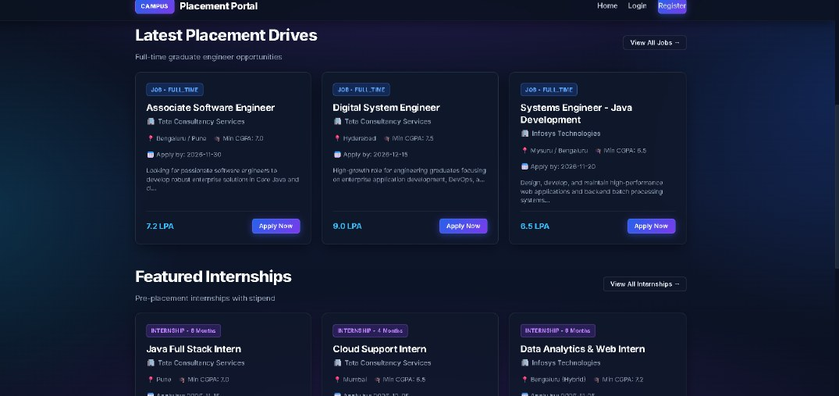
Deployed Prototype: Home and Listings
Home page with live counters and portal entry points
Placement drives with package (LPA), minimum CGPA and deadline
Cards show job title, company, location, package or stipend and an Apply button.
Internships list monthly stipend and duration; a "Why CampusHire?" panel explains value to students, companies and the TPO.
Counters and cards are sample data in the deployed instance.
Notes:
Ye deployed prototype ke real screenshots hain. Dhyan rahe ki counters aur cards sample data hain, real placement season ka data nahi.

Slide 11
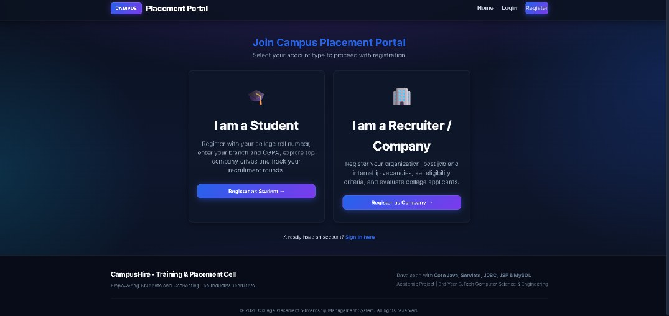
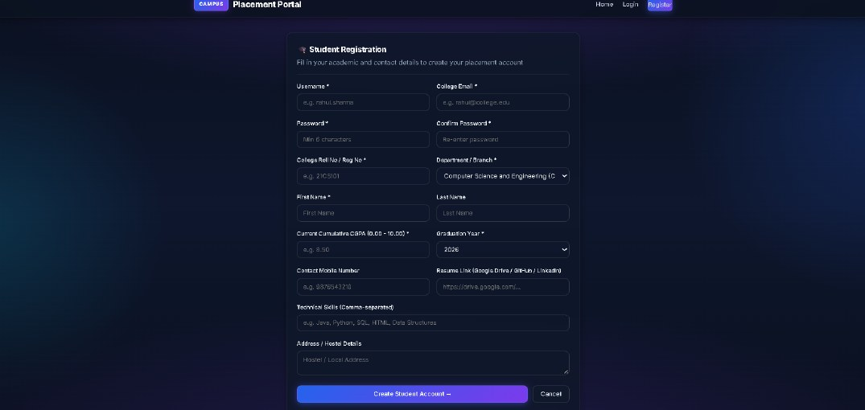
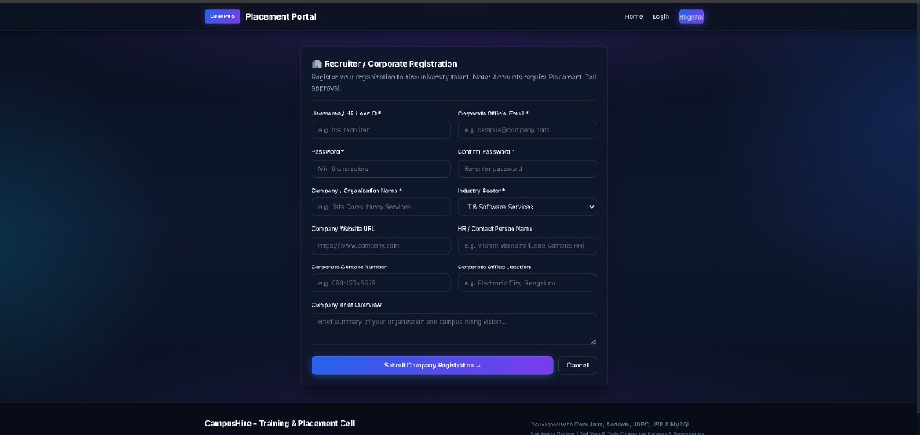
Registration and Login Screens
Registration chooser: student or recruiter
Student registration: roll no, branch, CGPA, résumé link
Company registration: needs TPO approval
Role-tabbed login: Student, Company HR, Admin / TPO
Notes:
Registration mein student aur company ke alag forms hain. Company ka account TPO approval ke baad hi active hota hai. Login page par teen tabs hain: Student, Company HR aur Admin/TPO.

Slide 12
Security: Threats and Limits
Threat | Reduced by design | Residual risk
Direct URL access | WEB-INF views + AuthFilter role check | New route not added to the filter
SQL injection | Prepared statements for all queries | A future developer may concatenate SQL
Fake company | TPO approval gate | TPO errors
Duplicate application | UNIQUE constraint | None known
Credential theft | One-way SHA-256 hash | Unsalted and fast; replace with bcrypt / Argon2id
Session / CSRF / XSS | Server-side sessions, TLS in cloud, JSP output encoding | Cookie flags, CSRF and escaping still to be verified
Injection payload tests: no successful injection observed. This shows known attacks failed, not that none exist.
Notes:
Hum honest hain: credential hashing abhi unsalted SHA-256 hai, jo weak hai aur ise bcrypt ya Argon2id se replace karna hai. CSRF aur XSS protections bhi verify karni baaki hain. Admin ya database operator ek residual insider risk hai.

Slide 13
Evaluation: Measured Engineering Values
2.45 MB
WAR size
1.75 s
Local container startup (5.2 s cloud)
168 MB
Idle JVM memory (210 MB cloud)
Team-recorded in single environments. Not a load test, user study or security audit; no framework baseline was measured.
Notes:
Ye values team ne apne environment mein measure ki hain. Cloud par latency zyada hai kyunki network round trip aur TiDB serverless hai. Ye load test nahi hai aur framework baseline se comparison nahi kiya gaya.

Slide 14
Conclusion and Future Work
Conclusion
Future Work
A framework-free Java stack can support the full placement lifecycle for three self-service roles
Server-side role checks, eligibility and duplicate prevention are built in
Implemented and deployed as a student prototype
Contribution is an integration and documented design, not a new algorithm
1
Salted, slow password hashing (bcrypt / Argon2id)
2
CSRF tokens, secure cookie flags, output encoding checks
3
Audit log and server-side lifecycle transitions
4
Framework baseline, load and security testing
5
Usability study and a limited pilot with a real placement cell
Notes:
Conclusion: framework-free Java stack se poora placement lifecycle possible hai. Hum limitations openly maante hain, aur future work mein password hashing, CSRF, audit log, aur proper testing planned hai.

Slide 15
Thank You
Questions are welcome
CampusHire | Arya College of Engineering & I.T., Jaipur
Notes:
Dhanyavaad. Koi sawal ho to poochh sakte hain.

