Slide 1

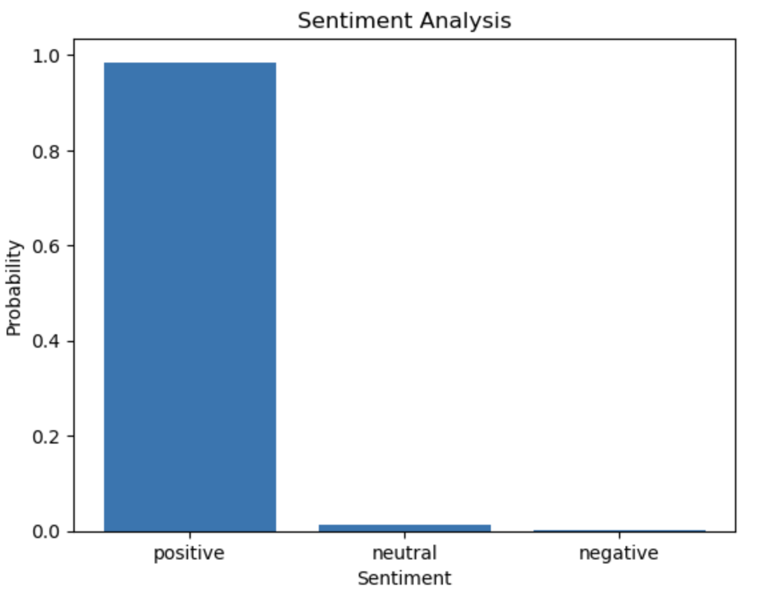
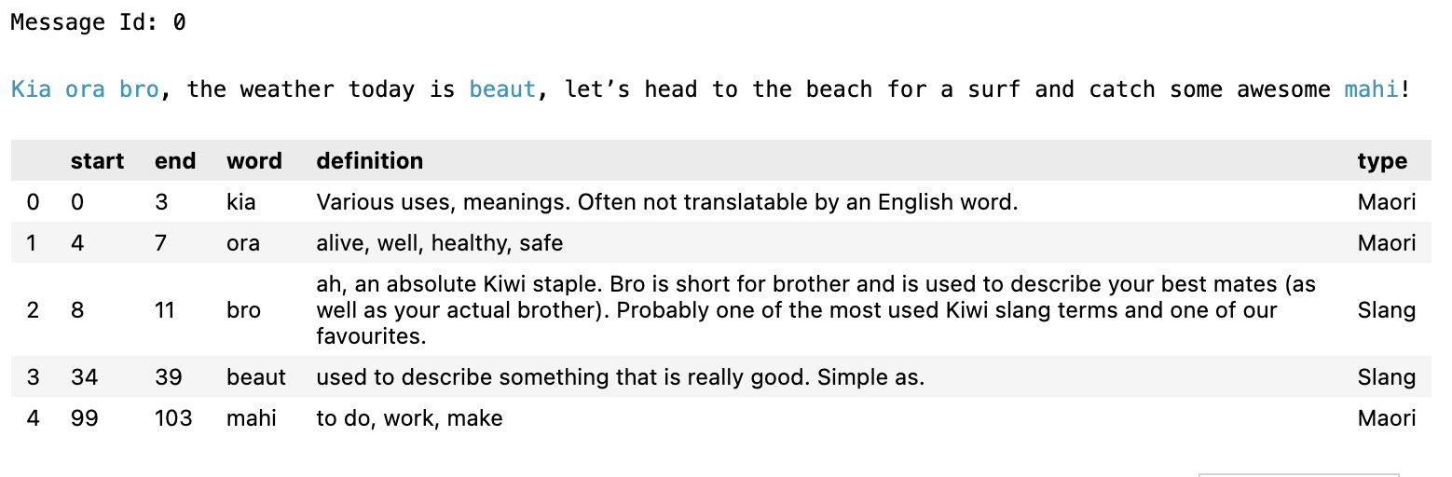
Deliverables
Overview:
A Report: Detailed documentation outlining the goal, addressed issues, methodologies, and key findings.
Proof of Concept: A Jupyter Notebook script showcasing content augmentation for improved moderation.
Cumulative negative score
Min
Max
The moderator should rest
when reaching the threshold.

