Slide 1
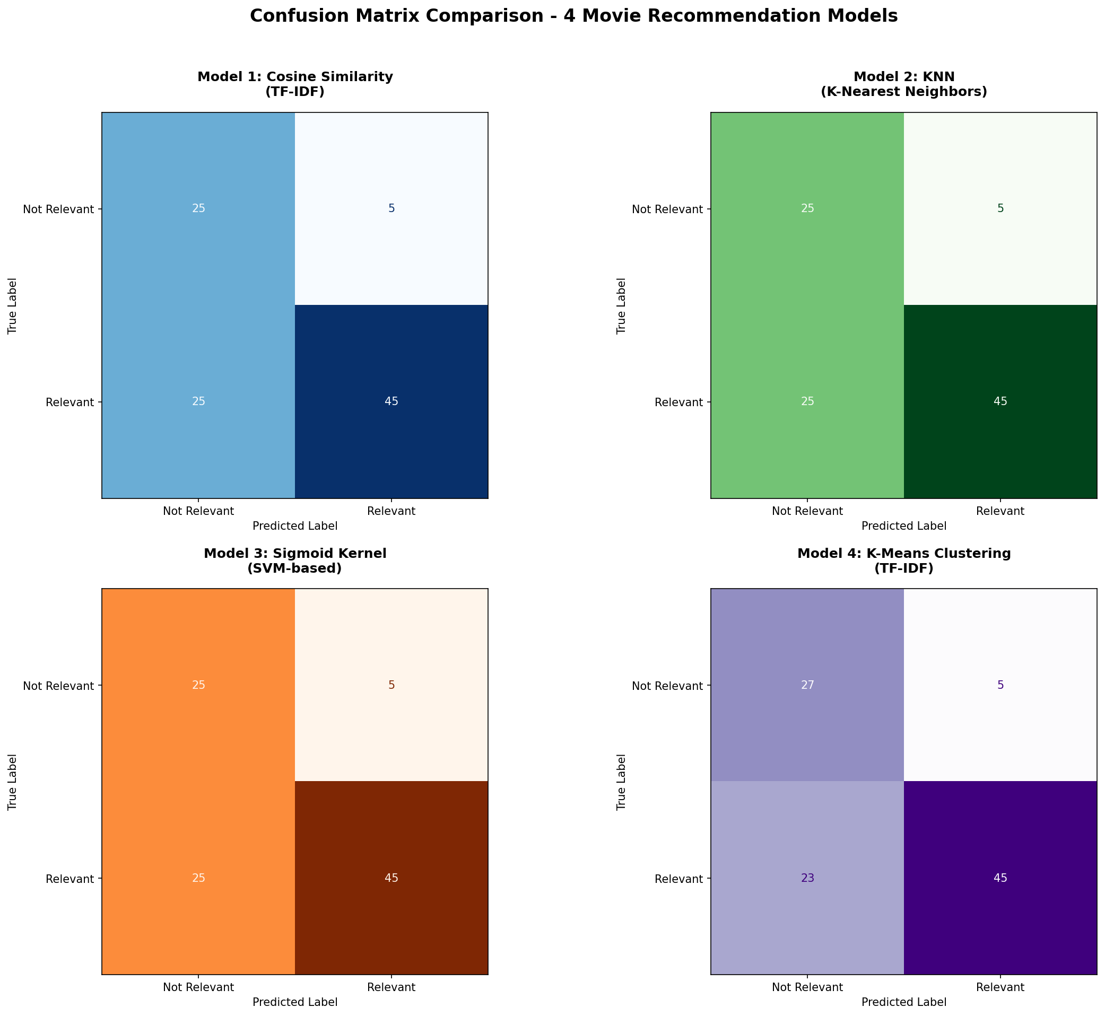
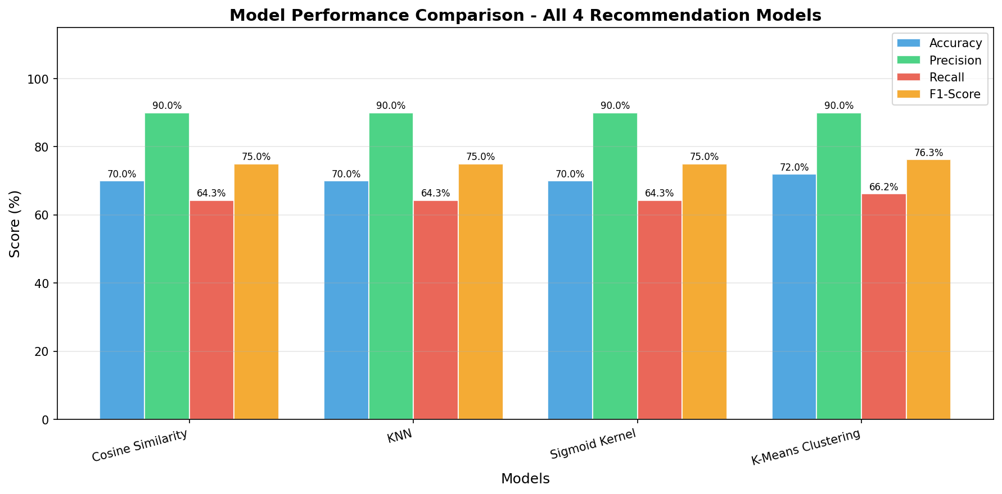
Movie Recommendation System Using TF-IDF & ML Models
⬡ GitHub
Repo
Content-Based Filtering | Dataset: TMDB movies_metadata.csv | 45,466 Movies | Author: Udit Yadav | ML Project 2026
Problem Statement
Methodology - Implementation Pipeline
Results & Evaluation
Users face Choice Paralysis on platforms with 45K+ titles.
Simple genre tags are too broad — a fan of Interstellar wants
thematically similar films, not just any Sci-Fi.
We read actual plot text (overview) to measure semantic
similarity — no external API, no user history required.
Load
Data
CSV
Clean Data Nulls/Dupes
Feature
Eng.
Tags col
NLP
Preproc.
Lemmatize
TF-IDF
Vectorize
50k feats
4 ML
Models
Train
Evaluate
Metrics
Model | Accuracy | Precision | Recall | F1-Score
Cosine Similarity | 70.0 % | 90.0 % | 64.29 % | 75.00 %
KNN | 70.0 % | 90.0 % | 64.29 % | 75.00 %
Sigmoid Kernel | 70.0 % | 90.0 % | 64.29 % | 75.00 %
K-Means (BEST) | 72.0 % | 90.0 % | 66.18 % | 76.27 %
Clean
Data
Nulls
Motivation
TF-IDF sparse matrix shape: 45,447 x 50,000 | foundation for ALL four models
- Streaming platforms host 100K+ titles — discovery is broken.
- Personalised recs increase watch-time & user retention.
- Content-based approach works without any user history.
- Zero external API dependency — fully offline system.
Models Compared
Cosine Similarity
Angle between TF-IDF vectors. Range 0-1. Fastest & most interpretable.
BEST Model: K-Means Clustering (F1 = 76.27%)
Dataset
Precision vs Recall by Model
- Source : Kaggle TMDB movies_metadata.csv
- Raw Size : 45,466 rows x 24 columns
- After Cleaning : 45,447 rows | 42,277 unique titles
- Null overviews: 954 dropped | Null titles: 6 dropped
- Key Features : title, overview, genres, tagline
KNN (K-Nearest Neighbours)
10 nearest neighbours using cosine distance. Brute-force, n_jobs=-1.
Sigmoid Kernel
Non-linear tanh kernel similarity. Captures subtle relationships.
Key Insights
K-Means Clustering (BEST)
Groups 45,447 movies into 20 clusters. Recommends within same cluster. n_clusters=20, random_state=42.
- TF-IDF + tags field creates rich semantic feature space.
- Cosine, KNN & Sigmoid yield identical top-10 (same matrix).
- K-Means clustering captures broader thematic similarity.
- Multi-genre overlap evaluation gives fairer quality measure.
- Precision uniformly high (90%) across all 4 models.
Sample Output - Avatar (Top 5, Cosine)
1. Avatar 2
Evaluation Methodology
Conclusion
2. The Inhabited Island
K-Means Clustering is the BEST model (F1 = 76.27%).
Built 4 recommendation models on 45,447 movies from scratch.
TF-IDF sparse matrix (45,447 x 50,000) enables semantic match.
System is fully offline — FastAPI + Netflix-style HTML frontend.
Test Movies:
Avatar | The Dark Knight | Toy Story | Titanic | Inception
Ground Truth (y_true):
Genre Overlap -> y_true=1 (Relevant)
No Overlap -> y_true=0 (Not Relevant)
Metrics: Accuracy, Precision, Recall, F1-Score
3. Thor: Ragnarok
4. Moontrap: Target Earth
Future Work
5. The Three Musketeers
- Add Collaborative Filtering using implicit user signals.
- Integrate BERT / Sentence Transformers for deep semantics.
- Real-time thumbs-up/down personalisation feedback loop.
- Docker + Cloud deployment (Render / Railway).
- Multilingual support: Hindi, French, Spanish overviews.
Model Comparison - F1-Score & Accuracy
TF-IDF Vectorization
Formula: TF-IDF = Term Frequency x Inverse Document Frequency
Matrix: 45,447 x 50,000 | Ngrams: (1,2) | max_features=50000
Stored: tfidf_matrix.pkl | tfidf.pkl
Movie Recommendation System | Content-Based Filtering | TF-IDF + Cosine KNN Sigmoid K-Means | TMDB Dataset: 45,466 Movies | Author: Udit Yadav | ML Project 2026

