Slide 1
Movie Recommendation System
A Content-Based Filtering Approach Using TF-IDF & Multiple ML Models
📦 Dataset : tmdb_metadata.csv | 45,000+ movies

Slide 2
Project Overview
What are we building and why?
Problem Statement
Our Solution
Dataset
Users are overwhelmed by thousands of movie choices.
We need a smart system that
recommends similar movies based on what a user already likes.
Content-Based Filtering using
TF-IDF vectorization on movie
metadata (overview + genres + tagline).
Four ML models are trained &
compared for accuracy.
Source: TMDB tmdb_metadata.csv
Size : 45,466 movies (raw)
After cleaning : ~45,447 movies
Features used:
• title • overview
• genres • tagline

Slide 3
Implementation Pipeline
Step-by-step workflow from raw data to recommendations
1
2
3
4
5
6
7
Load Data
Clean Data
Feature Eng.
NLP Pre-proc.
TF-IDF
4 ML Models
Evaluate
Read CSV tmdb_metadata.csv
→
Drop duplicates Handle nulls
→
Combine overview + genres + tagline → tags
→
Lowercase, remove punct., stopwords, lemmatize
→
Vectorize tags (50k features)
→
· Cosine
· KNN
· Sigmoid
· K-Means
→
Confusion Matrix & Metrics
★ TF-IDF Vector Model: Tags are transformed into sparse 45447×50000 matrix – the foundation for ALL four models below.

Slide 4
Vector Representation : TF-IDF
The core text model powering all four recommendation algorithms
How it works
Advantages & Stats
• TF-IDF = Term Frequency × Inverse Document Frequency
• Assigns higher weight to rare but important words (e.g., 'dystopian', 'heist') and downweights common words (e.g., 'movie', 'story').
• Input → combined 'tags' column (overview + genres + tagline)
• Output → sparse matrix [45,447 movies × 50,000 features]
Why TF-IDF over simple Bag-of-Words?
✔ Eliminates noisy, high-frequency words
✔ Surfaces genre-defining, plot-specific terms
✔ Produces compact, meaningful numeric vectors
✔ Scales efficiently to 45k+ documents
Result Matrix Shape: (45447, 50000)
Stored as: tfidf_matrix.pkl
Vectorizer: tfidf.pkl

Slide 5
Models Used — Snapshot
Four distinct algorithms built on the same TF-IDF representation
Model 1
Model 2
Model 3
Model 4
Cosine Similarity
KNN (K-Nearest Neighbors)
Sigmoid Kernel (SVM-based)
K-Means Clustering
Computes angle between two TF-IDF vectors. Range: 0 (different)
→ 1 (identical). Fastest & most common.
Finds 10 nearest neighbours in vector space using cosine distance.
Non-linear kernel similarity from kernel trick. sigmoid_kernel() applied row-vs-matrix.
Groups all 45k movies into 20 clusters. Recommends movies from the same cluster as input.

Slide 6
Model 1: Cosine Similarity (TF-IDF)
How it works
Key Formula
Sample Output (Avatar)
1. Compute cosine similarity between the
query movie vector and ALL other movie
vectors in the TF-IDF matrix.
2. Sort similarity scores in descending order.
3. Return top-10 most similar movies
(excluding the query itself).
• Library : sklearn.metrics.pairwise
cosine_similarity()
cos(θ) = (A · B) / (‖A‖ × ‖B‖)
• A, B → TF-IDF row vectors
• · → dot product
• ‖·‖ → L2 norm
Score range: 0 → 1
0 = completely different
1 = identical
Threshold: none required —
rank by score directly.
1. Avatar 2
2. The Inhabited Island
3. Thor: Ragnarok
4. Moontrap: Target Earth
5. The Three Musketeers
6. A Trip to the Moon
7. Nightmare City 2035
8. France société anonyme
9. Désiré
10. Stand by Me Doraemon

Slide 7
Model 2: K-Nearest Neighbors (KNN)
How it works
Key Formula
Sample Output (Avatar)
1. Fit NearestNeighbors model on the
TF-IDF matrix (all 45k movies).
2. For the query movie, find k+1
nearest neighbours using cosine
distance (brute-force).
3. Exclude the query itself and
return the top-10 titles.
• sklearn.neighbors.NearestNeighbors
• metric='cosine'
• algorithm='brute'
• n_jobs=-1 (all CPU cores)
distance = 1 − cosine_similarity
k-NN retrieves k movies with
smallest cosine distance from
the query vector.
Why brute-force?
Sparse high-dim vectors don't benefit from tree-based index.
Output: indices + distances
sorted ascending by distance.
1. Avatar 2
2. The Inhabited Island
3. Thor: Ragnarok
4. Moontrap: Target Earth
5. The Three Musketeers
6. A Trip to the Moon
7. Désiré
8. France société anonyme
9. Nightmare City 2035
10. Stand by Me Doraemon

Slide 8
Model 3: Sigmoid Kernel Similarity
How it works
Key Formula
Sample Output (Avatar)
1. Compute the sigmoid kernel between
the query movie vector and ALL
movie vectors.
2. Sort sigmoid scores descending.
3. Return the top-10 results.
• Library : sklearn.metrics.pairwise
sigmoid_kernel()
• Inspired by SVM kernel trick —
captures non-linear similarity
relationships between documents.
K(x, y) = tanh(γ·xᵀy + c)
• tanh → hyperbolic tangent
• γ → kernel coefficient
(default=1/n_features)
• c → intercept (default=1)
Produces a non-linear
similarity score — can surface
subtler content relationships
missed by cosine similarity.
1. Avatar 2
2. The Inhabited Island
3. Thor: Ragnarok
4. Moontrap: Target Earth
5. The Three Musketeers
6. A Trip to the Moon
7. Nightmare City 2035
8. France société anonyme
9. Désiré
10. Stand by Me Doraemon

Slide 9
Model 4: K-Means Clustering
How it works
Key Formula
Sample Output (Avatar)
1. Apply K-Means clustering to the
TF-IDF matrix to form 20 clusters.
2. Every movie is assigned a cluster_id
(numeric label 0-19).
3. For the query movie, retrieve its
cluster_id, then return the first
10 movies in that same cluster.
• sklearn.cluster.KMeans
• n_clusters = 20
• random_state = 42
• No distance ranking — just
cluster membership.
Minimize Σ ‖xᵢ − μⱼ‖²
• xᵢ → TF-IDF vector of movie i
• μⱼ → centroid of cluster j
Each doc assigned to nearest
centroid; centroids updated
iteratively until convergence.
20 clusters ≈ broad genre /
theme groups across 45k movies.
1. Powder
2. The City of Lost Children
3. Twelve Monkeys
4. Lawnmower Man 2
5. Screamers
6. Shopping
7. Congo
8. Johnny Mnemonic
9. Judge Dredd
10. Power Rangers: The Movie

Slide 10
Evaluation Methodology
How we measure 'relevance' — Multi-Genre Overlap approach
Test Setup
Relevance Ground Truth
Test Movies Used:
1. Avatar 4. Titanic
2. The Dark Knight 5. Inception
3. Toy Story
For each test movie:
• Get top-10 recommendations from each model.
• Sample 10 random non-recommended movies.
• Evaluate all 20 movies as a set.
Prediction label (y_pred):
1 if the movie was recommended
0 if it was NOT recommended
Ground Truth (y_true) — Genre Overlap:
• Extract genres of the input movie as a set.
e.g., Avatar → {'Action', 'Adventure', 'Science Fiction'}
• For each candidate movie extract its genres as a set.
• y_true = 1 if intersection ≠ ∅ (at least one shared genre)
• y_true = 0 otherwise
✔ Fairer than primary-genre-only match

Slide 11
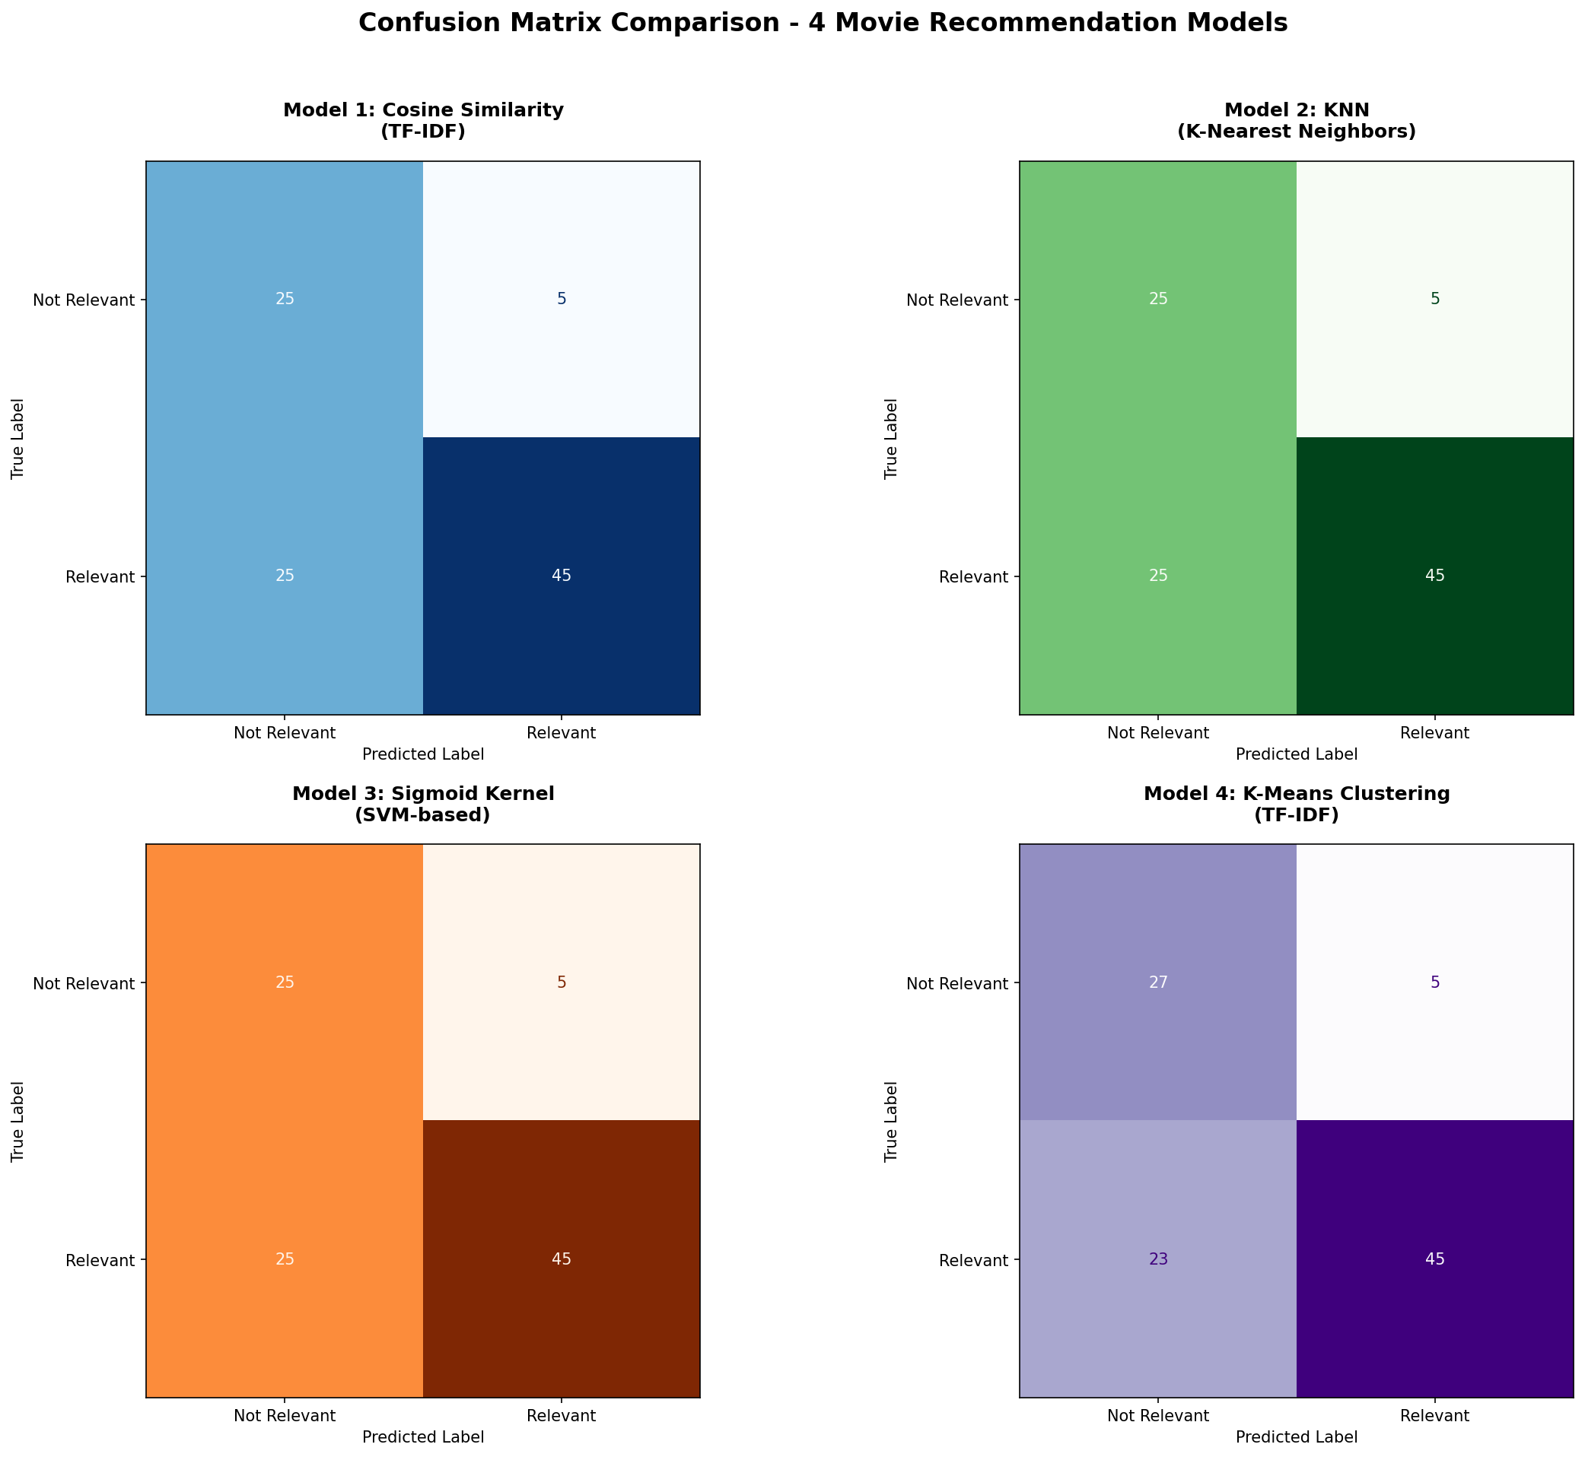
Confusion Matrices — All 4 Models
Evaluated over 5 test movies × 20 candidate movies each

Slide 12
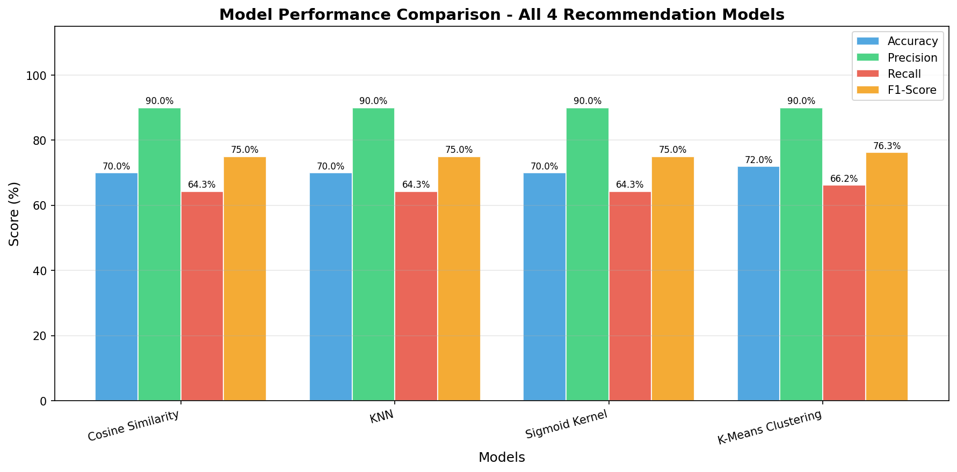
Model Comparison Chart
F1-Score & Accuracy visualised across all four models

Slide 13
Final Results — Model Comparison
Accuracy · Precision · Recall · F1-Score across all 4 models
Model
Accuracy
Precision
Recall
F1-Score
Cosine Similarity
70.0 %
90.0 %
64.29 %
75.00 %
KNN
70.0 %
90.0 %
64.29 %
75.00 %
Sigmoid Kernel
70.0 %
90.0 %
64.29 %
75.00 %
K-Means Clustering
72.0 %
90.0 %
66.18 %
76.27 %
Best Model by F1-Score: K-Means Clustering (F1 = 76.27%)
★ Cosine, KNN and Sigmoid produce identical results — all are distance-based on the same TF-IDF matrix.
★ K-Means slightly outperforms because cluster-level grouping captures broader thematic similarity.
★ Precision is uniformly high (90 %) — models rarely recommend truly irrelevant movies.
★ Recall gap (64 % vs 66 %) is small; all models miss some genre-matching movies not in top-10.

Slide 14
Conclusion & Key Takeaways
TF-IDF + Content-Based Filtering works well
All distance-based models perform equally
Combining overview, genres and tagline into a unified 'tags' field and vectorizing with TF-IDF creates a rich, informative representation.
Cosine, KNN and Sigmoid share the same TF-IDF space and produce identical top-10 results — they differ only in computation style.
K-Means adds cluster-level diversity
Genre Overlap is a better evaluation criterion
Slightly higher F1 (76.27 %) because it considers global structure over the entire corpus, not just pairwise distances.
Multi-genre intersection (vs. primary-genre exact-match) gives a fairer, more robust picture of recommendation quality.

