Slide 1
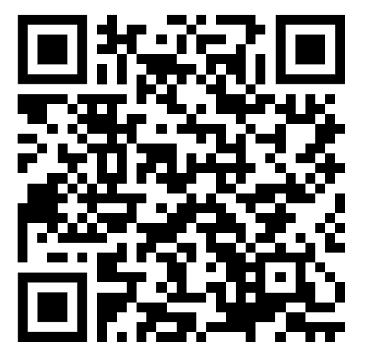

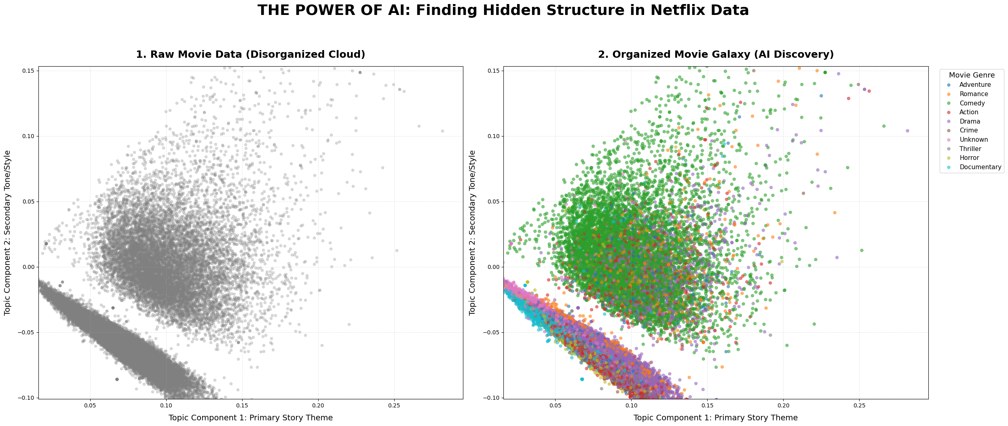
Movie Recommendation System Using TF-IDF & ML Models
Content-Based Filtering Approach | Dataset: TMDB tmdb_metadata.csv | 45,000+ Movies
Problem Statement
Methodology — Implementation Pipeline
Results & Evaluation
Users are overwhelmed by thousands of movie choices. A smart system must recommend similar movies based on what a user already likes.
Load Data Read CSV
Clean Data Nulls/Dupes
Feature Eng. tags col
TF-IDF Vectorize 50k feats
4 ML Models Train
Evaluate Metrics
Model | Acc. | Prec. | Recall | F1
Cosine | 70% | 90% | 64.3% | 75%
KNN | 70% | 90% | 64.3% | 75%
Sigmoid | 70% | 90% | 64.3% | 75%
K-Means ★ | 72% | 90% | 66.2% | 76.27%
★ TF-IDF sparse matrix shape: 45,447 × 50,000 — foundation for ALL four models
Motivation
Models Compared
● Streaming platforms have 100K+ titles — discovery is broken. ● Personalised recs increase watch-time and user retention.
Cosine Similarity
Angle between TF-IDF vectors. Range 0→1. Fastest & most interpretable.
★ Best Model: K-Means Clustering (F1 = 76.27%)
KNN
10 nearest neighbours using cosine distance.
Movie Galaxy Plot
Dataset
Sigmoid Kernel
Non-linear similarity via tanh kernel. Captures subtle relationships.
■ Source: TMDB tmdb_metadata.csv ■ Raw Size: 45,466 movies ■ After Cleaning: ~45,447 movies ■ Features: title, overview, genres, tagline
K-Means Clustering
Groups 45k movies into 20 clusters. Recommends within same cluster.
Evaluation Methodology
Sample Output — Avatar (Top 5)
Key Insights
Test Movies: Avatar | The Dark Knight | Toy Story | Titanic | Inception Ground Truth (y_true): Genre Overlap —> y_true=1 (Relevant) No Overlap -> y_true=0 (Not Relevant) Per movie: top-10 recommended + 10 random non-recommended evaluated as a set of 20.
1. Avatar 2
2. The Inhabited Island
● TF-IDF + tags field creates a rich, informative feature space. ● Cosine, KNN & Sigmoid give identical top-10 — same TF-IDF space. ● K-Means slightly outperforms with F1 = 76.27% via cluster diversity.
3. Thor: Ragnarok
Conclusion
4. Moontrap: Target Earth
K-Means Clustering is the best model (F1=76.27%). Cluster-level grouping captures broader thematic similarity.
Multi-genre overlap evaluation gives a fairer quality picture.
5. The Three Musketeers
TF-IDF Vectorization
Model Comparison — F1-Score & Accuracy
Future Work
Formula: TF-IDF = Term Freq × Inverse Doc Freq Matrix: 45,447 × 50,000 | Ngrams: 1-2 Stored: tfidf_matrix.pkl | tfidf.pkl
● Add collaborative filtering (user-based). ● Multilingual support : Hindi, and other languages. ● Deploy as a web application with real-time search.
Movie Recommendation System | Content-Based Filtering | TF-IDF + Cosine · KNN · Sigmoid · K-Means | TMDB Dataset — 45,000+ Movies

