Slide 1
QUALITY BASED VIDEO STREAMING
AI-Driven Adaptive DASH Streaming for Enhanced Video QoS
Video
DASH
A real MPEG-DASH demo where browser QoS telemetry feeds a Random Forest bitrate controller, applies video quality through dash.js, and logs evidence for analysis.
QoS
AI
Player
177
0.882
12
logged playback samples
average AI confidence
quality switches recorded
Project stack: FFmpeg + Flask + dash.js + Scikit-learn
Source: README.md, results/qos_summary.csv
01

Slide 2
STREAMING PROBLEM
Quality drops happen before a player can explain them.
The controller watches multiple QoS signals together instead of trusting bandwidth alone.
QoS signals must become a quality decision
Low throughput
Low buffer
higher rebuffer risk
quality must step down early
High RTT + jitter
Packet loss
late segment arrival
capacity estimate becomes unsafe
Source: ai_model.py feature set and player.js telemetry loop
02

Slide 3
SYSTEM ARCHITECTURE
The implementation closes the loop from playback telemetry to quality switching.
Input video
FFmpeg DASH packager
Flask server
Browser player
Result analysis
sample.mp4 / dataset video
4-second segments + manifest.mpd
segments + prediction API + logging
dash.js playback dashboard
QoS graphs + summary CSV
Random Forest predictor
Inputs: throughput, previous throughput, buffer, latency, packet loss, jitter, current quality
Source: app.py, generate_dash.py, ai_model.py, static/js/player.js
03

Slide 4
DASH ENCODING
A real bitrate ladder lets the AI choose actual playable representations.
generate_dash.py uses FFmpeg to create a manifest and segmented .m4s streams at multiple resolutions.
4 sec
segment duration
MPD
manifest
240p
360p
720p
1080p
400 kbps
1000 kbps
2500 kbps
6000 kbps
Source: generate_dash.py encoding ladder and media/dash outputs
04

Slide 5
AI BITRATE PREDICTION
The model translates seven network features into one safe quality level.
throughput
previous throughput
240p
400k
buffer
latency
Random Forest
360p
1000k
packet loss
jitter
180 trees, max depth 8, balanced classes
720p
2500k
current quality
1080p
6000k
Prediction returns quality label, bitrate, confidence, accuracy, and a human-readable reason such as low buffer or packet loss.
Source: ai_model.py
05

Slide 6
RUNTIME CONTROL LOOP
Every two seconds, playback evidence becomes a new quality decision.
1
Measure
2
Predict
3
Apply
4
Log
throughput, latency, buffer, loss, jitter
POST /api/predict to Flask model
dash.js quality set to selected index
append metrics and reason to CSV
2s loop
AI enabled: dash.js auto ABR is disabled and the predicted level is applied. AI disabled: normal dash.js ABR is used for comparison.
Source: static/js/player.js controlLoop()
06

Slide 7
DEMO DASHBOARD
The browser UI makes adaptive streaming observable and testable.
Video player
AI toggle
Network profiles
plays the generated DASH manifest with dash.js
switches between ML control and normal dash.js ABR
stable, medium, poor, and lossy conditions
Live charts
Decision reason
Session logging
throughput, bitrate, buffer, and latency
shows stable network, low buffer, limited throughput, or packet loss
saves every decision for later result graphs
This is a working project surface, not a static simulation.
Source: templates/index.html and static/js/player.js
07

Slide 8
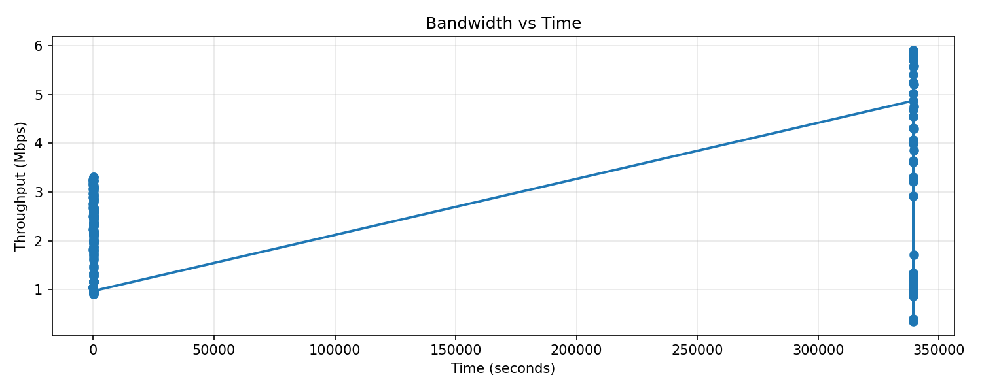
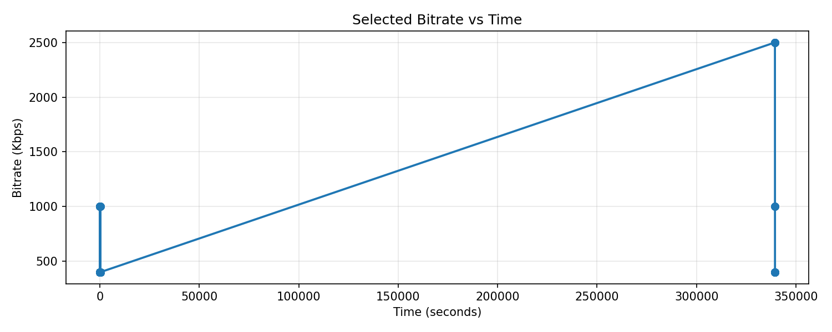
RESULTS
Logged sessions show adaptive decisions under constrained network conditions.
177
2.199
10.255s
72.928ms
63
0.882
samples
avg throughput
avg buffer
avg latency
low-buffer events
avg confidence
Quality selection changes as measured throughput varies, while AI confidence remains high on average.
Source: results/qos_summary.csv, results/bandwidth_vs_time.png, results/bitrate_vs_time.png
08

Slide 9
DEMO SCRIPT + NEXT STEPS
The project is ready to demonstrate as a controlled QoS experiment.
1
Start Flask server and open the dashboard
Future improvements
2
Play the generated DASH stream
Train on real network traces
Add VMAF/SSIM quality scoring
Compare ML vs BOLA/throughput ABR
Deploy local dash.js fallback
Export richer per-profile reports
3
Switch network profile from stable to poor/lossy
4
Show AI lowering bitrate before buffer collapse
5
Disable AI to compare normal dash.js ABR
6
Run analyze_results.py to produce graphs
Core achievement: real video packaging, real playback, live QoS telemetry, AI quality prediction, and result generation are connected end to end.
Source: README.md demo script and project implementation
09

Slide 10
NOVELTY
Our new contribution is a hybrid ML + QoS-risk guard, not just another bitrate switch.
Existing method
Decision basis
Weakness
What we added
Throughput ABR
recent bandwidth estimate
reactive; can over-upgrade during drops
uses throughput trend plus risk cap
Buffer ABR
buffer occupancy
ignores RTT, jitter, and packet loss
scores multi-signal QoS risk
dash.js default ABR
player-side ABR rules
less explainable in our demo
logs confidence, risk, and reason
Plain ML classifier
model output only
optimistic predictions can be unsafe
guard holds/downshifts when risk is high
Novel methodology
Random Forest predicts quality; QoS-Risk Guard computes a 0-1 risk score from low buffer, throughput drop, high RTT, packet loss, and jitter, then caps unsafe upgrades or triggers downshift.
Source: updated ai_model.py PredictionResult risk_score and protection_action
10

