Slide 1

Student Ambassador Projects
Notes:
Korrie

Slide 2
Utkrisht Solution Type: Prototype
Uditya Raj
Notes:
Korrie

Slide 3
The Opportunity
Industry Trends:
Growing Demand for Educational Apps – Personalization & Interaction
Pain Points:
Fragmented Content sources - Balancing Education and Entertainment – Personalization
Opportunities:
Centralized Storytelling Hub - AI-Driven Personalization - Interactive and Educational Content
Notes:
Korrie
updated 7/21

Slide 4
Solution
Imagimate was born out of a passion for creating memorable and educational experiences for children. As parents ourselves, we recognized the challenge of finding quality storytelling apps that offer both personalized and engaging content. We wanted to combine the magic of storytelling with the latest AI technology to create an app that adapts to each child's unique imagination and learning needs.
Pain Points Addressed:
Fragmented Content Sources:
Imagimate provides a centralized hub for reading, listening, saving, and sharing stories, eliminating the need for parents to juggle multiple platforms.
Lack of Personalization:
Our AI-driven personalization allows children to create stories based on their preferences and favorite characters, making each narrative unique and engaging.
Balancing Education and Entertainment:
We blend educational content with entertaining stories, ensuring that children are learning while being captivated by the tales.
Where We Fit In
Imagimate fits into the educational and entertainment segment of the children's app market. While not currently in the Gartner Magic Quadrant, we aim to establish ourselves as a leader in personalized and interactive storytelling apps. Our unique approach of combining AI-driven personalization with a vast library of stories sets us apart from traditional children's apps.
Notes:
Korrie
updated 7/21

Slide 5
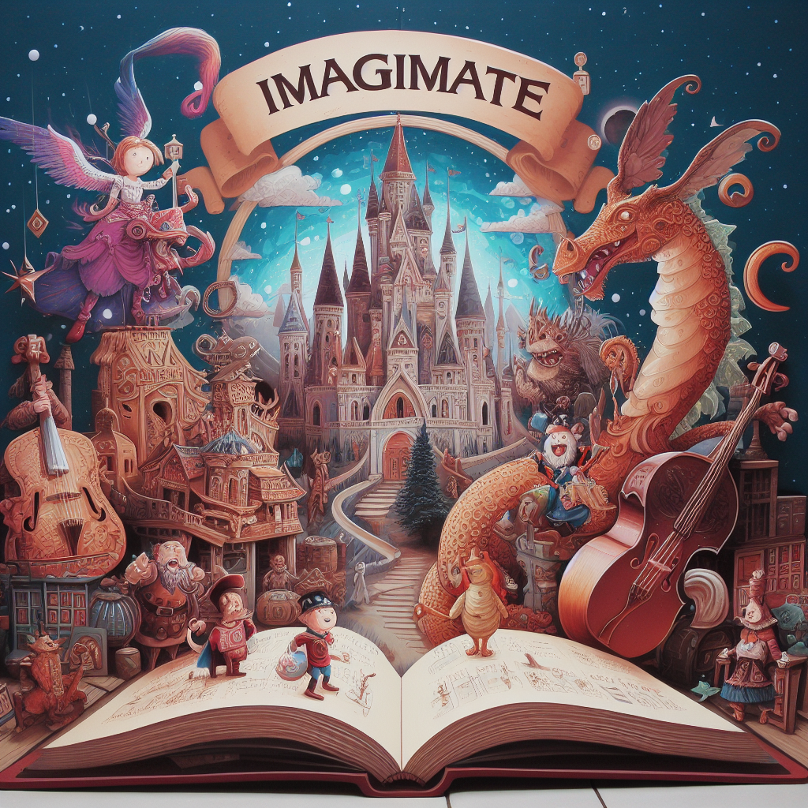
Demo
LINK: IMAGIMATE
Notes:
Korrie
updated 7/21

Slide 6
Takeaways
Imagimate revolutionizes bedtime and learning by centralizing all storytelling needs into one intuitive app, offering a vast library of pre-existing stories and AI-driven personalized tales. This solution addresses the fragmentation of content sources, lack of personalization, and high costs associated with multiple subscriptions. Parents and kids can now enjoy seamless, interactive, and educational storytelling experiences, saving time and money. Embrace the magic of personalized learning and interactive stories with Imagimate, simplifying your storytelling routine and enriching your child's imagination and knowledge.
Notes:
Korrie
updated 7/21

