Slide 1


Snakemake
Bioinformatics Workshop KCCR
August 2023

Slide 2
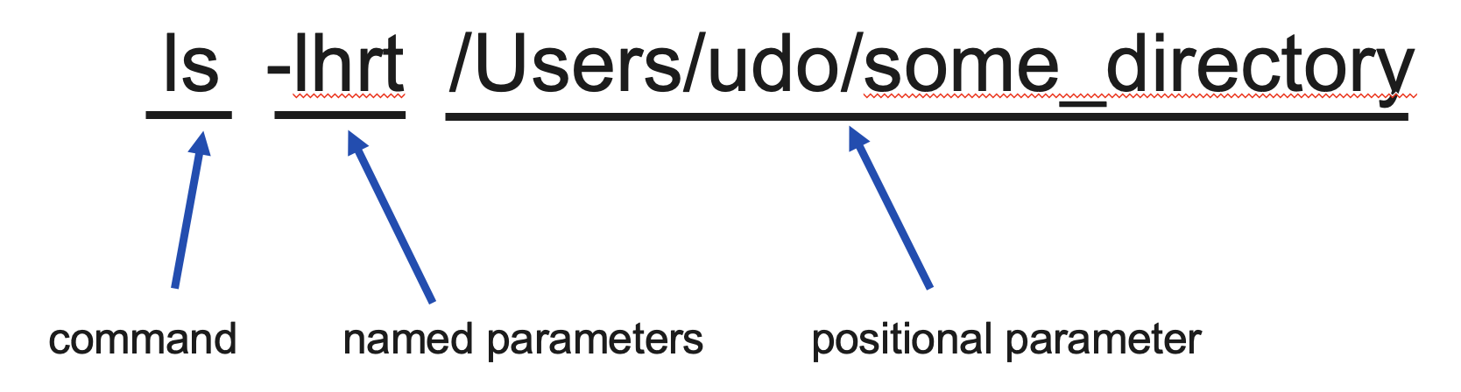
Snakemake intro
program called from the command line
snakemake -s Snakefile_simplified.smk --use-conda --cores 8 -np

Slide 3




Snakemake intro
snakemake -s Snakefile_simplified.smk --use-conda --cores 8 -np

Slide 4
Snakemake intro
snakemake -s Snakefile_simplified.smk --use-conda --cores 8 -np

Slide 5
Snakefile
List of rules
Each rule takes input and creates output
Snakemake figures out how to order the rules
Snakemake calls your commands for you
You say what should be done on which data with which software
Snakemake does the rest

Slide 6
Snakemake tutorial
Count the lines in the text file and write the output to another text file
Input: data/1-karamzov.txt
Output: output_data/my_output.txt
What to do?: count lines in the text file
Which software?: the program wc
wc -l data/1-karamazov.txt > output_data/my_output.txt
Notes:
wc -l data/1-karamazov.txt > output_data/my_output.txt

Slide 7

Snakemake tutorial
Snakemake reads instructions (rules)

Slide 8

Snakemake tutorial
Creates a list of
what to do

Slide 9

Snakemake tutorial
Calls the
commands of a rule

Slide 10
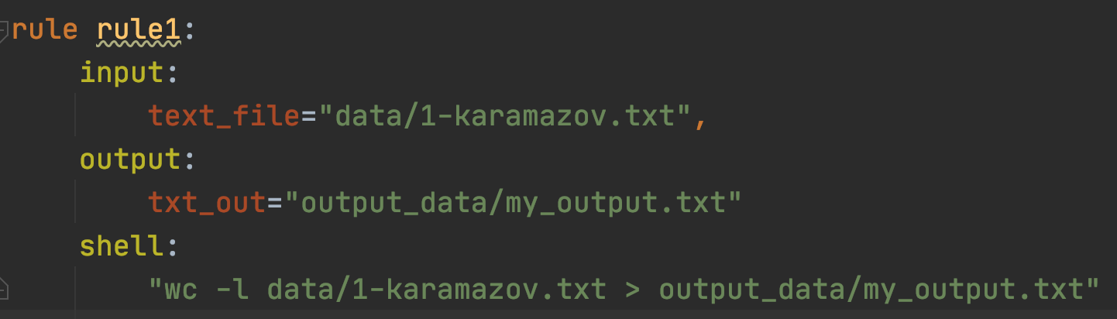
What does a rule look like?

Slide 11
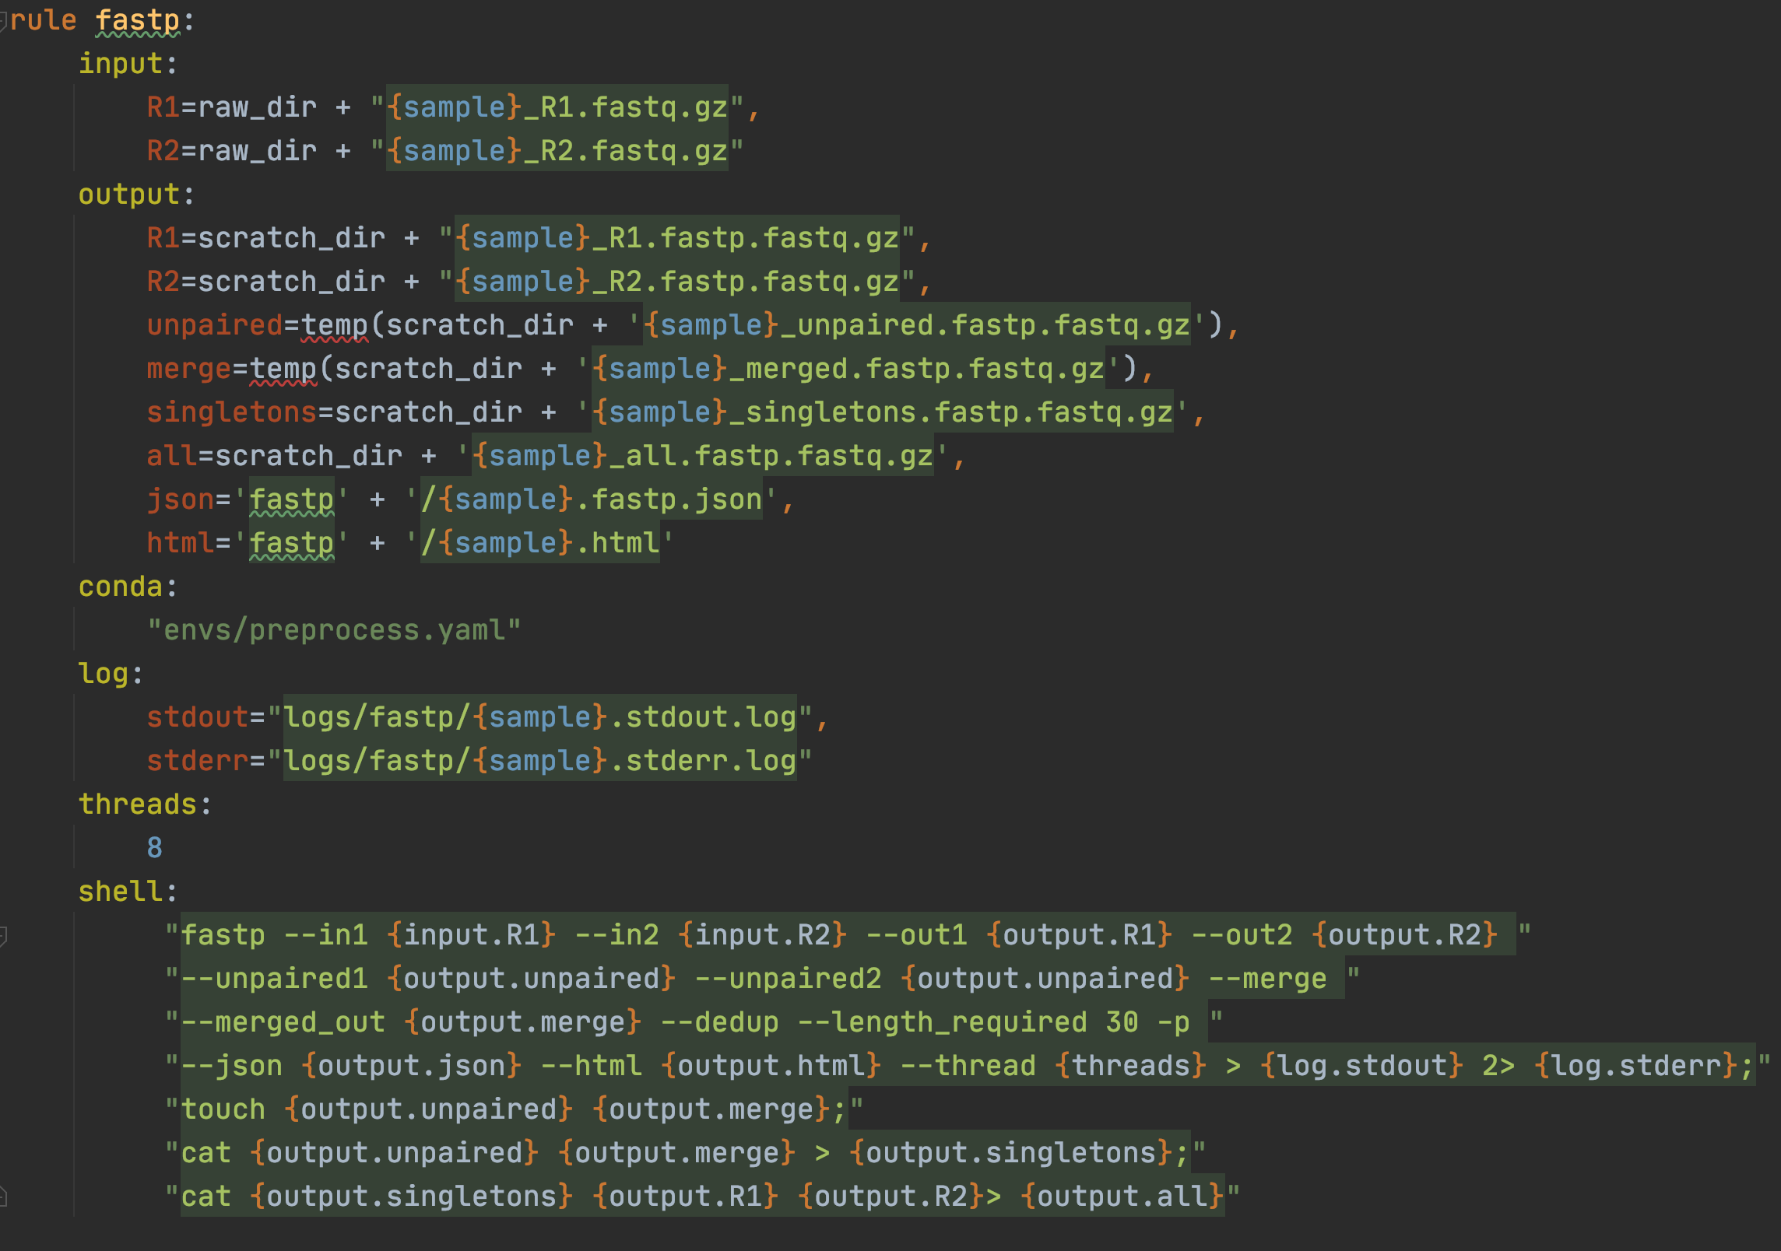
More complex rule
data
software
Command what to do?

Slide 12
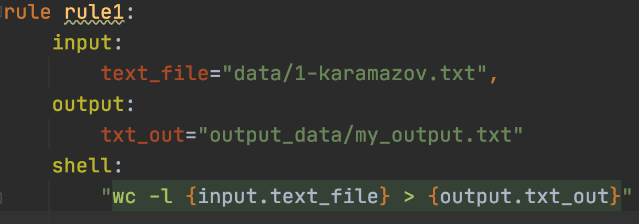
Replace input and output in the command

Slide 13
Hands on
Replacing the input files manually in PyCharm….

Slide 14
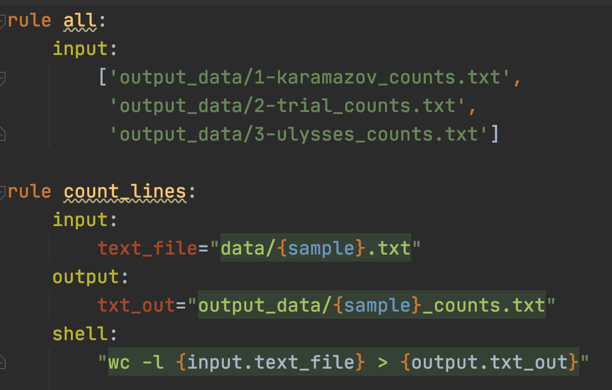
Processing multiple files

Slide 15
1-Karamazov.txt
2-trial.txt
3-ulysses.txt
rule count_lines
rule count_lines
rule count_lines
1-Karamazov_counts.txt
2-trial_counts.txt
3-ulysses_counts.txt
rule all

Slide 16
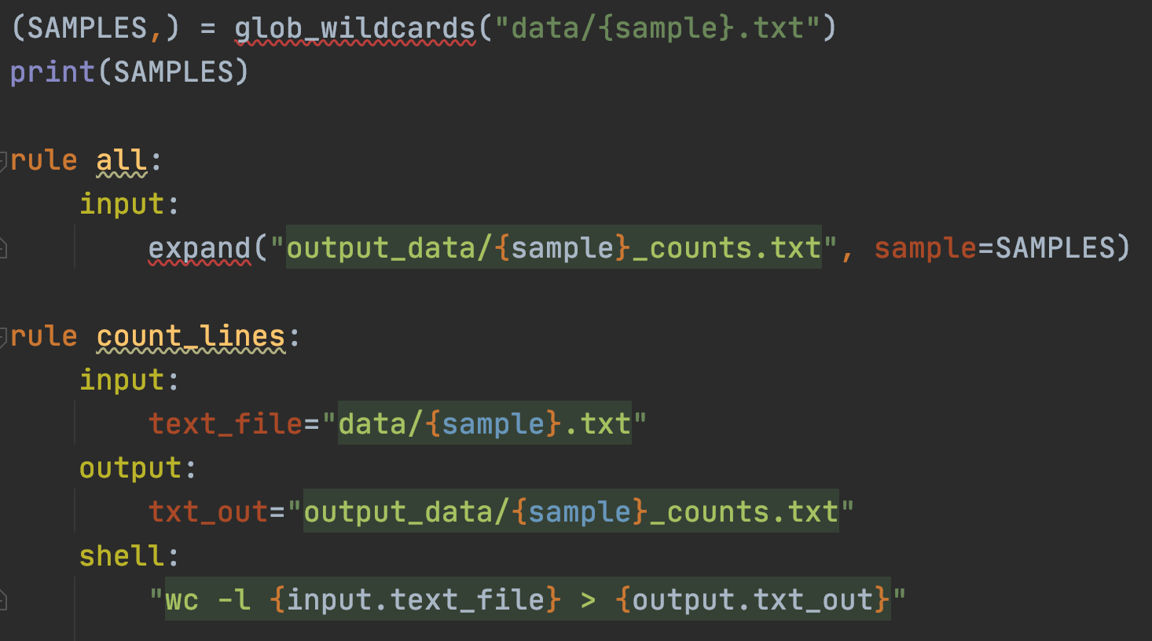
The return of the wildcards
ls data/*.txt

Slide 17
1-Karamazov.txt
2-trial.txt
3-ulysses.txt
rule count_lines
rule count_lines
rule count_lines
1-Karamazov_counts.txt
2-trial_counts.txt
3-ulysses_counts.txt
summarize_line_count
overall_line_count.txt
rule all

Slide 18
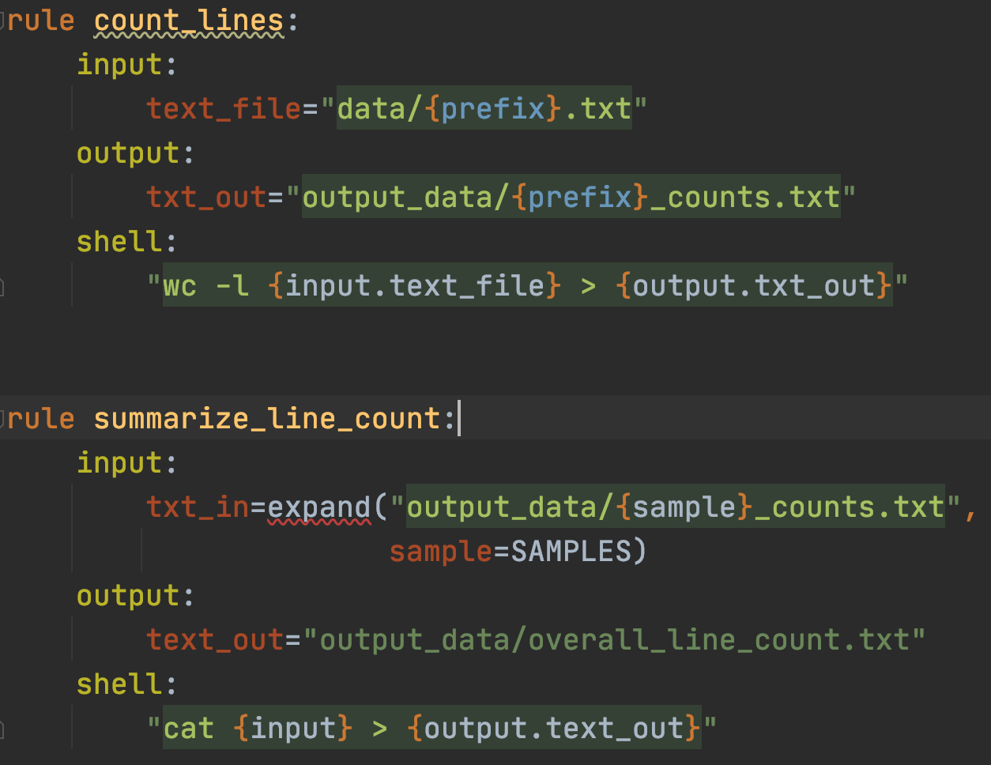

Slide 19
Snakemake exercises
Modify the Snakefile_start2.smk to count the lines in file 2-trial.txt. Write the output into the file my_count.txt
Modify the Snakefile_start_parallel.smk such that the output files have the suffix _line_counts instead of _counts. So e.g for the first file, instead of 1-karamazov_counts.txt the output file should be named 1-karamazov_line_counts.txt
Modify the Snakefile_cmd.smk such that the output files have the suffix _line_counts instead of _counts. So e.g for the first file, instead of 1-karamazov_counts.txt the output file should be named 1-karamazov_line_counts.txt
Modify the Snakefile_start_parallel2.smk such that a copy of each .txt file in the data directory is made. The copy shall be placed in a directory named copy_data

Slide 20
Snakemake exercises

