Slide 1


Linux commandline
Bioinformatics Workshop KCCR
August 2023

Slide 2

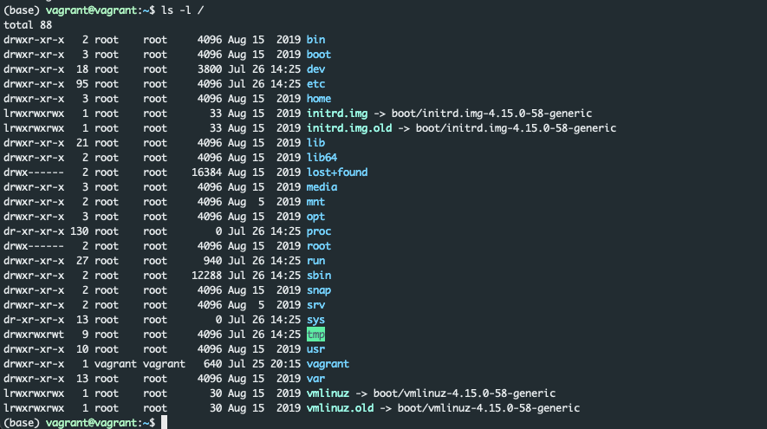
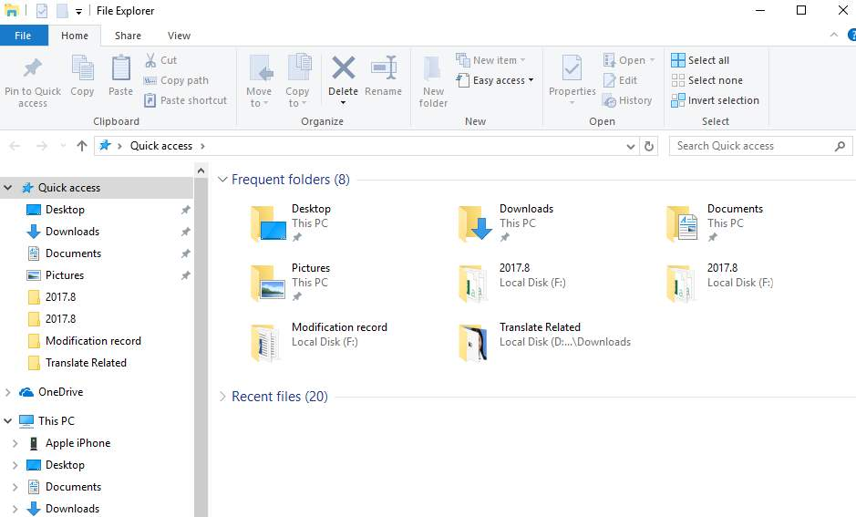

Linux commandline intro
Just another program
Interface to the computer
No mouse needed

Slide 3
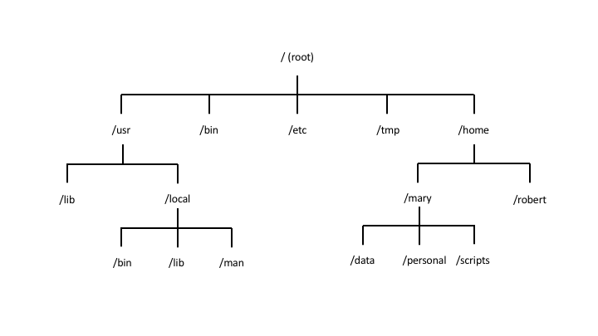
Linux commandline intro
In Linux all files and folder are located in a ”tree”
Navigation through the tree with
cd (change directory)
absolute path:
starting from the “root” (of the tree)
relative path:
staring from ”within” the tree
cd .. ➔ going on level “up”

Slide 4
Calling programs
ls -lhrt /Users/udo/some_directory
command
named parameters
positional parameter

Slide 5

Wildcards
Old-school auto-complete
Possible google searches that all start with “what to”

Slide 6
Wildcards
Find me
all files that start with Udo: ls Udo*
files that end with “.txt”: ls *.txt
Files that start with “Udo” and end with “.txt”: ls Udo*.txt
File names that would match:
Udo.txt
Udo_some_other_thing.txt
Udo123.txt
…

Slide 7
Navigating and exploring
The ls command
-l , -h, -t, -S, ls *.txt
The cd command
pwd (print working directory)
cat, zca t, head, tail (-n), less
Autocomplete by hitting the tab
Ctrl-A/Ctrl-E go to beginning/end of a line
Ctrl-R reverse-history search

Slide 8
Manipulating files
rm (remove)
-r
mv (move)
cp (copy)
r
mkdir (make directory)
ln -s (link to a file)

Slide 9
How do I know all the parameters?
Honestly:
I just google it most of the time
But you can also look at the manpage
good if just want to look sth up
”man command”, eg. “man ls”
also the parameter “-h” or ”--help” helps

Slide 10
Where does my output go?
A program usually outputs to two different locations
Standard output, stdout “>”
Standard error, stderr “2>”
Additionally you can specify any number of other locations

Slide 11
Where does my output go? stdout
Standard output (stdout)
Output of a program if everything goes right
Written to the screen of the terminal
Can be written to a file using the ”>” symbol
example: ls /Users/udo/Downloads > stdout.log

Slide 12
Where does my output go? stderr
Standard error (stderr)
Output of a program if an error happens
Also written to the screen of the terminal
Can be written to a file using the ”2>” symbol
example: ls /Users/udo/Downloads 2> stderr.log
stdout and stderr can both be written to files
example: ls /Users/udo/Down > stdout.log 2>stderr.log

Slide 13
Where does my output go? Pipes
You can connect output to another program
”zcat sample1_R1.fastq.gz | grep AGGGTCC”
Usually, stdout is passed on via the pipe
Very few exceptions exist
Specified in the manpage, helpfile
pipe symbol

Slide 14
Exercises
list the content of directory level_0
List the content and write it to a file called ls_level_0.txt
Try to find the directory level2_dir2 by navigating around with cd and listing directory content with ls
When in level2_dir2, list again the content of directory level_0 and write the output into a file within the current working directory
Same as above, but write the output into a file in the directory level_1_dir3. First you need to find this directory in the file tree

Slide 15
Exercises 2
Find directory level3_dir3
Give the absolute Path of this directory
Give the relative Path to this directory from level_0
Give the relative Path to this directory from level_1_dir2
Give the absolute Path of level_1_dir2

Slide 16
Tools to find stuff
grep
find

Slide 17
Tools to find stuff - grep
grep (Global regular expression print)
searches for ”patterns” within in a file
grep pattern file_name
e.g grep ATGC my_sample.fastq
”pattern” can be a lot of things
“^hepatitis” ➔ line starts with “hepatitis”
“hepatitis$” ➔ line ends with hepatitis
(or a regular expression when using grep -E or egrep) more info here

Slide 18
Tools to find stuff - grep
grep -i ➔ search is case-insensitive
grep -i bird my_file.txt ➔ any line that contains either the word Bird or bird
grep -r ➔ search recursively through all files for the given pattern
grep -c ➔ count the occurrences of a pattern
options can be combined: grep -r -i ”^Hepatitis B” ➔ search recursively through all files under the current working directory for occurrence of the words “Hepatitis B” at the beginning of the line

Slide 19
Tools to find stuff - grep
grep pattern file_name -A 10 ➔ print 10 lines after each found pattern
grep pattern file_name -B 10 ➔ print 10 lines before each found pattern

Slide 20
grep demo
grep in fastqs
grep in bih-pipeline
grep in protein-database

Slide 21
find
find lists all files and directories underneath the given path
find / ➔ list all directories and files under root
find / -type d ➔ list all directories under root
find / -type f ➔ list all files under root
find / -type f -name ‘*.fastq.gz’ ➔ all files that end on fastq.gz under root
Many more options, quick tutorial here

Slide 22
Quick exercise round
grep for the word hepatitis in the protein_ref.faa file
grep for the word hepatitis or Hepatitis in the protein_ref.faa file
grep for the words hepatitis c or Hepatitis C in the protein_ref.faa file
grep only for the header line of each fasta entry
the header always starts with “>”
Using ^ tells grep to only look for the occurrence at the beginning

Slide 23
Quick exercise round
Use grep to extract the fasta header file from the protein_ref.faa file and write the headers into a file called fasta_headers.txt
Bonus: in which genome does the amino acid sequence CSGSWLRDIWDWICEVL occur?

