Slide 1


Snakemake
Bioinformatic Workshop KCCR
August 2023

Slide 2
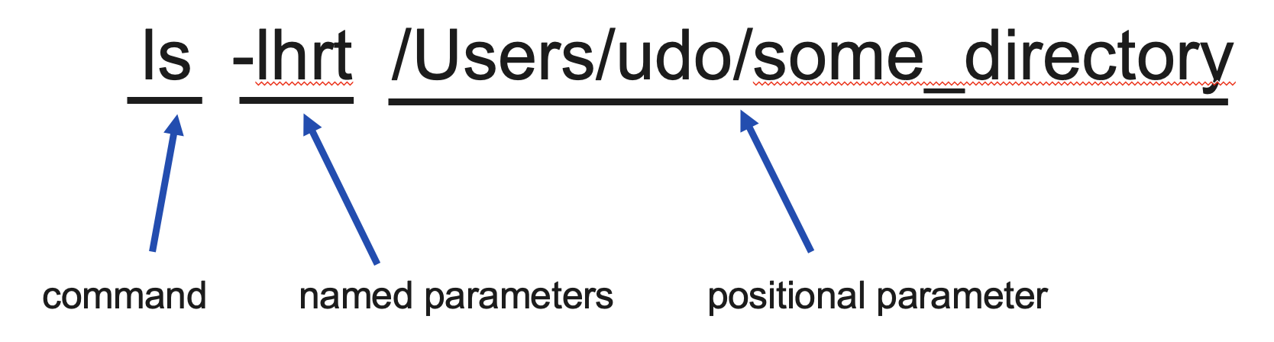
Snakemake intro
program called from the command line
snakemake -s Snakefile_simplified.smk --use-conda --cores 8 -np

Slide 3




Snakemake intro
snakemake -s Snakefile_simplified.smk --use-conda --cores 8 -np

Slide 4
Snakemake intro
snakemake -s Snakefile_simplified.smk --use-conda --cores 8 -np

Slide 5
Snakefile
List of rules
Each rule takes input and creates output
Snakemake figures out how to order the rules
Snakemake calls your commands for you
You say what should be done on which data with which software
Snakemake does the rest

Slide 6
Snakemake tutorial
Count the lines in the text file and write the output to another text file
Input: data/1-karamzov.txt
Output: output_data/my_output.txt
What to do?: count lines in the text file
Which software?: the program wc
wc -l data/1-karamazov.txt > output_data/my_output.txt
Notes:
wc -l data/1-karamazov.txt > output_data/my_output.txt

Slide 7
Snakemake tutorial
Snakemake reads instructions (rules)

Slide 8

Snakemake tutorial
-np ➔ don’t do anyting, just check if all data is available
Creates a list of
what to do

Slide 9

Snakemake tutorial
Calls the
commands of a rule

Slide 10
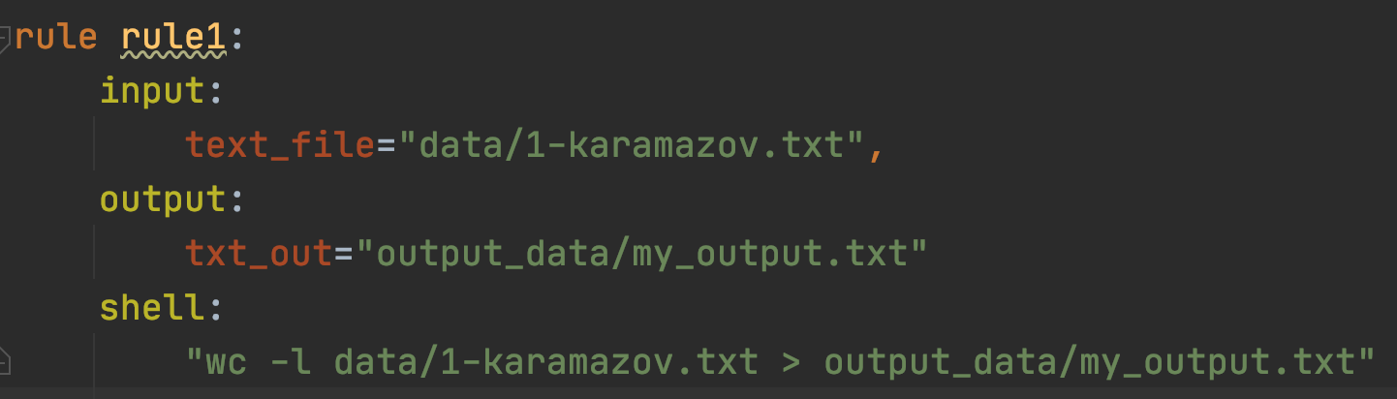
What does a rule look like?

Slide 11
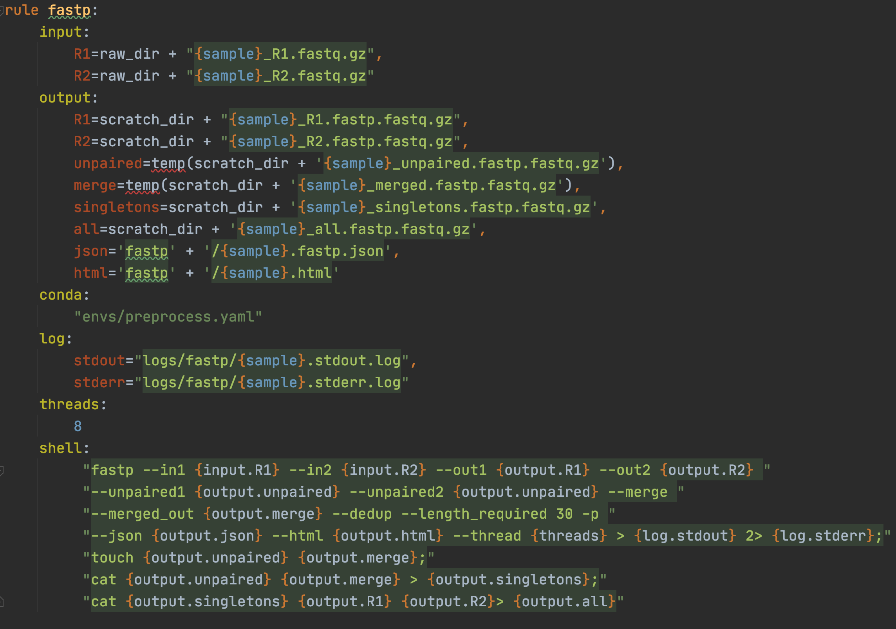
More complex rule
data
software
Command what to do?

Slide 12
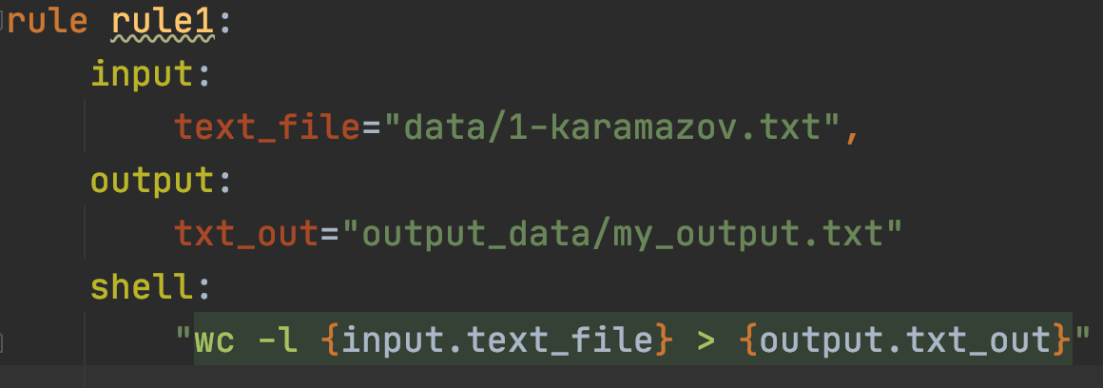
Replace input and output in the command

Slide 13
Exercise
Use Snakefile_start2 to count the lines in the other two files

Slide 14
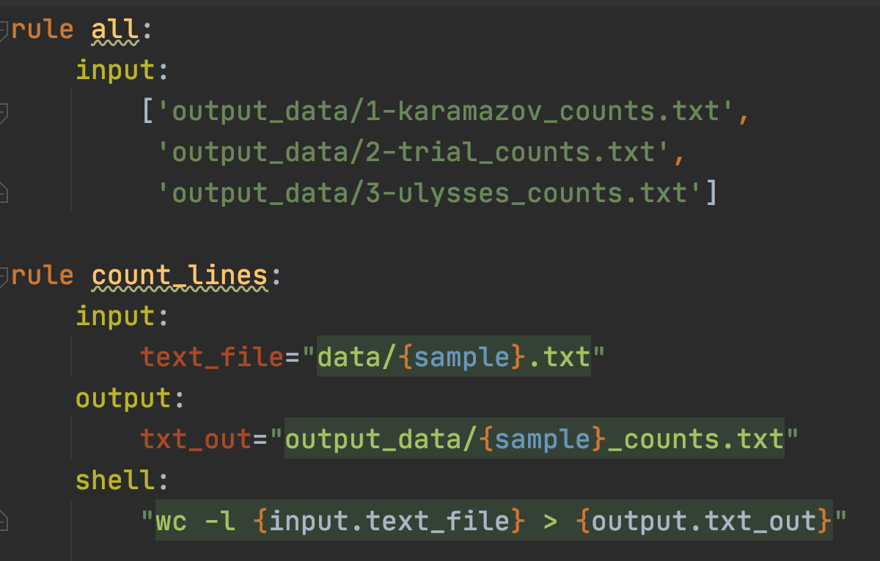
Processing multiple files

Slide 15
1-Karamazov.txt
2-trial.txt
3-ulysses.txt
rule count_lines
rule count_lines
rule count_lines
1-Karamazov_counts.txt
2-trial_counts.txt
3-ulysses_counts.txt
rule summarize_line_counts

Slide 16
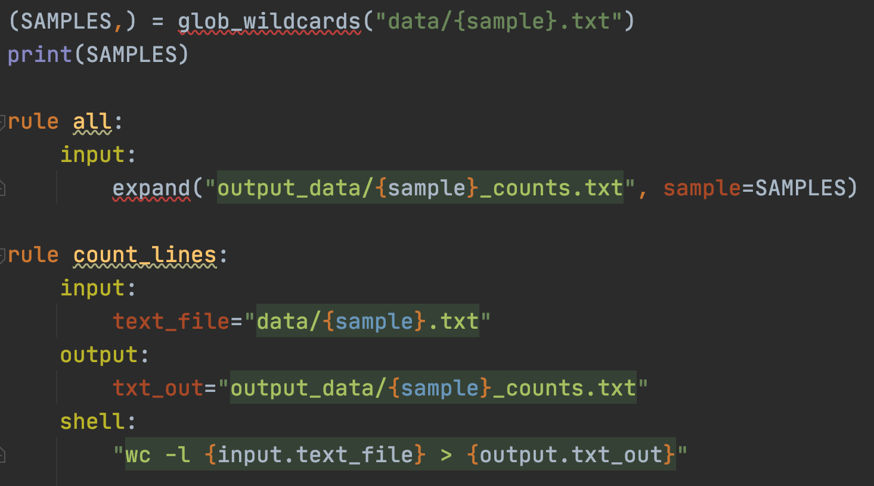
The return of the wildcards
ls data/*.txt

Slide 17
Snakemake exercises
Modify the Snakefile_start2.smk to count the lines in file 2-trial.txt. Write the output into the file my_count.txt
Modify the Snakefile_start_parallel2.smk such that the output files have the suffix _line_counts instead of _counts. So e.g for the first file, instead of 1-karamazov_counts.txt the output file should be named 1-karamazov_line_counts.txt
Modify the Snakefile_cmd.smk such that the output files have the suffix _line_counts instead of _counts. So e.g for the first file, instead of 1-karamazov_counts.txt the output file should be named 1-karamazov_line_counts.txt
Modify the Snakefile_start_parallel2.smk such that a copy of each .txt file in the data directory is made. The copy shall be placed in a directory named copy_data

Slide 18
Topics to cover
A bit of python code
Snakemake exercise
Going through the NGS pipeline
Snakefile logic
programs used
conda environments
manually calling the programs
adapting the pipeline to run with your NGS data

Slide 19
Topics to discuss
bcl2fastq and sample sheet
bcl2fastq with Snakemake
Pipeline from beginning (.bcl files) to end (.daa file)

Slide 20
Conda environment
Software is built upon other software
Some functionality is only available in certain versions of a software
For Reproducibility it is necessary to know which version was used to generate data
Other aspect:
Two different software packages might need different versions of a third software package

Slide 21
Conda environment
Other aspect:
Two different software packages might need different versions of a third software package
Software A
Software B
diamond 1.2
diamond 1.5

Slide 22
Conda environment
Other aspect:
Two different software packages might need different versions of a third software package
Tapestation Software
Software for old qPCR device
Windows 10
Windows XP

Slide 23
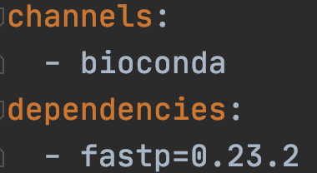
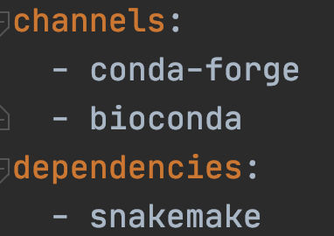
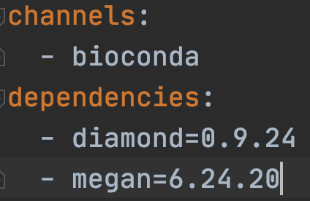
Conda environment
https://anaconda.org/
fastp
Snakemake
diamond & megan
conda env create -f environment.yml -n name

