Slide 1


Linux commandline
SEEG mission Assam
November 2022

Slide 2

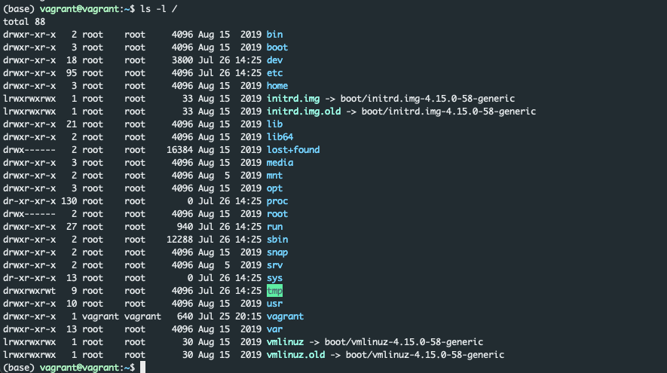
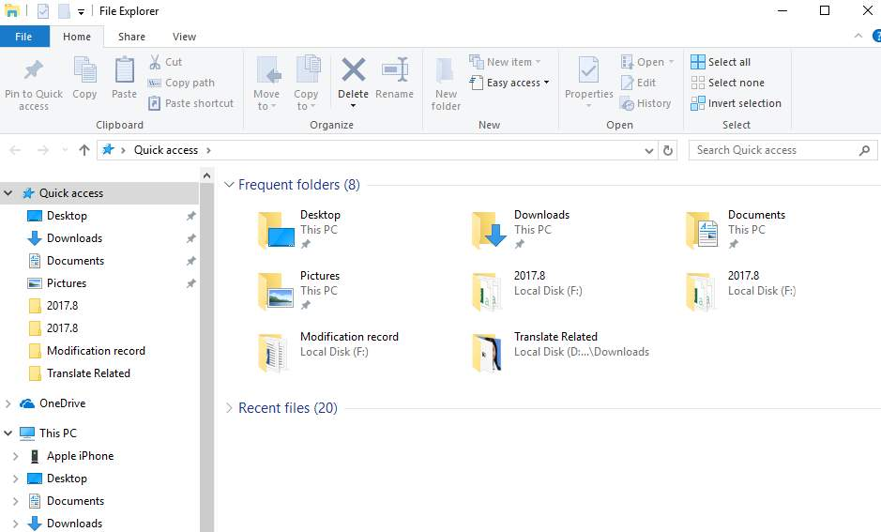

Linux commandline intro
Just another program
Interface to the computer
No mouse needed

Slide 3
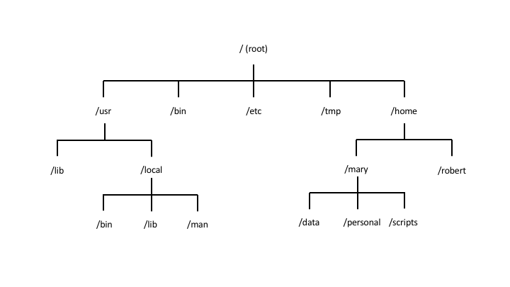
Linux commandline intro
In Linux all files and folder are located in a ”tree”
Navigation through the tree with
cd (change directory)
absolute path:
starting from the “root” (of the tree)
relative path:
staring from ”within” the tree
cd .. ➔ going on level “up”

Slide 4
Calling programs
ls -lhrt /Users/udo/some_directory
command
named parameters
positional parameter

Slide 5

Wildcards
Old-school auto-complete
Possible google searches that all start with “what to”

Slide 6
Wildcards
Find me
all files that start with Udo: ls Udo*
files that end with “.txt”: ls *.txt
Files that start with “Udo” and end with “.txt”: ls Udo*.txt
File names that would match:
Udo.txt
Udo_some_other_thing.txt
Udo123.txt
…

Slide 7
Navigating and exploring
The ls command
-l , -h, -t, -S, ls *.txt
The cd command
cat, zcat, head, tail (-n), less

Slide 8
Manipulating files
rm (remove)
-r
mv (move)
cp (copy)
r
mkdir (make directory)
ln -s (link to a file)

Slide 9
How do I know all the parameters?
Honestly:
I just google it most of the time
But you can also look at the manpage
good if just want to look sth up
”man command”, eg. “man ls”
also the parameter “-h” or ”--help” helps

Slide 10
Where does my output go?
A program usually outputs to two different locations
Standard output, stdout “>”
Standard error, stderr “2>”
Additionally you can specify any number of other locations

Slide 11
Where does my output go? stdout
Standard output (stdout)
Output of a program if everything goes right
Written to the screen of the terminal
Can be written to a file using the ”>” symbol
example: ls /Users/udo/Downloads > stdout.log

Slide 12
Where does my output go? stderr
Standard error (stderr)
Output of a program if an error happens
Also written to the screen of the terminal
Can be written to a file using the ”2>” symbol
example: ls /Users/udo/Downloads 2> stderr.log
stdout and stderr can both be written to files
example: ls /Users/udo/Down > stdout.log 2>stderr.log

Slide 13
Where does my output go? Pipes
You can connect output to another program
”zcat sample1_R1.fastq.gz | grep AGGGTCC”
Usually, stdout is passed on via the pipe
Very few exceptions exist
Specified in the manpage, helpfile
pipe symbol

Slide 14
Exercises
Create files, folders
Give relative and absolute paths
stdout and stderr questions on examples
Pipe with grep

