Slide 1




NGS Analysis
SEEG mission Assam
November 2022

Slide 2
Outline
Intro to me and my team
What to expect the coming days
Overview of NGS analysis

Slide 3
Intro to myself
Udo Gieraths
Background in
Computer Science (Bachelor)
Bioinformatics (Master)
Data Science (Booking.com, Soundcloud)
PhD studies since 2 years at Charite
Focus on virus discovery in ancient samples

Slide 4
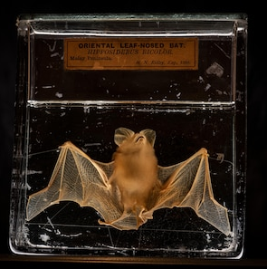
Intro to my PhD topic
My PhD topic
Ancient viral RNA/DNA genome discovery
Writing NGS pipelines
to detect just traces of viral RNA/DNA
to extract as many matching reads as possible
Reconstruct the ancient genome
CREDIT: Simon Townsley/The Telegraph

Slide 5
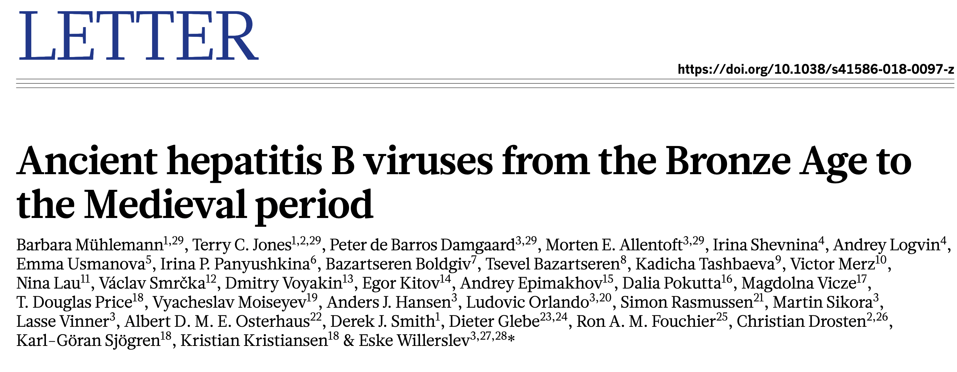
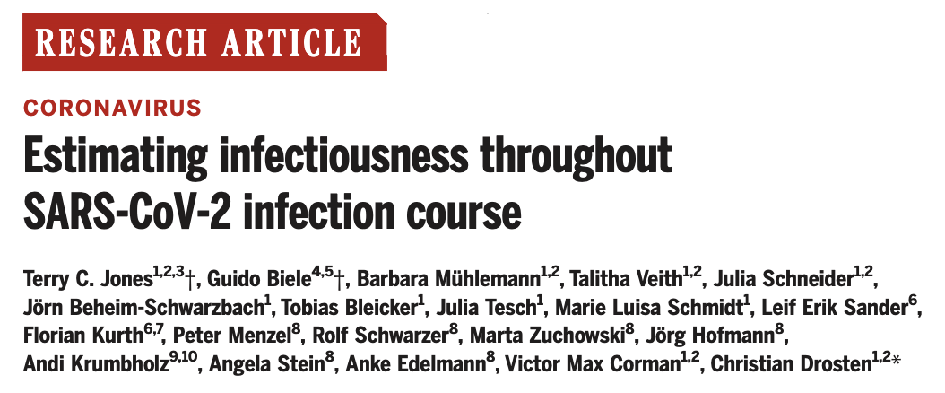
Intro to my team
Group of Terry Jones
3 PhD students (2 Bioinformatics, 1 Bioinfo/Lab)
1 Postdoc (Bioinformatics)
1 Lab technician (Jörn)
We handle most NGS processing of the virology department

Slide 6
What to expect the coming days
My Aim:
show how we process NGS data
Learn about your approaches
Discuss pros and cons
Learnings:
Overview of NGS processing steps
Intro to the commandline
Data processing pipelines

Slide 7
Overview of NGS analysis
raw data
BCL files (image files)
fastq files (text data)
filtered data
Remove primers
Filter out short reads, low quality base calls
genome data
Align against a reference genome
OR de-novo assembly
phylogeny
place the genome in a tree

Slide 8
Topics covered
Command line basics
cat data.csv | grep -i rota | wc -l
Understand these statements
Write them yourself
See how this is useful for biologists

Slide 9
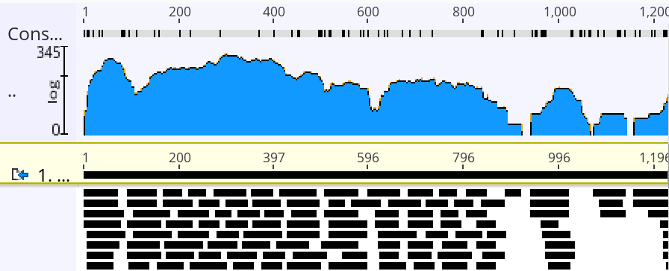
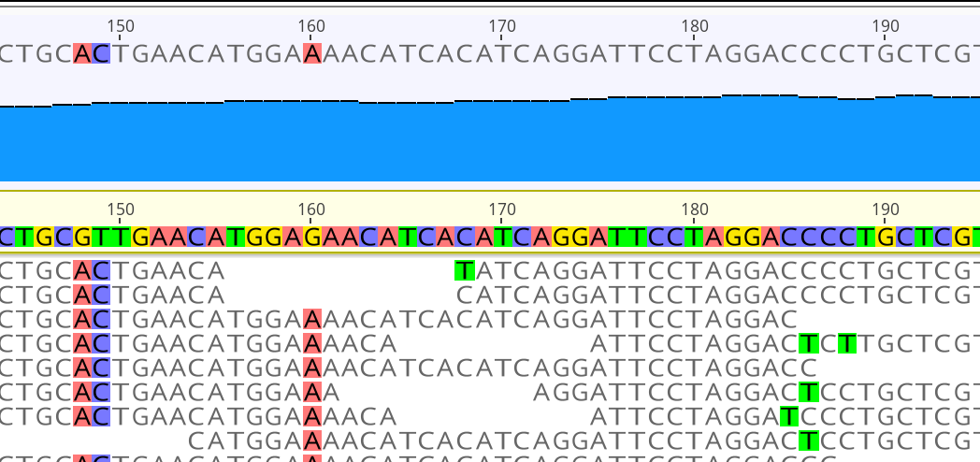
Topic covered
Alignment against a reference
Visualization done with Geneious Prime® 2022.2.2

Slide 10
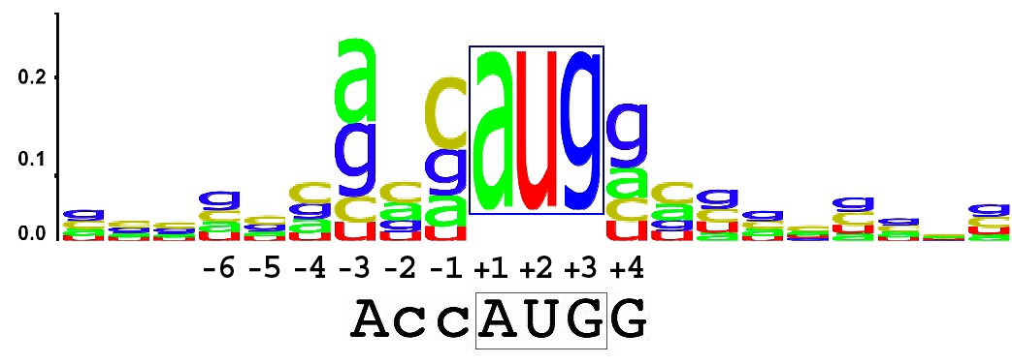
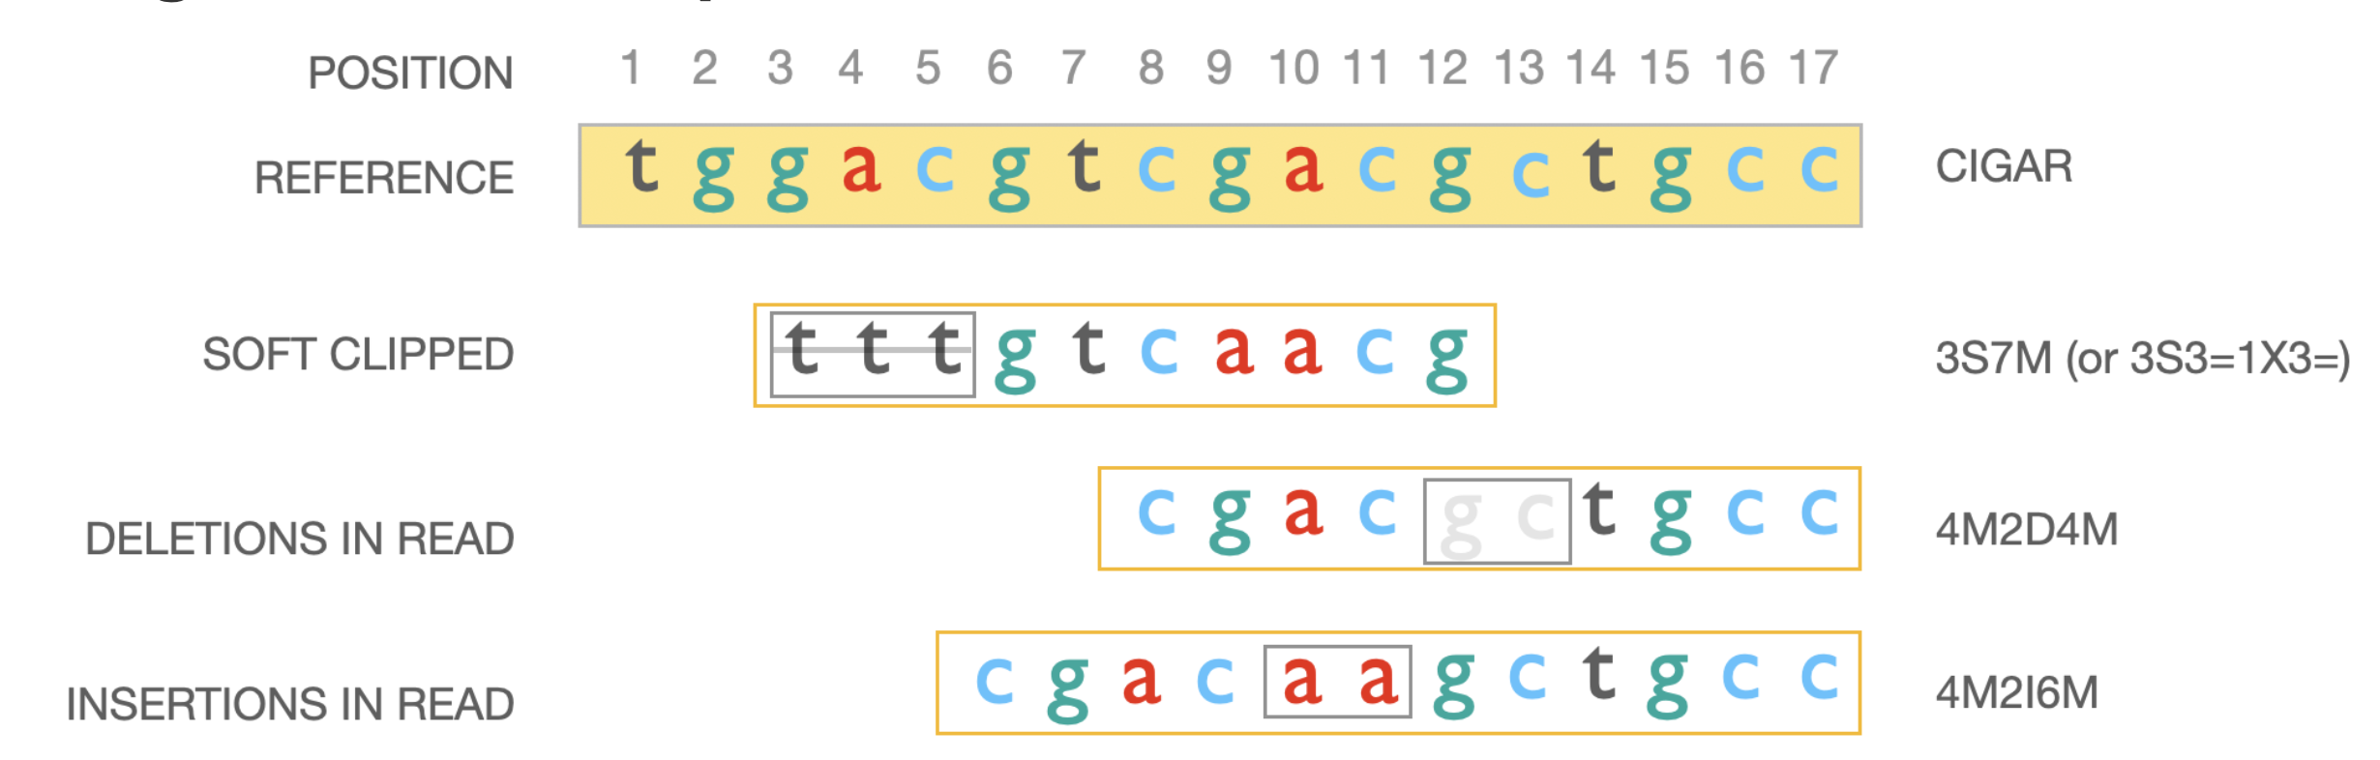
Topic covered
Consensus calling
https://upload.wikimedia.org/wikipedia/commons/b/bf/KozakConsensus.jpg

Slide 11
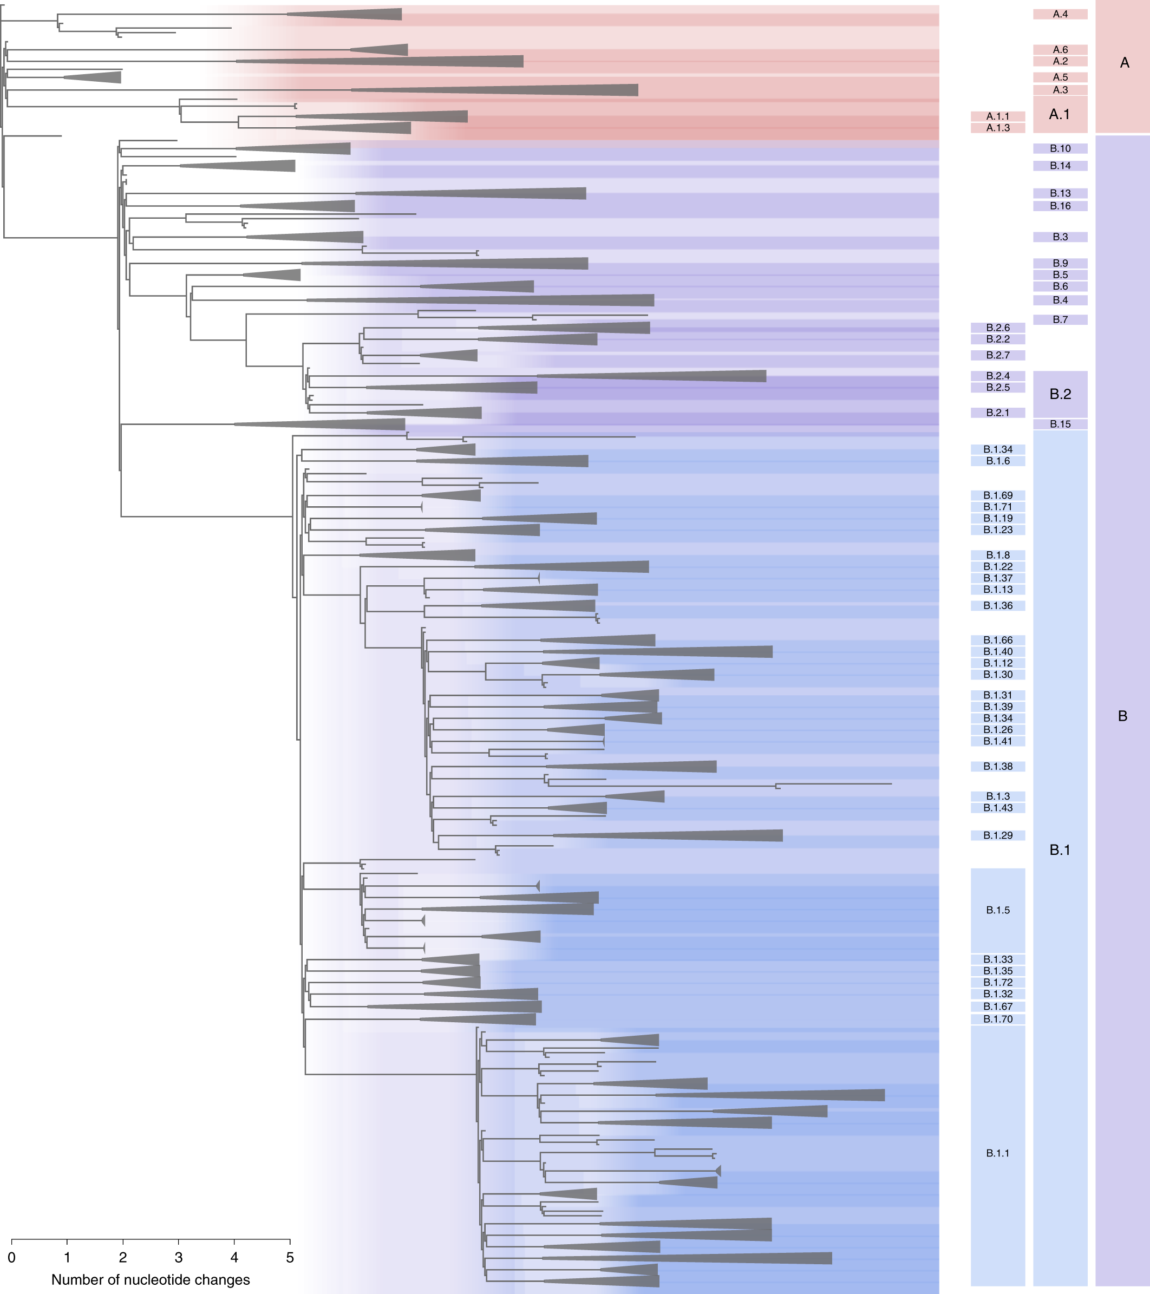
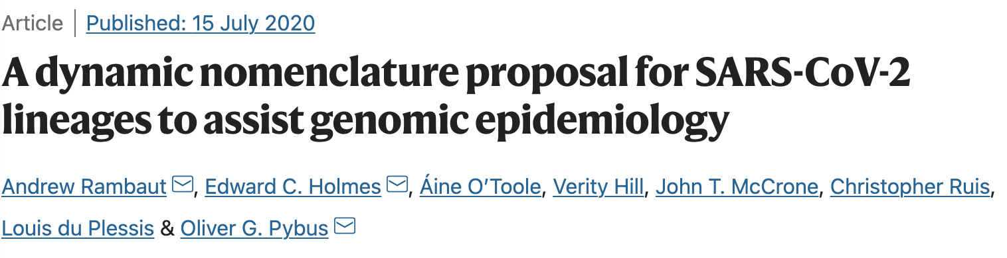
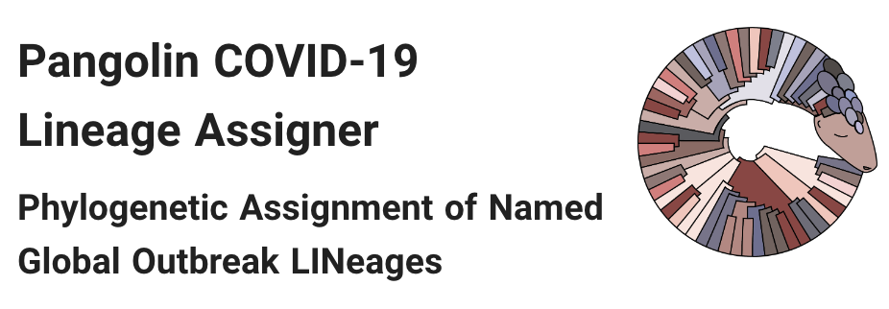
Topic covered
Lineage assignment
Rambaut et al. 2020

Slide 12
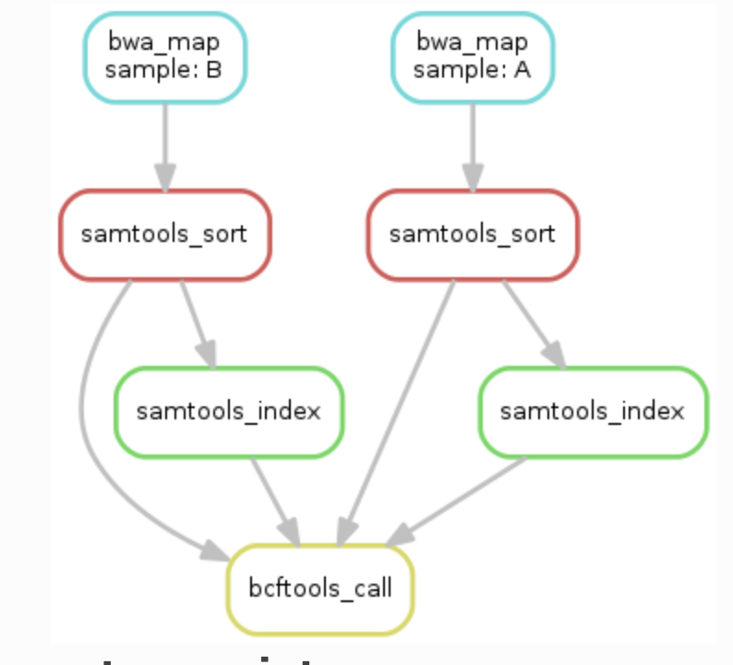
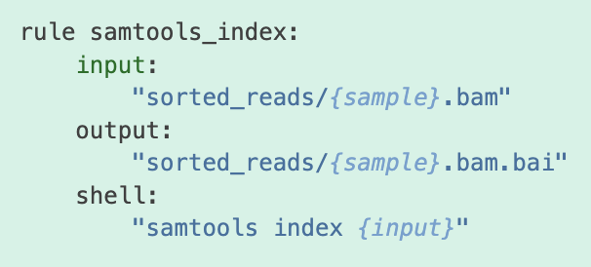
Topics covered
Automize and scale with a pipeline (snakemake)
https://snakemake.readthedocs.io/
https://snakemake.readthedocs.io/

Slide 13
Topics covered
Command line basics
Alignment against a reference
Consensus calling
Lineage assignment
Automize and scale with a pipeline (snakemake)
Apply pipeline to fresh sequencing data

