Slide 1
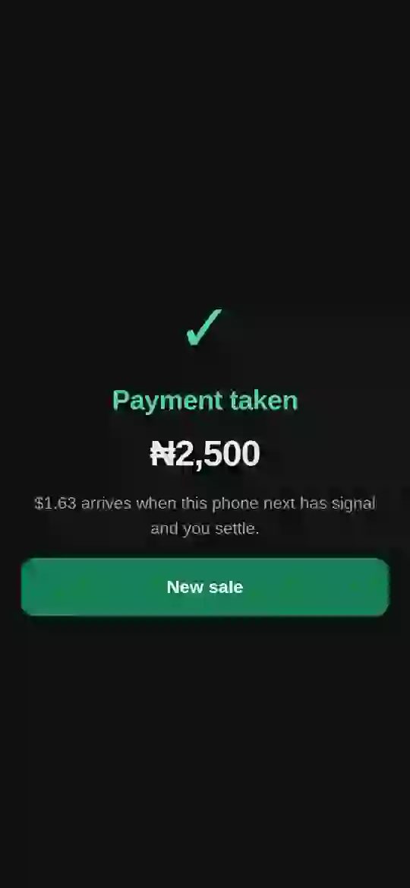
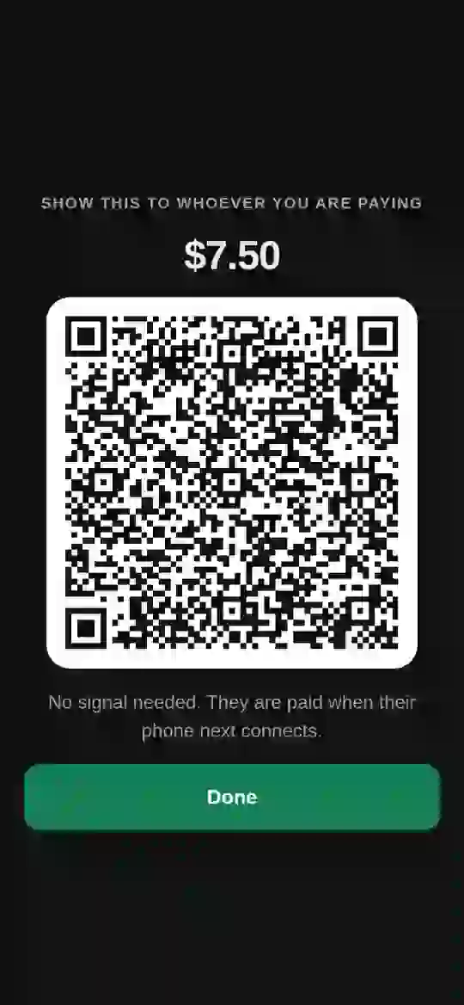




Every business can now take payments on Solana.
Even when the network is down.
Live on Solana mainnet
Paid into a Nigerian bank
Works with no network
Any Android phone
Notes:
One sentence of what nelo is, and four proofs a judge can check. Everything else follows.

Slide 2






Real sales. Real naira. In a real bank.
IT ALREADY WORKS
₦[amount]
Settled
Refused
Mainnet USDC → Nigerian bank, via paj.cash, in [N] seconds
Offline sale: both phones in airplane mode, settled on reconnect
Double spend: a replayed voucher is refused; a forged one freezes the vault
2 signed Android apps
40/40 on-chain tests
paj.cash + UseAzza live
Mobile Wallet Adapter
Mainnet tx: [signature] · paj.cash order: [order id] · Vault program (devnet): [program id]
Notes:
Fill the brackets from the real run: naira amount, seconds, Solscan signature, paj.cash order id.

Slide 3

A quarter of card payments fail. Daily.
THE PROBLEM
29.23%
15%
of POS transactions failed on 15 May 2026: ~157,000 declined in one day
average daily failure rate, reaching 25% at peak hours
When the network drops, the shop takes cash or loses the sale. Terminals cost a deposit, a wait and a fee.
Nigerian POS failure-rate reporting, 2026 · CBN dual-routing directive

Slide 4
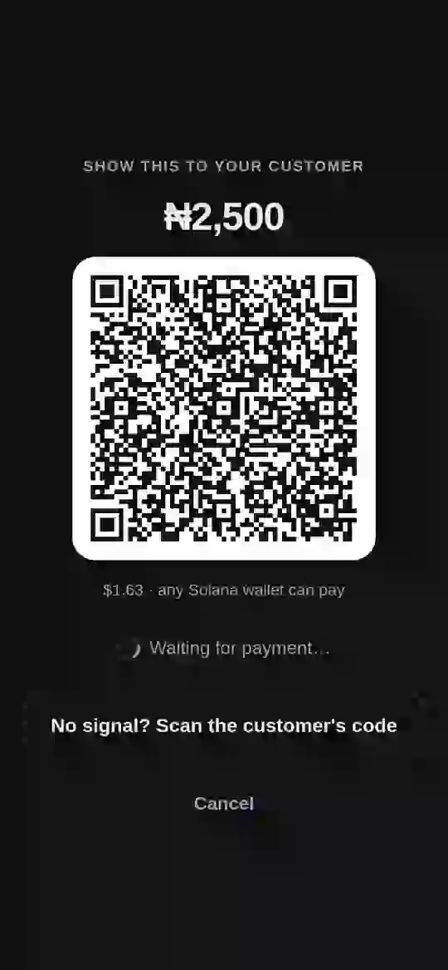
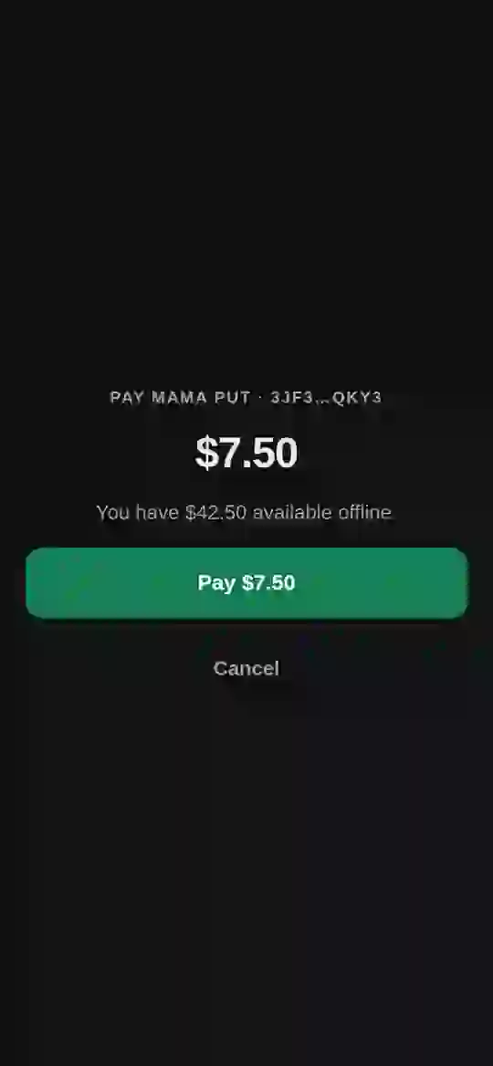


A payment terminal. With no terminal.
THE PRODUCT
nelo for business
Any phone is the till. Charge in naira; any Solana wallet pays. Cash out to the bank in ~20 s.
Offline
No signal on either phone? The sale still completes, and settles itself on reconnect.
nelo pay
Customers pay shops and friends, online or offline. No crypto words, just naira.

Slide 5


Offline is prepaid, never a promise.
HOW IT WORKS
1
2
3
4
5
Lock
Sign
Hand over
Verify
Settle
USDC set aside in an on-chain vault
The phone's secure chip signs the payment
QR both ways, no network needed
Solana checks the chip's signature
USDC moves; nelo pays the fee
Only on a phone
Only on Solana
A secure chip and a camera in one hand, at the counter.
secp256r1 verifies the chip on chain; sub-cent fees make a ₦2,500 sale worth settling.

Slide 6


SKR backs every offline payment.
SKR INTEGRATION
Stake → higher limit
Cheat → slashed
Earn → in SKR
Payers stake SKR to raise their offline spending limit. Sublinear, capped, revalued at every redemption.
A double spend freezes the vault and moves the staked SKR into the reserve. First-loss capital.
Merchants can take volume rebates in staked SKR at a premium. Priced honestly: ≈1.001× today.
Built: Anchor program with stake, unstake and slash · 40/40 tests · live on devnet with a test mint for SKR · rebate payouts after launch

Slide 7






$1.4T moves on phones. We start with 300.
MARKET
Who we serve
TAM
Mobile money value, Sub-Saharan Africa, 2025
$1.4T
Market traders and shops
Restaurants, food and beverage
SAM
In-person business payments: Nigeria, then 9+ currencies via UseAzza
Logistics, couriers and taxis
$42B
Field services, on-site pros
SOM
Year one: 300 businesses, 40% of takings on nelo
Fashion and luxury jewellery
$39.2M
Supermarkets, superstores, malls
347M mobile money accounts in SSA
$650B stablecoins on Solana, Feb 2026
75% of merchants prefer stablecoins
GSMA 2026 · 2026 Solana stablecoin reporting · Deloitte 2025 · SAM and SOM are nelo estimates

Slide 8




We earn on every payment. Both sides.
BUSINESS MODEL
0.61%
net on business volume
0.3–1.5%
on nelo pay services
0.50% fee + 0.50% payout spread, less reserve and rebate
Paying a friend is live today at 0.3%
From month 6, nelo pay becomes the money app: in crypto, felt in naira
Pay a friend
Cash out
Savings, yield
Bill payments
Stocks, RWAs
Agent API
Live · 0.3%
M7 · 0.75%
M9 · 1.5% of yield
M10 · 1%
M15 · 0.5%
M18 · 0.5%

Slide 9
$256K → $28.5M a year by year three.
PROJECTION
 | Year 1 | Year 2 | Year 3
Businesses | 300 | 3K | 25K
nelo pay users | 12K | 150K | 1.5M
Payment volume | $39.2M | $392M | $3.3B
Revenue | $256K | $3.1M | $28.5M
From nelo pay + agents | 7% | 22% | 30%
Year one: 100 businesses in 90 days, 300 by month 12, ~12K nelo pay users.
Run-rate at year end · $895 blended daily takings, 40% on nelo · users 40/50/60 per business · illustrative, not a forecast

Slide 10

Built by a Solana operator. Shipped before.
BUILDER AND NEXT STEPS
Udoka A.M
Roadmap
Founder · udokaam.dev
Days 0–90
100 businesses, one Lagos cluster
Months 3–6
Vault audit; offline payments to mainnet
Led product at Zinari Finance (now Yativo): DeFi, NFTs and payments, $M+ processed
Regional DevRel, Superteam Nigeria: $40K community GDP in 5 months; a Colosseum winner
Solana Foundation grant: SprintIQ, since acquired
4,000+ developers reached across Africa
Months 6–12
nelo pay services; 300 businesses
Year 2
Assets, agent API, new countries
github.com/Udoka-AM/nelo · udoka-am.github.io/nelo · Video: [link]

