Slide 1
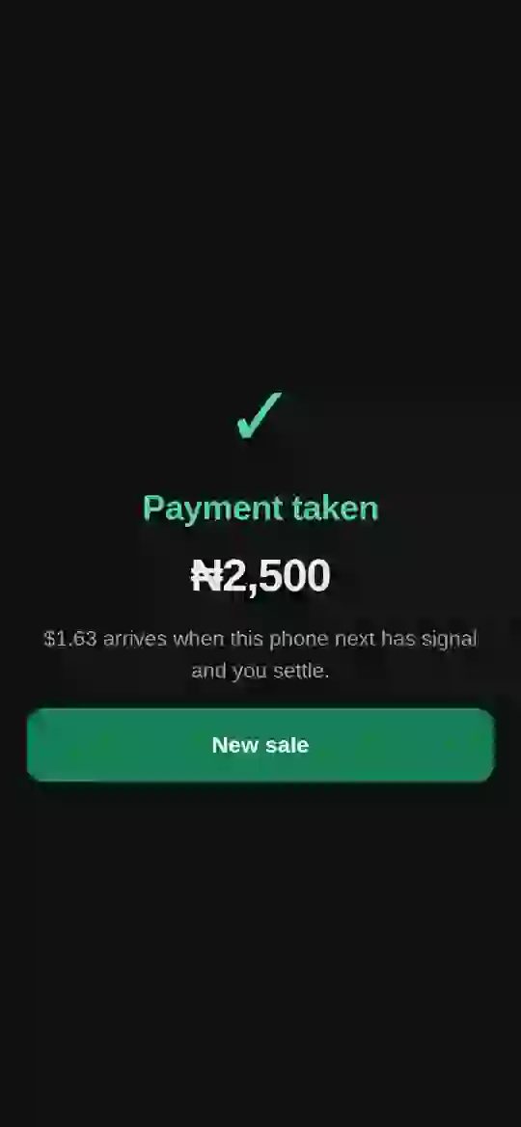
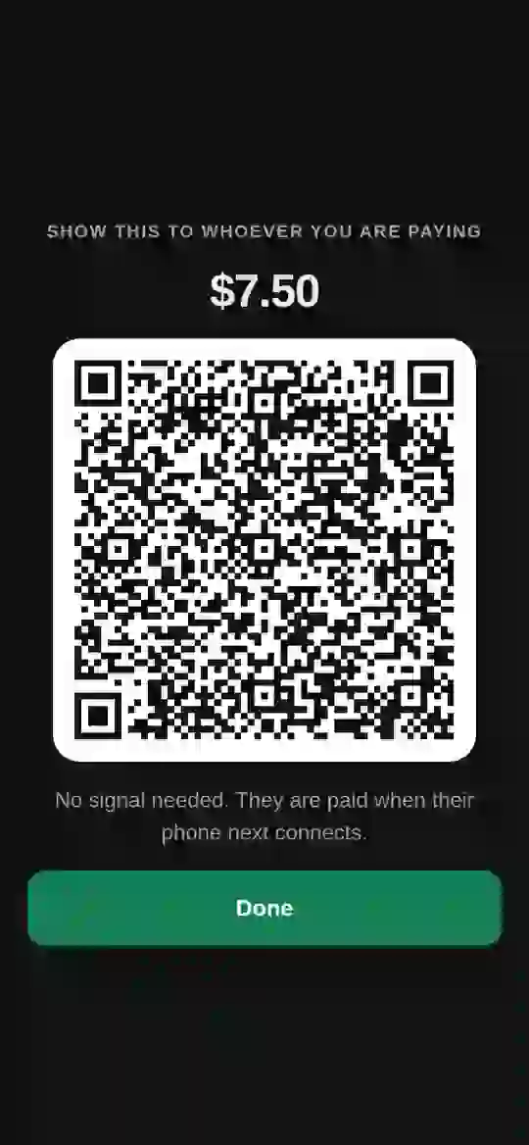
Every business can now take payments on Solana.
Even when the network is down.
CLOCK IN · a Solana Mobile hackathon presented by Radiants
[ Team names and roles ]
✓
Payment taken
₦2,500 · settles in naira
Notes:
nelo turns any Android phone into a payment terminal on Solana that keeps working offline and pays the business in naira, into its own bank.

Slide 2


A quarter of card payments fail. Every afternoon.
The problem
Adaeze sells phone accessories
29.23%
Her bank terminal took a deposit, a wait, and a fee she never stops noticing. It fails whenever the network drops, which is most afternoons. Then she takes cash, or loses the sale.
of POS transactions failed on 15 May 2026: about 157,000 declined in one day
15%
The regulator agrees
The central bank has mandated dual routing with automatic failover, because the single path keeps breaking. The same is true in Buenos Aires, Manila, Karachi and Lima.
daily average, reaching 25% at peak hours
Nigerian POS failure-rate reporting, 2026 · CBN dual-routing directive

Slide 3


Two things landed last year. Nobody had put them together.
Why now
June 2025 · Solana mainnet
Every modern Android phone
The secp256r1 precompile
Secure chips sign P-256
A Solana program can natively verify a P-256 signature on chain.
The one curve Android's secure hardware supports everywhere, the curve behind passkeys.
The phone's secure chip signs. Solana verifies. No trusted server sits in the path of the money.
SIMD-0075 · Android hardware-backed Keystore

Slide 4
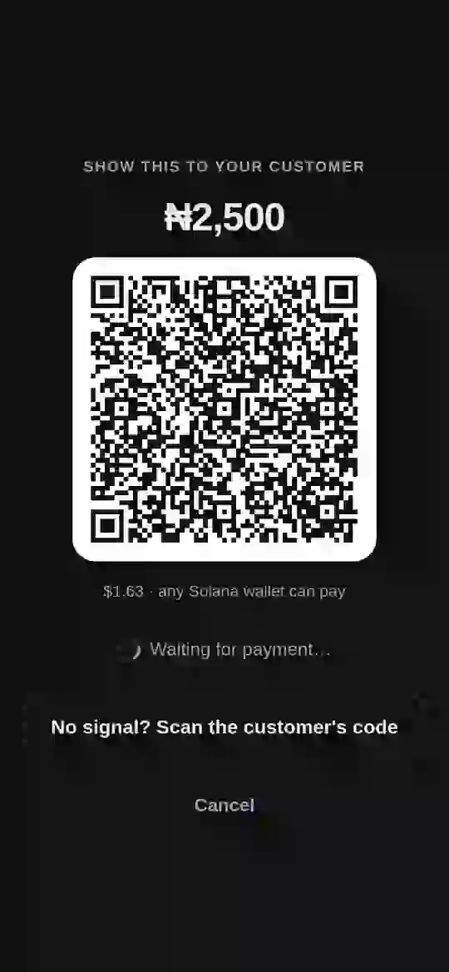
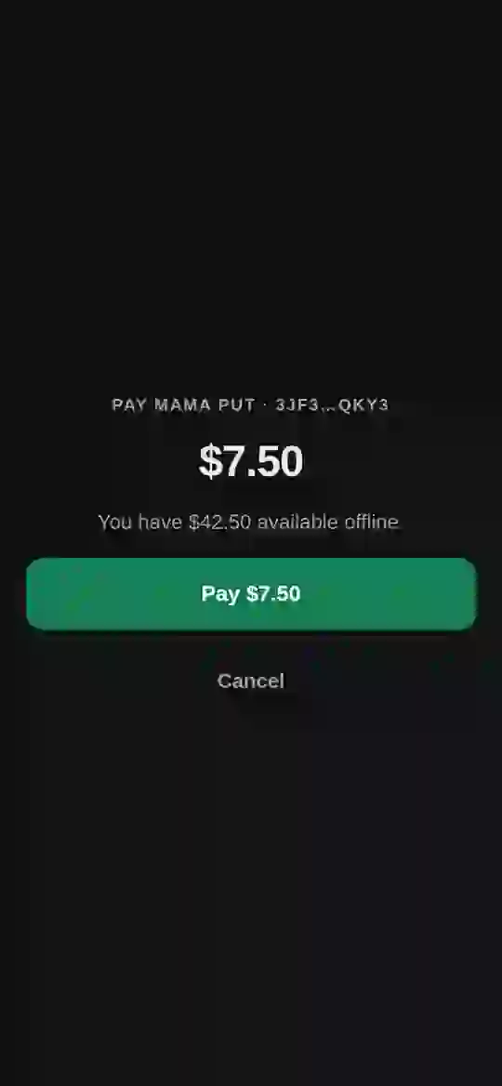



A payment terminal. With no terminal.
The product
nelo for business
Your till, in your pocket
Charge in naira; any Solana wallet or nelo pay can pay. Cash out to the bank in about 20 seconds.
Offline
Even with no internet
Both phones in airplane mode, the sale still completes, and settles itself when the till reconnects.
nelo pay
For your customers, and their friends
Pay a business, pay a friend, offline or online. The same voucher settles both.
Notes:
Everything the merchant sees is in naira and nothing says the word crypto. They sign up with the wallet they already have and name their bank account.

Slide 5
Offline is a prepaid balance, not a promise to pay.
How it works
1
2
3
4
5
Lock
Sign
Hand over
Adjudicate
Settle
The payer sets USDC aside in an on-chain vault while online. Nothing offline can exceed it.
The phone's secure chip signs a payment voucher with a key that never leaves the hardware.
QR, both ways. Neither phone has a network. The till checks the signature on the spot.
On reconnect, Solana verifies the signature and refuses any reused sequence.
USDC moves to the business. nelo's relayer pays the fee; the merchant signs nothing.
Solvency is on chain before the sale · a replayed voucher is refused for everyone · withdrawals are time-locked · a double spend freezes the vault and slashes its stake

Slide 6
A real sale. Then real naira in a real bank account.
It ran
Offline sale
Double spend
Mainnet cash-out
Settled
Refused
₦[amount]
Two phones in airplane mode; settled on reconnect through the relayer
A voucher shown twice was refused; a forged second voucher froze the vault
USDC on Solana mainnet to paj.cash, in a Nigerian bank in about [N] seconds
Mainnet transaction: [signature] · paj.cash order: [order id] · Vault program (devnet): [program id]
Signed release APKs on two Android phones · cash-out on Solana mainnet · offline payments on devnet
Notes:
Fill the brackets from the real run: naira amount, seconds, the cash-out transaction signature and the paj.cash order id.

Slide 7


Neither half of this works anywhere else.
Why a phone, why Solana
Only on a phone
Only on Solana
It needs a secure chip and a camera in the same hand at the same moment. There is no web version, and no way to bolt this onto a payment afterwards.
The secp256r1 precompile checks the secure chip's signature on chain. Sub-cent fees and sub-second finality make a ₦2,500 sale worth settling.
~35% of global on-chain stablecoin transfers by count already run on Solana

Slide 8





$1.4T moves on phones. Year one: 300 businesses.
Market
TAM $1.4T
Who we serve
Mobile money transaction value, Sub-Saharan Africa, 2025
Market traders and shops
Restaurants, food and beverage
SAM $42B
Logistics, couriers and taxis
≈3% of TAM: in-person business payments, Nigeria first, then the 9+ currencies UseAzza pays out in
Field services and on-site pros
SOM $39.2M
Fashion and luxury jewellery
Year one: 300 businesses, 40% of their takings through nelo
Supermarkets, superstores, malls
347M
$650B
75%
active mobile money accounts in Sub-Saharan Africa
stablecoin volume on Solana in one month, Feb 2026
of merchants planning crypto acceptance prefer stablecoins
GSMA State of the Industry 2026 · 2026 Solana stablecoin reporting · Deloitte 2025 merchant survey · SAM and SOM are nelo estimates

Slide 9
We earn on every payment. Two sides, one network.
Business model
Business category | Per 100 | Avg daily takings | Daily via nelo
Market traders and shops | 40 | $300 | $4,800
Restaurants, food and beverage | 20 | $1,200 | $9,600
Logistics, couriers and taxis | 15 | $400 | $2,400
Field services and on-site pros | 10 | $250 | $1,000
Fashion and luxury jewellery | 10 | $2,000 | $8,000
Supermarkets, superstores, malls | 5 | $5,000 | $10,000
Blended | 100 | $895 avg | $35,800
nelo for business
0.61%
net on volume: 0.50% fee + 0.50% payout spread, less reserve and Trust Stake rebate
nelo pay
0.3% – 1.5%
on paying a friend, cash-out, savings, bills and assets. Live today: pay a friend at 0.3%
Takings: what a business sells in a day. nelo carries 40% of it in year one.
Illustrative model: every input is a stated assumption, to be replaced with measured numbers

Slide 10
100 businesses in 90 days. 300 by month 12.
Year one
$1.1M
monthly volume at day 90
$39.2M
annual volume run-rate at month 12
12k
nelo pay users, ~40 per business
$256k
annual revenue run-rate, both apps
$895 blended daily takings · 40% through nelo · 0.61% net on business volume · illustrative, not a forecast
Notes:
The first 90 days are one market cluster, door to door: 25, 60, then 100 businesses. By month 12, 300 businesses across the six categories, with their customers on nelo pay.

Slide 11




nelo pay becomes the money app. In crypto, felt in naira.
From month 6
Pay a friend
Cash out to bank
Savings with yield
Live · 0.3%
Month 7 · 0.75%
Month 9 · 1.5% of yield
Bill payments
Stocks and real-world assets
Agent payments API
Month 10 · 1% biller fee
Month 15 · 0.5% per trade
Month 18 · 0.5% on volume
Every service runs on USDC and Solana underneath, and shows the user naira. Each one turns a customer who paid once into a user who stays: more reasons to open the app, more balance kept in it, more businesses that see their customers already on nelo.
Notes:
Agent payments API: AI agents running on terminals pay and get paid through nelo with spending limits, the same voucher primitive with a machine as the payer.

Slide 12
$256k to $28.5M a year. Both apps, one network.
Three-year projection
 | Year 1 | Year 2 | Year 3
Businesses | 300 | 3k | 25k
nelo pay users | 12k | 150k | 1.5M
Business volume | $39.2M | $392M | $3.3B
Business fees | $239k | $2.4M | $19.9M
nelo pay services | $17k | $621k | $7.8M
Agent payments API | — | $39k | $817k
Total revenue | $256k | $3.1M | $28.5M
From nelo pay and agents | 7% | 22% | 30%
Run-rate at each year end. Users: 40, 50, 60 per business. Service adoption ramps from launch; agents take 2% then 5% of business volume. Illustrative, not a forecast
Notes:
The business side is the wedge; nelo pay is where the growth compounds. By year three a third of revenue comes from people, not tills.

Slide 13


Stake raises the offline limit. Earning is a choice.
SKR · Trust Stake
Collateral that saturates
Earning, and a real choice
Stake raises a merchant's offline limit on a sublinear, reputation-weighted, hard-capped curve, and is first-loss capital before the reserve. Past the largest realistic basket, more stake buys nothing. That is correct.
Each period the merchant chooses: the rebate as a lower fee in naira, or paid in SKR, already staked, at a premium priced from the reserve capital their stake saves. A choice made each month is an incentive; an automatic accrual is a discount.
Honest number: the reserve model supports a premium of about 1.001×, not 1.5×. We say so rather than pick one.
docs/RESERVE.md · merchants electing SKR accept price risk, disclosed at the point of election

Slide 14


Door to door first. Then the network does the rest.
Distribution
Cluster by cluster
Customers spread it
Win one market completely before the next. Traders talk constantly.
Every customer who pays with nelo pay can pay a friend, and brings them in.
dApp Store
Payout partners
Placement seeds the customer side with people who already hold wallets.
paj.cash and UseAzza already have merchants and want volume. UseAzza adds 9+ more payout currencies.

Slide 15
Live, on devnet, and declared.
What actually ran
Live
On devnet
Declared, not built yet
Cash-out on Solana mainnet, paid to a Nigerian bank by paj.cash
Signed release APKs: the till and nelo pay
Mobile Wallet Adapter for every merchant signature
paj.cash's live naira rate on the till
Payout partners from day one: paj.cash and UseAzza (9+ currencies)
Vault program: secure-chip signatures verified on chain
Offline sale, both phones in airplane mode, settled on reconnect
Replay refused; a forged double spend freezes the vault
anchor test green: 40 of 40
nelo pay services beyond paying a friend
Rebate payout and the SKR premium (≈1.001×)
QR only; NFC not yet
Phone-number sign-up off (Privy SMS for Nigeria)
github.com/Udoka-AM/nelo · udoka-am.github.io/nelo · Video: [link]

Slide 16
Win one market. Then grow up with our users.
Roadmap
Days 0–90
Months 3–6
Months 6–12
Year 2
100 businesses
Harden
nelo pay grows up
Assets and agents
dApp Store listing. One market cluster in Nigeria, door to door. Cash-outs through paj.cash and UseAzza.
Vault audit. Offline payments move to mainnet. Reserve model on observed loss.
Cash out, savings with yield and bill payments in nelo pay. 300 businesses.
Stocks and real-world assets in local-currency terms. Agent payments API. New countries through UseAzza.
Payout partners were the one blocking dependency. paj.cash and UseAzza are live from day one: Nigeria first, then 9+ more currencies.

Slide 17


Who built it, and what unlocks the next stage.
Team and asks
A design partner
Team
One market association willing to run a hundred tills.
[ Name — role ]
[ Name — role ]
[ Name — role ]
A security review
Of the vault program, before offline payments move to mainnet.
Android and the secure chip · Rust and Anchor for the vault · design · partnerships
dApp Store placement
To seed nelo pay with people who already hold wallets.

