Slide 1

Exploratory Data Analysis
G2M insight for Cab Investment firm
Michael Udonna Egbuzobi
20-August-2024

Slide 2

Agenda
Executive Summary
Problem Statement
Approach
EDA
Hypothesis Testing
Recommendations

Slide 3
Executive Summary
Executive Summary
XYZ, a private firm in the US, is considering an investment in the competitive cab industry. To support this decision, a detailed analysis of two cab companies' data from 2016 to 2018 was conducted. The analysis focuses on ride volumes, profitability, customer demographics, and market trends. Key insights will guide XYZ in identifying the optimal investment opportunity, ensuring alignment with market conditions and customer preferences.

Slide 4
Executive Summary
Problem Statement
Given the presence of multiple key players in the cab industry, XYZ seeks to make an informed investment decision. The goal is to understand the market dynamics, customer behaviour, and financial performance of two cab companies. This analysis provides actionable insights to determine the better-performing company and the most promising investment opportunity for XYZ.

Slide 5
Executive Summary
The Datasets
The analysis utilizes four datasets:
Cab_Data.csv: Contains transaction details for two cab companies.
Customer_ID.csv: A mapping table linking customer IDs to their demographic details.
Transaction_ID.csv: A mapping table linking transactions to customers and payment modes.
City.csv: Lists US cities along with their populations and number of cab users.

Slide 6
Executive Summary
Data pre-processing approach
Data Integration: The analysis started with merging the provided datasets in Excel using VLOOKUP functions to create a unified dataset.
Profit Calculation: A new profit column was calculated and added to the dataset to facilitate financial analysis.
Data Integrity Check: A thorough examination was conducted using the filter function to ensure no blanks or missing values, confirming the dataset's completeness and reliability for further analysis.

Slide 7
Data pre-processing approach
The final dataset contained 14 features, including five calculated features.
Dataset contained 359, 394 records.
Cab Data
Transaction ID
City Data
Customer ID
Merged Cab Data

Slide 8
Executive Summary
Exploratory Data Analysis

Slide 9
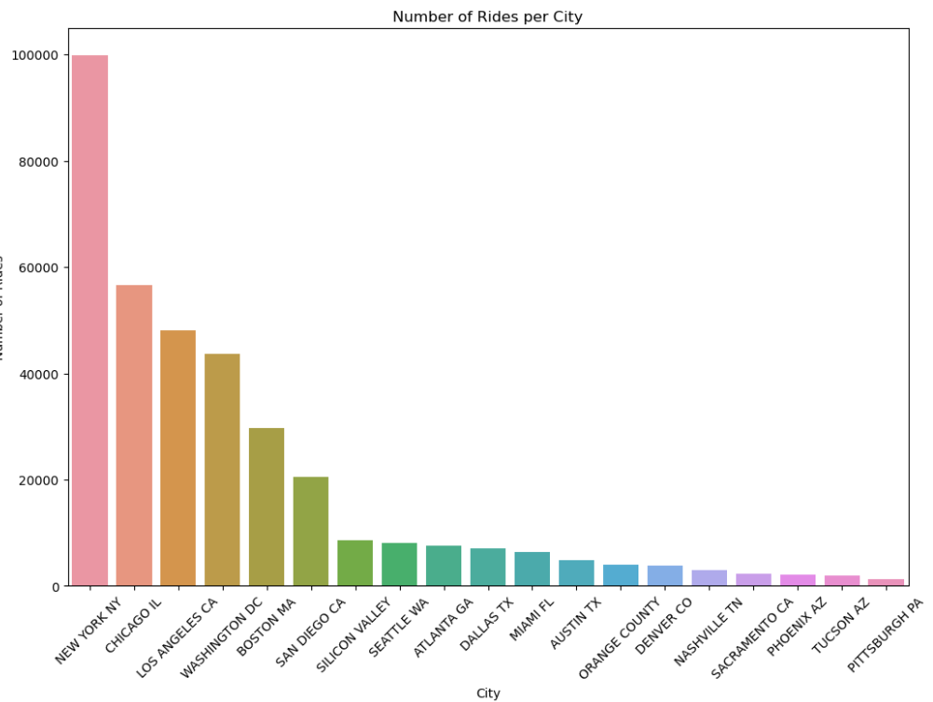
Executive Summary
Number of Rides per City
The chart indicates that New York has the highest number of rides, followed by Chicago, Los Angeles, and Washington D.C. This suggests that larger metropolitan areas tend to have a higher volume of ride bookings compared to smaller cities.

Slide 10
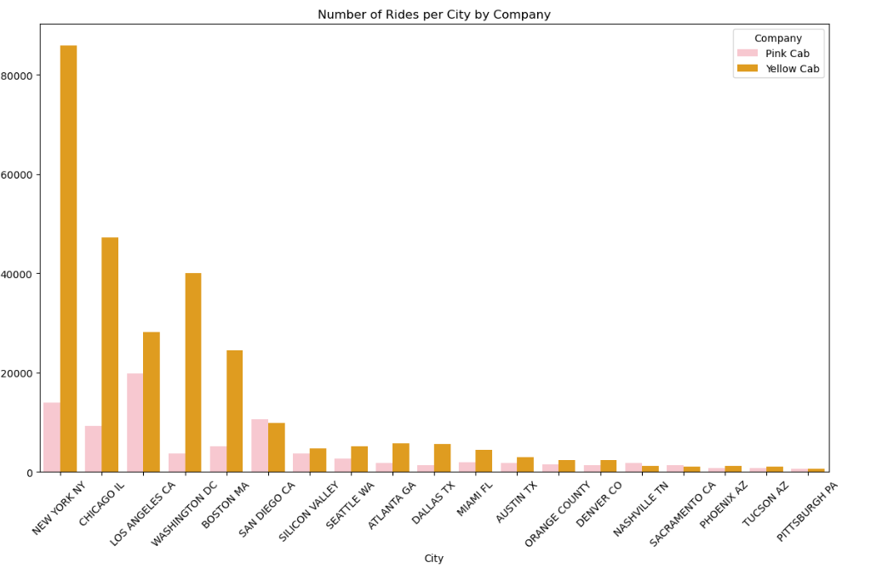
Executive Summary
Number of Rides per City by Company
After adding "company" as a variable, it was observed that the majority of the customer base for both companies is concentrated in large metropolitan areas, as described by the number of rides per city, with Yellow Cab having the highest number of rides.

Slide 11
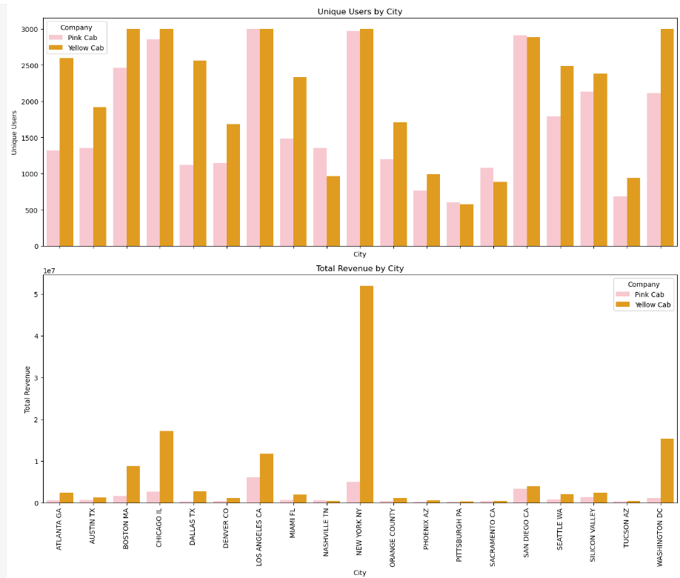
Number of Unique Users and Total Revenue per City by Company
The analysis of the number of unique users—defined as distinct individuals who utilized the service, including first-time users—and total revenue by city aligns with previous findings. Large metropolitan cities generate more revenue and attract a higher number of unique users, with Yellow Cab slightly outperforming Pink Cab in both metrics.

Slide 12
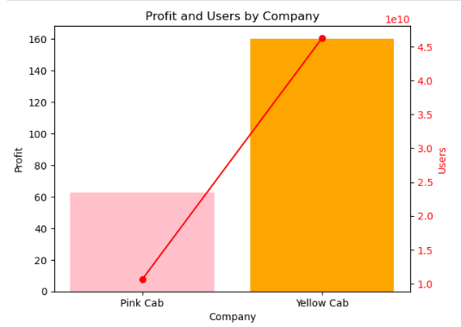
Executive Summary
Profit and Users by Company
Once again, Yellow Cab outperforms Pink Cab in both total profit and number of users per company.

Slide 13
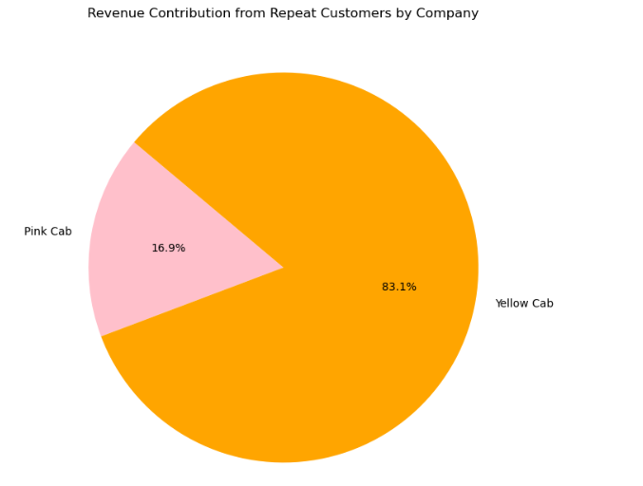
Executive Summary
Revenue Contribution from Repeat
Yellow Cab has a significantly higher percentage of repeat customers, accounting for 83.1%, while Pink Cab has only 16.9%, indicating that Yellow Cab retains a larger proportion of its customer base.

Slide 14
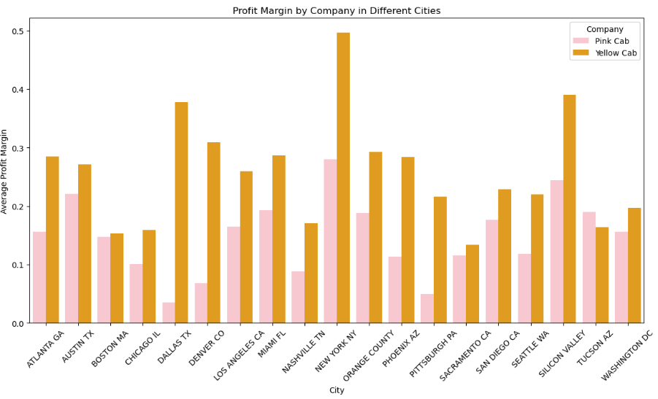
Executive Summary
Profit Margin by Company in Different Cities
Same as revenue, profit is higher in large metropolitan cities, with yellow cab outperforming pink cab.

Slide 15
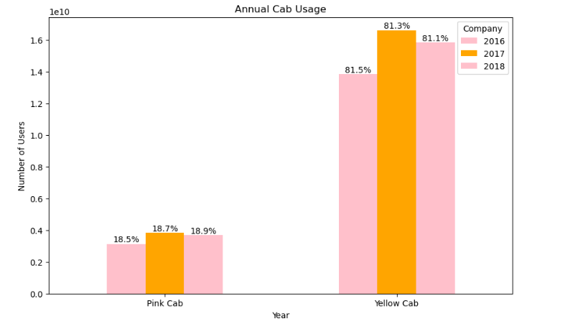
Executive Summary
Annual Cab Usage
Annual cab usage data shows that Yellow Cab consistently dominates the market, with usage rates of 81.5%, 81.3%, and 81.1% for 2016, 2017, and 2018, respectively, compared to Pink Cab’s 18.5%, 18.7%, and 18.9%. Additionally, the data indicates that 2017 was a peak period for both companies.

Slide 16
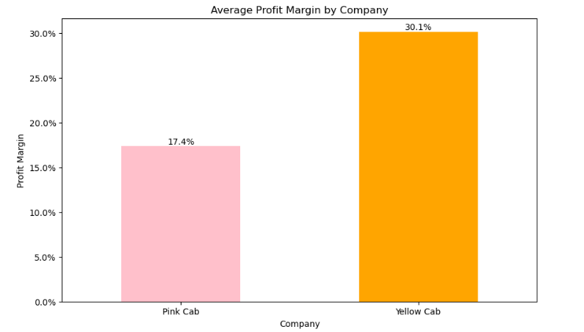
Executive Summary
Average Profit Margin by Company
The average profit margins are 17.4% for Pink Cab and 30.1% for Yellow Cab, indicating that Yellow Cab enjoys a substantially higher profit margin compared to Pink Cab.

Slide 17
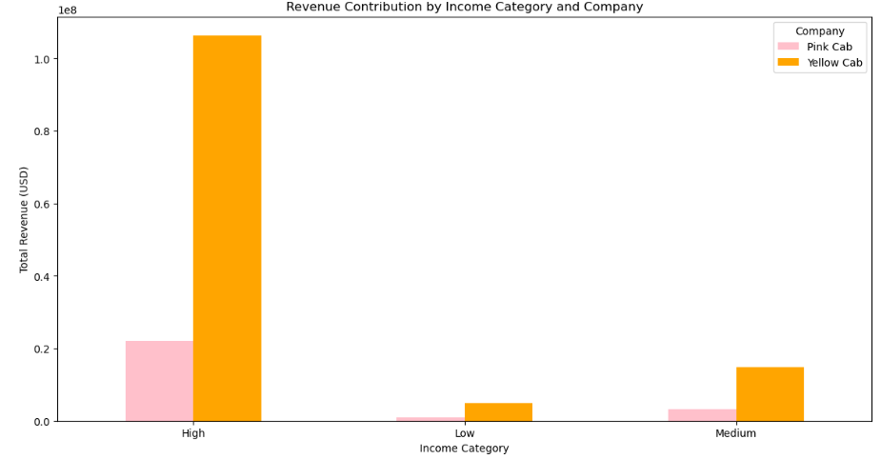
Executive Summary
Revenue Contribution by Income Category and Company
The analysis of revenue contribution by income category and company indicates that high-income earners utilize cab services more frequently than other income groups. Furthermore, Yellow Cab derives greater benefits from this demographic compared to its competitor.

Slide 18
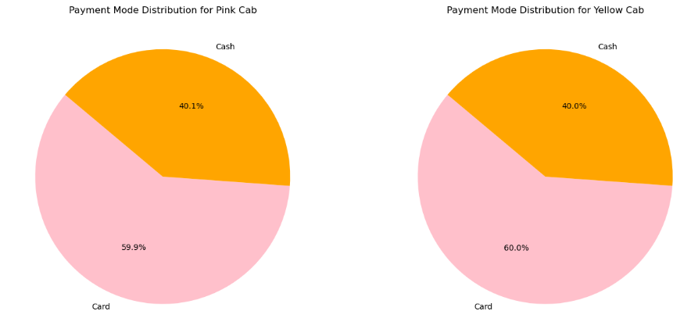
Executive Summary
Payment Mode Distribution by Company
The data reveals that customers predominantly use card payments for both companies, suggesting a strong preference for card transactions over other payment methods.

Slide 19
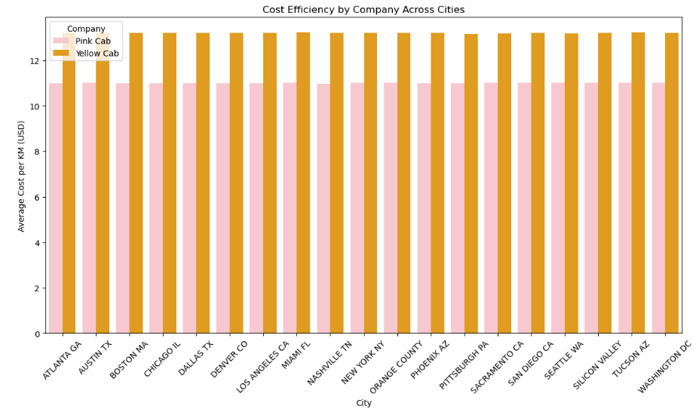
Executive Summary
Cost Efficiency by Company Across Cities
Yellow Cabs demonstrate greater cost-efficiency compared to Pink Cabs.

Slide 20
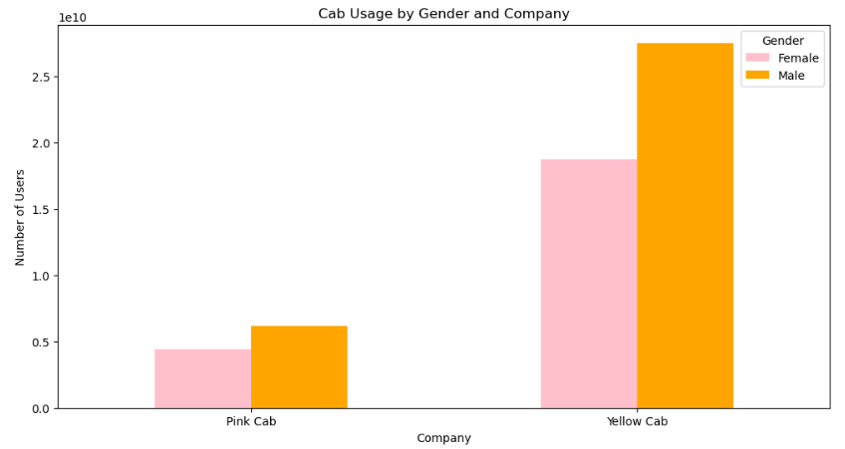
Executive Summary
Cab Usage by Gender and Company
Based on the data, males utilize cab services more frequently than females. Additionally, Yellow Cabs once again outperform Pink Cabs in terms of usage.

Slide 21
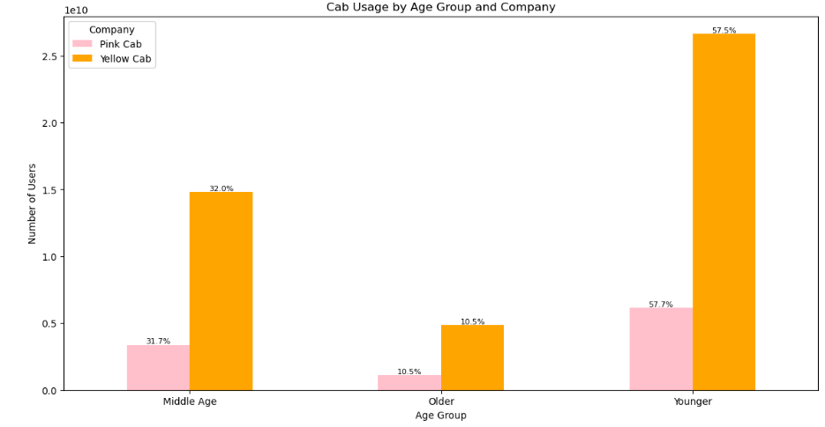
Executive Summary
Cab Usage by Age Group and Company
Younger age groups utilize cab services more frequently than older age groups and tend to favour Yellow Cabs over Pink Cabs.

Slide 22
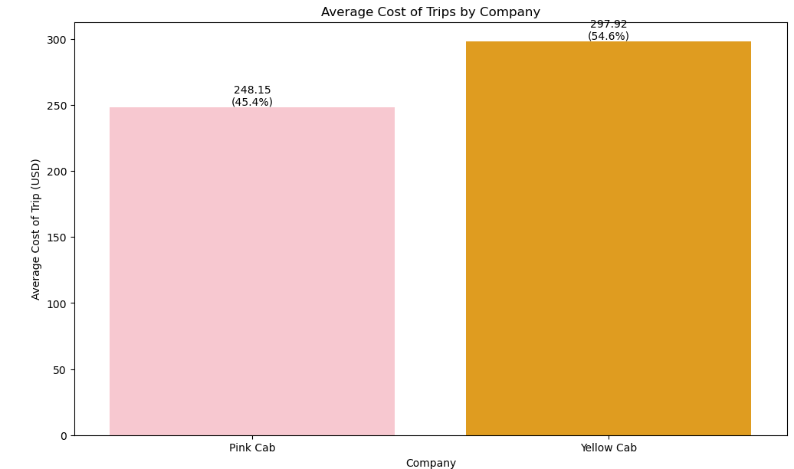
Executive Summary
Average Cost of Trips by Company
The average cost of trips indicates that Yellow Cabs are more expensive on average compared to Pink Cabs.

Slide 23
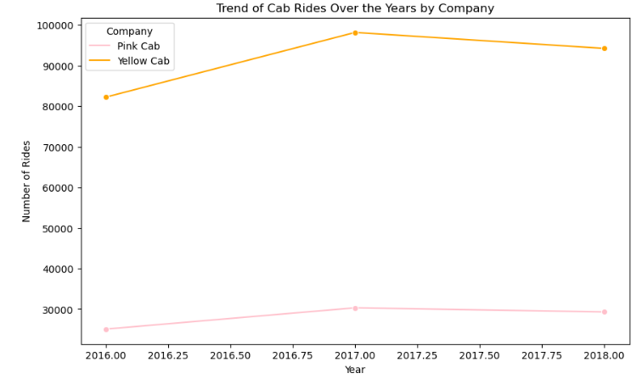
Executive Summary
Trend of Cab Rides Over the Years by Company
As indicated by the annual cab usage data, the trend in cab rides over the years shows that 2017 was the peak year for both companies.

Slide 24
Executive Summary
Hypothesis Testing

Slide 25

Executive Summary
Hypothesis
H1: Is there a significant difference in cab usage between males and females?
H2: Does Yellow Cab have a significantly higher average profit margin compared to Pink Cab?
H3: Does revenue generation differ between high-income and low-income earners for Yellow Cab?

Slide 26

Executive Summary
Hypothesis
H4: How does the average trip cost compare between Yellow Cab and Pink Cab?
H5: Is cab usage uniformly distributed across different age groups?
H6: Does the choice of payment mode affect cab usage frequency?

Slide 27
Executive Summary
Hypothesis
H7: Is there a significant difference in cab usage between males and females?

Slide 28
Executive Summary
Recommendations
Based on the comprehensive exploratory data analysis (EDA), the following insights and recommendations favour investing in Yellow Cab:
Market Share and Usage: Yellow Cab consistently demonstrates a dominant market share with higher annual usage compared to Pink Cab. This is evident from the data showing Yellow Cab's significant share in overall rides and revenue across large metropolitan areas.
Profitability: Yellow Cab exhibits a notably higher average profit margin of 30.1% compared to Pink Cab's 17.4%. This superior profit margin indicates better financial performance and efficiency in generating profits.
Customer Retention: Yellow Cab has a higher proportion of repeat customers (83.1%) compared to Pink Cab (16.9%). This suggests stronger customer loyalty and satisfaction with Yellow Cab’s services.

Slide 29
Executive Summary
Recommendations
Demographic and Usage Trends: Younger age groups and high-income earners show a clear preference for Yellow Cab, indicating a robust customer base with potential for future growth.
Performance Trends: Historical data indicates that Yellow Cab has maintained its leading position consistently over the years, with 2017 being a peak year for both companies but Yellow Cab showing stronger performance.
Revenue Contribution: Analysis of revenue contribution by income category shows that high-income earners contribute significantly more to Yellow Cab’s revenue. This reflects Yellow Cab's strong appeal to affluent customer segments who may also be more likely to use cab services regularly

Slide 30
Executive Summary
Recommendations
Payment Preferences: Yellow Cab benefits from a higher proportion of card payments, suggesting a more modern and potentially higher-value customer base compared to Pink Cab, which may influence overall financial stability and transaction efficiency.
Cost of Trips: The average cost of trips for Yellow Cab is higher, indicating that it caters to a premium segment of the market. This premium positioning can lead to higher revenue per ride and suggests Yellow Cab’s ability to command better pricing.
Operational Consistency: Yellow Cab shows more consistent performance across different metrics and time periods. Its ability to maintain high usage rates and profitability even during peak periods underscores its operational strength and market resilience.

Slide 31
Executive Summary
Recommendations
Cost Efficiency: Yellow Cab is more cost-efficient, managing operational costs effectively while maintaining higher revenue and profit margins.

Slide 32
Thank You

