Slide 1

INLP Project: Neural Dependency parser
Team: NSU_NLP
Member 1: Nikhil Chawla (2022201045)
Member 2: Shubham Deshmukh (2022201076)
Member 3: Udrasht Pal (2022201020)

Slide 2
Problem Objective
In this project, we are developing a dependency parser for the Hindi language using a Hindi Dependency Treebank (HDTB). A dependency parser is used to recognize the syntactic relationships between words in a sentence. Despite abundant literature on dependency parsing in the NLP community, there are limited sophisticated tools available specifically for Indian languages.

Slide 3
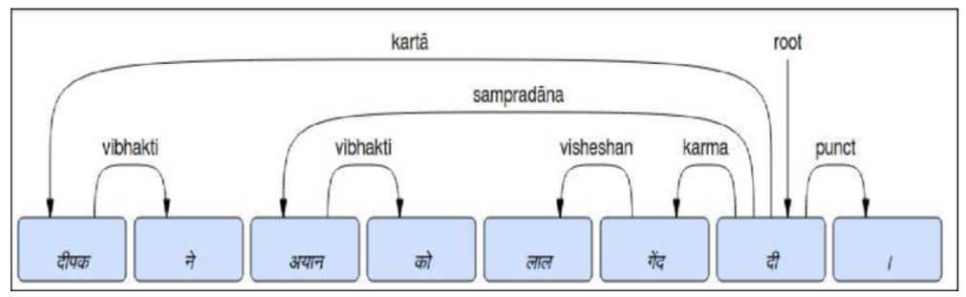
Dependency Parser
A dependency parser analyzes the grammatical structure of a sentence, establishing relationships between "head" words and words that modify those heads. The figure below shows a dependency parse of a short sentence. The arrow from the word “दी” to the word “दीपक” indicates that “दीपक” modifies “दी”, and the label “Karta” assigned to the arrow describes the exact nature of the dependency.
A dependency parsing mechanism can give a parsed dependency tree for a given sentence, which involves a set of relations over its words such that one is a ‘dependent’ of the other.

Slide 4
Our Methodology
We are using a Transition-based parsing approach
Transition-based Dependency Parsing: This parser creates sentence structures by reading words one by one. It uses a stack to track words being processed and a buffer for words to process. It applies three actions—LEFT-ARC, RIGHT-ARC, and SHIFT—to build the structure. A neural network decides which action to take based on the current state. The training uses an oracle to determine the correct actions for each step in the training data.
Advantages of Transition-based Parsing:
● Faster processing.
● Easier implementation.
● Works well for incremental parsing.

Slide 5
Dataset
We are using Hindi Dependency Treebank (HDTB):
Link to the dataset: https://ltrc.iiit.ac.in/treebank_H2014/
The Hindi Dependency Treebank (HDTB) is a linguistic resource created to facilitate the study of the syntactic structure of Hindi sentences. It consists of manually annotated sentences with syntactic dependencies, providing a detailed analysis of the grammatical relationships between words in Hindi. The HDTB was developed by the Language Technology Research Center (LTRC) at the International Institute of Information Technology, Hyderabad (IIIT-H), India. Creating the HDTB aims to support research and development in natural language processing (NLP) tasks specific to Hindi, such as parsing, machine translation, information retrieval, and sentiment analysis.

Slide 6
Steps of Data Preparation
Manual Data Extraction
1
Data was manually sourced and selected from from the "news_articles_and_heritage" section of LTRC (Language Technologies Research Centre), a division of LDC.
2
Simplified Data Extraction:
The next involves extraction of information about constituents, terminal nodes, sentences, parts of speech and other relevant information.
Extraction of head:
3
The corpus is divided into sentences and each sentence is divided into chunks. This step involves determining chunk heads based on their part-of-speech tags based on the predefined mapping.
4
Extraction of Dependency:
Extraction of Dependency from the processed data for the data based on its chunk and removal of unknown and non-parsable dependency from our processed data. Then the processed data is parsed based on a transition based parsing approach.

Slide 7
Manual Data Extraction
<Sentence id='1'>
1 (( NP <fs name='NP' drel='r6:NP2'>
1.1 यह DEM <fs af='यह,pn,any,sg,3,d,,' posn='10' name='यह'>
1.2 एशिया NNP <fs af='एशिया,n,m,sg,3,o,0,0' posn='20' name='एशिया'>
1.3 की PSP <fs af='का,psp,f,pl,,o,,' posn='30' name='की'>
))
2 (( NP <fs name='NP2' drel='k7:VGF'>
2.1 सबसे INTF <fs af='सबसे,avy,,,,,,' posn='40' name='सबसे'>
2.2 बड़ी JJ <fs af='बड़ा,adj,f,pl,,o,,' posn='50' name='बड़ी'>
2.3 मस्जिदों NN <fs af='मस्जिद,n,f,pl,3,o,0,0' posn='60' name='मस्जिदों'>
2.4 में PSP <fs af='में,psp,,,,,,' posn='70' name='में'>
2.5 से PSP <fs af='से,psp,,,,,,' posn='80' name='से'>
))
3 (( NP <fs name='NP3' drel='k1:VGF'>
3.1 एक QC <fs af='एक,num,any,any,,any,,' posn='90' name='एक'>
))
4 (( VGF <fs name='VGF' voicetype='active' stype='declarative'>
4.1 है VM <fs af='है,v,any,sg,3,,है,hE' posn='100' name='है'>
))
5 (( BLK <fs name='BLK' drel='rsym:VGF'>
5.1 । SYM <fs af='।,punc,,,,,,' posn='110' name='।'>
))
</Sentence>

Slide 8
Simplified Data Extraction
<Sentence id='1'>
H NP NP r6 NP2
T यह DEM यह
T एशिया NNP एशिया
T की PSP का
H NP NP2 k7 VGF
T सबसे INTF सबसे
T बड़ी JJ बड़ा
T मस्जिदों NN मस्जिद
T में PSP में
T से PSP से
H NP NP3 k1 VGF
T एक QC एक
H VGF VGF NULL ROOT
T है VM है
H BLK BLK rsym VGF
T । SYM ।
</Sentence>

Slide 9
Extraction of Head
H एशिया एशिया NP NNP NP r6 NP2
H मस्जिदों मस्जिद NP NN NP2 k7 VGF
H एक एक NP QC NP3 k1 VGF
H है है VGF VM VGF NULL ROOT
H । । BLK SYM BLK rsym VGF

Slide 10
Extraction of Dependency
H एशिया एशिया NP NNP NP r6 NP2 ; H मस्जिदों मस्जिद NP NN NP2 k7 VGF ; R ; r6
H मस्जिदों मस्जिद NP NN NP2 k7 VGF ; H है है VGF VM VGF NULL ROOT ; R ; k7
H एक एक NP QC NP3 k1 VGF ; H है है VGF VM VGF NULL ROOT ; R ; k1
ROOT ; H है है VGF VM VGF NULL ROOT ; L ; ROOT
H है है VGF VM VGF NULL ROOT ; H । । BLK SYM BLK rsym VGF ; L ; rsym
H मस्जिदों मस्जिद NP NN NP2 k7 VGF ; H एक एक NP QC NP3 k1 VGF ; U ; NULL
H एशिया एशिया NP NNP NP r6 NP2 ; H है है VGF VM VGF NULL ROOT ; U ; NULL
H एक एक NP QC NP3 k1 VGF ; H । । BLK SYM BLK rsym VGF ; U ; NULL
H मस्जिदों मस्जिद NP NN NP2 k7 VGF ; H । । BLK SYM BLK rsym VGF ; U ; NULL
H एशिया एशिया NP NNP NP r6 NP2 ; H । । BLK SYM BLK rsym VGF ; U ; NULL
ROOT ; H एक एक NP QC NP3 k1 VGF ; U ; NULL
ROOT ; H मस्जिदों मस्जिद NP NN NP2 k7 VGF ; U ; NULL
ROOT ; H एशिया एशिया NP NNP NP r6 NP2 ; U ; NULL

Slide 11
Modeling:
These are the classification and modeling techniques used in the Dependency parser:
Support Vector Machines (SVM)
Neural Network (FFNN)

Slide 12
Support Vector Machines (SVM)
A support vector machine (SVM) is a supervised machine learning model that uses classification algorithms for two-group classification problems. A support-vector machine constructs a hyperplane or set of hyperplanes in a high- or infinite-dimensional space, which can be used for classification, regression, or other tasks like outliers detection.
Input: Features and their combination.
Output: Edge labels and Edge Relationship that can be either Left, Right or Unknown

Slide 13
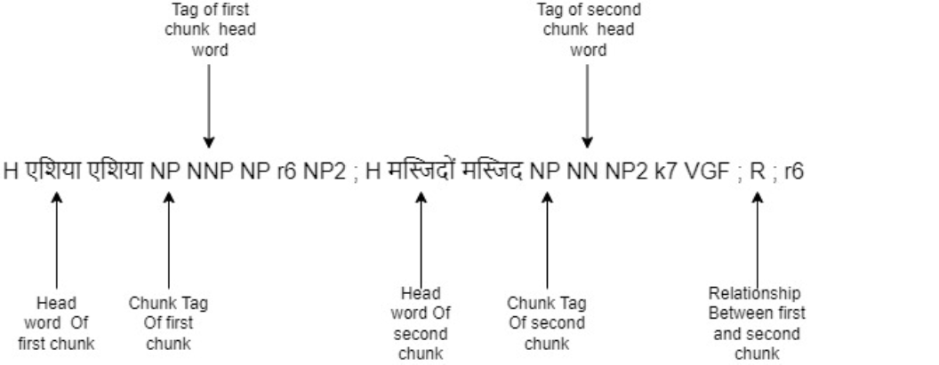
Feature are :
Head Word: The word that represent the chunk
POS tags : Tag of head word of chunk
Chunk Tags: Tag of Chunk

Slide 14
Classifiers and their Results that are used based on Feature selected:
S.No
Classifiers with features
Accuracy
1.
Chunk LRU
0.77
2.
POS LRU
0.72
3.
POS Chunk LRU
0.76
4.
Word LRU
0.77
5.
Word Chunk LRU
0.78
6.
Word POS LRU
0.77
7.
Word POS Chunk LRU
0.78

Slide 15
Neural Network -Feedforward Neural Network (New Work):
This is the new work that we have done in this project
We're developing a Feedforward Neural Network (FFNN) for dependency parsing on Hindi language data. Our approach involves leveraging pre-trained word embeddings specifically tailored for Hindi, utilizing the "IndicNLP" embedding model.
chunk_tags": ["NP", "VGF", "BLK", "CCP", "JJP", "VGNN", "VGNF", "RBP", "NEGP", "ROOT"]
"pos_tags": ["NNP", "NN", "VM", "QC", "SYM", "PRP", "CC", "NST", "JJ", "WQ", "QF", "RB", "QO", "NEG", "ROOT"]

Slide 16
Use "IndicNLP" to easily create embeddings for Hindi words and their tags, of embidding size 100.
S.No
Model with features
Embedding
1.
Chunk LRU
one hot encoding
2.
POS LRU
one hot encoding
3.
POS Chunk LRU
IndicNLP_embedding
4.
Word LRU
IndicNLP_embedding
5.
Word Chunk LRU
IndicNLP_embedding
6.
Word POS LRU
IndicNLP_embedding
7.
Word POS Chunk LRU
IndicNLP_embedding

Slide 17
FFNN Results:
S.No
Model with features
Accuracy
1.
Chunk LRU
0.77
2.
POS LRU
0.76
3.
POS Chunk LRU
0.78
4.
Word LRU
0.80
5.
Word Chunk LRU
0.83
6.
Word POS LRU
0.82
7.
Word POS Chunk LRU
0.83

Slide 18
Advantages of FFNN over SVM:
Fixed Input Length
Efficient for Fixed-Length Inputs
Simple and Easy to Understand
Works with Large Datasets
Saves Memory

Slide 19
Analysis and Conclusions:
S.No.
Features
SVM Accuracy
FFNN Accuracy
1.
Chunk LRU
0.77
0.77
2.
POS LRU
0.72
0.76
3.
POS chunk LRU
0.76
0.78
4.
Word LRU
0.77
0.80
5.
Word Chunk LRU
0.78
0.83
6.
Word POS LRU
0.77
0.82
7.
Word POS Chunk LRU
0.78
0.83
Neural network consistently outperformed SVM in all combinations tested.
Highest accuracy (83%) for neural network was observed with Word POS Chunk LRU and Word Chunk LRU.
For SVM, highest accuracy (78%) was achieved with Word Chunk LRU, while the lowest (72%) was with POS LRU.
The neural network's lowest accuracy was 76% with POS LRU combination.

Slide 20
Reference
Transition-based Dependency Parsing with Rich Non-local Features https://aclanthology.org/P11-2033.pdf
Deep Biaffine Attention For Neural Dependency Parsin https://arxiv.org/pdf/1611.01734.pdf
Baseline http://web2py.iiit.ac.in/research_centres/publications/download/inproceedings.pdf
Transition parsing https://aclanthology.org/P11-2033.pdf
https://web.stanford.edu/~jurafsky/slp3/old_oct19/15.pdf
http://pages.di.unipi.it/attardi/Paper/LREC-PParsing.pdf
https://medium.com/data-science-in-your-pocket/dependency-parsing-associated-algorithms-in-nlp-96d65dd95d3e
Standford Documentationhttps://nlp.stanford.edu/software/nndep.html#:~:text=A%20dependency%20parser%20analyzes%20the,parse%20of%20a%20short%20sentence.&text=A%20Fast%20and%20Accurate%20Dependency%20Parser%20Using%20Neural%20Networks
https://indicnlp.ai4bharat.org/pages/home/
Dataset:
HDTB Data corpus taken from LTRC, IIIT Hyderabad https://ltrc.iiit.ac.in/treebank_H2014/

Slide 21
Thank You
We would like to express our sincere gratitude for your time and attention during this presentation. Your feedback and insights have been invaluable in shaping our project's direction.

