Slide 1

Presentation on CarSell24X7
Presented By
Mahesh
Engineering Intern at Skill-lync

Slide 2
CarSell24X7
CarSell24X7 is a responsive car selling website.
The technologies used in this project was HTML, CSS and JavaScript.
There are a few important sections in the project like Home section, Vehicles section, Services section, Featured section, Reviews section, Contact section etc.

Slide 3
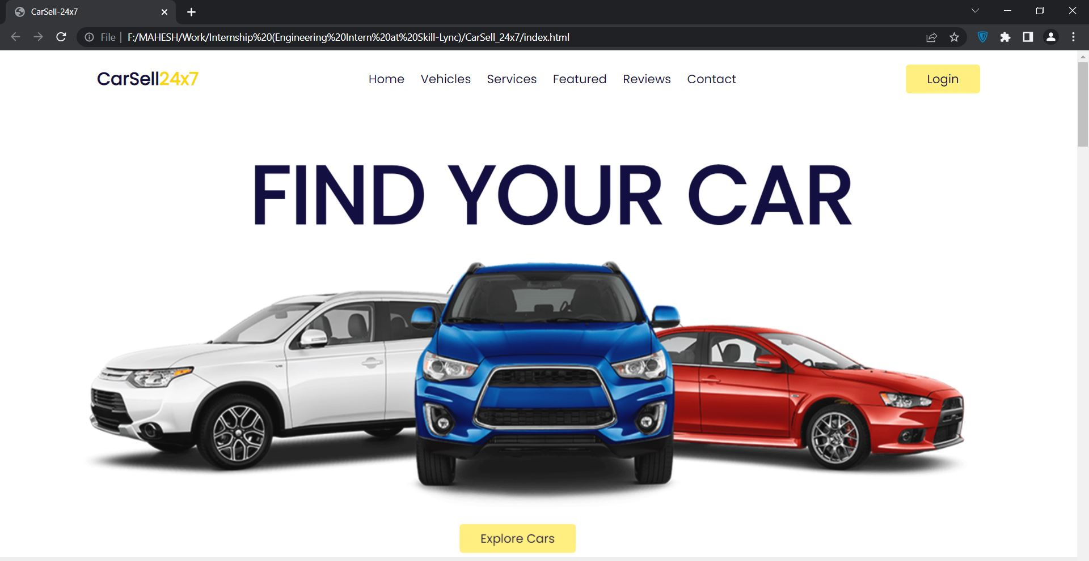
Home section

Slide 4
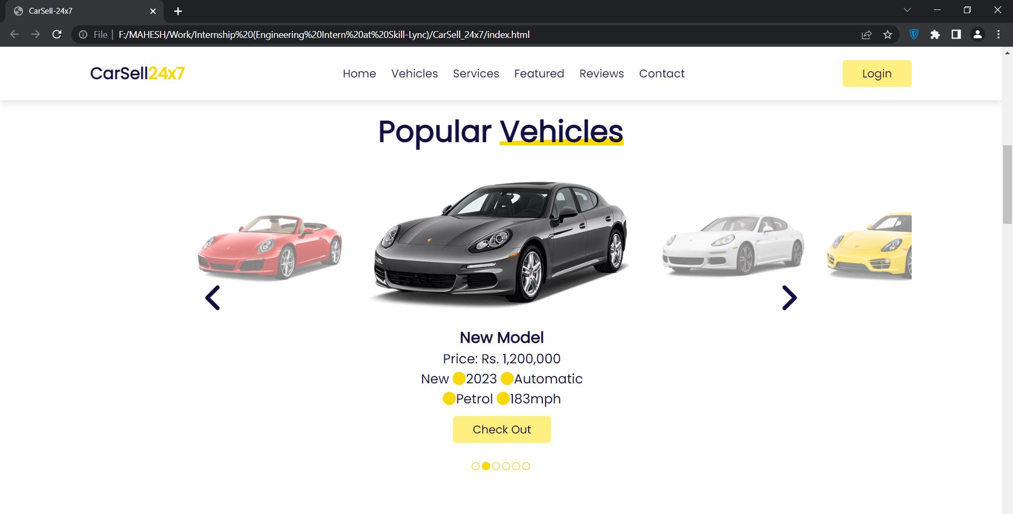
Vehicles section

Slide 5
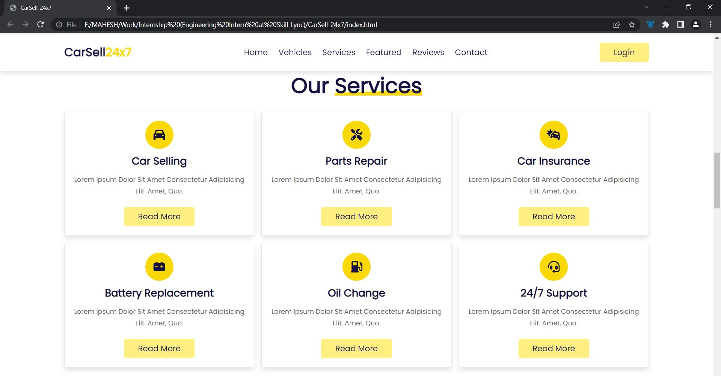
Services section

Slide 6
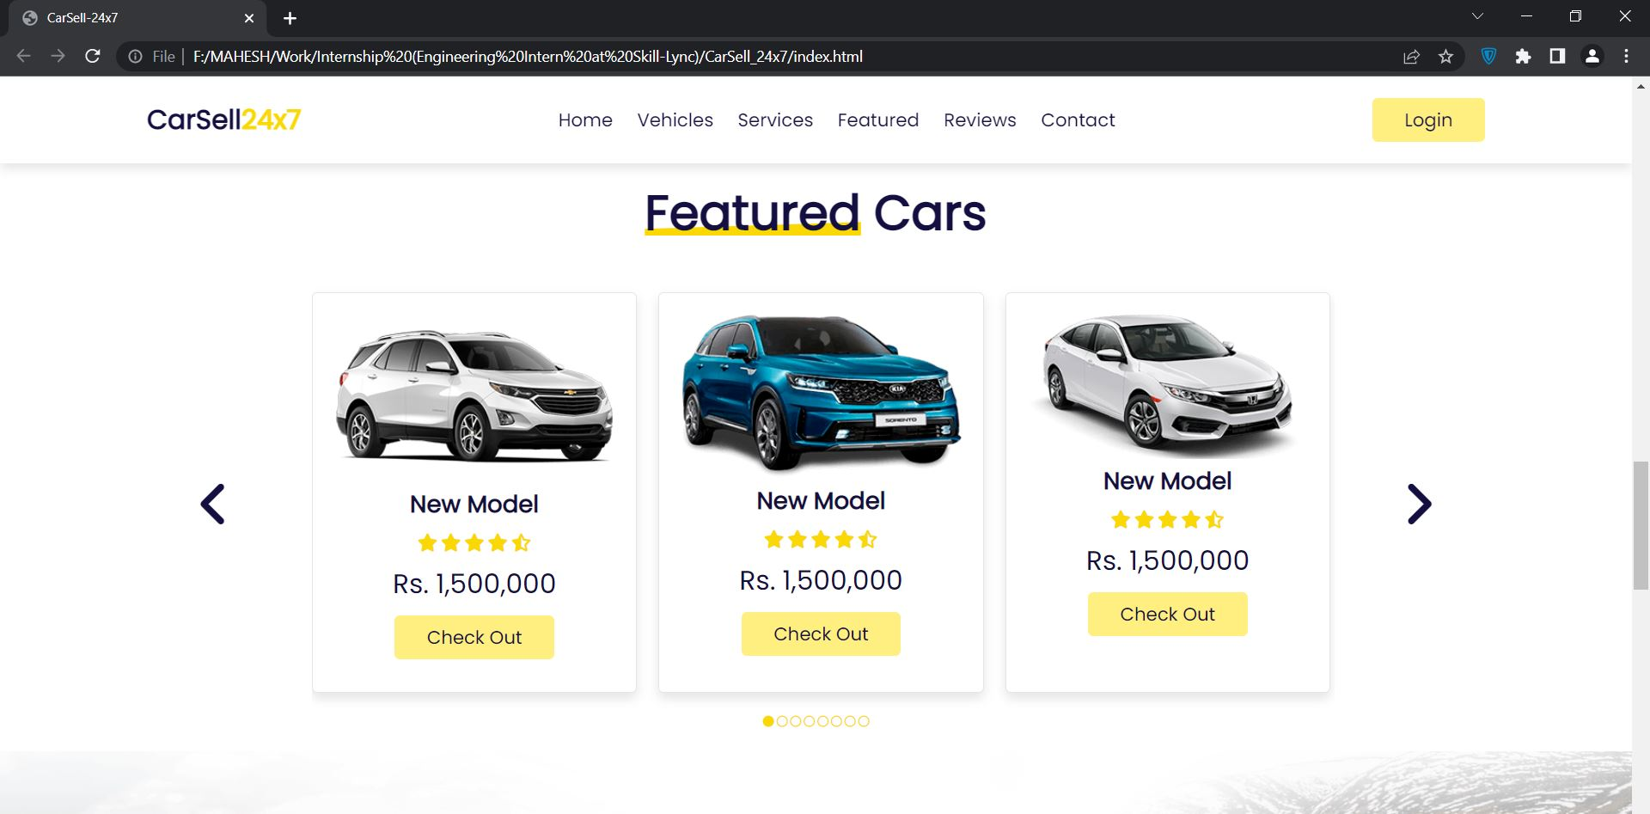
Featured section

Slide 7
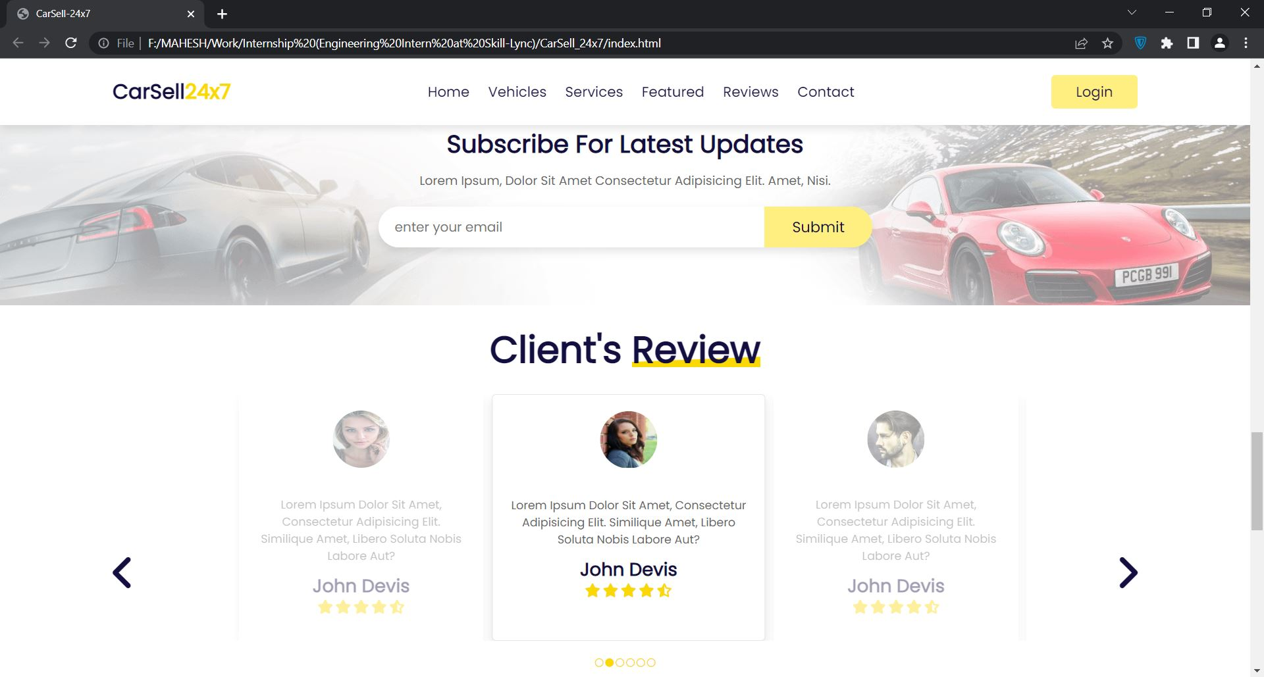
Reviews section

Slide 8
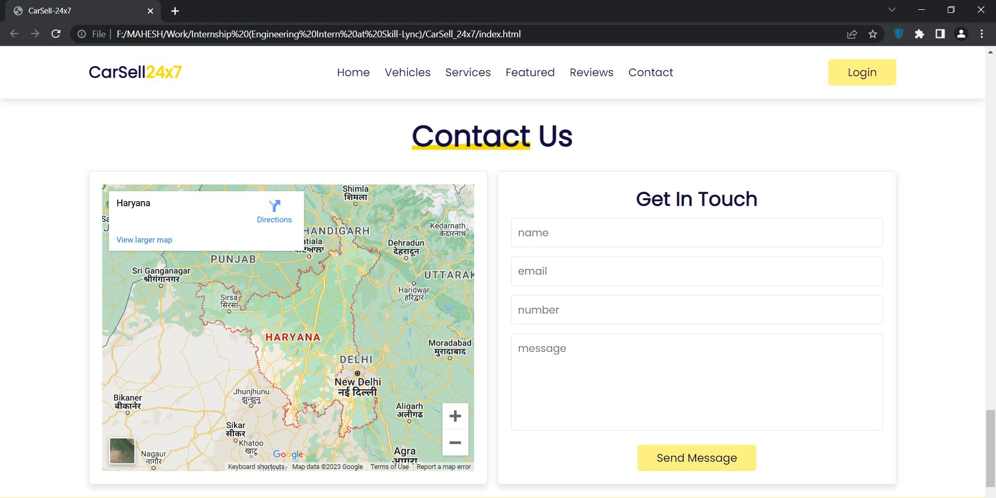
Contact section

Slide 9
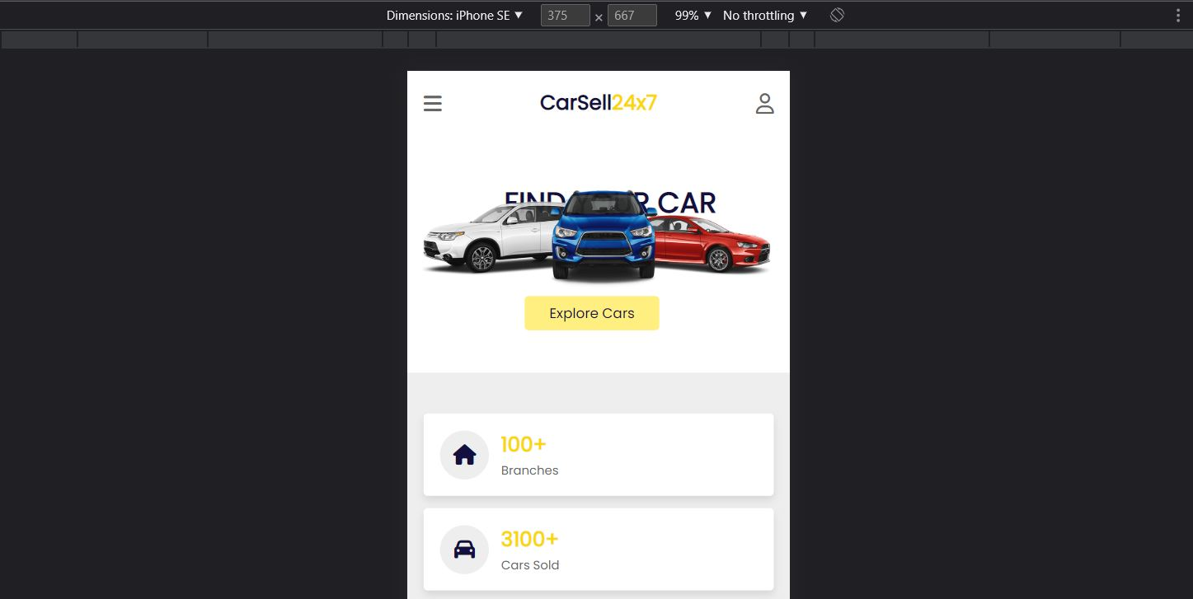
Responsive Web-Site (Moblie)

Slide 10
Thank You

