Slide 1
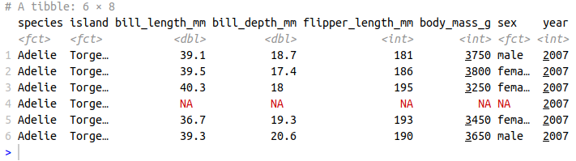
Homework
1. Use “palmerpenguins” dataset in R and do as requested:
install.packages("palmerpenguins")
library(palmerpenguins)
dim(penguins)
head(penguins)
a. Calculate the variance of "body_mass_g" and use the tapply function to calculate the variance of "body_mass_g" by species.
b. Calculate the covariance and correlation between "body_mass_g" and "flipper_length".
c. Check if the body mass of penguins is normally distributed (plot and statistic).
d. Determine if there is any statistical difference in body mass between gender groups.
e. Determine if there is any statistical difference in body mass among the penguin species groups.

Slide 2
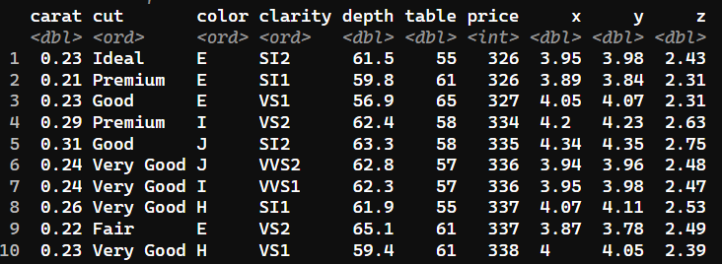
2. Install packages “gcookbook”, open dataset “diamonds” in R and do as requested: a. Check if the depth and price of diamonds having Ideal cut and premium cut are normally distributed (plot and statistic) b. Determine if there is any statistical difference in depth between Ideal and premium cut. c. Determine if there is any statistical difference in price between Ideal, premium and Fair cut

