Slide 1
3. Download file

Slide 2
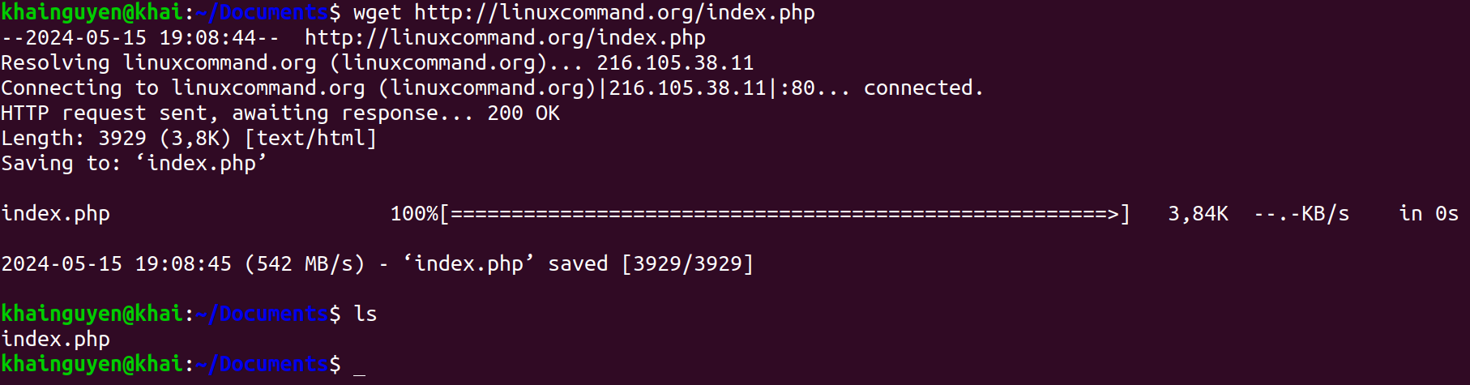
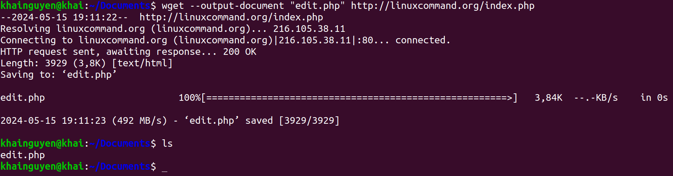
Download file
wget command: Downloader
Default: Download file from a URL
--output-document option: download file from URL, with a different name

Slide 3
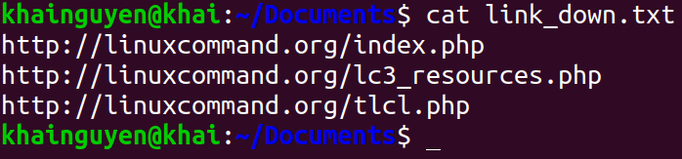
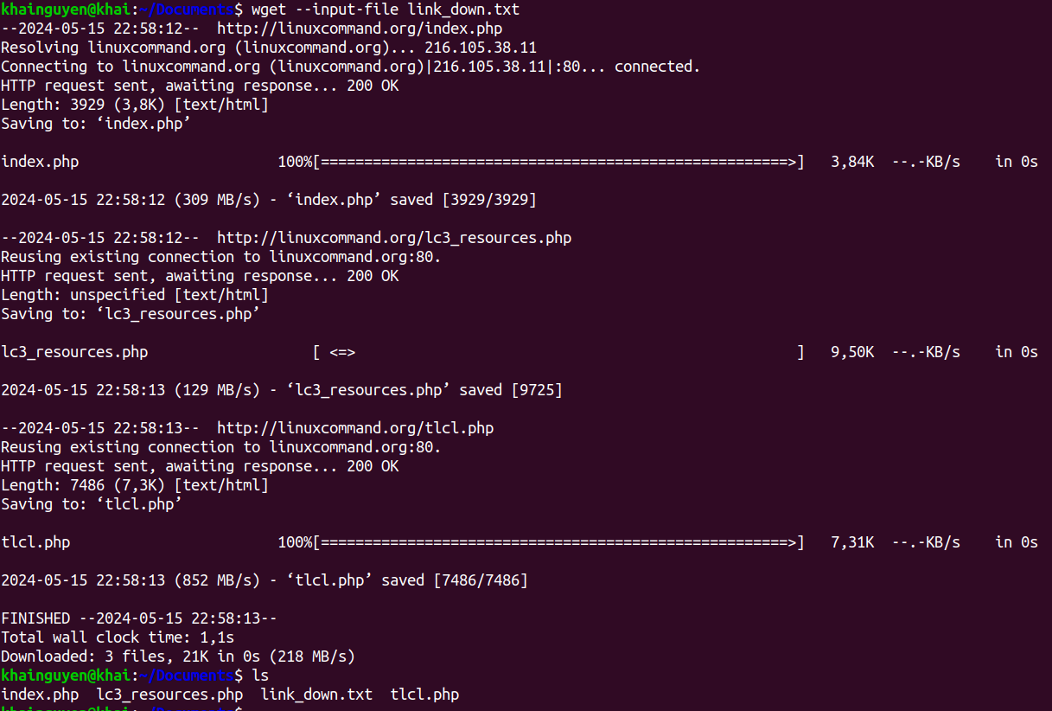
Download file
--input-file option: download from multiple URL
1. Create a text file containing URLs, each line includes a URL, use: nano.
2. wget --input-file link_down.txt

Slide 4
4. File permission

Slide 5
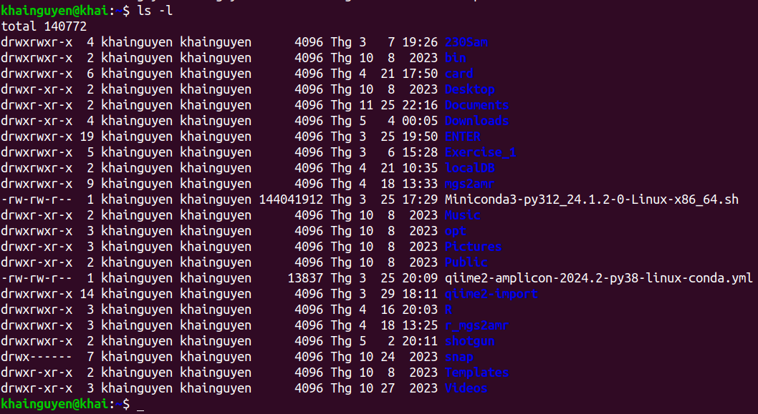
When run: ls -l
user (or owner)
permission
other
permission
Owner of file
(user_name)
user group
group
permission
snap directory
- User permission: read (yes), write (yes), execute (yes).
- Group permission: read (no), write (no), execute (no).
- Other permission: read (no), write (no, execute(no).
Meaning of r, w, x, -:
r = readable
w = writeable
x = executable
- = denied
Templates directory
- User permission: read (yes), write (yes), execute (yes).
- Group permission: read (yes), write (no), execute (yes).
- Other permission: read (yes), write (no), execute (yes).

Slide 6
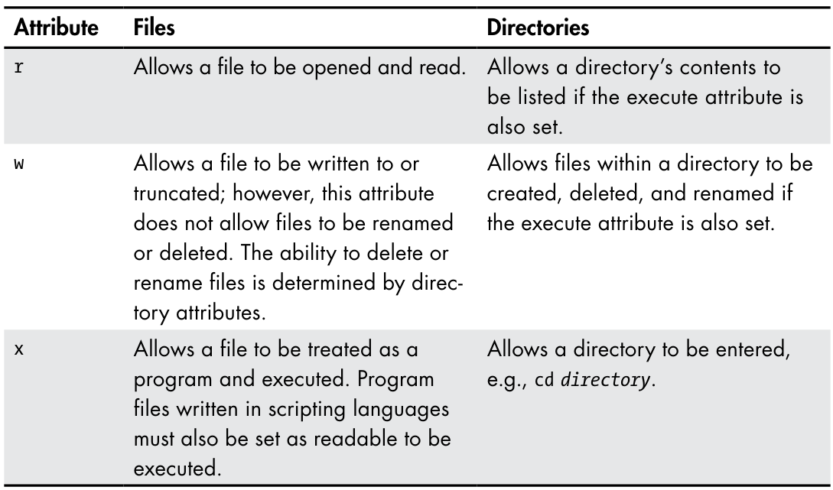
Permission Attributes
https://shorturl.at/prOPY

Slide 7

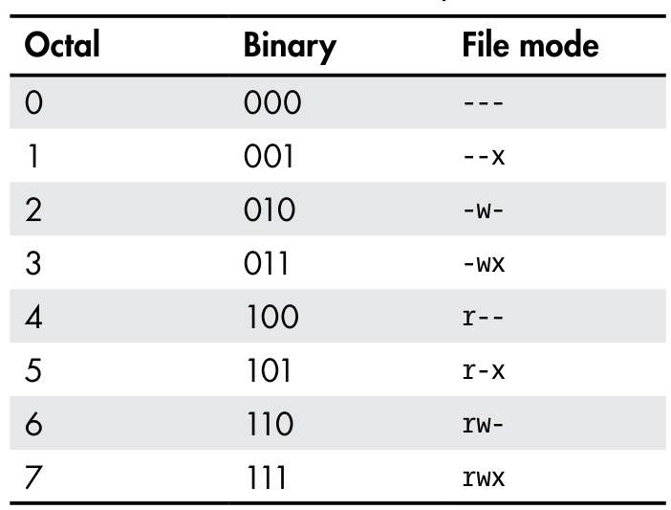
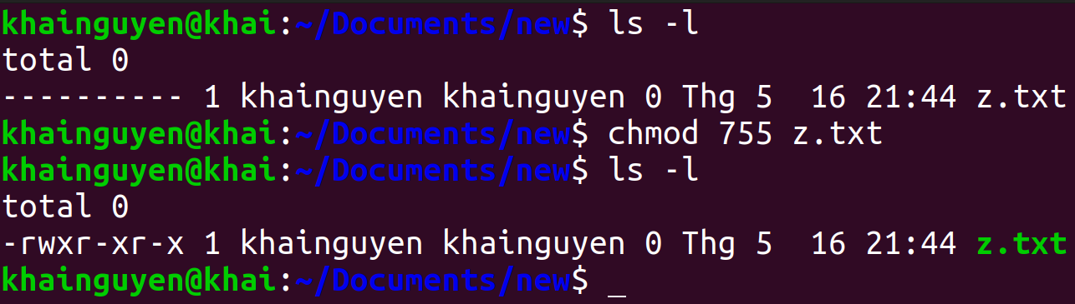
chmod: Change File Mode
To change the mode (permissions) of a file or directory, use the chmod command.
chmod supports two distinct ways of specifying mode changes:
1. Octal number representation
rwx
(user)
r-x
(group)
r-x
(other)
File Modes in Binary and Octal
https://shorturl.at/prOPY

Slide 8
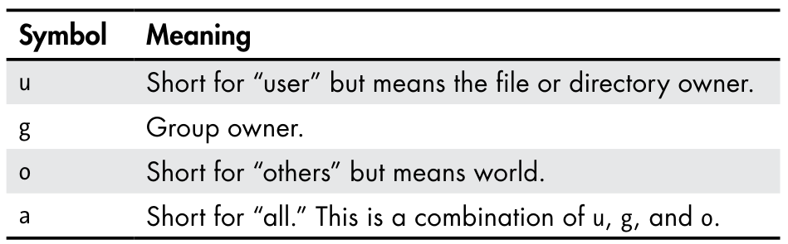
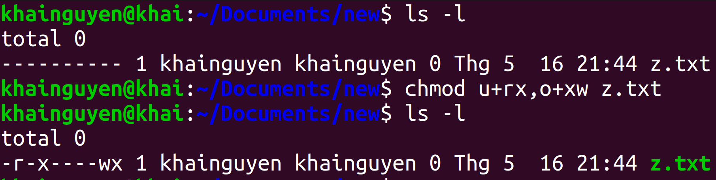
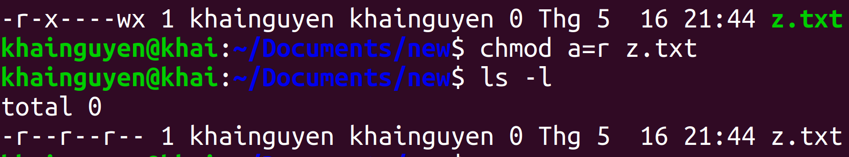
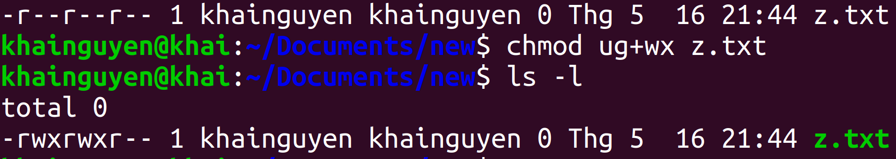
chmod: Change File Mode
2. Symbolic representation
chmod Symbolic Notation
If no character is specified, “all” will be assumed.
+ a permission is to be added.
- a permission is to be taken away.
= only the specified permissions are to be applied and that all others are to be removed.
Permission:
r readable
w writeable
x executable
https://shorturl.at/prOPY

Slide 9
5. Compress and decompress

Slide 10
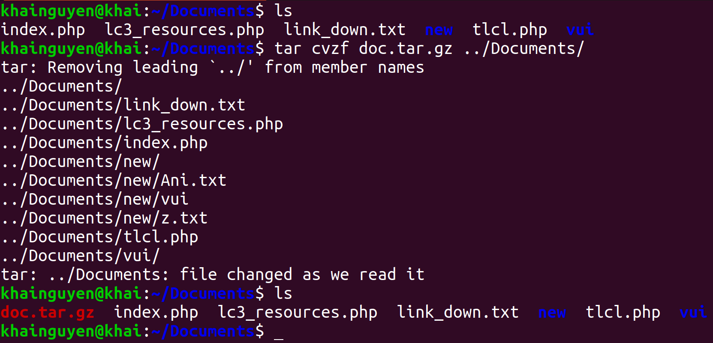
Compress and decompress
tar command: compress and decompress
Compress all files and directories in the “Documents" directory to a compressed file named “doc.tar.gz"
-c --create: create a new archive file
-z, --gzip: Using gzip to compress
-f or --file: compressed file name
-v or --verbose: Verbosely list files processed
The four options "-c -v -z -f" can be written as "cvzf"

Slide 11
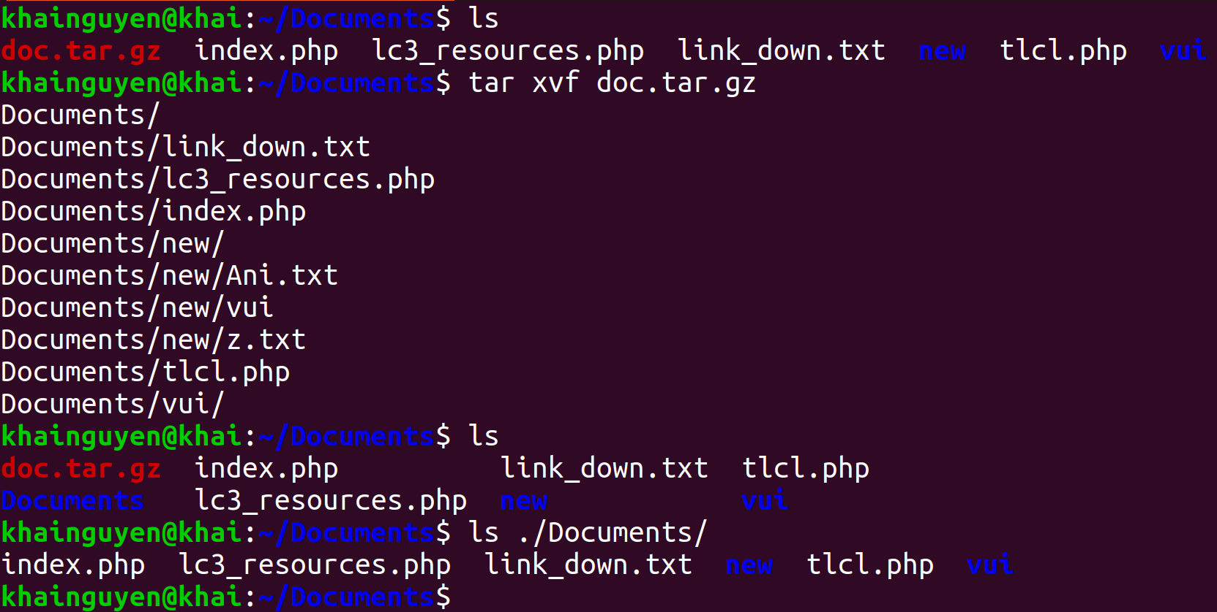
Compress and decompress
Decompress a compressed file named “doc.tar.gz"
-x, --extract: Extract files from an archive.

Slide 12
Summary
find | search for files or directories in a directory
head | prints the first few lines in the file
tail | prints the last few lines in the file
wc | print newline, word, and byte counts for each given file
cut | Print selected parts of lines from each FILE
grep | print lines that match patterns

Slide 13
Summary
| | pipe
“>”, “>>” | output redirection
“<” | input redirection
wget | download file from <link>
chmod | Change File Mode
tar | compress and decompress

Slide 14
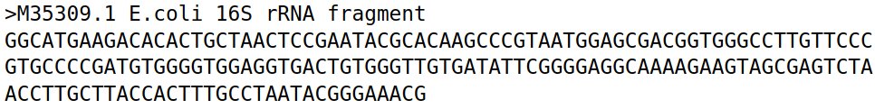
Homeworks
1. Create a directory named “hw2".
2. Move to “hw2" directory, and download this file (SRR25653406.fasta.tar.gz) using wget command:
https://github.com/UeenHuynh/MGMA_2024/raw/main/lecture2/2.%20basic%20Linux%20commands%20part%202/SRR25653406.fasta.tar.gz
3. Decompressing this file SRR25653406.fasta.tar.gz using tar command.
Additional information about FASTA format (The file has the extension .fasta, .faa, .fna, etc.):
FASTA format is a text-based format, contains two lines:
- First line: is the comment (description) line.
+ Always starts with “>” sign (This information is useful for the exercise).
+ Give basic information about the sequence (nucleotide or amino acid).
- Second line: The actual sequence of the first line description, using a standard one-letter character string.
Example:
(https://www.ncbi.nlm.nih.gov/nuccore/M35309.1?report=fasta)
=> Let's call this single-sequence FASTA format (https://en.wikipedia.org/wiki/FASTA_format), so if a text file contains a single-sequence FASTA format, this file is called a single-sequence FASTA file.
If a text file contains two or more single-sequence FASTA format, this file is called a multiple-sequence FASTA file or multi-FASTA file.

Slide 15
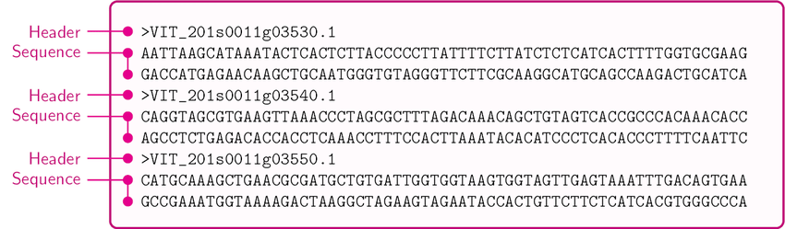
Homeworks
An example of multi-FASTA format :
(https://www.researchgate.net/figure/A-sample-of-the-Multi-FASTA-file_fig1_309134977)
Additional information for this file: SRR25653406.fasta (after decompressing using tar command).
- This is a multi-FASTA file. It is converted from fastq to fasta format file (Don't worry about fastq format in this exercise), the original fastq format file is obtained from the sequencing machine.
- Each single-sequence FASTA in this file is information about a read - a piece of DNA sequence obtained from the sequencing machine:
+ First line: some information about the sequencing platform of this file, that's all, don't worry about the details.
+ Second line: DNA sequence of that read, a character string consisting of 4 types of letters: A, T, G, C representing 4 types of nucleotides. In addition, there is the letter N, which means 1 of 4 possible types of nucleotides, because the sequencing machine cannot identify which type of nucleotide it is.

Slide 16
Homeworks
A single-sequence FASTA in this file:
(The DNA sequence has 2 lines because the screen is not enough to display 1 line, so it is split into 2 lines)
4. How many lines does this file have? Using: wc.
5. How many reads does this file have? Using: grep for the search “^>” means the line starts with the character ">", and -c option.
6. How many reads do not have any N? Using: grep with -v, -c option; pipe.
7. Create a file named "id_read.txt" containing only the first line (the line contains information) of all reads. Using: grep with “^v"; output redirection.

Slide 17
Homeworks
8. Create a file named "part_of_id_read.txt" containing a part of the first line (the line contains information) of all reads. Using: grep; pipe; cut; output redirection.
Two lines of 1 read:
(The line containing the DNA sequence has 2 lines because the screen is not enough to display 1 line, so it is split into 2 lines).
a part of the first line of 1 reads:

