Slide 1
2. Some basic Linux commands work with files and directories

Slide 2
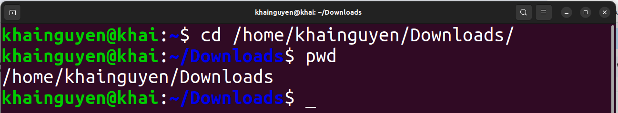
change working directory
cd command, an abbreviation for ‘change directory’.

Slide 3
Path shortcuts
~ the home directory of the currently logged in ‘user_name’
/ the root directory
. the current directory (or the working directory)
.. the parent directory of the working directory
../.. the parent directory of the parent directory of the working directory

Slide 4
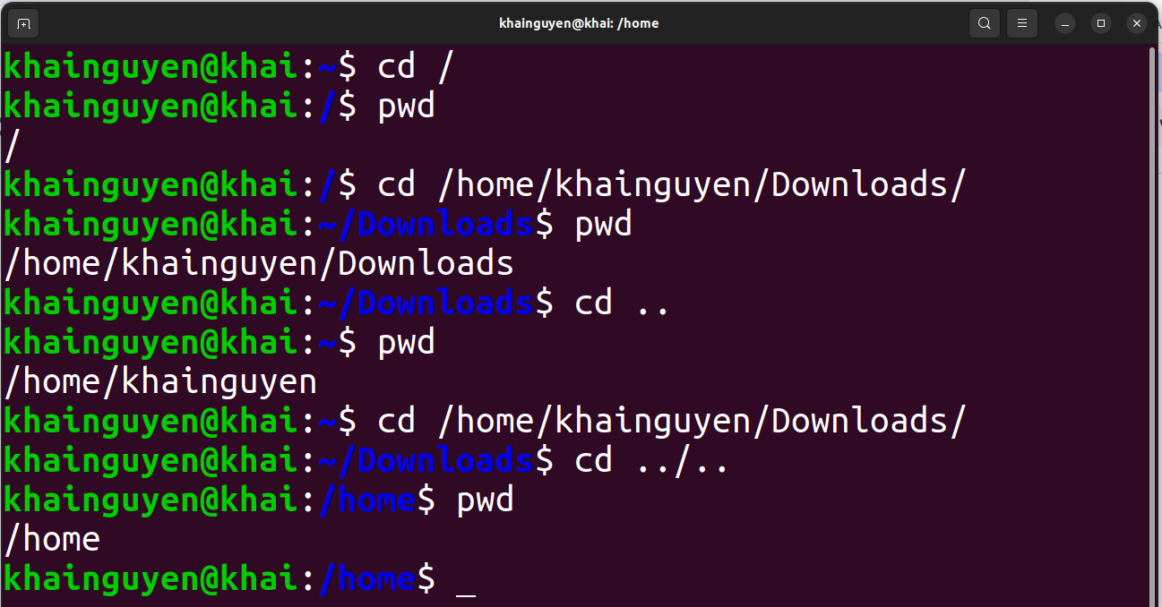
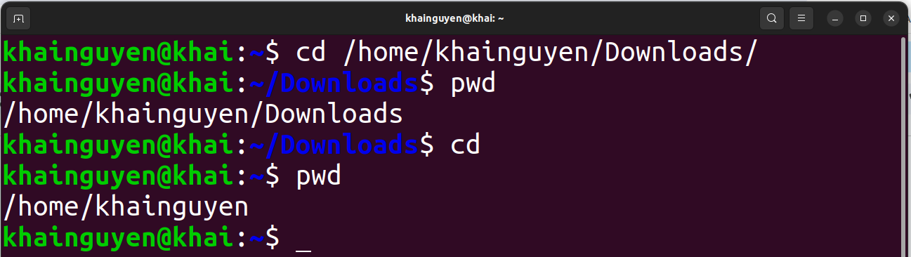
just cd to change to ~

Slide 5
Absolute path: from the root directory to the interest directory/file.
Relative path: from the working directory to the interest directory/file.
Absolute path
Relative path

Slide 6
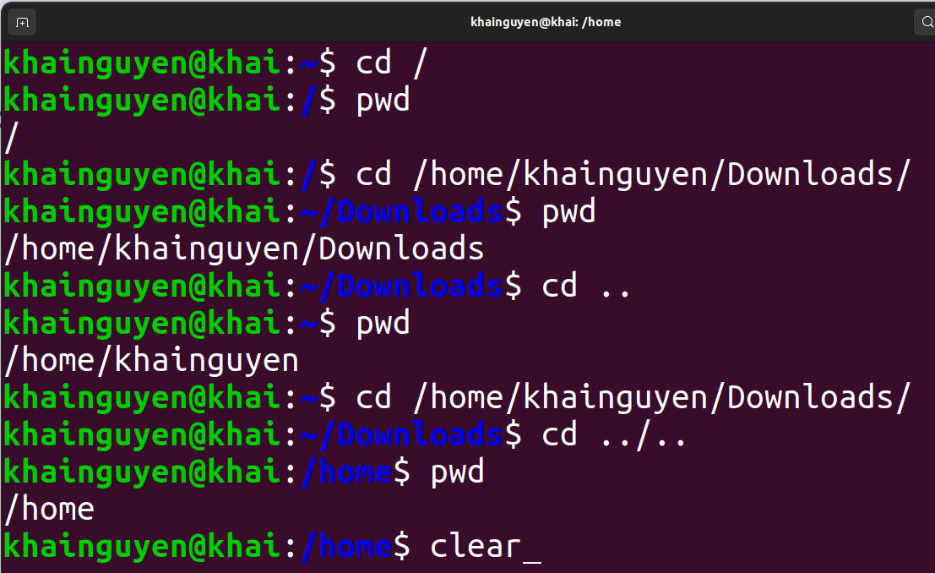
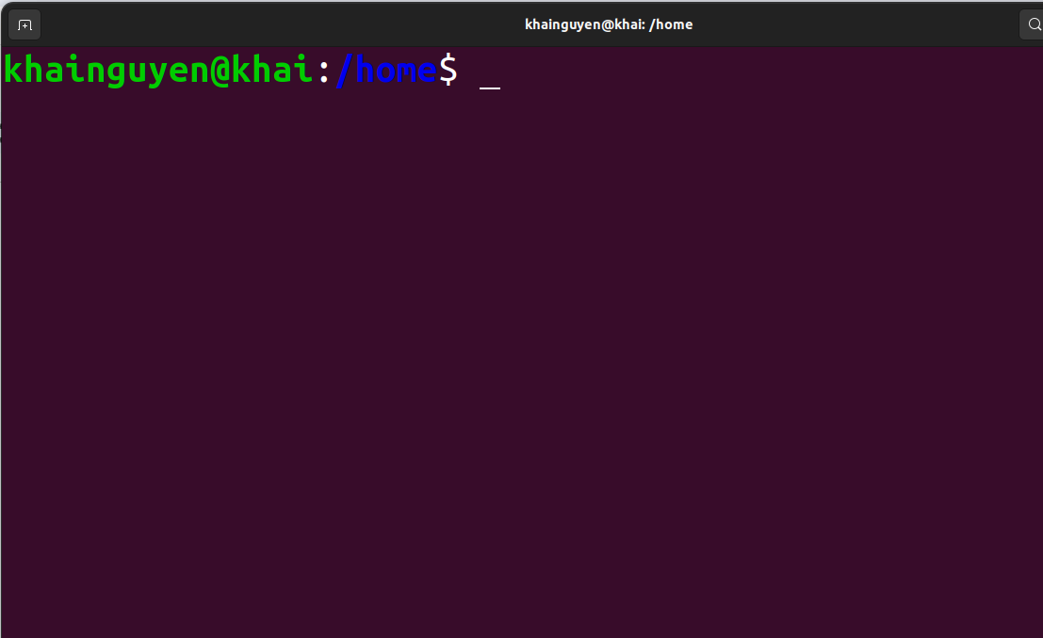
Clean up all the command lines and results above, with command: clear
ENTER
or using: Ctrl-L

Slide 7
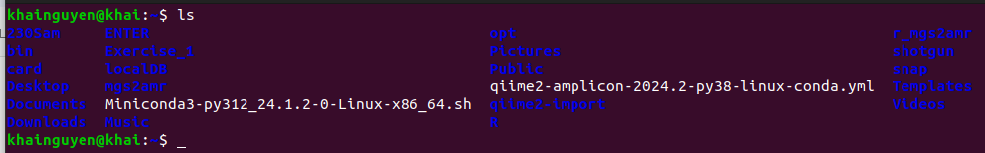
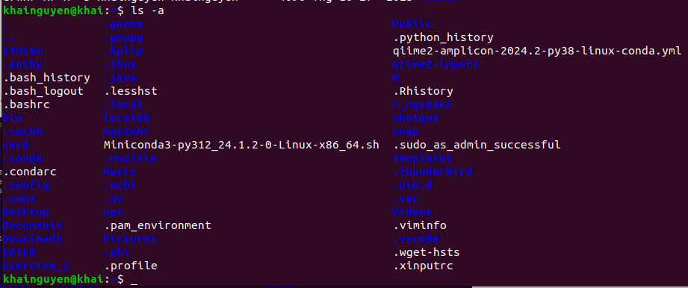
Listing content (files and subdirectories) of a directory
with command: ls (“ls" stands for “list”)
list files and directories in current directory (in short format):
ls
list all files and directories in current directory (in short format):
ls -a
or
ls --all
ls --help

Slide 8
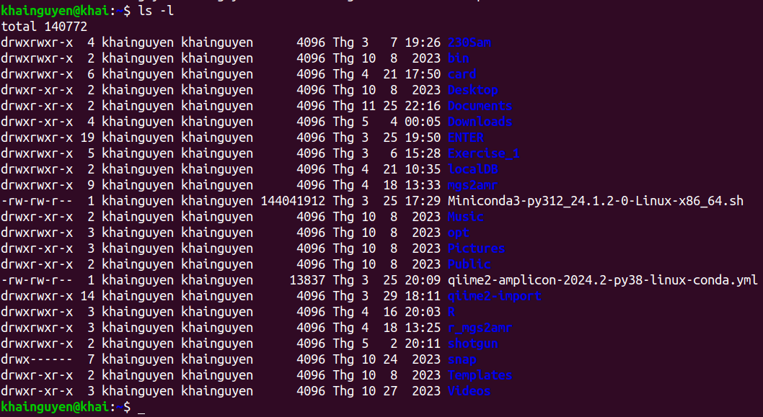
list files and directories in current directory (in long format):
ls -l
ls --help

Slide 9
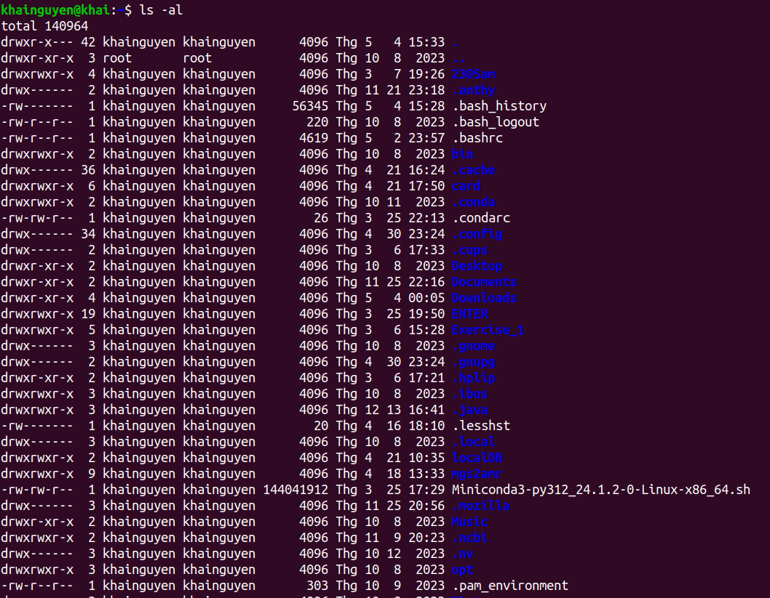
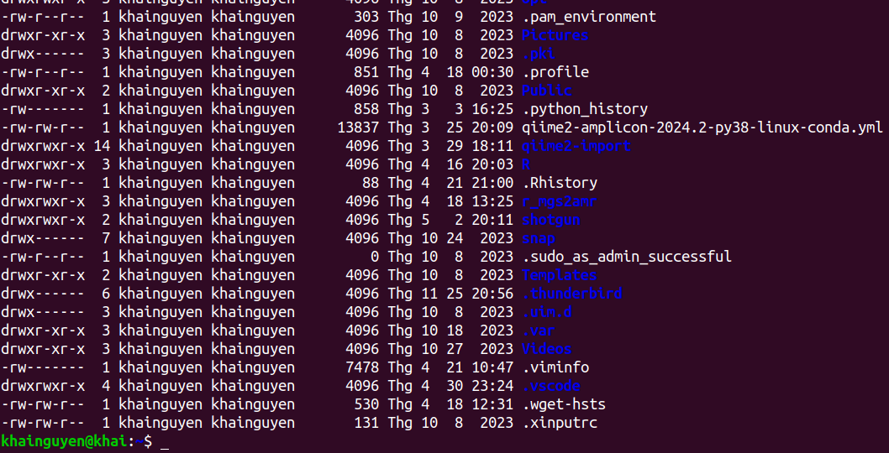
list all files and directories in current directory (in long format):
ls -al

Slide 10
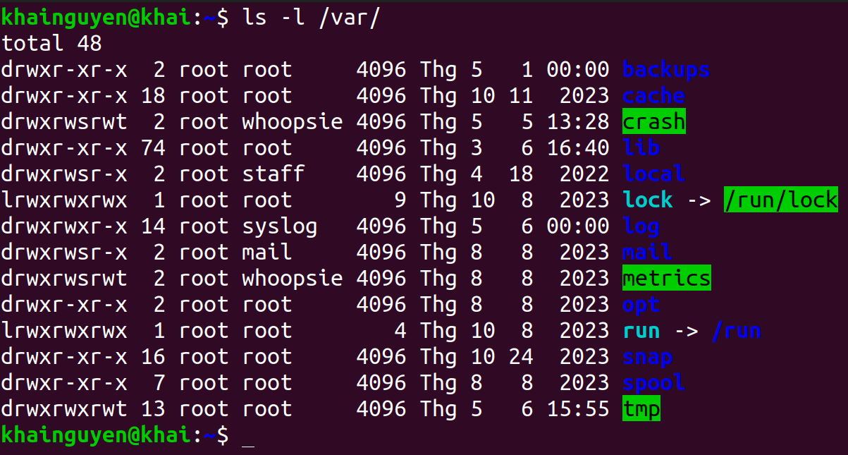
list files and directories in another directory (in long format):
ls -l path_to_directory

Slide 11
File type:
“d” means this is a directory
Permissions
Owner of file
(user_name)
user group
size
(in bytes)
Last modification time
directory/file name
number of hard links

Slide 12
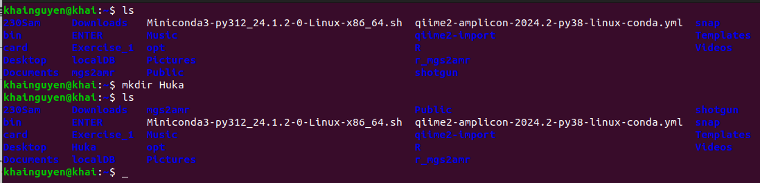
Create and remove directory
Create a directory named “Huka” in the current directory (~) , with the command: mkdir
mkdir Huka
or
mkdir ./Huka
“mkdir” stands for “make directory”
Run “ls" to check
a new directory is created

Slide 13
Create and remove directory
Create three directory named “Huki”, “Huka", “Huke" in the current directory
mkdir Huki Huka Huke
Delete a empty directory named “Huka” in current directory, with command: rmdir
rmdir Huka
“rmdir” stands for “remove directory”
Delete a non-empty directory named “Huka” in current directory, with the command “rm”, option -r:
rm -r Huka
or
rm -R Huka
or
rm --recursive Huka/
“rm” stands for “remove”
rm --help

Slide 14
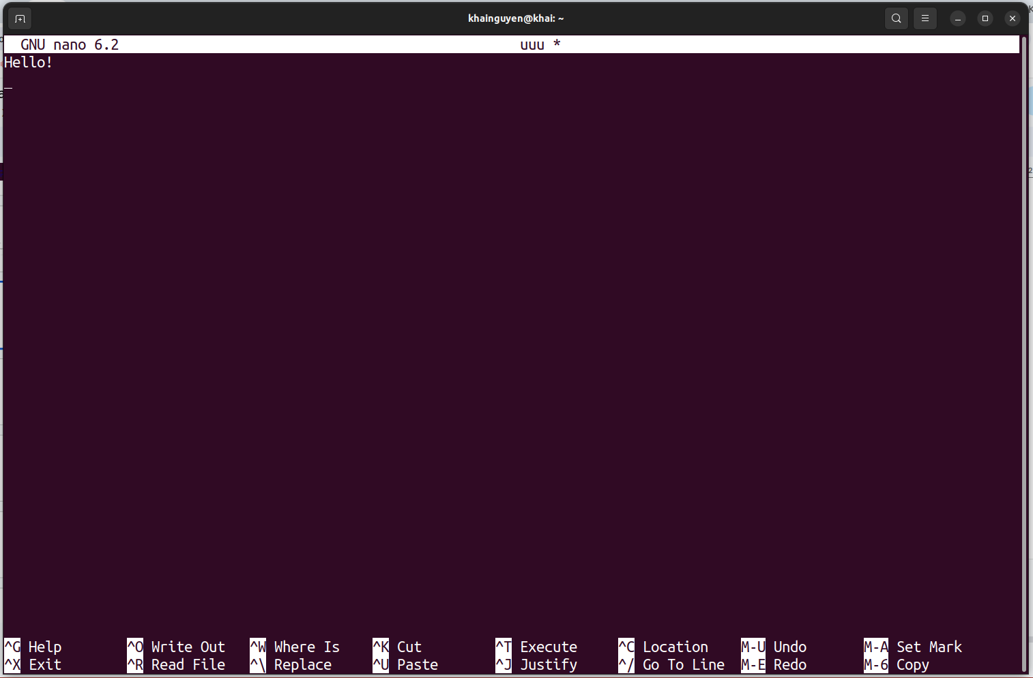
Create and remove file
Create and edit text file with nano, a text editor
1. Create a text file named “uuu" (“uuu” doesn't exist):
nano
or
nano uuu

Slide 15
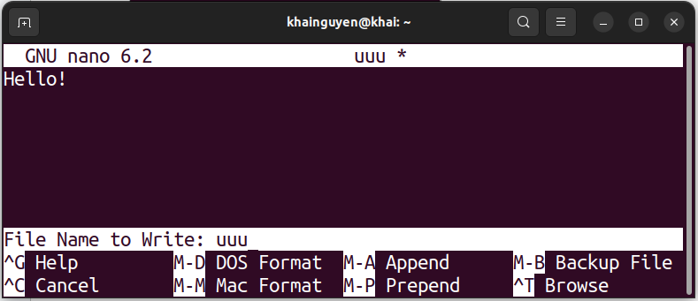
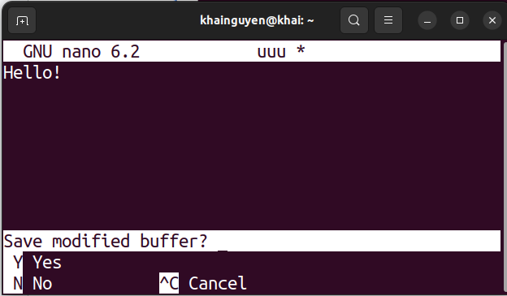
2. Exit nano: ctrl + x
3. Type “y" to save:
Edit the file name if you don't want the name "uuu"
4. Finish: press ENTER key
We can view the file “uuu" with nano by run (if the file exist in current directory):
nano uuu
Create a empty file named “uuu", with “touch” command :
touch uuu
rm uuu
Delete a (empty or non-empty) file named “uuu” in current directory, with the command “rm”:

Slide 16
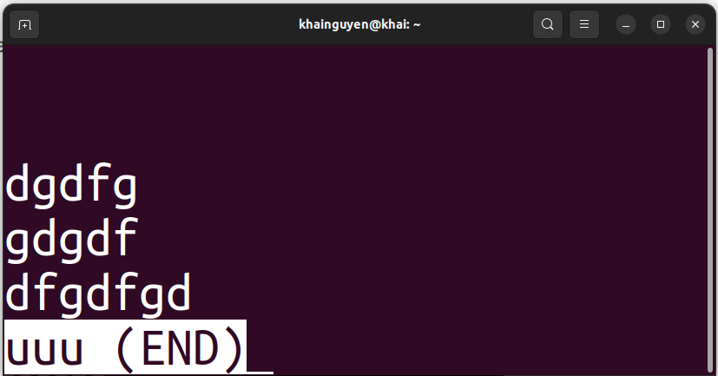
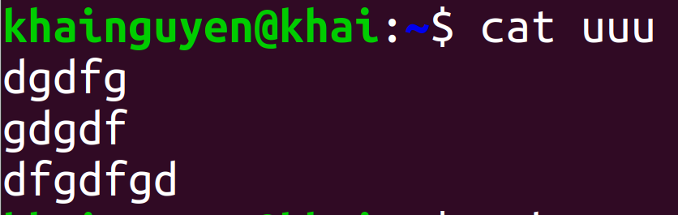
View the file with another commands
View the file with command: less
ENTER
press “q" key to quit
View the file with command: cat

Slide 17
Copy and move file/directory
Copy a file named “uuu” in the current directory to ./Download/, with command: cp
cp ./uuu ./Download/
“cp” stands for “copy”
Copy three the file named “uuu”, “iii", “yyy" in the current directory to./Download/
cp ./uuu ./iii ./yyy ./Download/
or
cp uuu iii yyy ./Download/
or
cp ./{iii,yyy,uuu} ./Downloads/
Create a copy of the file named "uuu" with a different name "ooo" in the current directory
cp ./uuu ./ooo
Copy a empty directory named “Huka” in the current directory to ./Download/
cp ./Huka/ ./Download/
note again: ./ means the current directory

Slide 18
Copy and move file/directory
Copy a non-empty directory named “Huka” in the current directory to ./Download/
cp -r ./Huka/ ./Download/
Move a file named “uuu” in the current directory to /home/khainguyen/Download/, with command: mv
mv ./uuu ./Download/
“mv” stands for “move”
Move a empty directory named “Huka” in the current directory to /home/khainguyen/Download/
mv ./Huka/ ./Downloads/
if Huka/ is a non-empty directory, add -r option:
mv -r ./Huka/ ./Downloads/
Rename a file named “uuu” to “eee":
Rename a directory named “Huka” to “Huko":
mv ./uuu ./eee
mv ./Huka/ ./Huko/

Slide 19
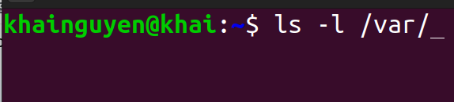
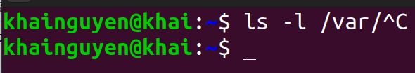
Shortcuts:
∙ Ctrl-C stops the current in-progress command and/or
Ctrl-C
∙ Up arrow key: shows previous commands
∙ history command: will show the history of commands you have run.

Slide 20
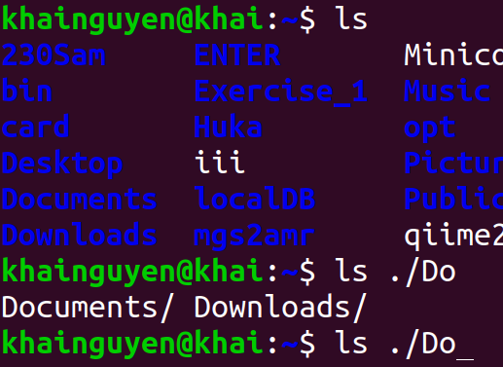
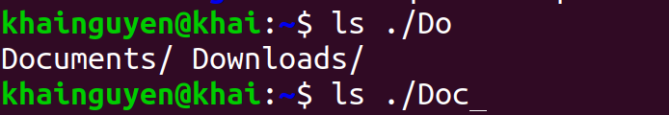
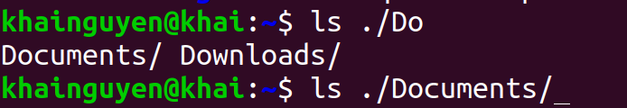
Shortcuts:
∙ Ctrl-A moves the cursor to the beginning of the line.
∙ Ctrl-E moves the cursor to the end of the line.
∙ Tab key automatically completes commands.
type “c"
have the same “Do”
press tab
press tab a second time
∙ Ctrl-D exit the terminal.

Slide 21
Summary
pwd | print working directory (or current directory) path
cd | change working directory
ls | Listing content (files and subdirectories) of the directory
clear | clean up all the command lines and results above
mkdir | create the directory
rmdir | delete the empty directory
rm | delete file
rm -r | delete non-empty (or empty) directory, delete file

Slide 22
Summary
nano | a text editor: create, view, edit the text file
touch | create the empty file
less | view text file page by page
cat | Print the content of the text file to the terminal
cp | copy file/directory
mv | move file/directory, rename file/directory
man command_name | Instructions for using the command
command_name --help

Slide 23
Homework
Move to the “Documents” directory in “user_name" directory in home directory. Use: cd
Solve the questions below while still in the “Documents” directory
Create 01 directory named “bio1” in “Documents” directory. Use: mkdir
Create 01 file named “chr1” in “bio1" directory. Use: touch or nano
Create 02 directories named “bio2” and “bio3” in “Documents” directory, with one command line. Use: mkdir
Create: 2 files named “chr2” and “chr3” in “bio2" directory, 2 files named “chr4” and “chr5” in “bio3" directory, with one command line. Use: mkdir
Copy “chr2" file into “bio1" directory, with a different name “c2". Use: cp
Delete all newly created files and folders above, with one command line. Use: rm -r
Answers will be sent on 22/05/2024

