Slide 1

Chúc Phụ Nữ Việt Nam luôn vui tươi xinh!

Slide 2
MGMA 2024 Long Read Microbiome
20 Oct 2024
Phuc Loi Luu, PhD
Luu.p.loi@googlemail.com

Slide 3
Content
Projects find home
PacBio and ONT present their microbiome platforms
ONT: De novo assembly + mapping + variant calling
PacBio: 16S Full-length

Slide 4
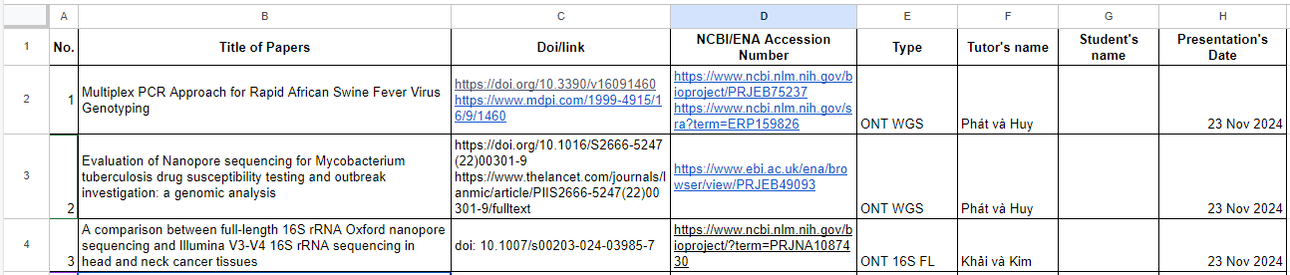
Projects find home
Each group select a project either ONT WGS, ONT full length 16S, ONT shotgun, PacBio WGS, PacBio full length 16S and PacBio shotgun
One or 2 or 3 students per group
Presentation’s day: 23/11/2024 (30 min = present 20 min + Q&A 10 min)
List of Projects and register at
https://docs.google.com/spreadsheets/d/1M_KTe991iK4zjKD3HL1fmI-FMEHXirKvB65XYLUnVbI/edit?gid=0#gid=0

Slide 5
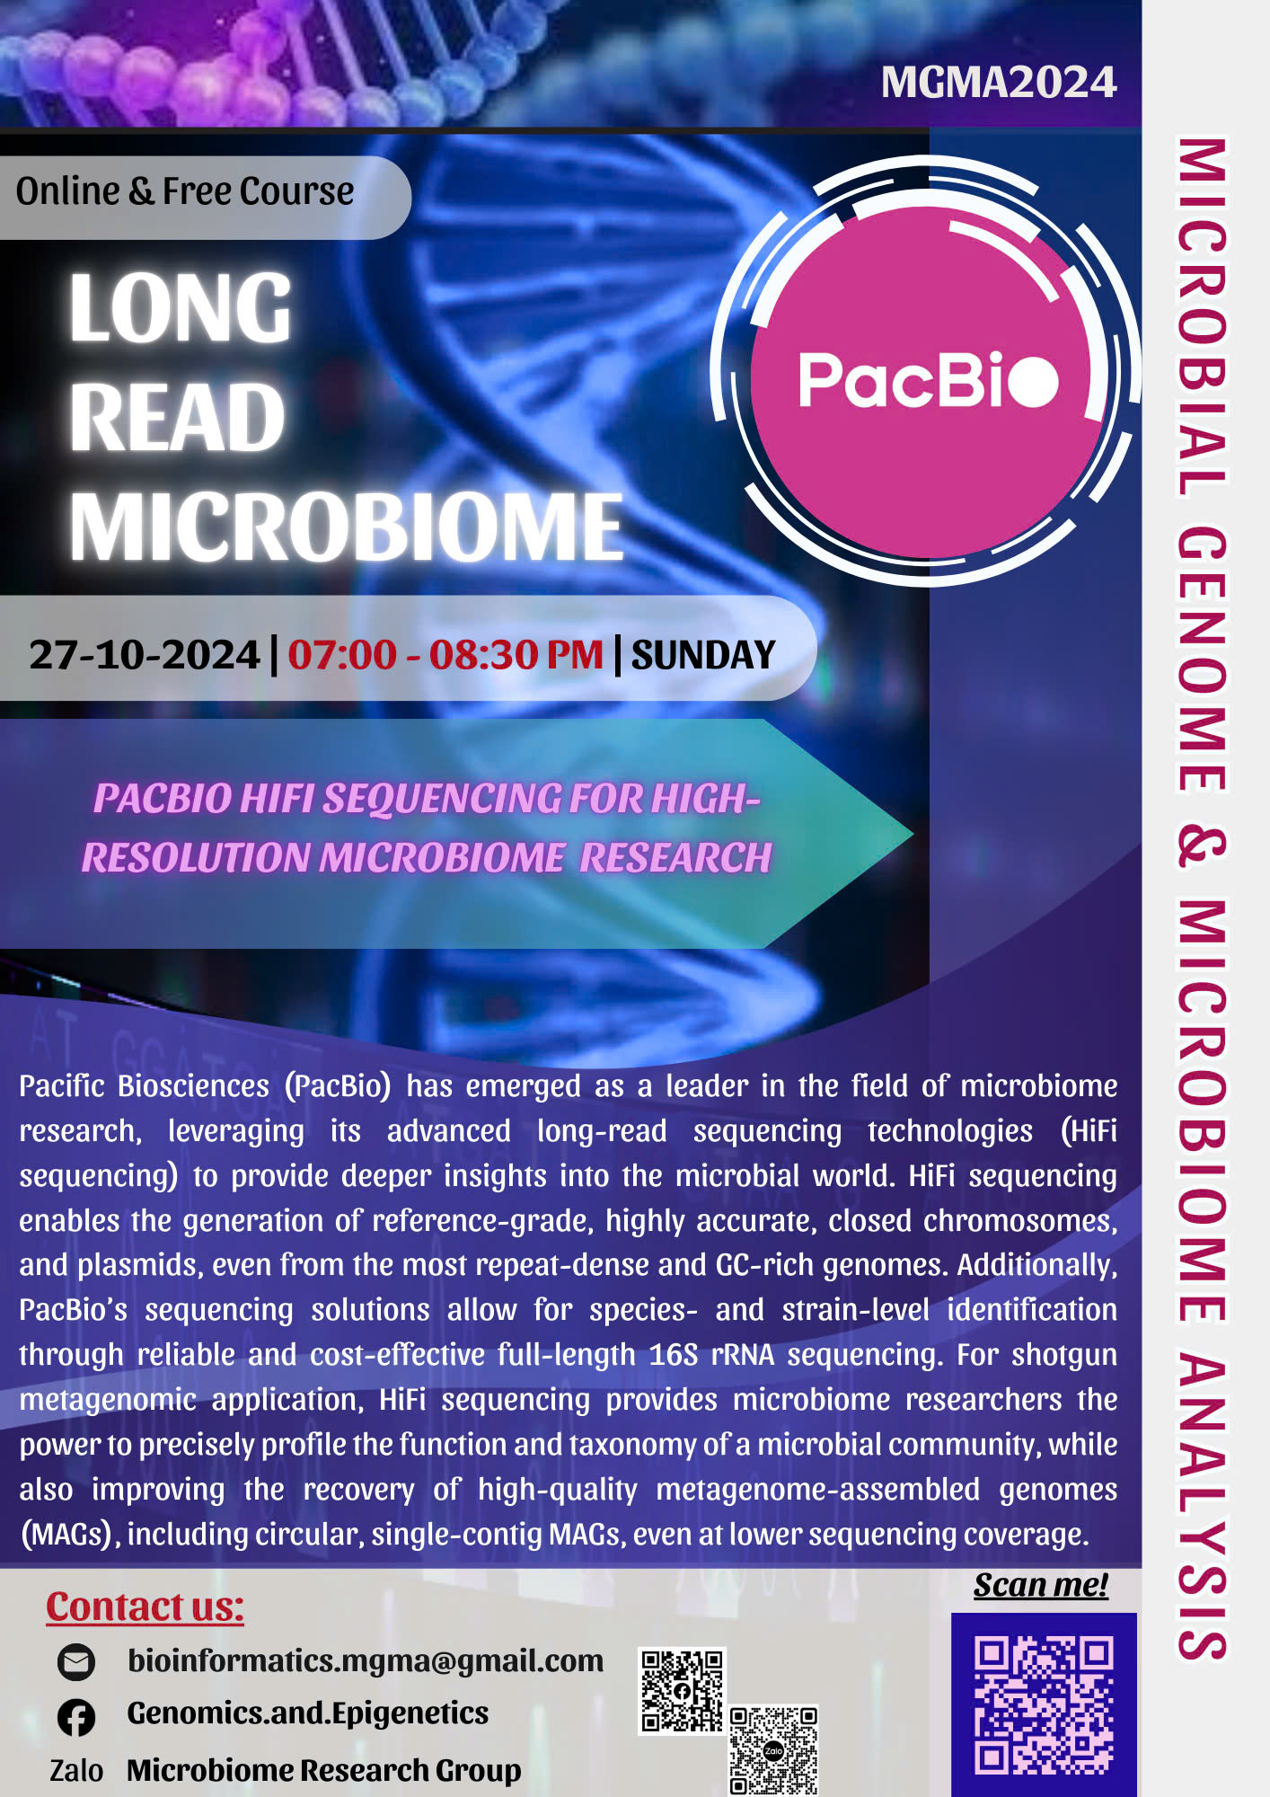
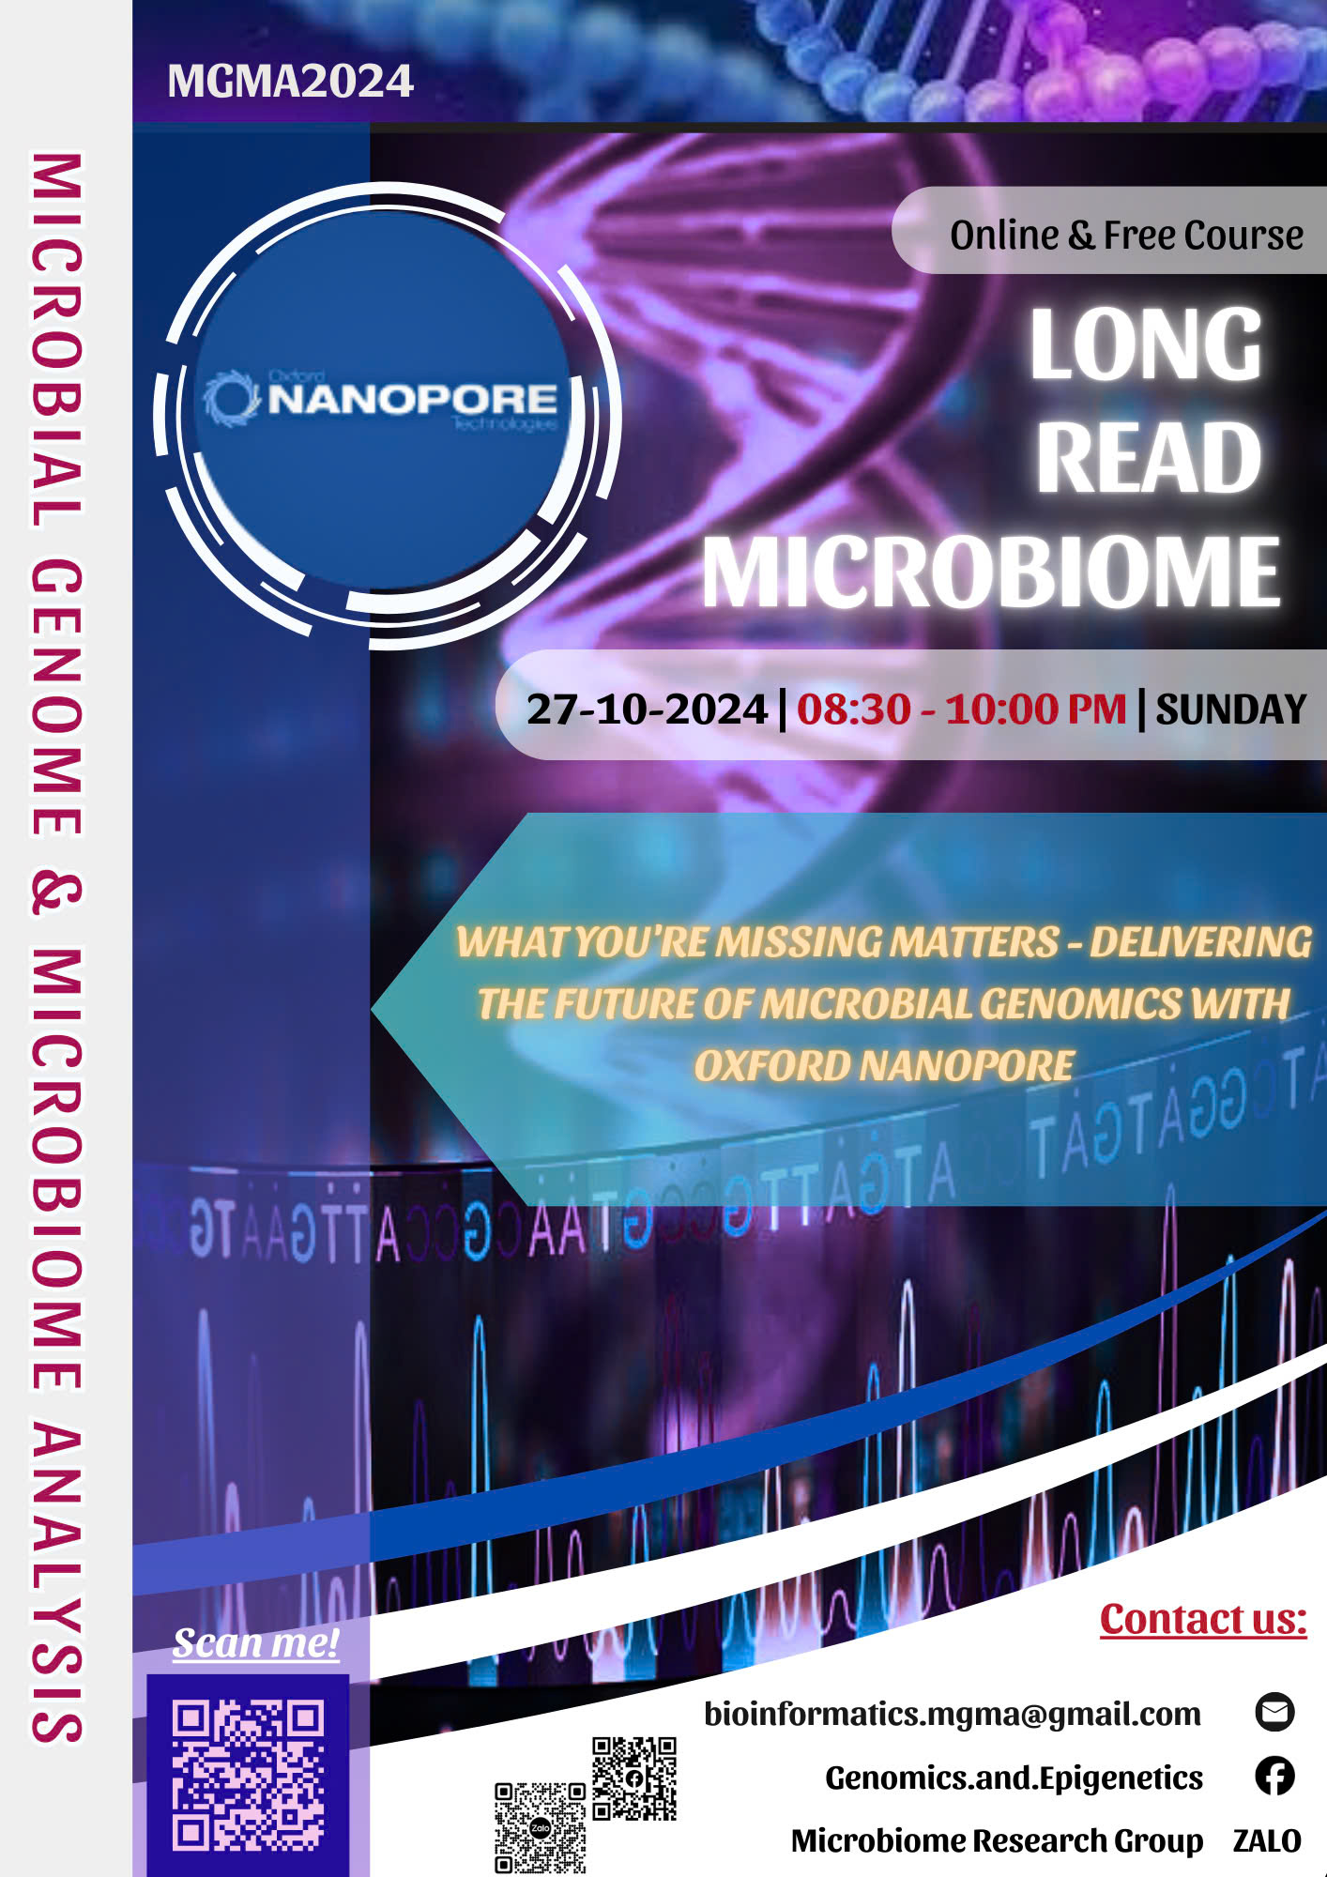
PacBio and ONT present their microbiome platforms

