Slide 1
Current challenges and best-practice protocols for microbiome analysis
Phuc Loi Luu, PhD
luu.p.loi@googlemail.com
July 07 2024

Slide 2
Content
NGS-based microbial genotyping
Gene amplicon/target/marker Metagenomics
Shotgun Metagenomics
Experimental challenges and solutions
Sequencing and computational challenges
Discussion
https://doi.org/10.1093/bib/bbz155

Slide 3
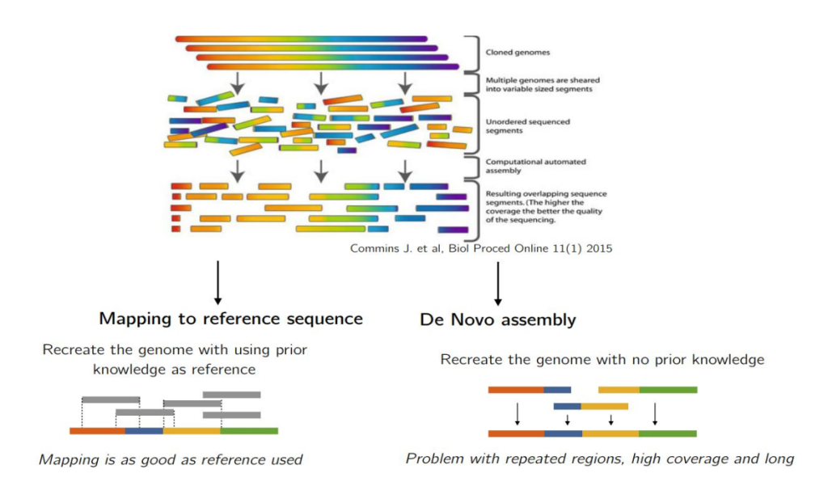
Next-Generation Sequencing (NGS): 1) Reference 2) Massive Parallel Sequencing
https://pharmafeatures.com/cracking-genetic-ciphers-secondary-ngs-analysis/

Slide 4
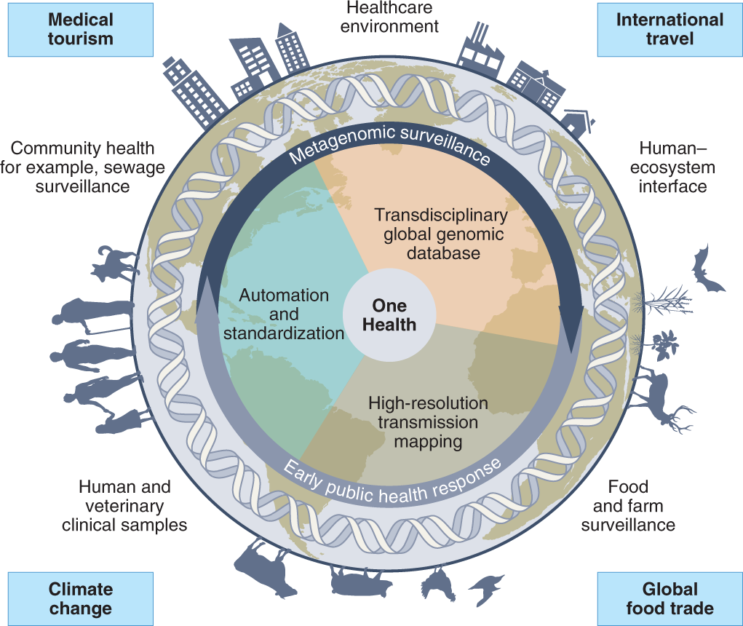
The opportunities for transdisciplinary One Health surveillance, utilizing metagenomic sequencing
A way to unify workflows and harmonize data. Key drivers for this integration are highlighted, including climate change and its impact on zoonotic reservoirs, globalization and international travel, medical tourism and global food trade.
https://www.nature.com/articles/s41564-022-01089-w

Slide 5
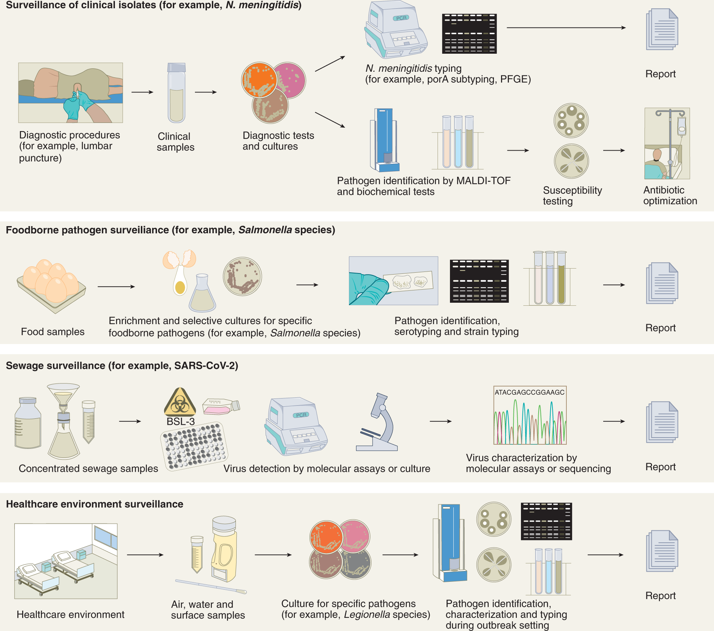
Culture-dependent/gold standard approach
The culturing step is followed by various typing and phenotypic assays
https://www.nature.com/articles/s41564-022-01089-w

Slide 6
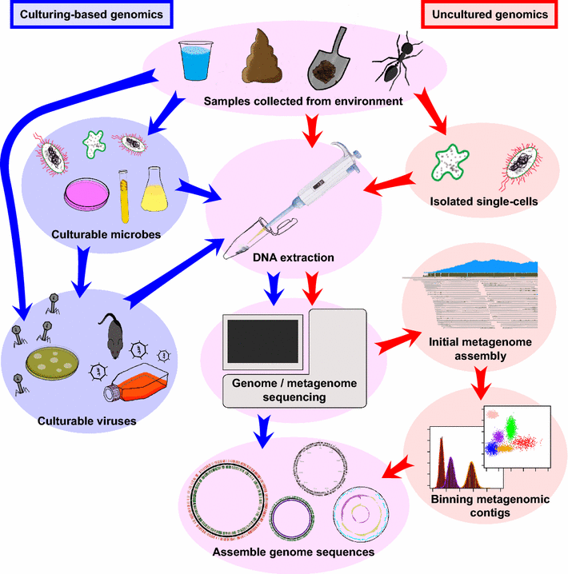
Culture vs unculture genomics
There are many variations of each protocol and additional steps, such as filtering samples according to molecular size cutoffs and normalization of data which are not illustrated in this diagram. The purpose is to illustrate simplified general steps to obtain uncultured genomes, which are common in most of the studies.
https://link.springer.com/article/10.1007/s00018-015-2004-1

Slide 7
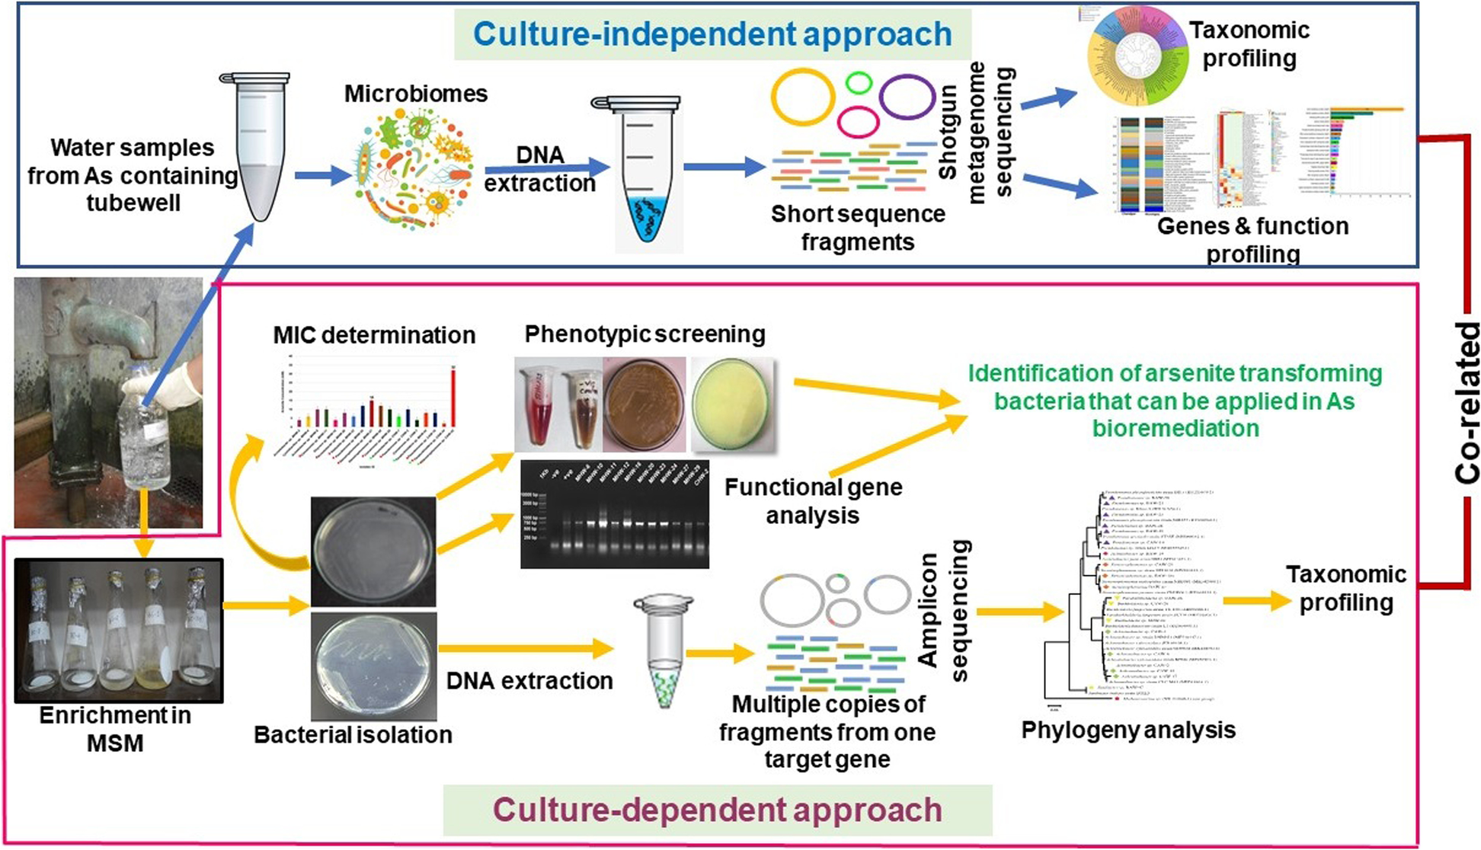
Metagenomic and culture-dependent
This study was carried out to assess the diversity and transformation potentials of the arsenic-affected groundwater microbiomes using both culture-dependent and independent (shotgun metagenomics) approaches
https://bmcmicrobiol.biomedcentral.com/articles/10.1186/s12866-023-02980-0

Slide 8
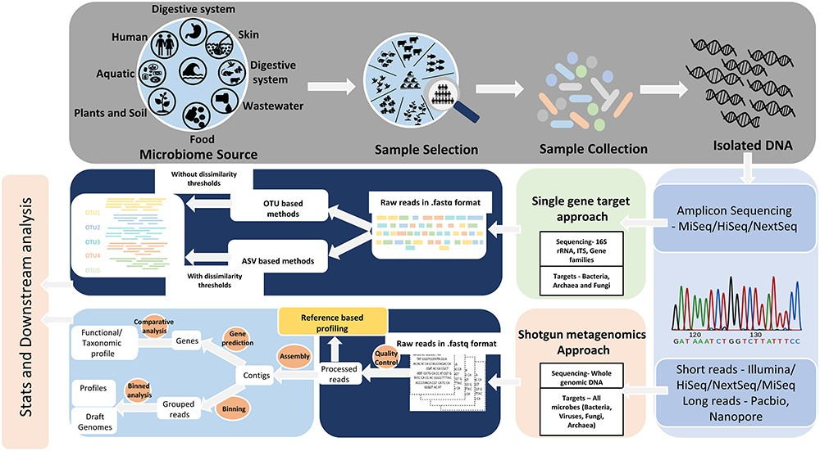
Targeted amplicon and metagenomic sequencing approaches
https://doi.org/10.1093/bib/bbz155

Slide 9
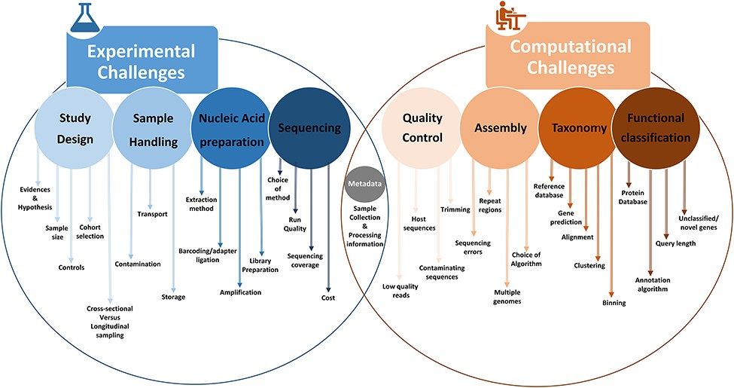
Overview of common experimental and computational challenges

Slide 10
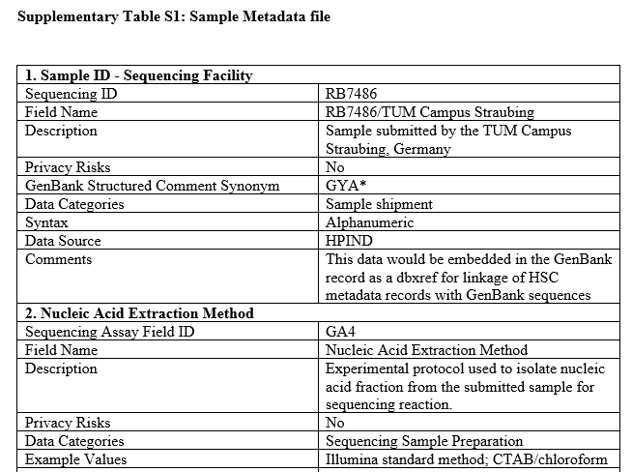
Study design/experimental design eliminating confounding effects
Number of samples: choosing appropriate sample sizes based on statistical principles can certainly help to avoid biases and spurious interpretations.
Controls: whether a signal is real and not just a stochastic
Cross-sectional and longitudinal studies
Metadata

Slide 11
Sample collection and handling a significant confounding factor
Contamination: time, temperature, humidity and proximity distance
Transportation: several chemical preservation methods and immediate freezing
Storage and safety: −80°C conserves microbiota diversity

Slide 12
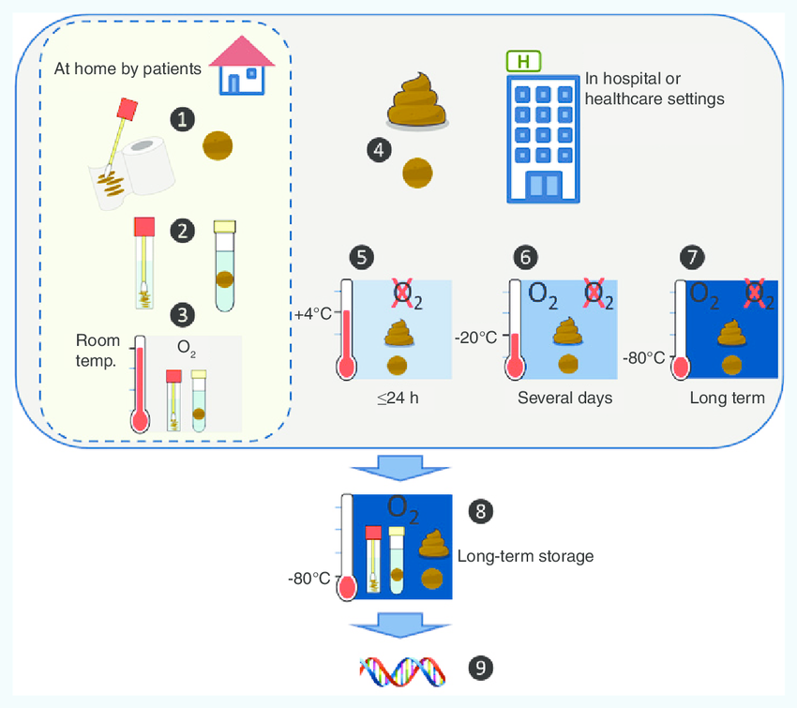
Sample collection and handling a significant confounding factor
Overview of methods that can be used for sample collection and storage before DNA extraction. Collections can be performed at home by patients, or in healthcare settings. When performed at home by patients (left) it is easier to collect stool samples rather than the complete bowel movement. If 16S analysis is to be performed, swabbing toilet paper can collect sufficient amount of material, whereas whole genome shotgun sequencing will require more material (∼1 g) (1). In both cases, collected material will have to be immersed in stabilization buffer (2) before shipping to the lab that can then be done at ambient temperature and ambient atmosphere (3). In hospital or healthcare settings, the full specimen or samples can be collected (4). In both cases intermediary storage can be performed: (5) at 4°C in anaerobic atmosphere for less than 24 h, (6) at -20°C for several days (anaerobic or ambient atmosphere), (7) directly at -80°C for several months/ years (anaerobic or ambient atmosphere). Long-term storage of samples immersed in stabilization buffer, of the complete specimen or of the stool sample can be performed at -80°C in ambient atmosphere (8) before DNA extraction (9).
https://doi.org/10.2217/fmb.15.87

Slide 13
Nucleic acid extraction effectively capture all types of microbes
There are two major extraction methodologies:
mechanical lysis/bead beating
chemical lysis

Slide 14
Nucleic acid preparation effectively capture all types of microbes
Widely used DNA isolation kits for library prep of short-read NGS:
Nextera DNA Flex
both large and small genome sizes with input DNA amounts of 100–500 ng and 1–500 ng
96 multiplexed metagenomic samples
Nextera XT
1 ng of input DNA samples
384 uniquely indexed samples can be pooled and sequenced together
TruSeq DNA PCR-Free: little amounts of input DNA (~1 ng)

Slide 15
Nucleic acid preparation effectively capture all types of microbes
Third-generation sequencing platforms (PacBio and ONT) prove to be more efficient
longer read sizes
Species/strain-level resolution
absence of DNA amplification-based biases
Pacbio Sequel II
enzymatic lysis of DNA for the extraction of longer DNA fragments
DNA output from > 10 Gb
ONT MinION
portable (size of a USB stick)
provides the agility to sequence samples from extreme conditions

Slide 16
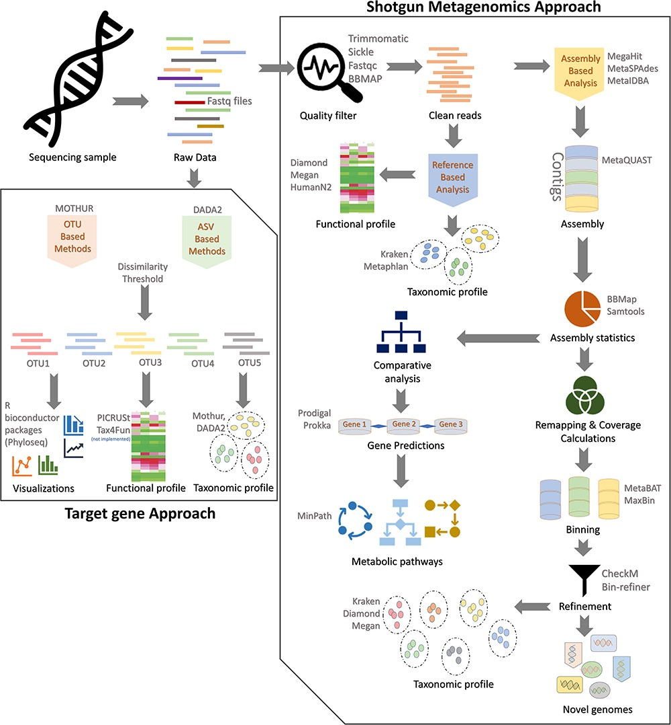
Challenges for amplicon sequencing analysis
Raw reads are quality filtered and processed by either
OTU-based (QIIME and Mothur):
a predefined identity threshold (commonly 97%) into OTUs
lower taxonomic resolution
ASV-based (DADA2, Deblur, MED, and UNOISE) denoising methods utilizing a dissimilarity threshold
Taxonomy: Microbial communities are identified through a rigorous protocol that results in multiple pangenome alignments using customized databases (SILVA, Greengenes and RDP)
Functional annotation: Tax4Fun (R-based algorithm utilizing SILVA) or PICRUSt (clusters protein sequences based on KEGG or COG gene families and 16S rRNA gene copy numbers).
Data visualization: R Bioconductor package phyloseq

Slide 17
Challenges in shot-gun metagenomics analysis Quality filtering
Tools for trimming
Trimmomatic
Sickle
BBTools

Slide 18
Challenges in shot-gun metagenomics analysis Reference-based analysis
Taxonomy: Compositional profiling of communities from metagenomic sequencing data can be optimally done by either using unique clade-specific marker genes identified from 3000 reference genomes (MetaPhlAn) or by exact alignments of k-mers alongside a classification algorithm (Kraken).
Functional annotation: The functional profiling of metagenomic communities can be optimally performed using HUMAnN2 or Megan pipelines. For long reads the DIAMOND sequence aligner can be used alone or with Megan to perform pairwise and frameshift alignments.

Slide 19
Challenges in shot-gun metagenomics analysis Assembly-based analysis
The three most optimal assembling algorithms: MegaHit, MetaSPAdes and MetaIDBA
Contig assembly: assembled reads are clustered into contigs and evaluated by MetaQUAST
Assembly statistics: This step is a prerequisite of remapping/coverage calculations and comparative analysis with BBMap (both short- and long-read sequences from Illumina, PacBio, or MinION)
Comparative analysis: incorporates algorithm-based gene predictions and metabolic pathway identifications. Prokka annotates the data by predicting genes using Prodigal and then performs functional annotation on these genes. The MinPath algorithm could be implemented for biological pathway reconstructions based on protein family predictions.

Slide 20
Challenges in shot-gun metagenomics analysis Assembly-based analysis
Binning: binning or grouping of generated contigs is done before further downstream analysis. Either MetaBAT with an adaptive binning algorithm or MaxBin that utilizes an EM algorithm could be used for metagenomic contig binning.
Refinement: generating taxonomic profiles and annotation of any novel genomes present in samples. Both CheckM and bin-refiner are optimally used for estimating genome completeness and contamination. Taxonomic profiles and novel genome identification can be optimally performed using Kraken and Diamond algorithms with or without the Megan pipeline.

Slide 21
Thank you!
https://github.com/grimmlab/MicrobiomeBestPracticeReview

