Slide 1

2806 Neural Computation
Radial Basis Function Networks
Lecture 5
2005 Ari Visa

Slide 2
Agenda
Some historical notes
Radial Basis Function Networks
Some theory
Regularization Networks
Generalized Radial-Basis Function Networks
Approximating properties of RBF Networks
Learning Strategies
Comparison of RBF networks and Multilayer Perceptrons
Conclusions

Slide 3
Some Historical Notes
Learning is equivalent to finding a surface in a multidimensional space that provides a best fit to the training data.
Powell (1985): Radial-basis functions were introduced in the solution of the real multivariate interpolation problem.
Broomhead and Lowe (1988) were the first to exploit the use of radial-basis functions in the design of neural networks.
Cover (1965): A pattern-classification problem cast in a high-dimensional space is more likely to be linearly separable than in a low-dimensional space.

Slide 4
Some Historical Notes
Mhaskar, Niyogi and Girosi (1996): The dimension of the hidden space is directly related to the capacity of the network to approximate a smooth input-output mapping (the higher the dimension of the hidden space, the more accurate the approximation will be).

Slide 5

Radial-Basis Function Networks
In its most basic form Radial-Basis Function network (RBF) involves three layers with entirely different roles.
The input layer is made up of source nodes that connect the network to its environment.
The second layer, the only hidden layer, applies a nonlinear transformation from the input space to the hidden space.
The output layer is linear, supplying the response of the network to the activation pattern applied to the input layer.

Slide 6
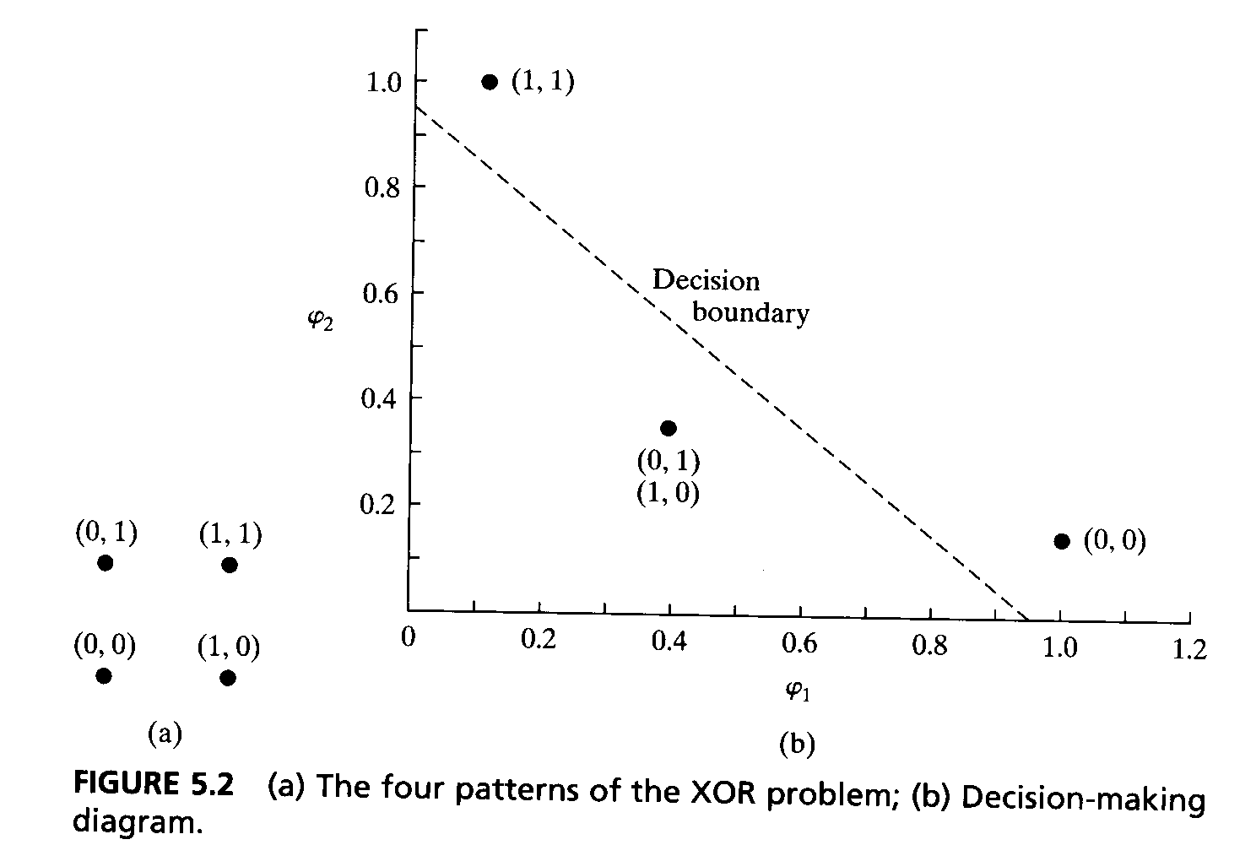
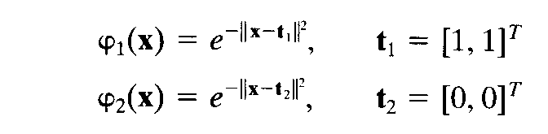
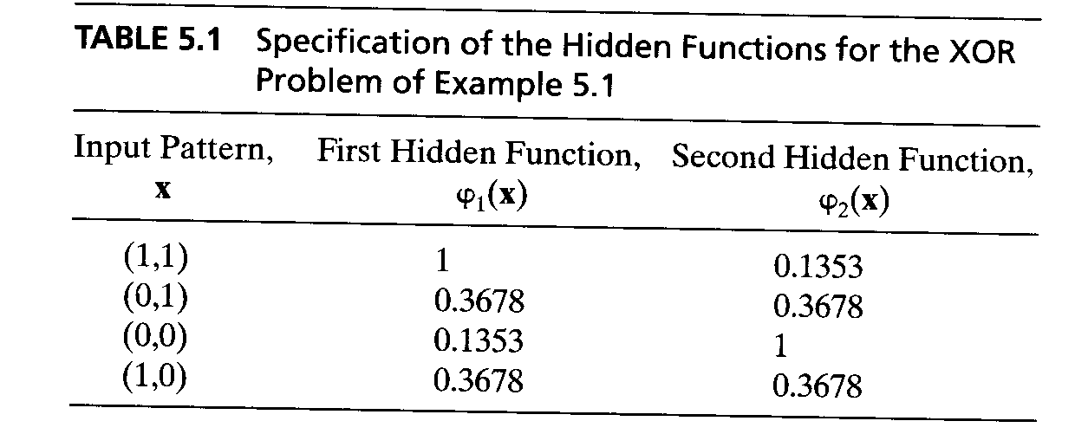
Some Theory
The XOR problem: (x₁ OR x₂) AND NOT (x₁ AND x₂)

Slide 7
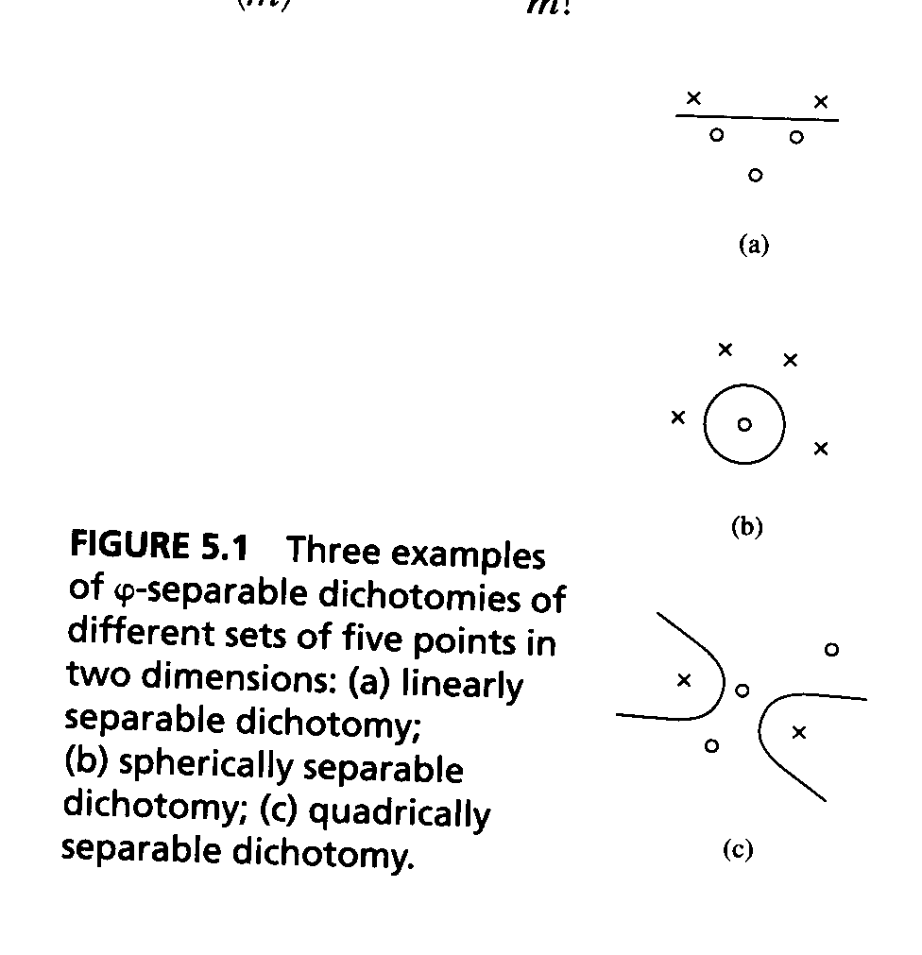
Some Theory
Cover’s theorem on the separability of patterns (1965): A complex pattern-classification problem cast in a high-dimensional space nonlinearly is more likely to be linearly separable than in a low-dimensional space.
Dichotomy = binary partition
Let H denote a set of N patterns x₁,x₂, …,x_{N}. Each of which assigned to one of two classes H₁ and H_{2.}
ϕ(x) = [ϕ(x)₁. ϕ(x)₂…. ϕ(x)_{m1} ]^{T}
A dichotomy {H₁ . H₂} of H is ϕ-separable if there exists am m₁-dimensional vector w such that
w^{T}ϕ(x) > 0, x∈ H₁
w^{T}ϕ(x) < 0, x∈ H₂

Slide 8
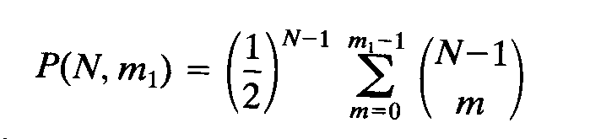
Some Theory
Separating surfaces:
Hyperplanes, quadrices, hypersheres, …
P(N,.m₁) denote the probability that a particular dictomy picked at random is ϕ-separable.
Repeated sequence of Bernoulli trials ->
E[N] = 2m₁ and Median[N]= 2m₁
The expected maximum number of randomly assigned patterns that are linearly separable in a space of dimensionality m₁ is equal to 2m₁.

Slide 9
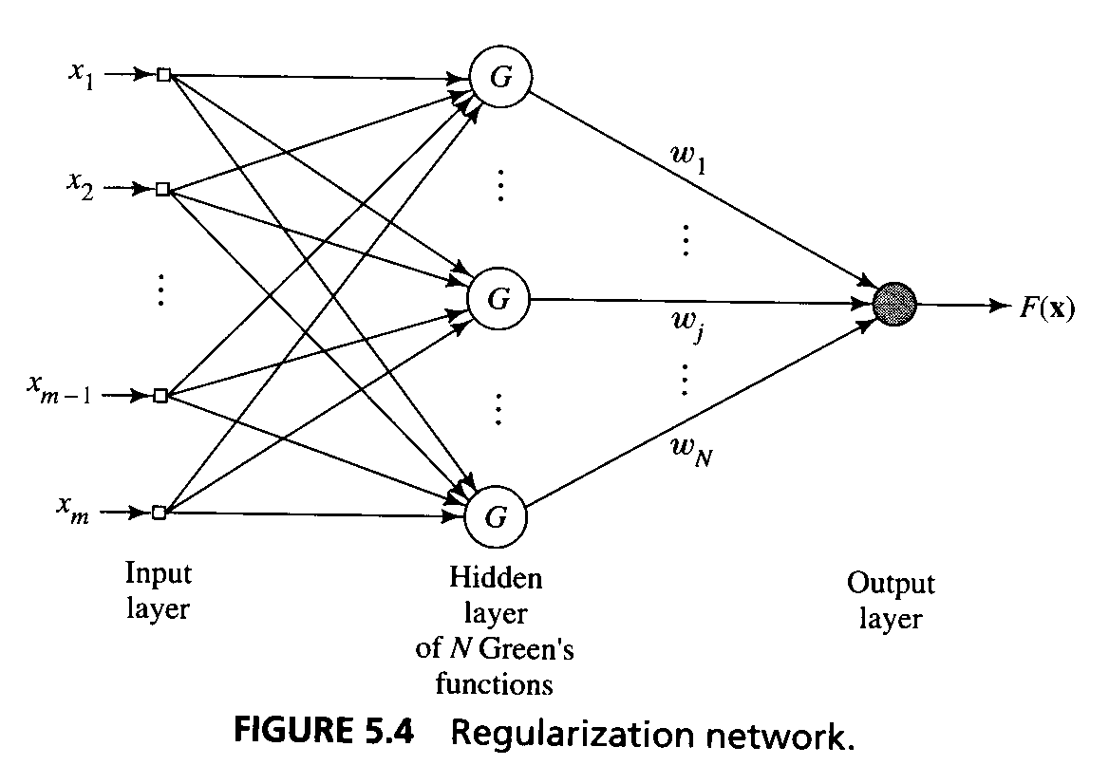
Some Theory
Interpolation Problem:
Consider a feedforward network with an input layer, a single hidden layer, and an output layer consisting of a single unit.
The network performs a nonlinear mapping from the input space to the hidden layer followed by a linear mapping from the hidden space to the output space
The training phase constitutes the optimization of a fitting procedure for the surface Γ based on known data points presented to the network in the form of input-output examples.
The generalization phase is synonymous with interpolation between the data point, with the interpolation being performed along the constrained surface generated by the fitting procedure as the optimum approximation to the true surface Γ.

Slide 10
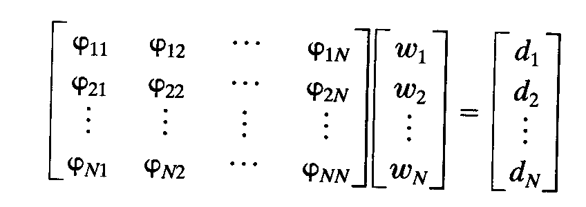
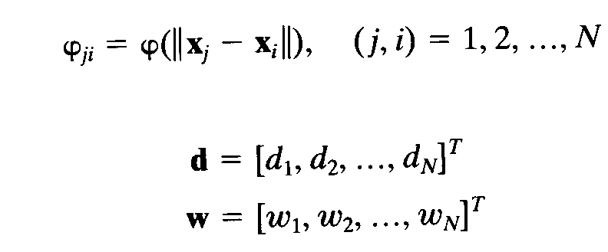
Some Theory
Given a set of N different points {x_{i}∈ R^{m0} | i=1,2,...,N} and a corresponding set of N real numbers {d_{i} ∈ R¹ | i=1,2,...,N}, find a function F:R^{N}->R¹ that satisfies the interpolation condition
F(x_{i}) = d_{i} , i=1,2,...,N
The radial-basis functions technique consists of choosing a function F
F(x) = Σ^{N} _{i=}1 w_{i} ϕ(⎢⎢x-x_{i} ⎢⎢)

Slide 11
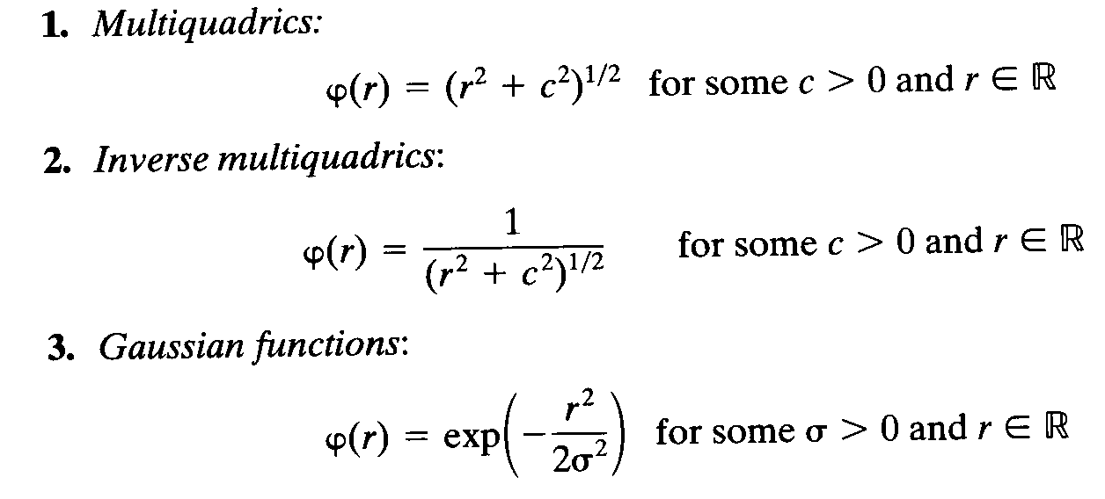
Some Theory
Micchelli’s Theorem
Let {x_{i}}^{N}_{i=1} be a set of distinct points in R^{m0} . . Then the N-by-N interpolation matrix Φ , whose ji-th element is ϕ_{ij} =ϕ(⎢⎢x_{j}-x_{i} ⎢⎢) is nonsingular.

Slide 12
Some Theory
The strict interpolation procedure is not a good strategy for the training of RBF networks because of poor generalization to new data.
Learning is viewed as a problem of hyperspace recontruction, given a set of data points that may be sparse.
Two related problems are said to be the inverse of each other if the formulation of each of them requires partial or full knowledge of each other.

Slide 13
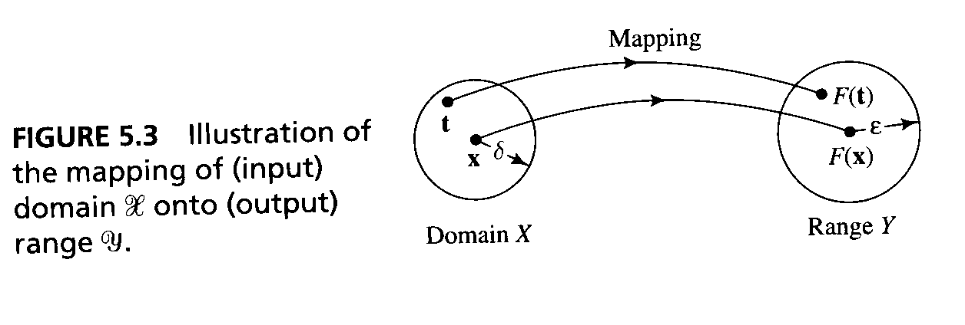
Some Theory
Assume a domain X and a range Y taken to be metric space, and that is related by a fixed but unknown mapping f.
The problem of reconstructing the mapping f is said to be well-posed if three conditions are satisfied:
Existence: For every input vector x ∈ H, there does exist an output y=f(x), where y ∈ H .
Uniqueness: For any pair of input vectors x,t ∈ H, we have f(x)=f(t) if, and only if x=t.
Continuity: (=stability) for any ε>0 there exists δ=δ(ε) such that the condition ρ_{x}(x,t)<δ implies that ρ_{y}(f(x),f(t))<ε, where ρ(.,.) is the symbol for distance between the two arguments in their respective spaces.

Slide 14
Some Theory
If any of these conditions is not satisfied, the problem is said to be ill-posed.
An ill-posed problem means that the large data sets may contain a surprisingly small amount of information about the desired solution
Regularisation: how to make an ill-posed problem into a well-posed one.

Slide 15
Some Theory
Regularization (Tikhonov 1963): in the context of a hypersurface reconstruction problem, the basic idea is to stabilize the solution by means of some auxiliary nonnegative function that embeds prior information about the solution.
The most common form of prior information involves the assumption that the input-output mapping function is smooth.

Slide 16
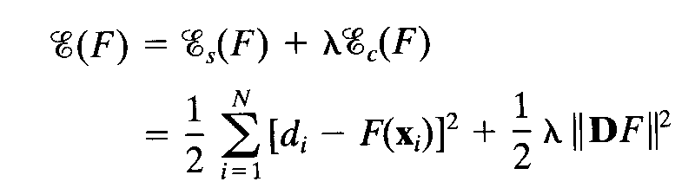
Some Theory
Input signal: x_{i}∈ R^{m0} | i=1,2,...,N.
Desired response: d_{i} ∈ R¹ | i=1,2,...,N.
The approximating function is denoted by F(x).
Standard Error term denoted by E_{s} (F).
Regularizing Term denoted by E_{c}(F) depends on the geometric properties of the approximating function F(x). D is a linear differential operator. Prior information about the form of the solution is embedded in the operator D, which is problem-dependent.
The quantity to be minimized in regularization theory is given below:

Slide 17
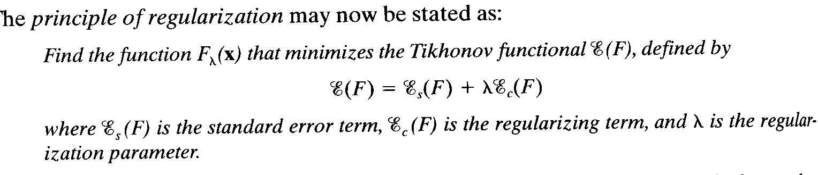
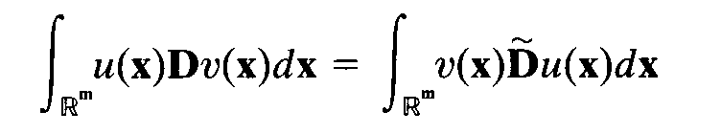
Some Theory
Fréchet differential of the Tikhonov Functional
The principle of regularization may be stated as:
Fréchet differential of a function may be interpreted as the best local linear approximation.
Green’s identity

Slide 18
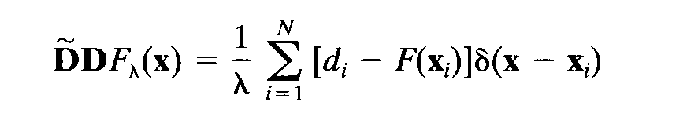
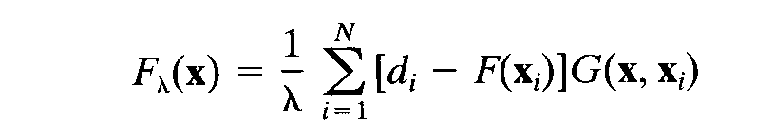
Some Theory
Euler-Lagrange equation for the Tikhonov function E(F) defines a necessary condition for the Tikhonov functional to have an extremum at F_{λ}(x).
The equation represents a partial differential equation in the approximating function F.
L = D~D.
The minimizing solution F_{λ}(x) to the regularization problem is a linear superposition of N Green’s function. The x_{i} represents the centers of the expansion, and the weights [d_{i}-F(x_{i})]/λ represent the coefficients of the expansion.

Slide 19
Some Theory
Green’s Function: Let G(x,ξ) denote a a function in which both vectors x and ξ appear on equal footing but for different purpose: x as a parameter and ξ as an argument.
For a fixed ξ , G(x,ξ) is a function of x and satisfies the prescriped boundary condition.
Except at the point x = ξ. The derivates of G(x,ξ) with respect to x are all continuous; the number of derivates is determined by the order of the operator L.
With G(x,ξ) considered as a function of x , it satisfies the partial differential equation L G(x,ξ) = 0 everywhere except at the point x = ξ, where it has a singularity. That is L G(x,ξ) = δ(x - ξ) where δ(x - ξ) is the Dirac delta function positioned at the point x = ξ.

Slide 20
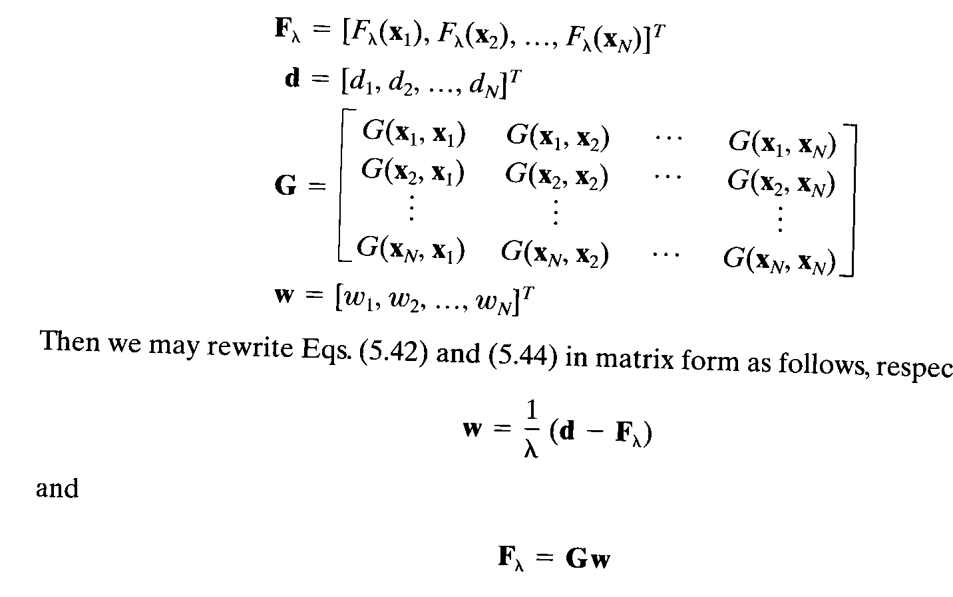
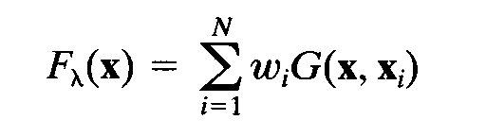
Some Theory
Determination of the Expansion Coefficients
(G + λI)w = d
w = (G + λI) ⁻¹ d
-> F_{λ}(x) = Σ^{N}_{i=1} w_{i}G(x,x_{i})
The expansion of the solution in terms of a set of Green’s functions.
The number of Green’s function = the number of examples used in the training process.

Slide 21
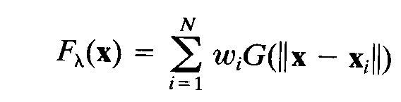
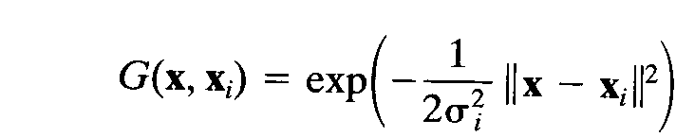
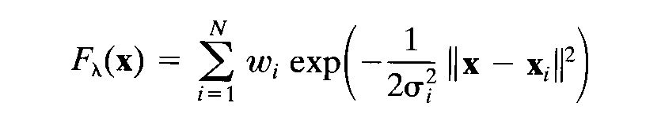
Some Theory
If the stabilizer D is both translationally and rotationally invariant ->
G(x,x_{i}) = G(||x - x_{i}||)
-> strict interpolation
An example of a Green’s function is the multivariate Gaussian function

Slide 22
Regularization Networks
The regularization network is a universal approximator
The regularization network has the best approximation property
The solution computed by the regularization network is optimal.

Slide 23
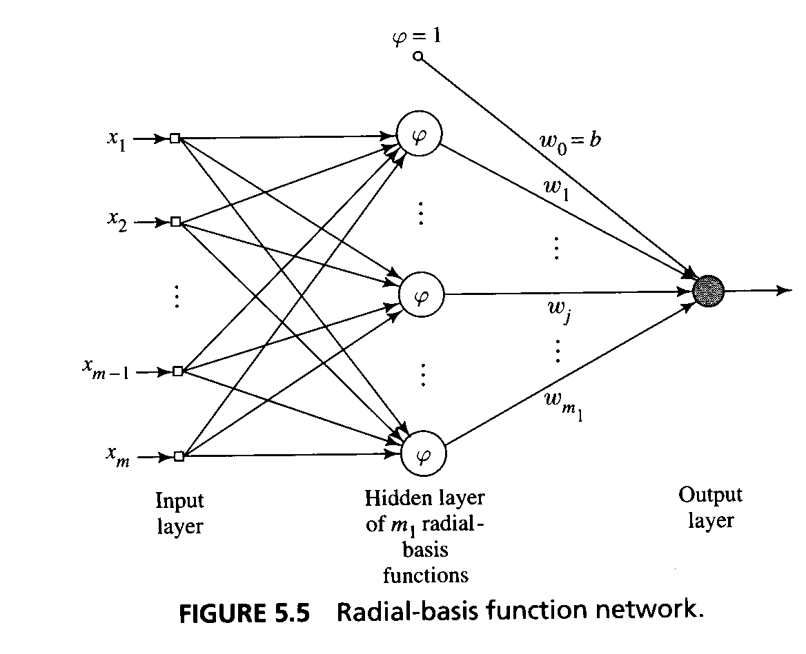
Generalized Radial-Basis Function Networks
When N is large, the one-to-one correspondence between the training input data and the Green’s function produces a regularisation network that may be considered expensive. ->
An approximation of the regularized network.

Slide 24
Generalized Radial-Basis Function Networks
The approach taken involves searching for suboptimal solution in a lower-dimensional space that approximates the regularized solution (Galerkin’s method).
F*(x) = Σ^{m}₁ _{i=1} w_{i} ϕ_{i}(x),
where {ϕ_{i}(x) | i=1,2,...,m₁ ≤ N} is a new set of linearly independent basis functions and the w_{i} constitute a new set of weights.
We set ϕ_{i}(x) = G(⎢⎢x-t_{i} ⎢⎢), i=1,2,... m₁ where the set of centers {t_{i} | i=1,2,...,m₁} is to be determined.
Note that this particular choice of basis functions is the only that guarantees that in the case of m₁ = N and x_{i} = t_{i} i=1,2,...,N the correct solution is consistently recovered.

Slide 25
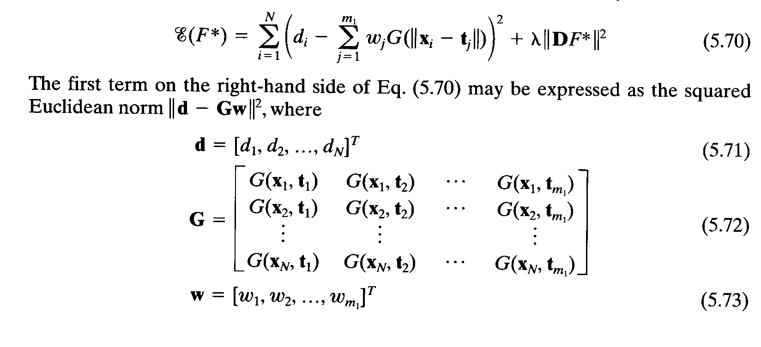
Generalized Radial-Basis Function Networks
F*(x) = Σ^{m}₁ _{i=1} w_{i} G(⎢⎢x-t_{i} ⎢⎢)
Minimize the new cost functional E(F*)
Note, that the matrix G is now N-by-m₁ and therefore no longer symmetric, and the vector w is m₁-by-1.->
w = G⁺ d, λ=0 where G⁺ is the pseudoinverse of matrix G (G⁺ = (G⁺ G)⁻¹ G^{T} ).

Slide 26
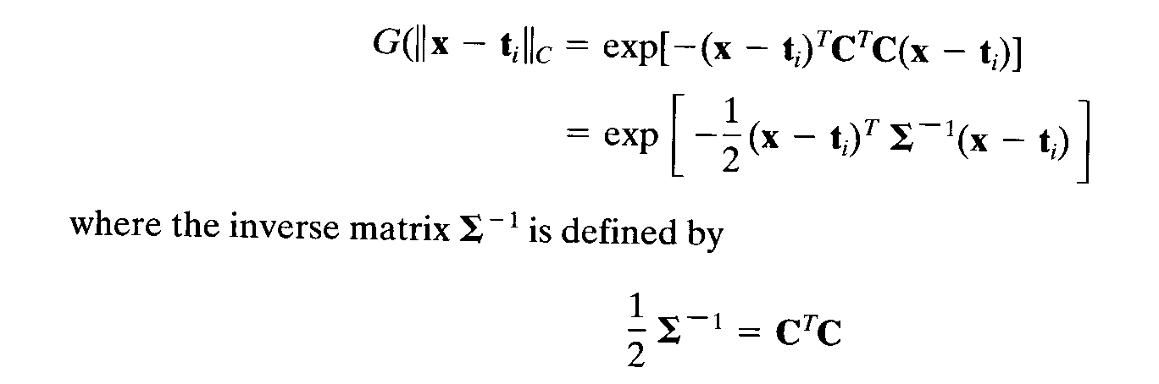
Generalized Radial-Basis Function Networks
The norm in the approximate solution is ordinarily inteded to be a Euclidean norm. When the individual elements of the input vector x belong to different classes, it is more appropriate to consider a general weighted norm.
||x||²_{c} =(Cx)^{T}(Cx) where C is an m₀-by-m₀ norm weighting matrix. ->
F*(x) = Σ^{m}₁ _{i=1} w_{i} G(⎢⎢x-t_{i} ⎢⎢_{C})
The weighted norm ~ a) an affine transformation to the original input space. b) follows directly from a generalization of m₀-dimensional Laplacian in the definition of the pseudo-differential operator D.

Slide 27
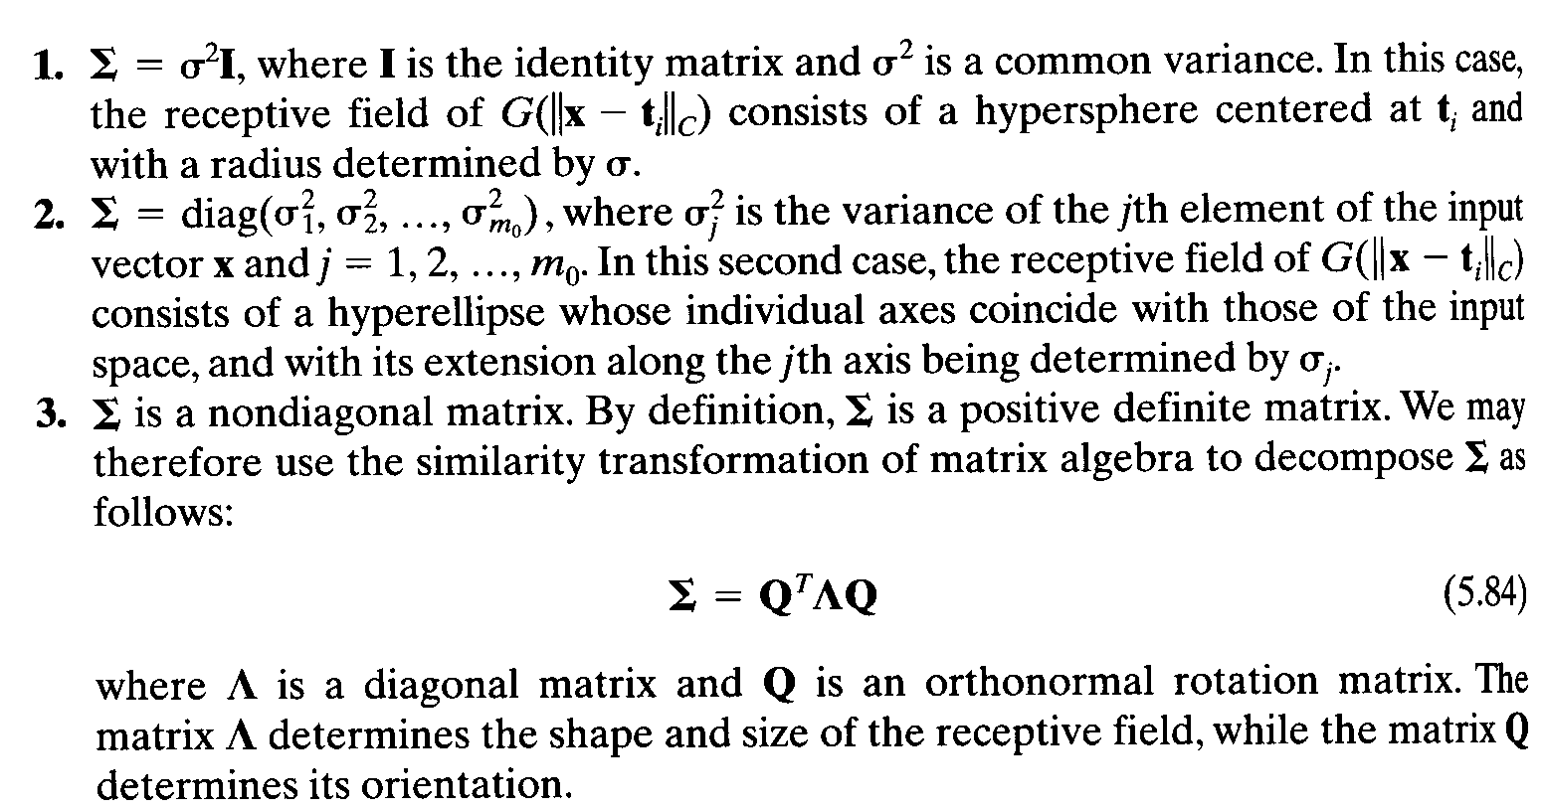
Generalized Radial-Basis Function Networks
The covariance matrix Σ determines the receptive field of G(⎢⎢x-t_{i} ⎢⎢_{C}).
ψ(x) = G(⎢⎢x-t_{i} ⎢⎢_{C}) –a
We may define three different scenarios pertaining to the covariance matrix Σ and its influence on the shape, size, and orientation of the receptive field.

Slide 28
Generalized Radial-Basis Function Networks
The generalized RBF network differs from the regularization RBF:
The number of nodes in the hidden layer: m₁ < N (generalized RBF), N (regularization RBF).
The linear weights associated with the output layer, and the positions of the centers of radial-basis functions and the norm weighting matrix associated with the hidden layer have to be learned (generalized RBF).
The linear weights of the output layer have to be learned (regularization RBF).

Slide 29
Learning Strategies
1) Fixed Centers Selected at Random
- an isotropic Gaussian function whose standard deviation is fixed:
G(⎢⎢x-t_{i} ⎢⎢²) = exp(-m₁/d²_{max} ⎢⎢x-t_{i} ⎢⎢²), i =1,2,.. m₁
The linear weights in the output layer of the network should be learned.
w = G⁺ d
- May require a large training set for a satisfactory level of performance.

Slide 30
Learning Strategies
2) Self-Organized Selection of Centers
a hybrid learning process:
Self-organizing learning stage estimates appropriate locations for the centers of the radial basis functions in the hidden layer.
Supervised learning stage, which completes the design of the network by estimating the linear weights of the output layer.

Slide 31
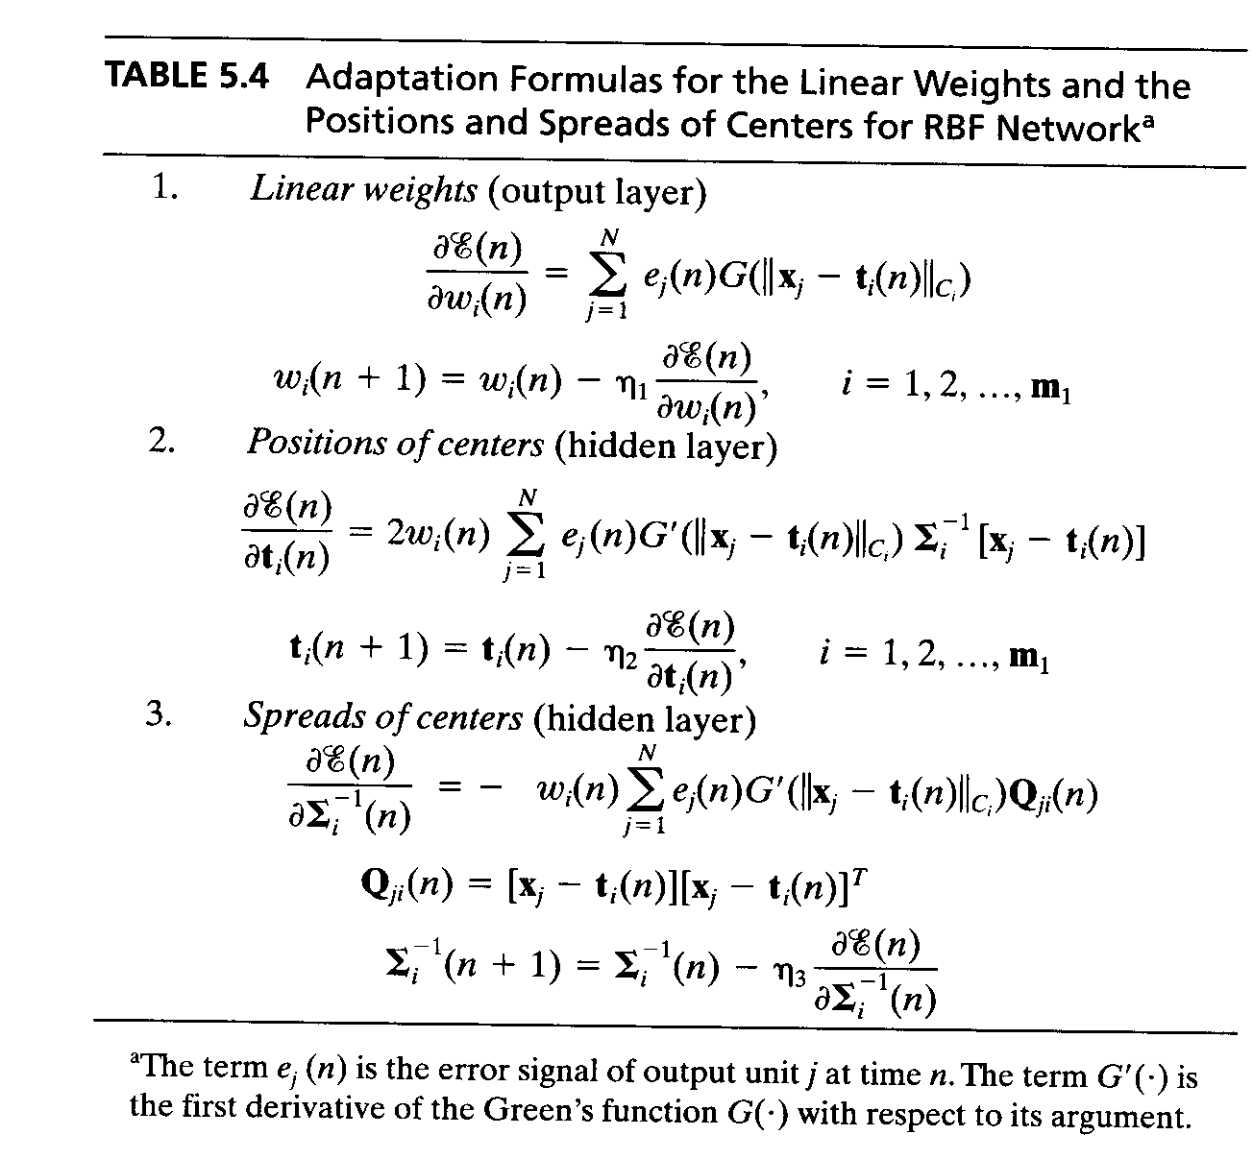
Learning Strategies
3) Supervised Selection of Centers
The centers of the radial basis functions and all other free parameters of the network undergo a supervised learning process (= a gradient descent procedure)

Slide 32
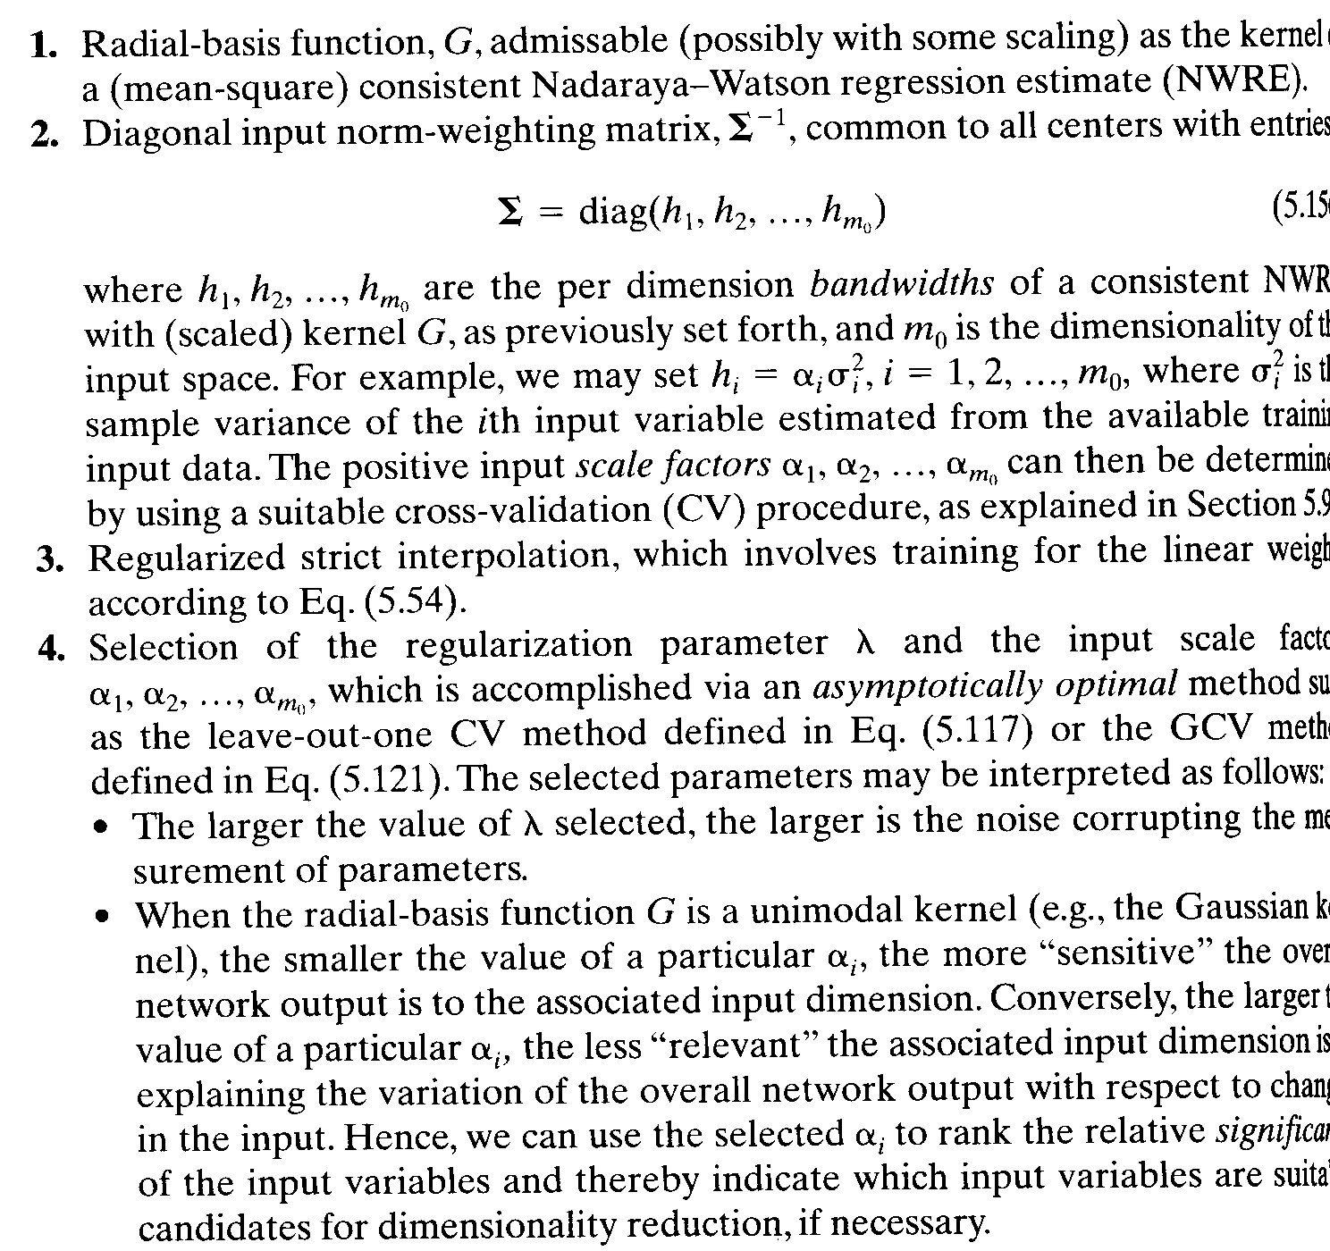
Learning Strategies
4) Strict Interpolation with Regularization

Slide 33
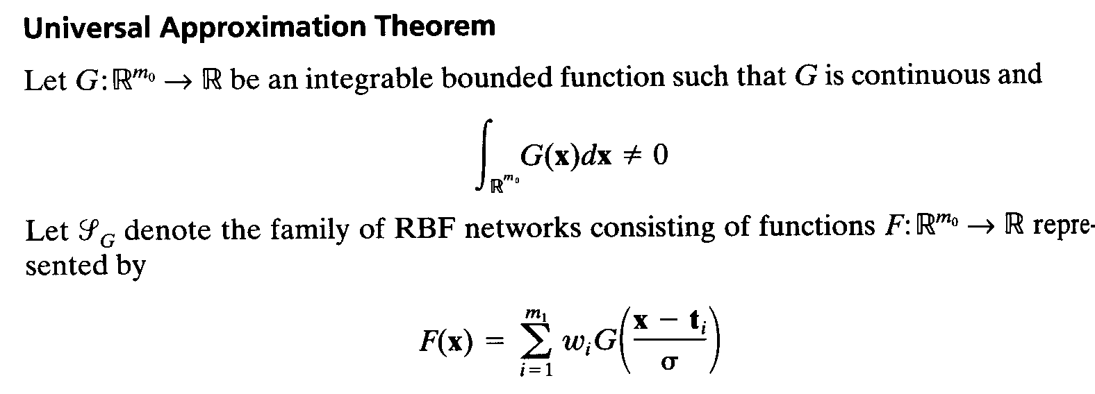
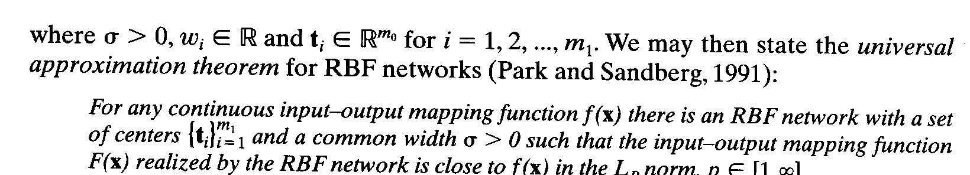
Approximating properties of RBF Networks
Note that the kernel G:R^{m0} → R is not required to satisfy the property of radial symmetry.

Slide 34
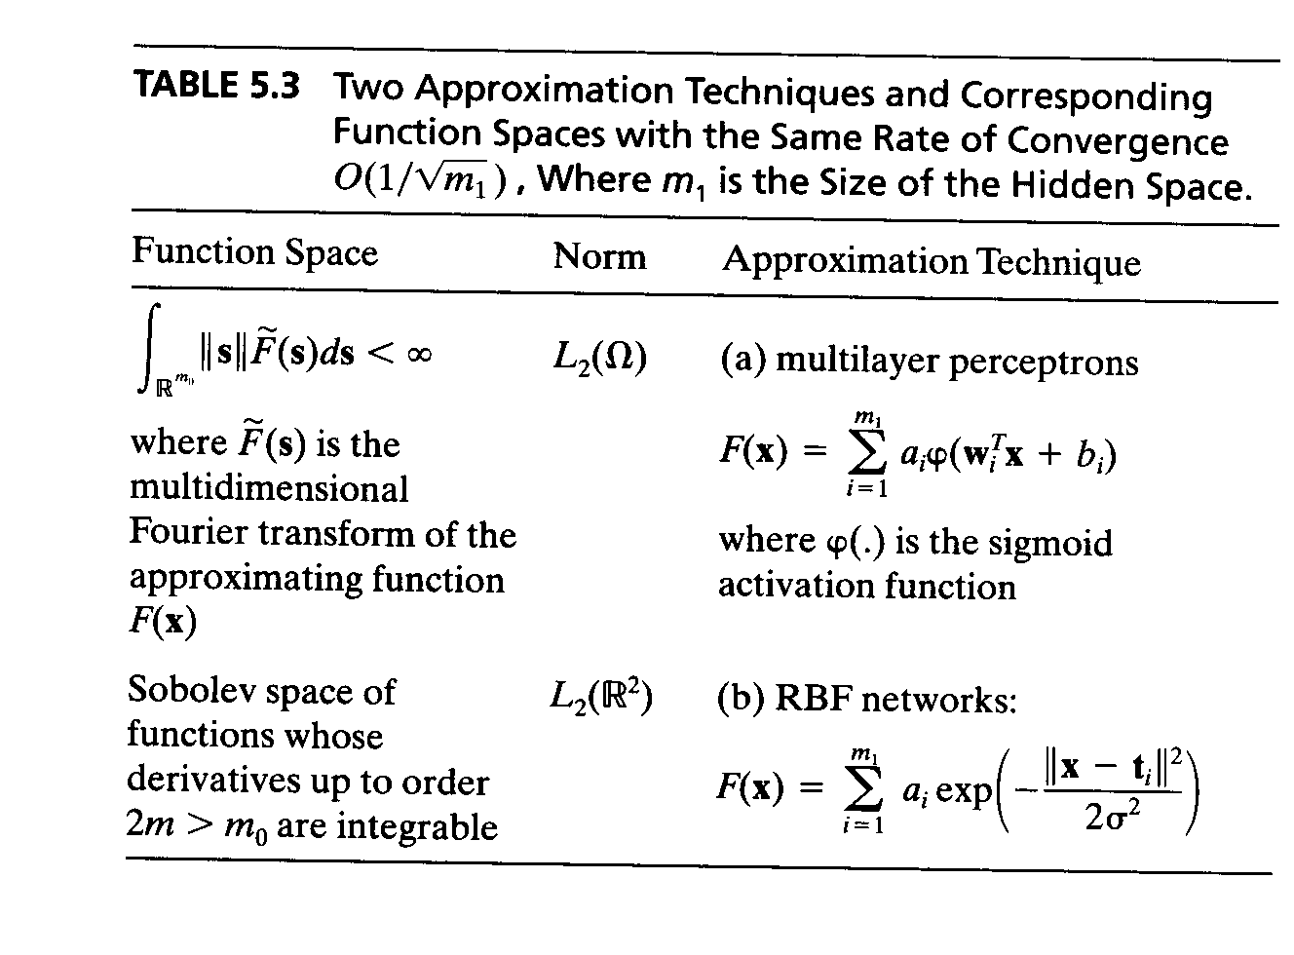
Approximating properties of RBF Networks
The space of approximating functions attainable with multilayer perceptrons and RBF networks becomes increasingly constrained as the input dimensionality m₀ is increased.
The generalization error converges to zero only if the number of hidden units m₁ increases more slowly than the size N of the training samples.
For a given size N of training sample, the optimum number of hidden units, m₁* behaves as m₁* ∝ N ^{1/3}.
The RBF network exhibits a rate of approximation O(1/ m₁) that is similar to that derived by Barron for the case of a multilayer perceptron with sigmoid activation functions.

Slide 35
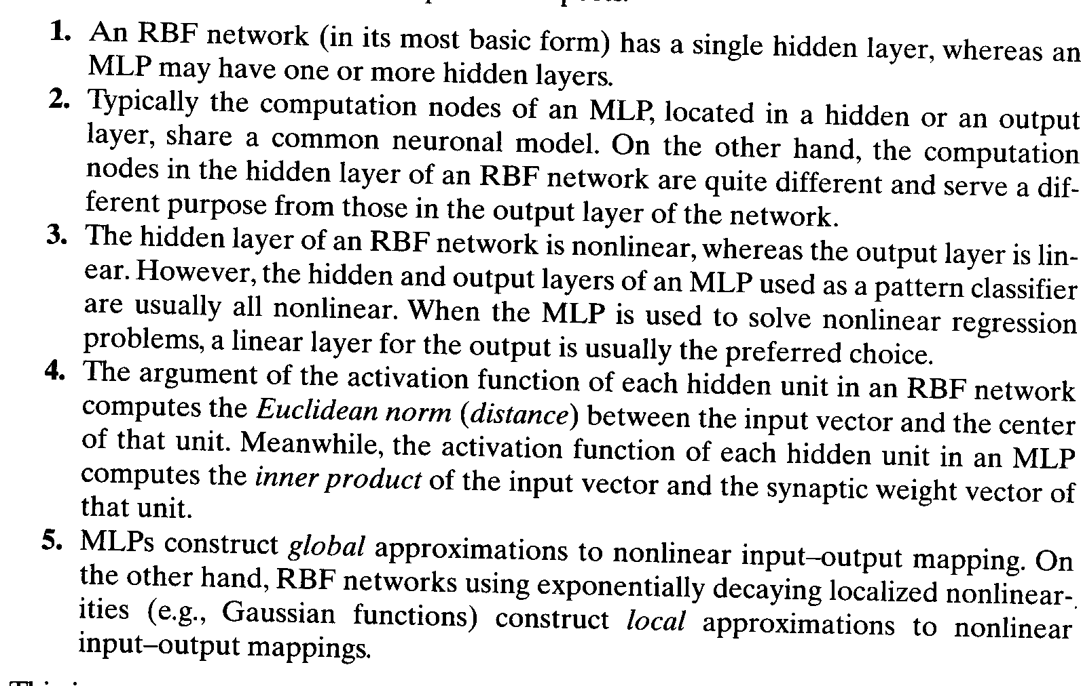
Comparison of RBF networks and Multilayer Perceptrons
Radial-basis function networks and multilayer perceptrons are both universal approximators.
For the approximation of a nonlinear input-output mapping, the MLP may require smaller number of parameters than the RBF network for the same degree of accuracy.
Some differences:

Slide 36
Summary
The structure of an RBF network is unusual in that the constitution of its hidden units is entirely different from that of its output units.
Tikhonov’s regularization theory provides a sound mathematical basis for the formulation of RBF networks.
The Green’s function G(x,ξ) plays a central role in the theory.

