Slide 1
Radial Basis Functions Networks
By:
Roi Levy
Israel Waldman
Hananel Hazan
Neuron Networks Seminar
Dr. Larry Manevitz

Slide 2
Presentation Structure
The problems this model should solve.
The structure of the model.
Radial functions.
Cover’s theorem on the separability of patterns.
    4.1 Separability of random patterns
    4.2 Separating capacity of a surface
    4.3 Back to the XOR problem

Slide 3
Part 1
The Problems this Model Should Solve

Slide 4
radial basis function (RBF) networks
RBFN are artificial neural networks for application to problems of supervised learning:
  Regression
  Classification
  Time series prediction.

Slide 5
Supervised Learning
A problem that appears in many disciplines
Estimate a function from some example input-output pairs with little (or no) knowledge of the form of the function.
The function is learned from the examples a teacher supplies.

Slide 6
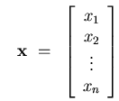

Example of Supervised Learning
The training set:

Slide 7
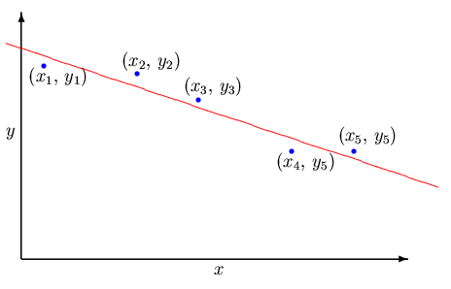
Parametric Regression
Parametric regression-the form of the function is known but not the parameters values.
Typically, the parameters (both the dependent and independent) have physical meaning.
E.g. fitting a straight
line to a bunch
of points-

Slide 8
Non Parametric Regression
No priori knowledge of the true form of the function.
Using many free parameters which have no physical meaning.
The model should be able to represent a very broad class of functions.

Slide 9
Classification
Purpose: assign previously unseen patterns to their respective classes.
Training: previous examples of each class.
Output: a class out of a discrete set of classes.
Classification problems can be made to look like nonparametric regression.

Slide 10


Time Series Prediction
Estimate the next value and future values of a sequence, such as:
The problem is that usually it is not an explicit function of time. Normally time series are modeled as auto­regressive in nature, i.e. the outputs, suitably delayed, are also the inputs:
To create the training set from the available historical sequence first requires the choice of how many and which delayed outputs affect the next output.

Slide 11
Supervised Learning in RBFN
Neural networks, including radial basis function networks, are nonparametric models and their weights (and other parameters) have no particular meaning in relation to the problems to which they are applied.
Estimating values for the weights of a neural network (or the parameters of any nonparametric model) is never the primary goal in supervised learning.
The primary goal is to estimate the underlying
function (or at least to estimate its output at certain desired values of the input).

Slide 12
Part 2
The Structure of the Model

Slide 13

Linear Models
A linear model for a function y(x) takes the form:
The model f is expressed as a linear combination of a set of m basis functions.
The freedom to choose different values for the weights, derives the flexibility of f , its ability to fit many different functions.
Any set of functions can be used as the basis set, however, models containing only basis functions drawn from one particular class have a special interest.

Slide 14


Special Base Functions
Classical statistics - polynomials base functions:
Signal processing applications-combinations of sinusoidal waves (Fourier series):
artificial neural networks (particularly in multi­layer perceptrons ,MLPs)–logistic functions:

Slide 15


Example – the straight line
A linear model of the form:
Which has two basis functions:
Its weights are:

Slide 16
Linear Models – summary
Linear models are simpler to analyze mathematically.
In particular, if supervised learning problems are solved by least squares then it is possible to derive and solve a set of equations for the optimal weight values implied by the training set .
The same does not apply for nonlinear models, such as MLPs, which require iterative numerical procedures for their optimization.

Slide 17
Part 3
Radial Functions

Slide 18
Radial Functions
Characteristic feature-their response decreases (or increases) monotonically with distance from a central point.
The center, the distance scale, and the precise shape of the radial function
are parameters of the model, all fixed if it is linear.
Typical radial functions are:
  The Gaussian RBF (monotonically decreases with distance from the center).
  A multiquadric RBF (monotonically increases with distance from the center).

Slide 19
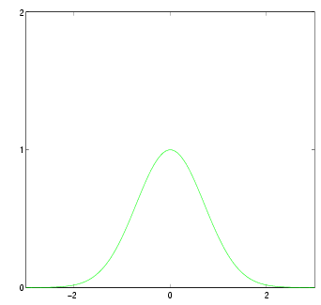

A Gaussian Function
A Gaussian RBF monotonically
decreases with distance from the center. Gaussian­like RBFs are local (give a significant response only in a neighborhood near the center) and are more commonly used than multiquadric­type RBFs which have a global response. They are also more biologically plausible because their response is finite.

Slide 20
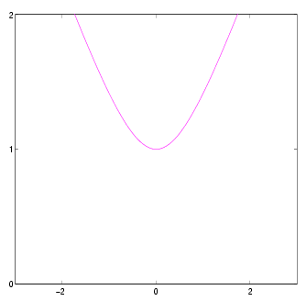

A multiquadric RBF
A multiquadric RBF which, in the case of scalar input, is monotonically increases with distance from the centre.

Slide 21
Radial Basis Functions Networks
RBF are Usually used in a single layer network.
An RBF network is nonlinear if the basis functions can move or change size or if there is more than one hidden layer.

Slide 22
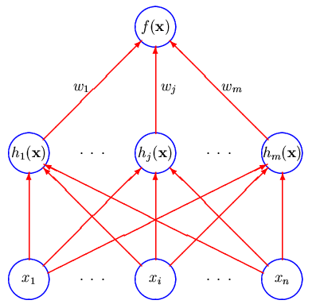

Radial Basis Functions Networks-cont’d

Slide 23
Part 4
Cover’s Theorem on the Separability of Patterns

Slide 24
Covers Theorem
“A complex pattern-classification problem cast in high-dimensional space nonlinearly is more likely to be linearly separable than in a low dimensional space”
(Cover, 1965).

Slide 25
Introduction to Cover’s Theorem
Let X denote a set of N patterns (points) x₁,x₂,x₃,…,x_{N}
Each point is assigned to one of two classes: X⁺ and X⁻
This dichotomy is separable if there exist a surface that separates these two classes of points.

Slide 26

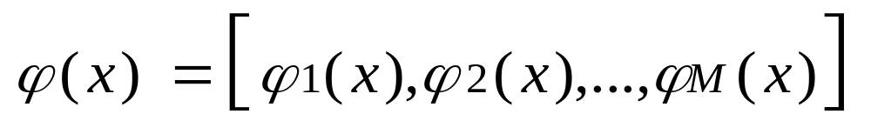

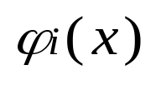
Introduction to Cover’s Theorem – Cont’d
For each pattern define the next
vector: ^{T}
The vector maps points in a p-dimensional input space into corresponding points in a new space of dimension m.
Each is a hidden function, i.e., a hidden unit

Slide 27


Introduction to Cover’s Theorem – Cont’d
A dichotomy {X⁺,X⁻} is said to be φ-separable if there exist a m-dimensional vector w such that we may write (Cover, 1965):
  w^{T} φ(x) 0, x X⁺
  w^{T} φ(x) < 0, x X⁻
  The hyperplane defined by w^{T} φ(x) = 0, is the separating surface between the two classes.

Slide 28
Introduction to Cover’s Theorem – Cont’d
Given a set of patterns X in an input space of arbitrary dimension p, we can usually find a nonlinear mapping φ(x) of high enough dimension M such that we have linear separability in the φ space.

Slide 29
Separability of Random Patterns
Basic assumptions:
N input vectors (patterns) are chosen independently according to a probability measure μ on the input space.
The dichotomy of the N input vectors is chosen at random with equal probability from the 2^{N} possible dichotomies.

Slide 30

Separability of Random Patterns – Cont’d
Basic assumptions – cont’d:
The set X={x₁,x₂,…, x_{N}} is in φ-general position, I.e., every m-element subset of the set of M dimensional vectors {φ(x₁), φ(x₂),…, φ(x_{N})} is linearly independent for every m M.

Slide 31
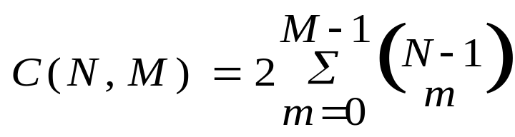
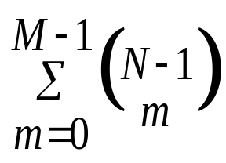
Separability of Random Patterns – Cont’d
Following the later assumptions, there are two statements:
The number of the φ-separable dichotomies is:
        Schlafli’s formula
        for function
        counting
The probability that a random dichotomy is φ-separable is:
^{Cover’s separability}
P(N,M)=(1/2)^{N-1 theorem for random}
^{patterns}

Slide 32
Separability of Random Patterns –
Conclusion
The important point to note from Cover’s separability theorem for random patterns is that the higher M is, the closer will be the probability to unity.

Slide 33
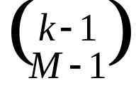
Separating Capacity of a Surface
Let X={x₁,x₂,…, x_{N}} be a sequence of random patterns.
We will define the random variable N to be the largest integer such that the set X={x₁,x₂,…, x_{N}} is φ-separable.
P(N=k)=(1/2)^{k}
E[N]=2M

Slide 34
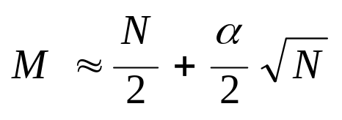
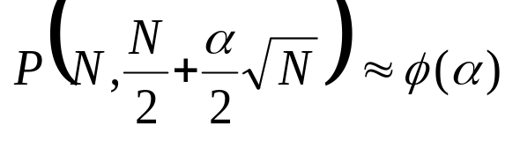
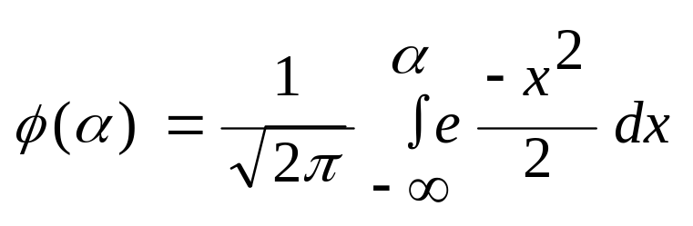
Separating Capacity of a Surface– Cont’d
The asymptotic probability that N patterns are separable in a space of dimension
is given by
where Φ(α) is the cumulative Gaussian
distribution, that is:

Slide 35
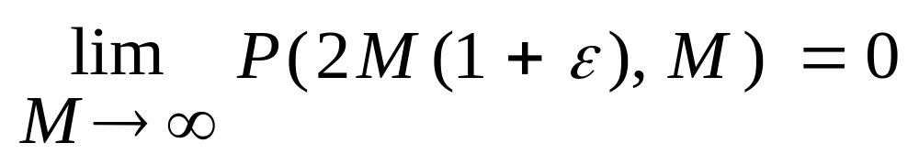
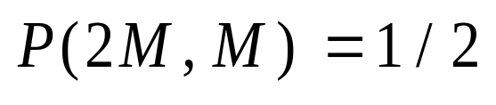
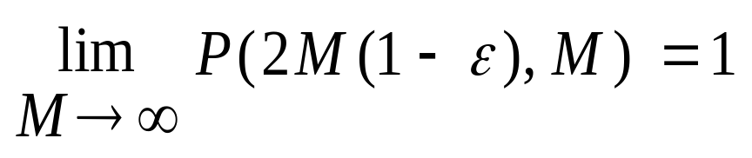
Separating Capacity of a Surface– Cont’d
In addition, for ε > 0, we have:
The separability threshold is when the number of patterns is twice the number of dimensions (Cover, 1965).

Slide 36
Back to the XOR Problem
Recall that in the XOR problem, there are four patterns (points), namely, (0,0),(0,1),(1,0),(1,1), in a two dimensional input space.
We would like to construct a pattern classifier that produces the output 0 for the input patterns (0,0),(1,1) and the output 1 for the input patterns (0,1),(1,0).

Slide 37
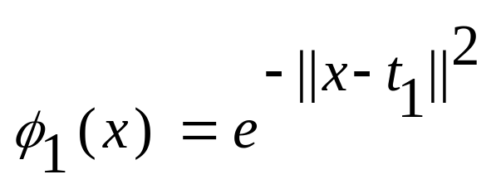
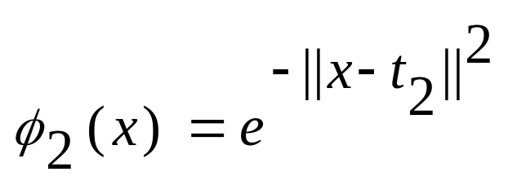
Back to the XOR Problem – Cont’d
We will define a pair of Gaussian hidden functions as follows:
, t₁=[1,1]^{T}
, t₂=[0,0]^{T}

Slide 38
Back to the XOR Problem – Cont’d
Using the later pair of Gaussian hidden functions, the input patterns are mapped onto the φ₁- φ₂ plane, and now the input points can be linearly separable as required.
φ₂
(0,0)
(1,1)
(0,1)
        (1,0) φ₁
        0.2 0.4 0.6 0.8 1

