Slide 1
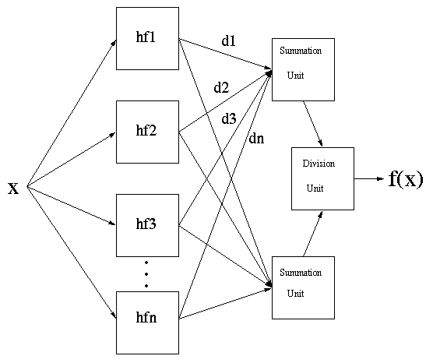
Review: General Regression Neural Networks (GRNNs)
GRNNs are global methods that consist of:
  A hidden layer of Gaussian neurons (one neuron for each t_{i})
  A set of weights w_{i}, where w_{i} = d_{i}
  A set of standard deviations, σ_{i} for each training instance i
d_{q}= f(t_{q}) = (Σhf_{i}(t_{q},t_{i})d_{i}) / Σhf_{i}(t_{q},t_{i})
hf_{i}(t_{q},t_{i}) = exp(- (||t_{q}- t_{i}||²)/2σ_{i}²)

Slide 2
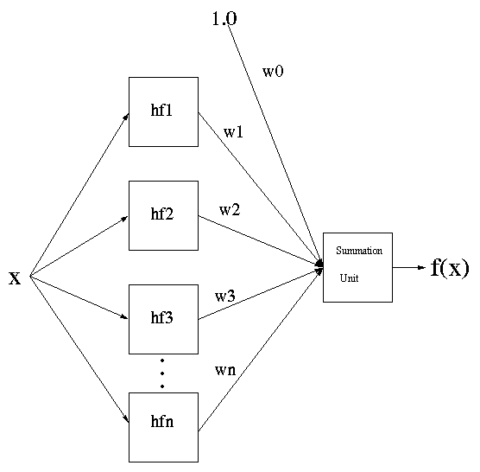
Radial Basis Function Networks (RBFNs)
Radial Basis Function Networks consist of:
  A hidden layer of k Gaussian neurons A set of weights w_{i},
  A set of k standard deviations, σ_{i} for each neuron I
d_{q}= f(t_{q}) = w₀ + Σ^{k}_{i=1} hf_{i}(t_{q},v_{i}) w_{i}
hf_{i}(t_{q},v_{i}) = exp(- (||t_{q}- v_{i}||²)/2σ_{i}²)

Slide 3
Radial Basis Function Networks (RBFNs)
RBFNs are trained using a two step process:
  Determine the K neurons using:
    Kohonen (Winner-Take-All) Unsupervised Learning
    Genetic Search
  Determine the weights
    Supervised Learning (Backpropagation)
    Genetic Search

Slide 4
Kohonen Unsupervised Learning:
Winner-Take-All
The algorithm is as follows:
  Randomly generated K vectors (v₁, v₂, …, v_{k})
  For each training instance t_{i}, determine the closest v, label this vector v_{winner}.
  Let Δv_{winner} = η(t_{i} – v_{winner})
  v_{winner} = v_{winner} + Δv_{winner}

Slide 5
Determining the K Neurons Using:
Genetic Search
How could we do this?

Slide 6
Determining the Weights Using Backpropagation
For each training instance, t_{j}
  Δw_{i} = η (d_{i} –f(t_{i})) hf_{i}(t_{j},v_{i})
  w_{i} = w_{i} + Δw_{i}

