Slide 1
Machine Learning 21431
Instance Based Learning

Slide 2
Question of the Day
U2 has to give a concert in 17 minutes. In order to get to the arena they have to cross a bridge. It is dark and they have to use a torch light. The bridge can only carry two persons at a time, one of the band members has to return the torch light to the other side for the next party to cross. The four walk at different speeds, A needs 1 minute for a crossing, B 2 minutes, C 5 minutes and D 10 minutes. The slower of the pair determines how long it takes to cross. How can they reach the concert in time?

Slide 3
Outline
K-Nearest Neighbor
Locally weighted learning
Local linear models
Radial basis functions

Slide 4
Literature & Software
T. Mitchell, “Machine Learning”, chapter 8, “Instance-Based Learning”
“Locally Weighted Learning”, Christopher Atkeson, Andrew Moore, Stefan Schaal
ftp:/ftp.cc.gatech.edu/pub/people/cga/air.html
R. Duda et ak, “Pattern recognition”, chapter 4 “Non-Parametric Techniques”
Netlab toolbox
  k-nearest neighbor classification
  Radial basis function networks

Slide 5
When to Consider Nearest Neighbors
Instances map to points in R^{N}
Less than 20 attributes per instance
Lots of training data
Advantages:
Training is very fast
Learn complex target functions
Do not loose information
Disadvantages:
Slow at query time
Easily fooled by irrelevant attributes

Slide 6
Instance Based Learning
Key idea: just store all training examples <x_{i},f(x_{i})>
Nearest neighbor:
Given query instance x_{q}, first locate nearest training example x_{n}, then estimate f(x_{q})=f(x_{n})
K-nearest neighbor:
Given x_{q}, take vote among its k nearest neighbors (if discrete-valued target function)
Take mean of f values of k nearest neighbors (if real-valued) f(x_{q})=Σ_{i=1}^{k} f(x_{i})/k

Slide 7
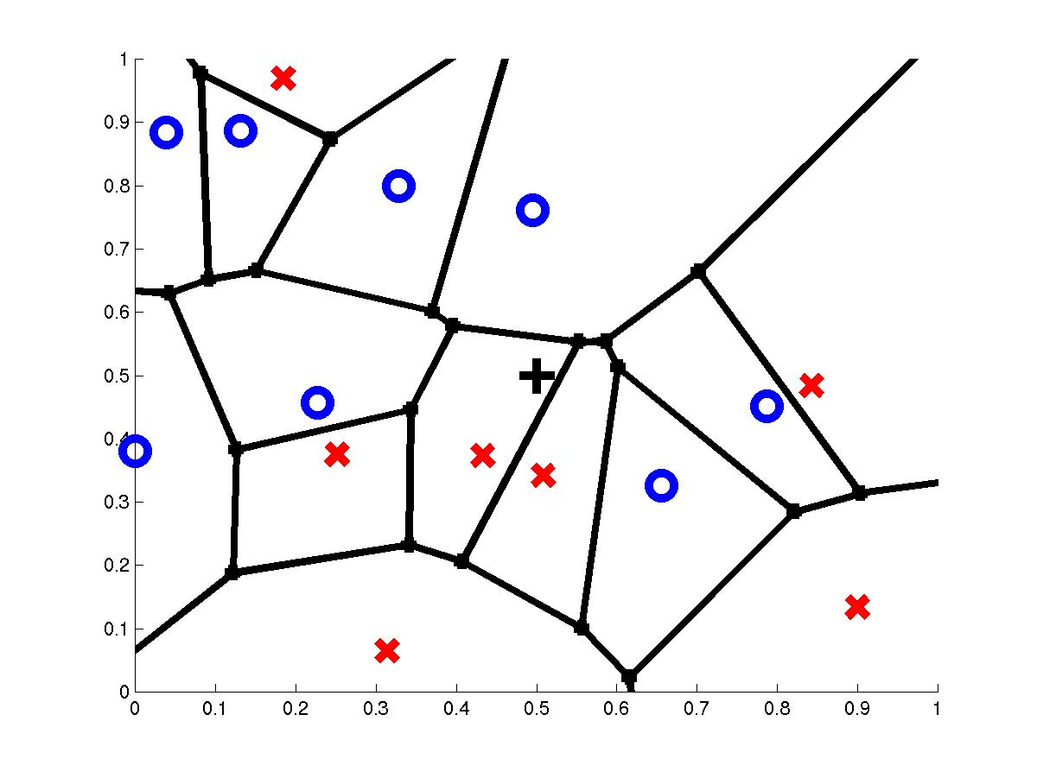
Voronoi Diagram
query point q_{f}
nearest neighbor q_{i}

Slide 8
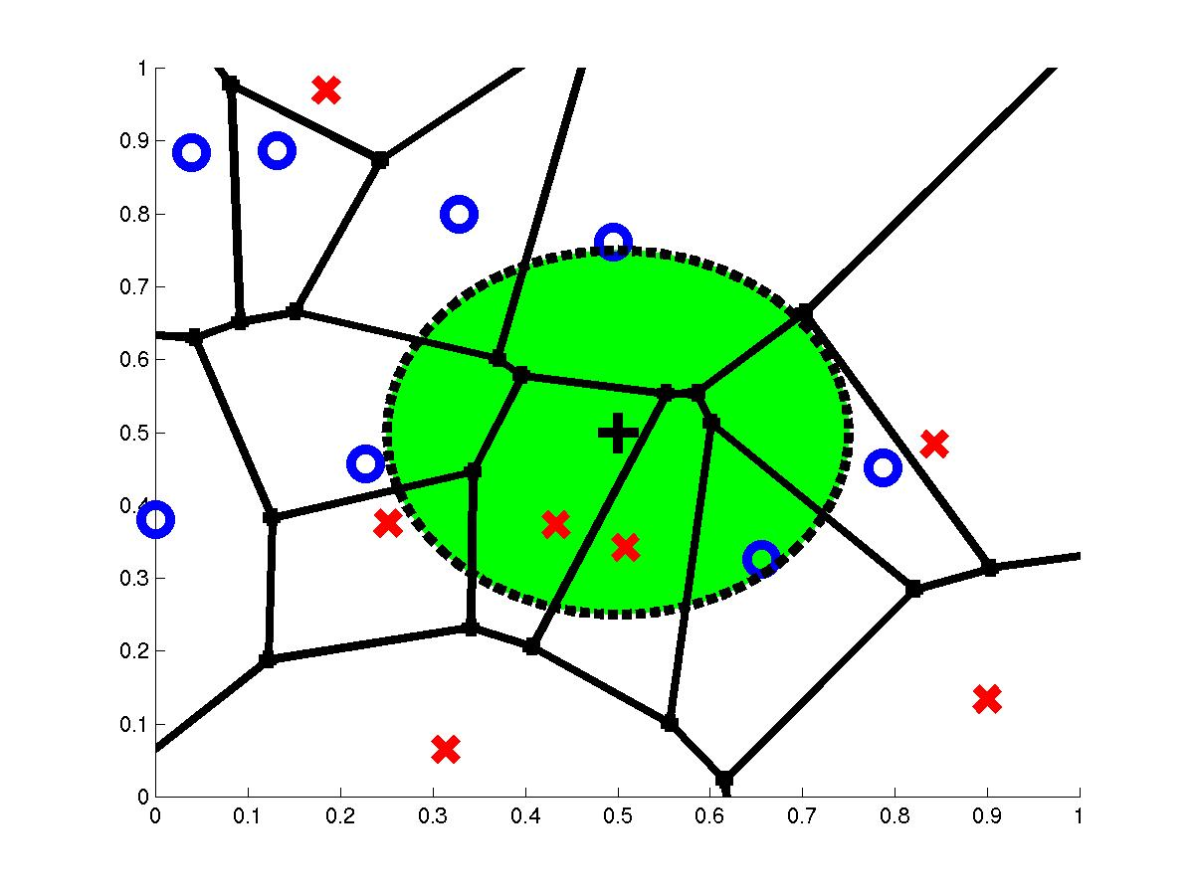
3-Nearest Neighbors
query point q_{f}
3 nearest neighbors
2x,1o

Slide 9
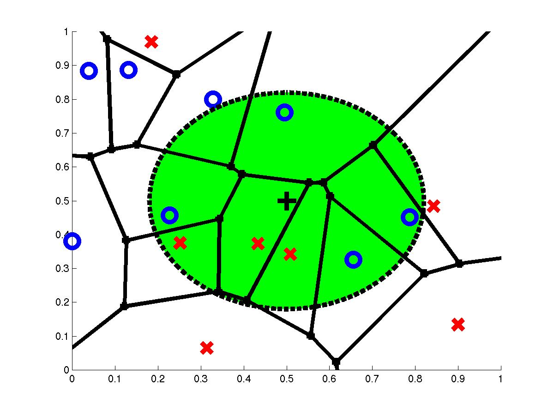
7-Nearest Neighbors
query point q_{f}
7 nearest neighbors
3x,4o

Slide 10
Behavior in the Limit
Consider p(x) the probability that instance x is classified as positive (1) versus negative (0)
Nearest neighbor:
As number of instances →∞ approaches Gibbs algorithm
Gibbs algorithm: with probability p(x) predict , else 0
K-nearest neighbors:
As number of instances →∞ approaches Bayes optimal classifier
Bayes optimal: if p(x)> 0.5 predict 1 else 0

Slide 11
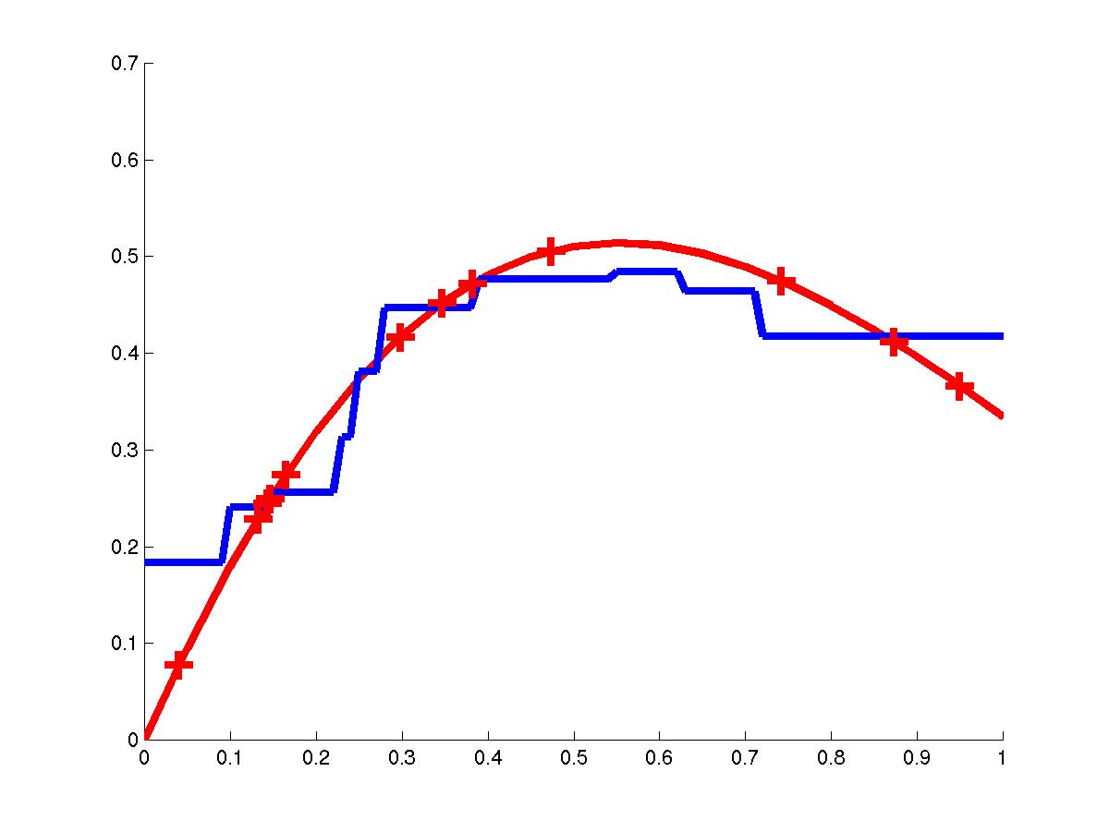
Nearest Neighbor (continuous)
3-nearest neighbor

Slide 12
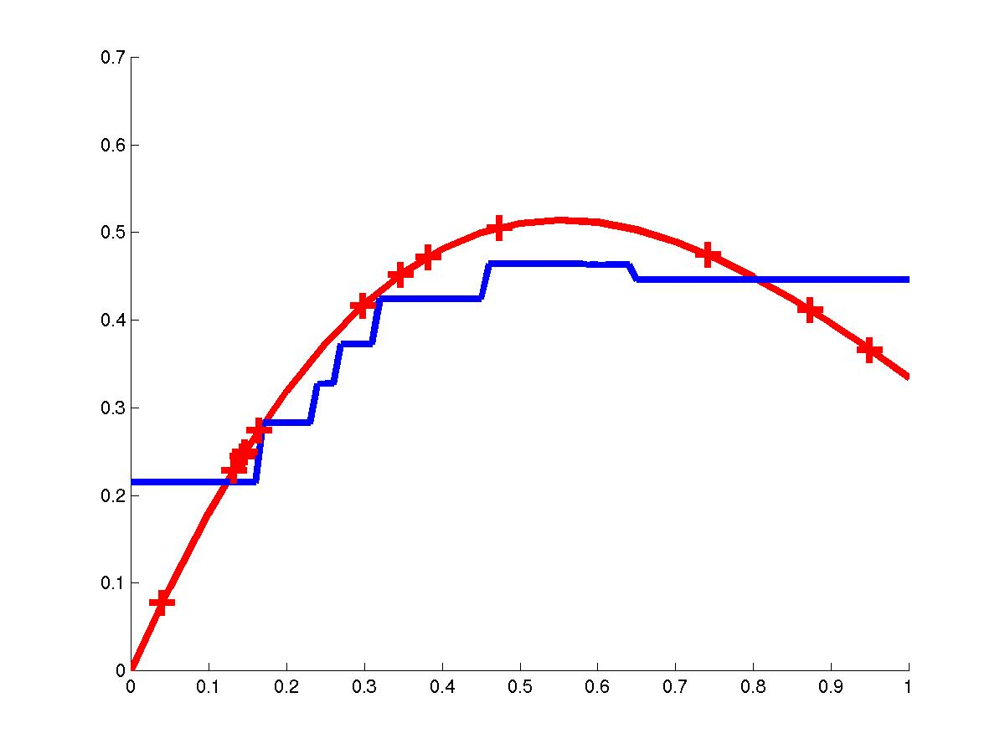
Nearest Neighbor (continuous)
5-nearest neighbor

Slide 13
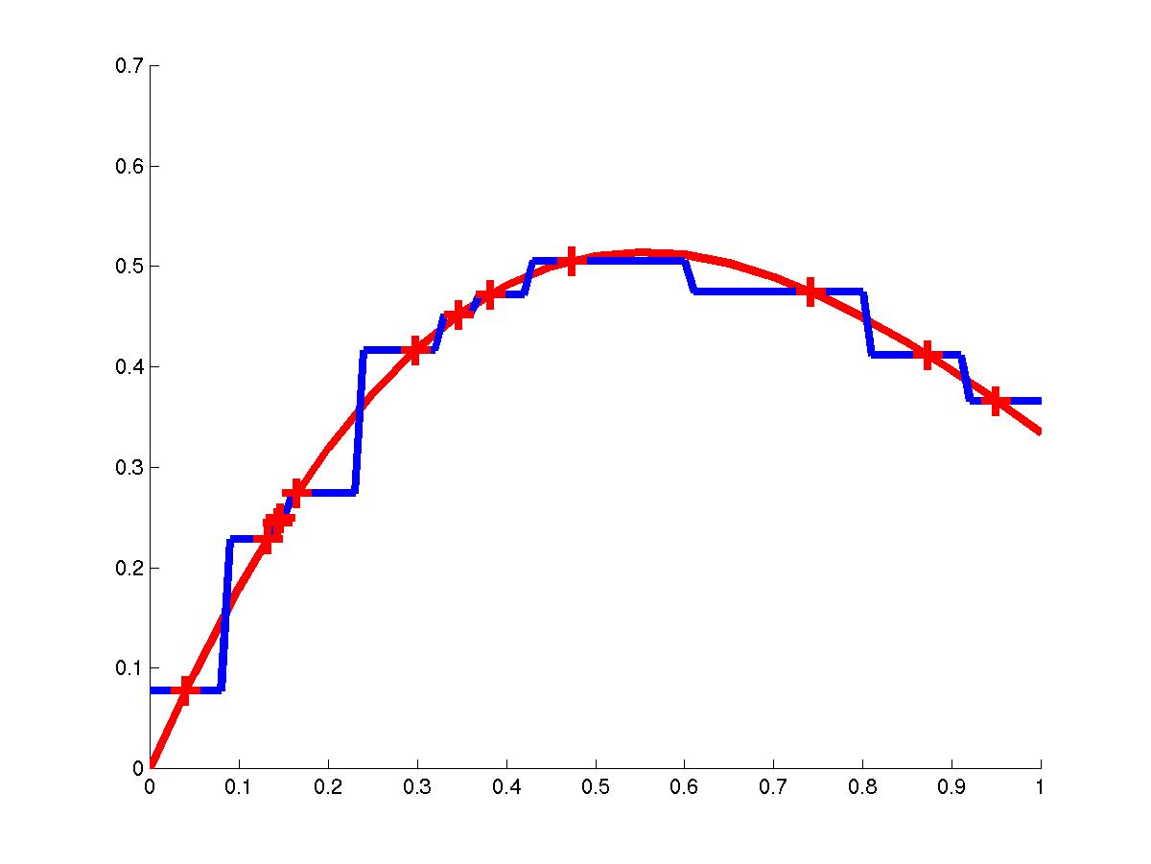
Nearest Neighbor (continuous)
1-nearest neighbor

Slide 14
Locally Weighted Regression
Forms an explicit approximation f*(x) for region surrounding query point x_{q}.
  Fit linear function to k nearest neighbors
  Fit quadratic function
  Produces piecewiese approximation of f
Squared error over k nearest neighbors
E(x_{q}) = Σ_{xi ∈ nearest neighbors} (f*(x_{q})-f(x_{i}))²
Distance weighted error over all neighbors
E(x_{q}) = Σ_{i} (f*(x_{q})-f(x_{i}))² K(d(x_{i},x_{q}))

Slide 15
Locally Weighted Regression
Regression means approximating a real-valued target function
Residual is the error f*(x)-f(x)
in approximating the target function
Kernel function is the function of distance that is used to determine the weight of each training example. In other words, the kernel function is the function K such that w_{i}=K(d(x_{i},x_{q}))

Slide 16
Distance Weighted k-NN
Give more weight to neighbors closer to the query point
f*(x_{q}) = Σ_{i=1}^{k} w_{i} f(x_{i}) / Σ_{i=1}^{k} w_{i}
where w_{i}=K(d(x_{q},x_{i}))
and d(x_{q},x_{i}) is the distance between x_{q} and x_{i}
Instead of only k-nearest neighbors use all training examples (Shepard’s method)

Slide 17
Distance Weighted Average
Weighting the data:
  f*(x_{q}) = Σ_{i} f(x_{i}) K(d(x_{i},xq))/ Σ_{i} K(d(x_{i},x_{q}))
  Relevance of a data point (x_{i},f(x_{i})) is measured by calculating the distance d(x_{i},x_{q}) between the query x_{q} and the input vector x_{i}
Weighting the error criterion:
E(x_{q}) = Σ_{i} (f*(x_{q})-f(x_{i}))² K(d(x_{i},x_{q}))
the best estimate f*(x_{q}) will minimize the cost E(x_{q}), therefore ∂E(x_{q})/∂f*(x_{q})=0

Slide 18
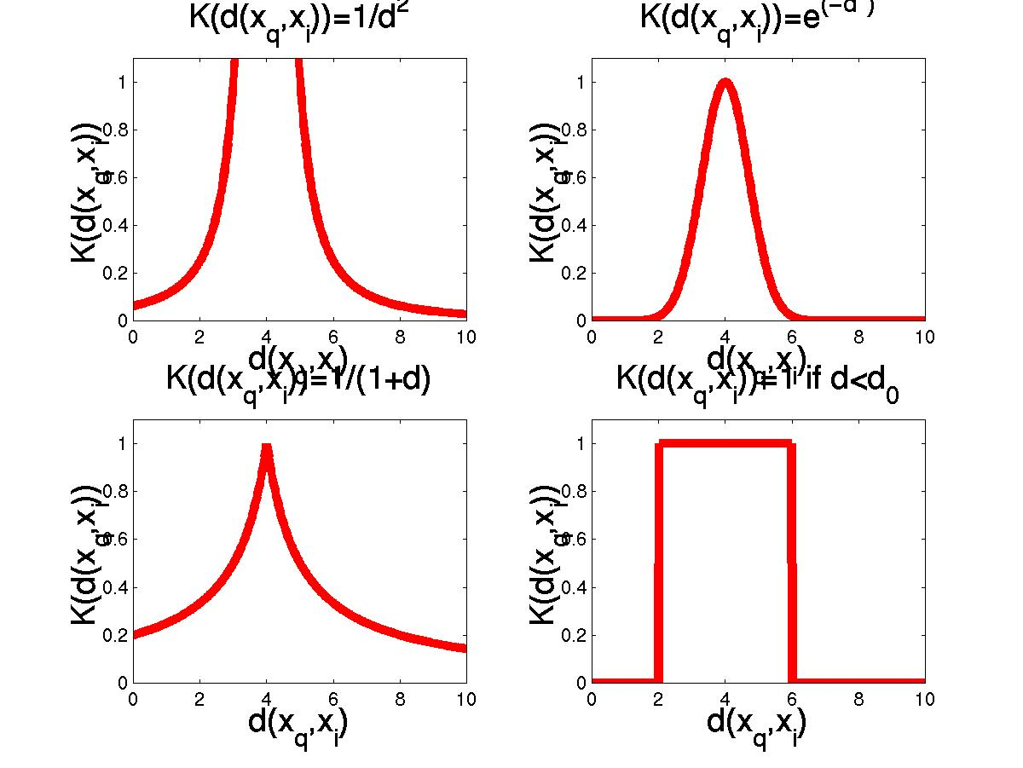
Kernel Functions

Slide 19
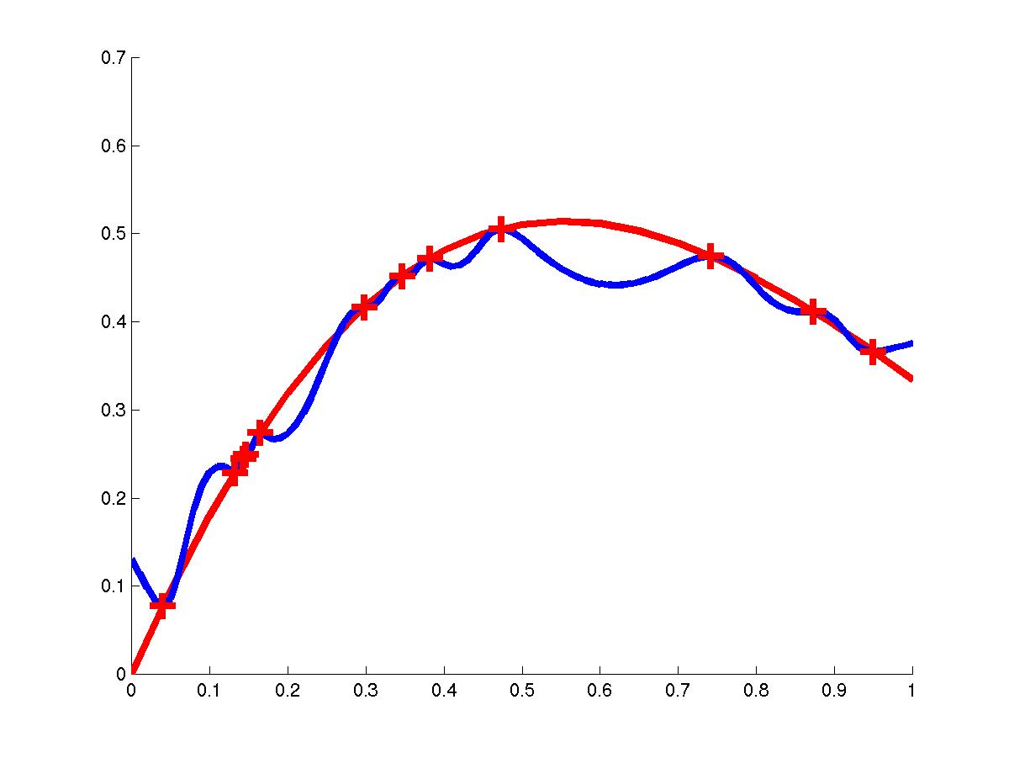
Distance Weighted NN
K(d(x_{q},x_{i})) = 1/ d(x_{q},x_{i})²

Slide 20
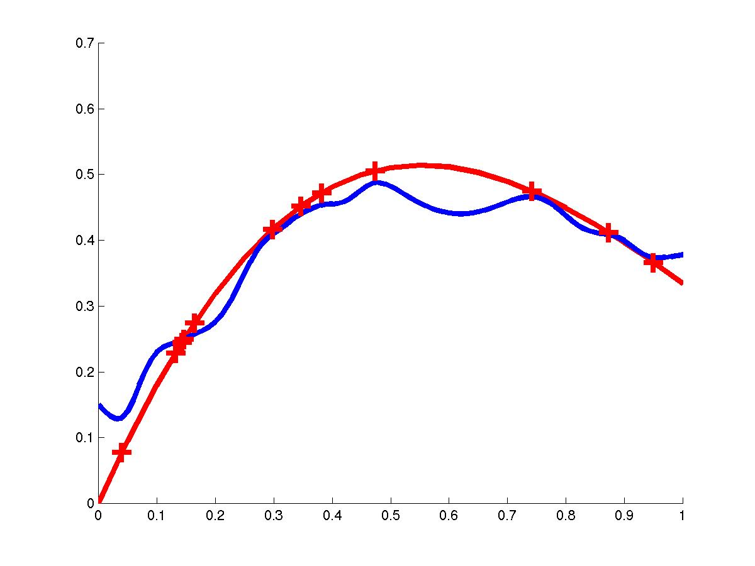
Distance Weighted NN
K(d(x_{q},x_{i})) = 1/(d₀+d(x_{q},x_{i}))²

Slide 21
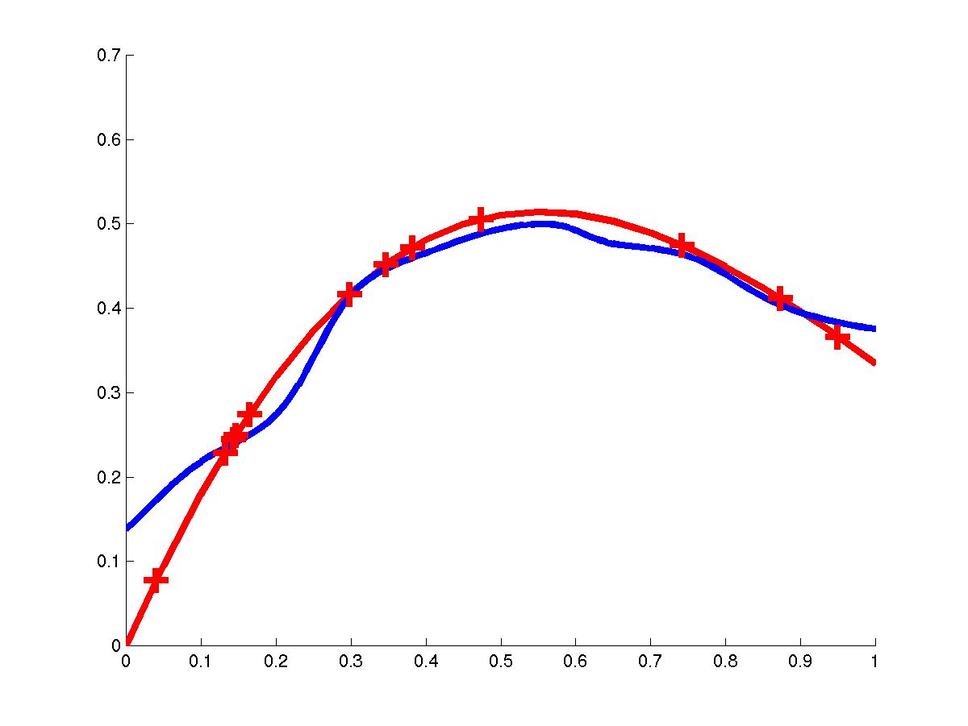
Distance Weighted NN
K(d(x_{q},x_{i})) = exp(-(d(x_{q},x_{i})/σ₀)²)

Slide 22
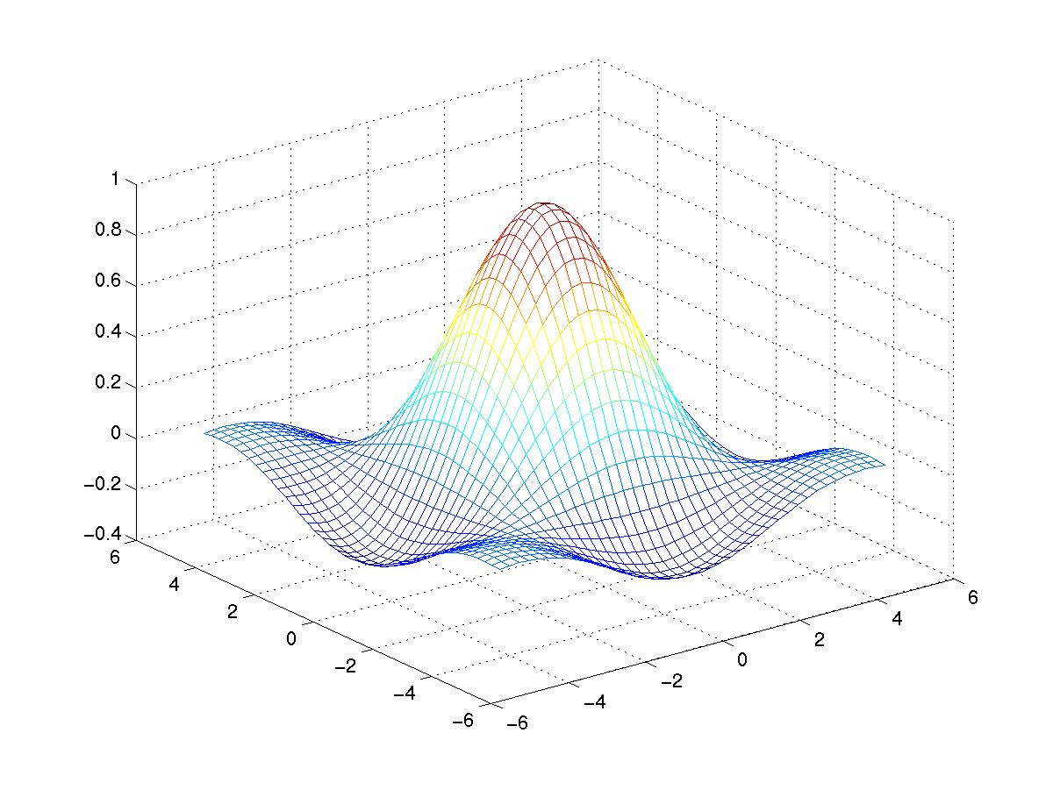
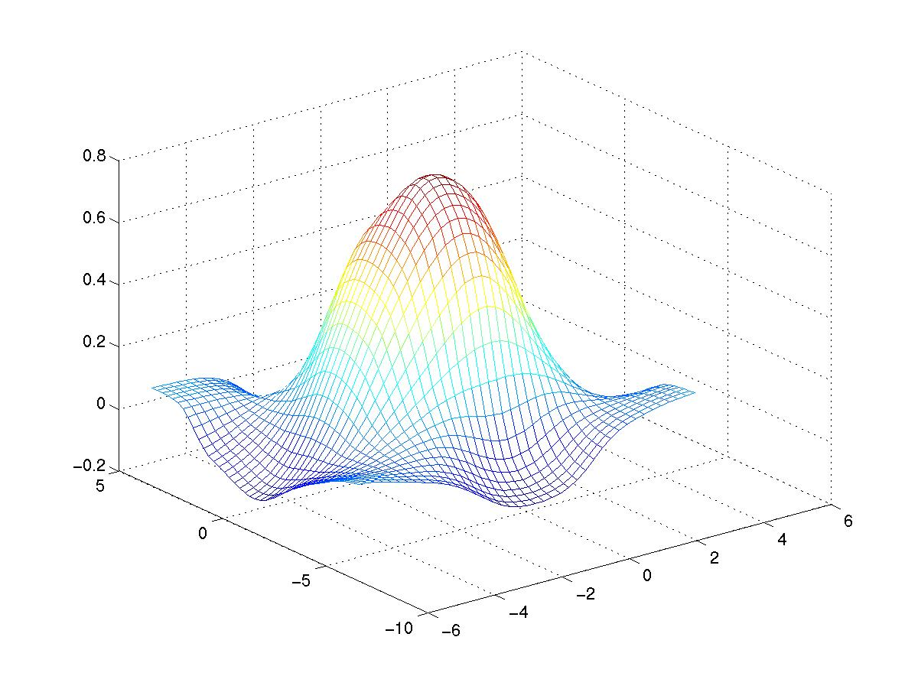
Example: Mexican Hat
f(x₁,x₂)=sin(x₁)sin(x₂)/x₁x₂
approximation

Slide 23
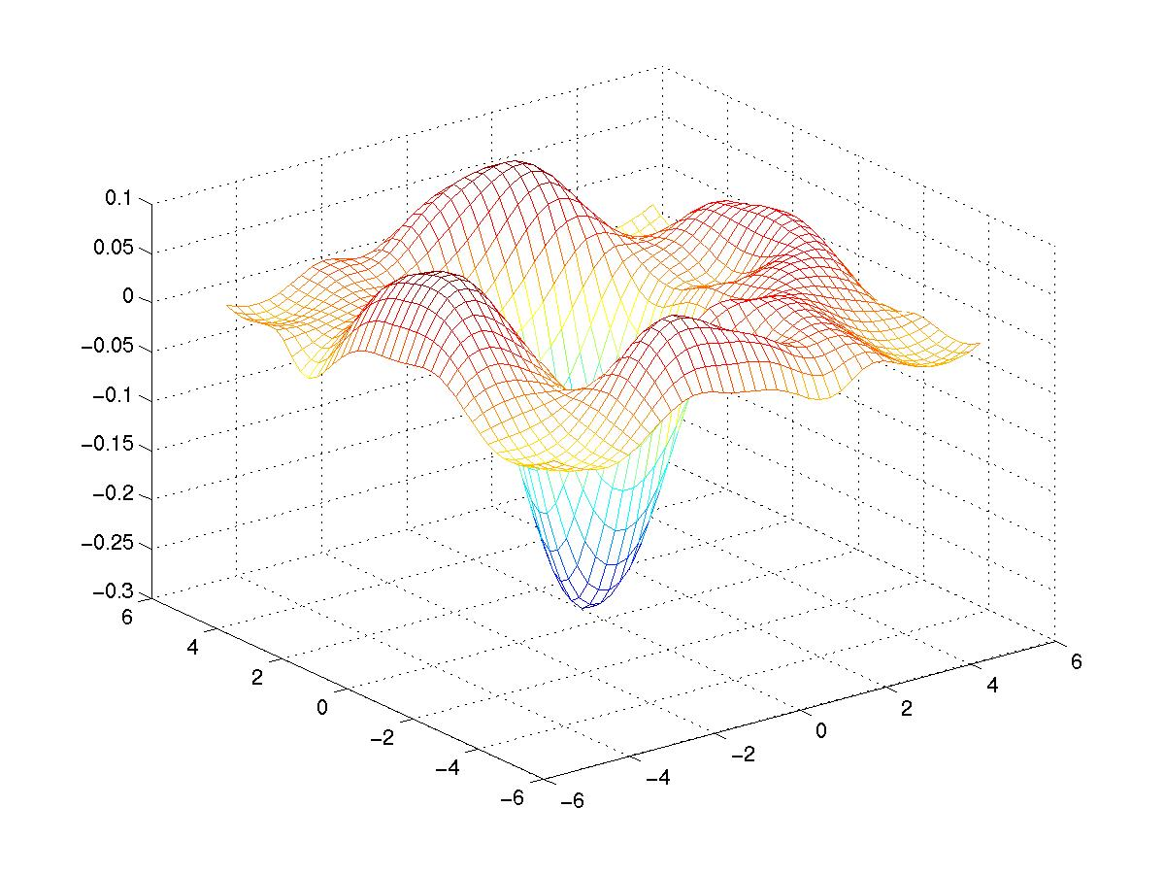
Example: Mexican Hat
residual

Slide 24
Locally Weighted Linear Regression
Local linear function
f*(x) = w₀ + Σ_{n} w_{n} x_{n}
Error criterion
E = Σ_{i} (w₀ + Σ_{n} w_{n} x_{qn} -f(x_{i}))² K(d(x_{i},x_{q}))
Gradient descent
  Δw_{n} = Σ_{i} (f*(x_{q})- f(x_{i})) x_{n} K(d(x_{i},x_{q}))
Least square solution
  w = ((KX)^{T} KX)⁻¹ (KX)^{T} f(X)
  with KX NxM matrix of row vectors K(d(x_{i},x_{q})) x_{i} and
  f(X) is a vector whose i-th element is f(x_{i})

Slide 25
Curse of Dimensionality
Imagine instances described by 20 attributes but only are relevant to target function
Curse of dimensionality: nearest neighbor is easily misled when instance space is high-dimensional
One approach:
Stretch j-th axis by weight z_{j}, where z₁,…,z_{n} chosen to minimize prediction error
Use cross-validation to automatically choose weights z₁,…,z_{n}
Note setting z_{j} to zero eliminates this dimension alltogether (feature subset selection)

Slide 26
Linear Global Models
The model is linear in the parameters β_{k}, which can be estimated using a least squares algorithm
  f^(x_{i}) = Σ_{k=1}^{D} w_{k} x_{ki} or F(x) = X β
  Where x_{i}=(x₁,…,x_{D})_{i}, i=1..N, with D the input dimension and N the number of data points.
  Estimate the β_{k} by minimizing the error criterion
  E= Σ_{i=1}^{N} (f^(x_{i}) – y_{i})²
  (X^{T}X) β = X^{T} F(X)
  β = (X^{T} X)⁻¹ X^{T} F(X)
  β_{k}= Σ_{m=1}^{D} Σ_{n=1}^{N} (Σ_{l=1}^{D} x^{T}_{kl} x_{lm})⁻¹ x^{T}_{mn} f(x_{n})

Slide 27
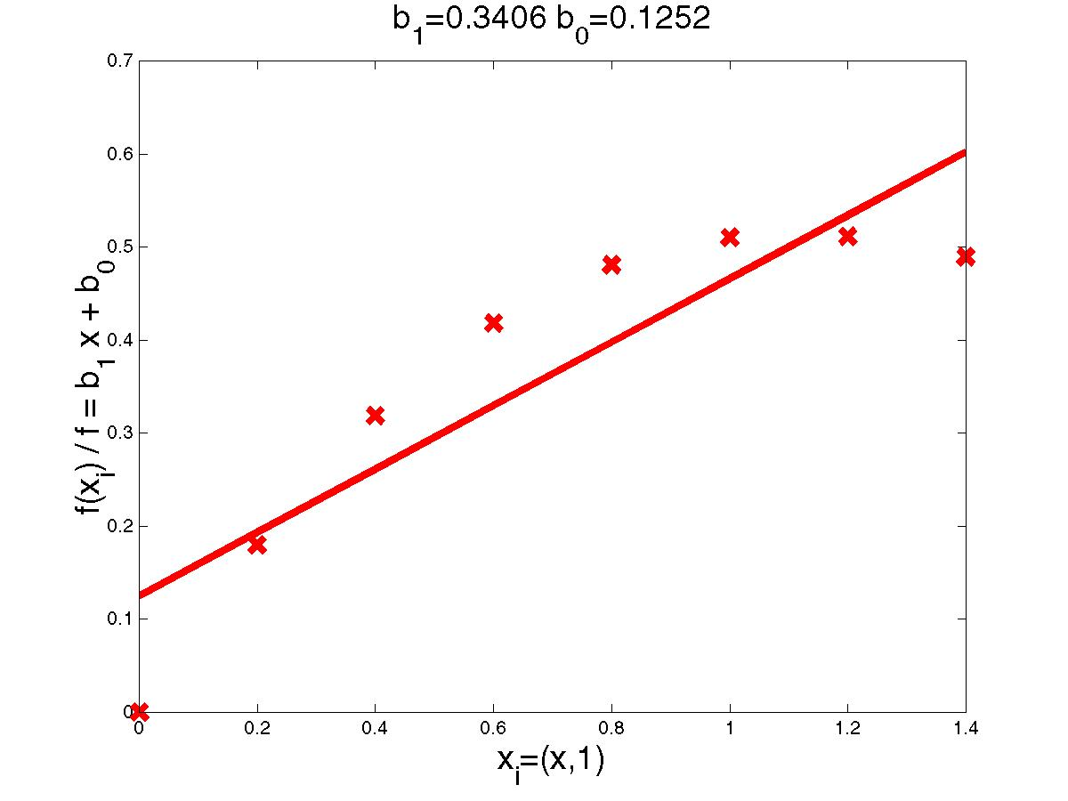
Linear Regression Example

Slide 28
Linear Local Models
Estimate the parameters β_{k} such that they locally (near the query point x_{q}) match the training data either by
weighting the data:
  w_{i}=K(d(x_{i},x_{q}))^{1/2} and transforming
  z_{i}=w_{i} x_{i}
  v_{i}=w_{i} y_{i}
or by weighting the error criterion:
E= Σ_{i=1}^{N} (x_{i}^{T} β – y_{i})² K(d(x_{i},x_{q}))
still linear in β with LSQ solution
  β = ((WX)^{T} WX)⁻¹ (WX)^{T} F(X)

Slide 29
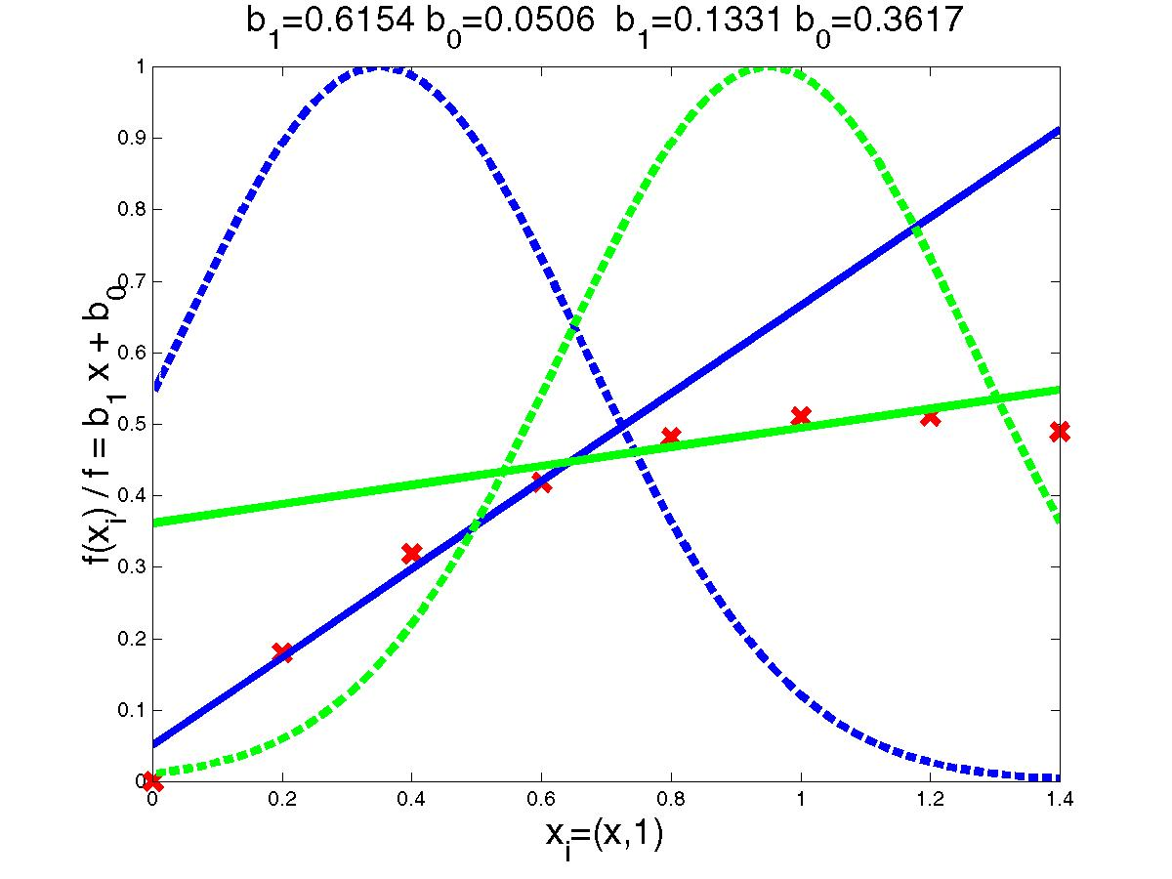
Linear Local Model Example
Kernel K(x,x_{q})
Local linear
model:
f^(x)=b₁x+b₀
f^(x_{q})=0.266
query point
X_{q}=0.35

Slide 30
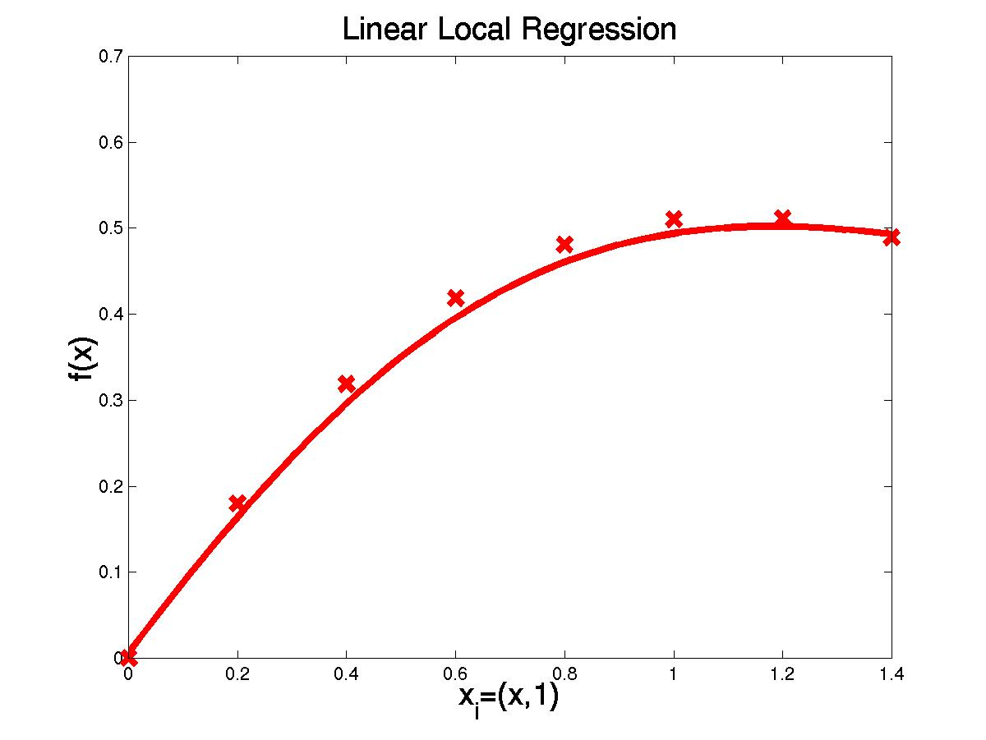
Linear Local Model Example

Slide 31
Design Issues in Local Regression
Local model order (constant, linear, quadratic)
Distance function d
feature scaling: d(x,q)=(Σ_{j=1}^{d} m_{j}(x_{j}-q_{j})²)^{1/2}
irrelevant dimensions m_{j}=0
kernel function K
smoothing parameter bandwidth h in K(d(x,q)/h)
  h=|m| global bandwidth
  h= distance to k-th nearest neighbor point
  h=h(q) depending on query point
  h=h_{i} depending on stored data points
See paper by Atkeson [1996] ”Locally Weighted Learning”

Slide 32
Radial Basis Function Network
Global approximation to target function in terms of linear combination of local approximations
Used, e.g. for image classification
Similar to back-propagation neural network but activation function is Gaussian rather than sigmoid
Closely related to distance-weighted regression but ”eager” instead of ”lazy”

Slide 33
Radial Basis Function Network
output f(x)
w_{n}
linear parameters
Kernel functions
K_{n}(d(x_{n},x))=
exp(-1/2 d(x_{n},x)²/σ²)
x_{i}
input layer
f(x)=w₀+Σ_{n=1}^{k} w_{n} K_{n}(d(x_{n},x))

Slide 34
Training Radial Basis Function Networks
How to choose the center x_{n} for each Kernel function K_{n}?
  scatter uniformly across instance space
  use distribution of training instances (clustering)
How to train the weights?
  Choose mean x_{n} and variance σ_{n} for each K_{n}
  non-linear optimization or EM
  Hold K_{n} fixed and use local linear regression to compute the optimal weights w_{n}

Slide 35
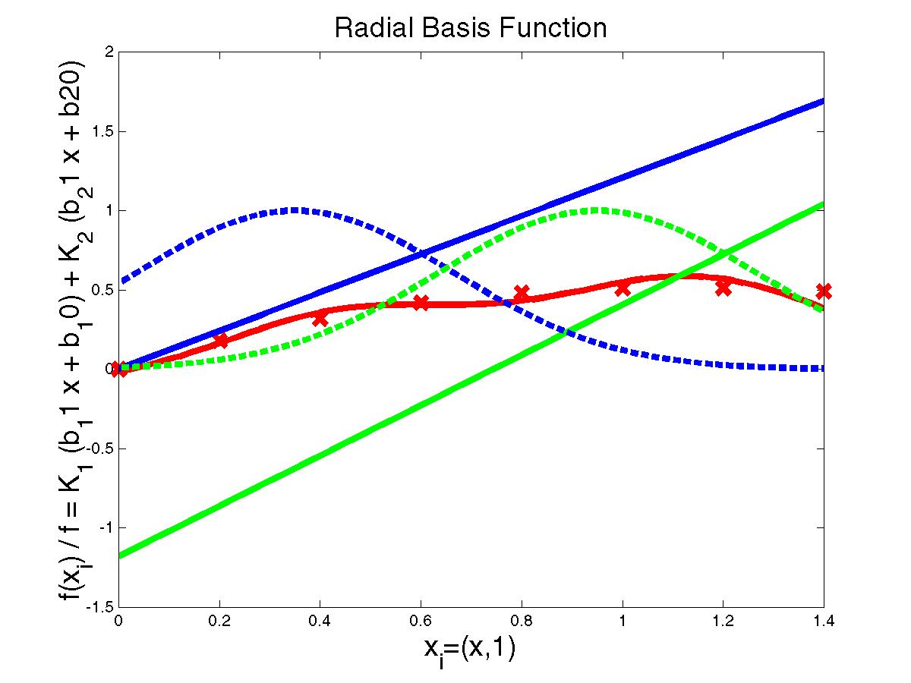
Radial Basis Network Example
K₁(d(x₁,x))=
exp(-1/2 d(x₁,x)²/σ²)
w₁ x+ w₀
f^(x) = K₁ (w₁ x+ w₀)
+ K₂ (w₃ x + w₂)

Slide 36
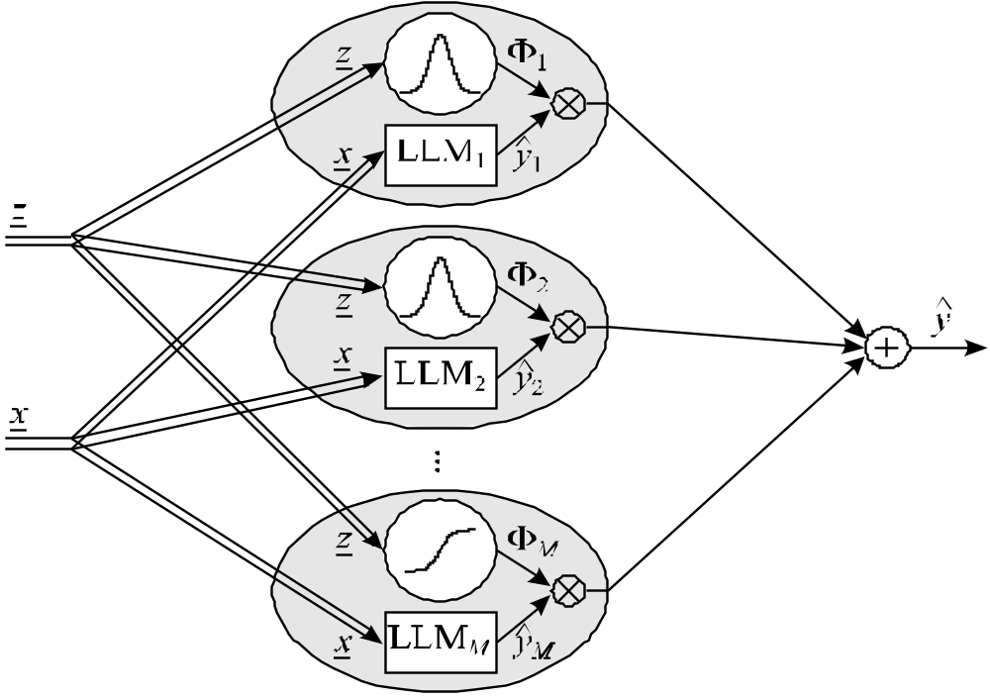
Local Linear Models

Slide 37
Local Linear Model Tree (LOLIMOT)
incremental tree construction algorithm
partitions input space by axis-orthogonal splits
adds one local linear model per iteration
start with an initial model (e.g. single LLM)
identify LLM with worst model error E_{i}
check all divisions : split worst LLM hyper-rectangle
in halves along each possible dimension
find best (smallest error) out of possible divisions
add new kernel function and LLM
repeat from step 2. until termination criteria is met

Slide 38
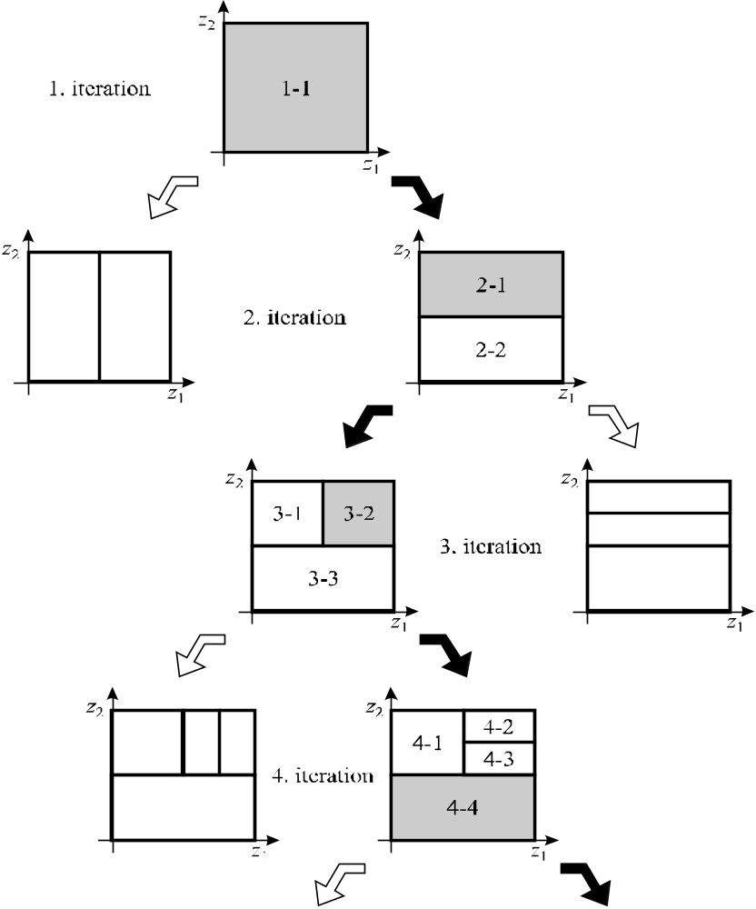
LOLIMOT
Initial global linear model
Split along x1 or x2
Pick split that minimizes
model error (residual)

Slide 39
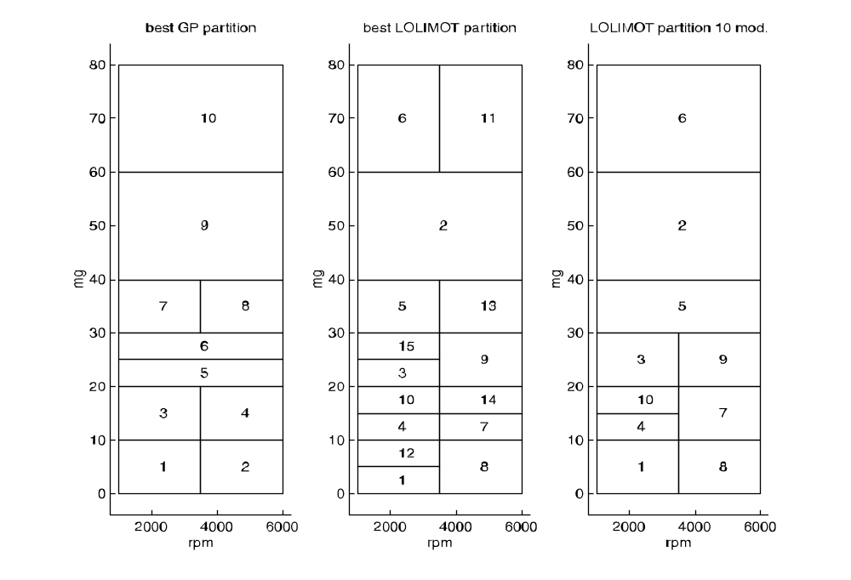
LOLIMOT Example

Slide 40
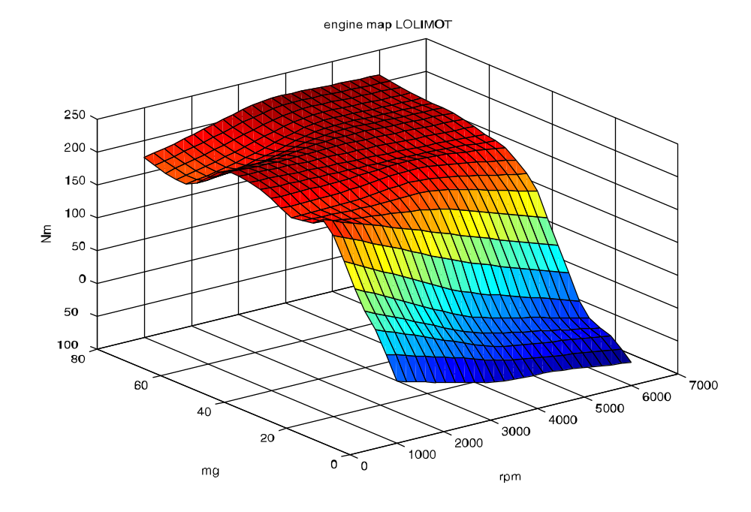
LOLIMOT Example

Slide 41
Lazy and Eager Learning
Lazy: wait for query before generalizing
  k-nearest neighbors, weighted linear regression
Eager: generalize before seeing query
  Radial basis function networks, decision trees, back-propagation, LOLIMOT
Eager learner must create global approximation
Lazy learner can create local approximations
If they use the same hypothesis space, lazy can represent more complex functions (H=linear functions)

Slide 42
Laboration 3
Distance weighted average
Cross-validation for optimal kernel width σ
Leave 1-out cross-validation
  f*(x_{q}) = Σ_{i≠q} f(x_{i}) K(d(x_{i},xq))/ Σ_{i ≠q} K(d(x_{i},x_{q}))
Cross-validation for feature subset selection
Neural Network

Slide 43
Question of the Day
U2 has to give a concert in 17 minutes. In order to get to the arena they have to cross a bridge. It is dark and they have to use a torch light. The bridge can only carry two persons at a time, one of the band members has to return the torch light to the other side for the next party to cross. The four walk at different speeds, A needs 1 minute for a crossing, B 2 minutes, C 5 minutes and D 10 minutes. The slower of the pair determines how long it takes to cross. How can they reach the concert in time?
A,B -> A<- C,D-> B-> A,B->
2 + 1 + 10 + 2 + 2 = 17

