Slide 1
Radial-Basis Function Networks
A function is approximated as a linear combination of radial basis functions (RBF). RBF’s capture local behaviors of functions.
Biological motivation:
RBF’s represent local receptors:

Slide 2


ARCHITECTURE
Input layer: source
of nodes that
connect the NN
with its
environment.
x₁
w₁
x₂
y
w_{m1}
x_{m}
Hidden layer: applies a non-linear transformation from the input space to the hidden space.
Output layer: applies a linear transformation from the hidden space to the output space.

Slide 3
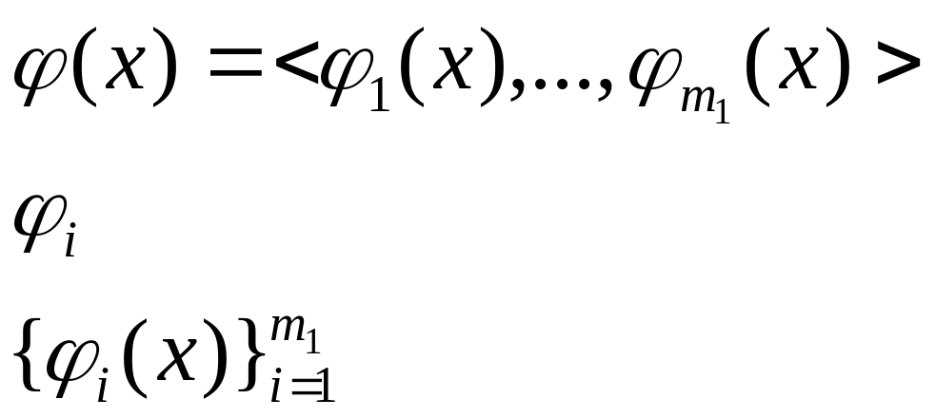
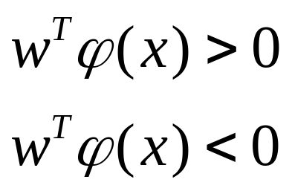
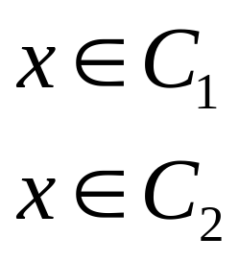
φ-separability of patterns
Hidden function
Hidden space
A (binary) partition, also called dichotomy, (C₁,C₂) of the training set C is φ-separable if there is a vector w of dimension m₁ such that:

Slide 4
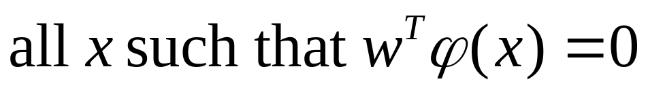
Examples of φ-separability
Separating surface:
Examples of separable partitions (C1,C2):
Linearly separable:
Quadratically separable:
Spherically separable:

Slide 5
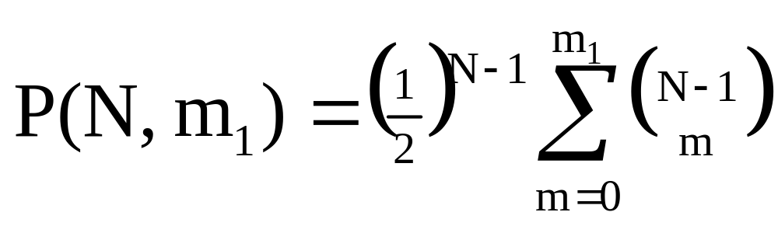
Cover theorem
size of feature space φ =<ϕ1, …, ϕm1>
P(N, m₁) Probability that a particular partition (C1,C2) of the training set C picked at random is φ-separable
Cover theorem. Under suitable assumptions on C = {x₁, …, x_{N}} and on the partitions (C1,C2) of C:

Slide 6
Cover Theorem
A complex pattern-classification problem cast in a high-dimensional space non-linearly is more likely to be linearly separable than in a low-dimensional space
Corollary:
  The expected maximum number of randomly assigned patterns that are linearly separable in a space of dimension m₁ is equal to 2m₁

Slide 7
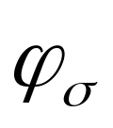
HIDDEN NEURON MODEL
Hidden units: use a radial basis function
φ_{σ}( || x - t||²)
the output depends on the distance of
the input x from the center t
x₁
φ_{σ}( || x - t||²)
t is called center
σ is called spread
center and spread are parameters
x₂
x_{m}

Slide 8
Hidden Neurons
A hidden neuron is more sensitive to data points near its center. This sensitivity may be tuned by adjusting the spread σ.
Larger spread ⇒ less sensitivity
Biological example: cochlear stereocilia cells have locally tuned frequency responses.

Slide 9
Gaussian Radial Basis Function φ
φ :
center
σ is a measure of how spread the curve is:
Large σ
Small σ

Slide 10
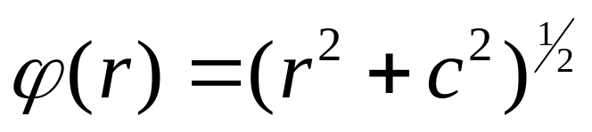
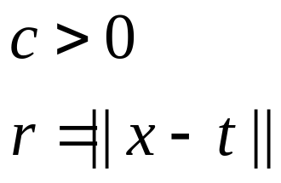
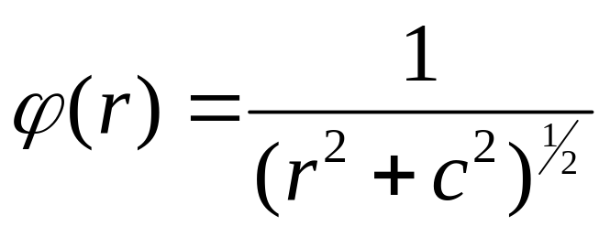

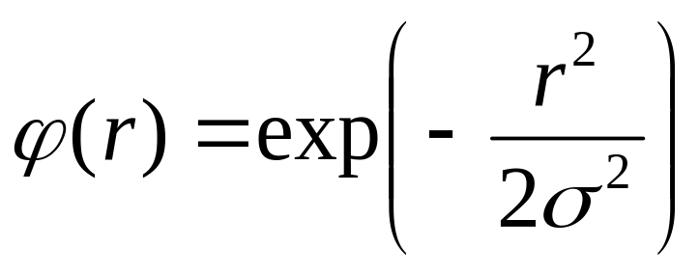

Types of φ
Multiquadrics:
Inverse multiquadrics:
Gaussian functions:

Slide 11
Example: the XOR problem
x₂
Input space:
Output space:
Construct an RBF pattern classifier such that:
  (0,0) and (1,1) are mapped to 0, class C1
  (1,0) and (0,1) are mapped to 1, class C2
(0,1)
(1,1)
x₁
(0,0)
(1,0)
0
1
y

Slide 12
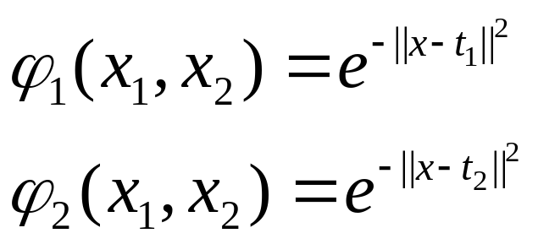
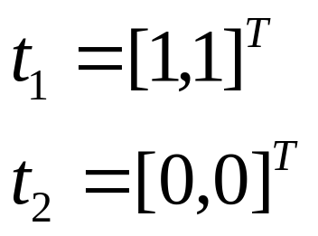
Example: the XOR problem
In the feature (hidden) space:
When mapped into the feature space < ϕ₁ , ϕ₂ >, C1 and C2 become linearly separable. So a linear classifier with ϕ₁(x) and ϕ₂(x) as inputs can be used to solve the XOR problem.
φ₂
(0,0)
Decision boundary
1.0
0.5
(1,1)
0.5
1.0
φ₁
(0,1) and (1,0)

Slide 13
Learning Algorithms
Parameters to be learnt are:
  centers
  spreads
  weights
Different learning algorithms

Slide 14
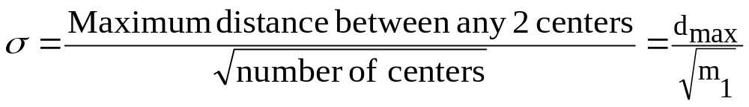
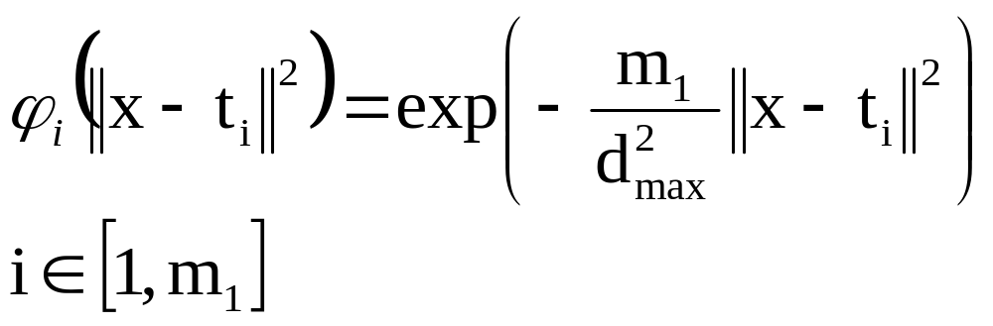
Learning Algorithm 1
Centers are selected at random
  center locations are chosen randomly from the training set
Spreads are chosen by normalization:

Slide 15
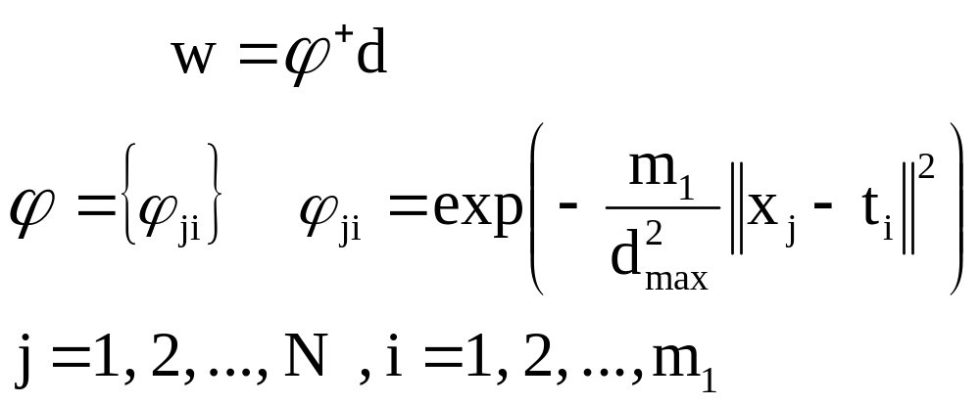

Learning Algorithm 1
Weights are found by means of pseudo-inverse method
Desired response
Pseudo-inverse of

Slide 16
Learning Algorithm 2
Hybrid Learning Process:
    Self-organized learning stage for finding the centers
    Spreads chosen by normalization
    Supervised learning stage for finding the weights, using LMS algorithm

Slide 17
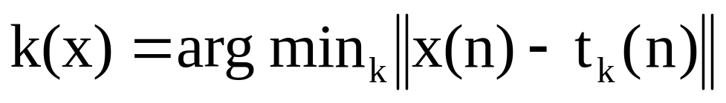
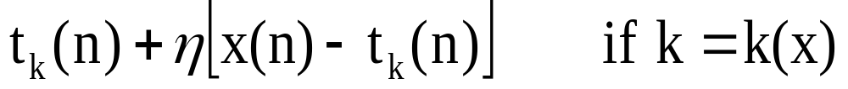
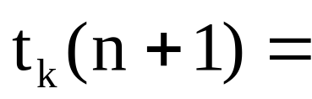
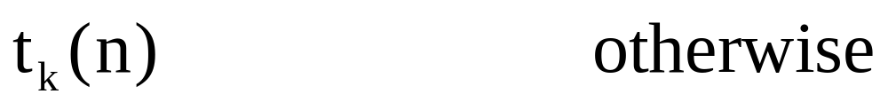
Learning Algorithm 2: Centers
K-means clustering algorithm for centers
  Initialization: t_{k}(0) random k = 1, …, m₁
  Sampling: draw x from input space C
  Similarity matching: find index of best center
  Updating: adjust centers
  Continuation: increment n by 1, goto 2 and continue until no noticeable changes of centers occur

Slide 18
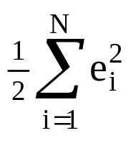
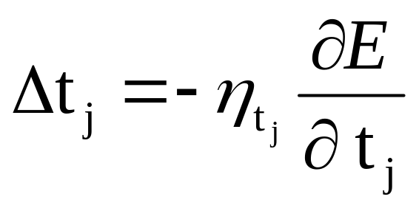

Learning Algorithm 3
Supervised learning of all the parameters using the gradient descent method
  Modify centers
Instantaneous error function
Learning rate for
Depending on the specific function can be computed using the chain rule of calculus

Slide 19
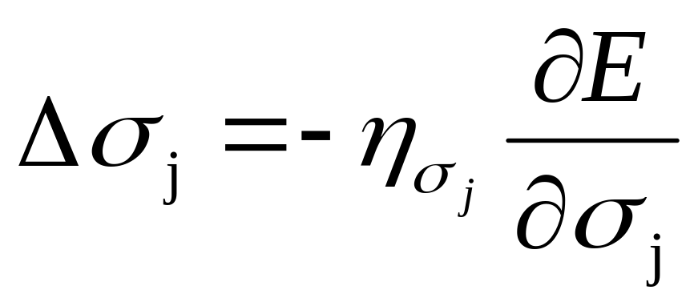
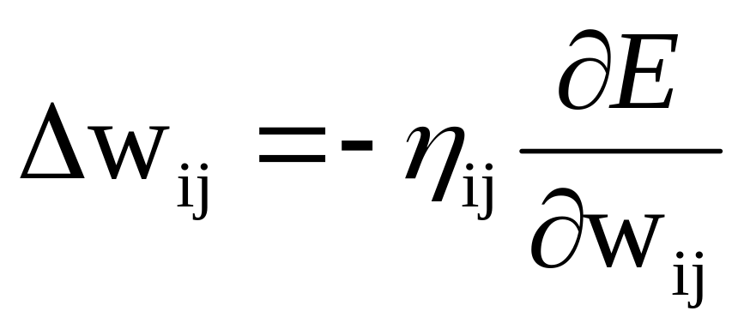
Learning Algorithm 3
Modify spreads
Modify output weights

Slide 20
Comparison with multilayer NN
RBF-Networks are used to perform complex (non-linear) pattern classification tasks.
Comparison between RBF networks and multilayer perceptrons:
Both are examples of non-linear layered feed-forward networks.
Both are universal approximators.
Hidden layers:
  RBF networks have one single hidden layer.
  MLP networks may have more hidden layers.

Slide 21
Comparison with multilayer NN
Neuron Models:
  The computation nodes in the hidden layer of a RBF network are different. They serve a different purpose from those in the output layer.
  Typically computation nodes of MLP in a hidden or output layer share a common neuron model.
Linearity:
  The hidden layer of RBF is non-linear, the output layer of RBF is linear.
  Hidden and output layers of MLP are usually non-linear.

Slide 22
Comparison with multilayer NN
Activation functions:
  The argument of activation function of each hidden unit in a RBF NN computes the Euclidean distance between input vector and the center of that unit.
  The argument of the activation function of each hidden unit in a MLP computes the inner product of input vector and the synaptic weight vector of that unit.
Approximations:
  RBF NN using Gaussian functions construct local approximations to non-linear I/O mapping.
  MLP NN construct global approximations to non-linear I/O mapping.

