Slide 1
Parameterising Reconfigurable Designs for Image Warping
Jun Jiang and Wayne Luk
Department of Computing
Imperial College

Slide 2
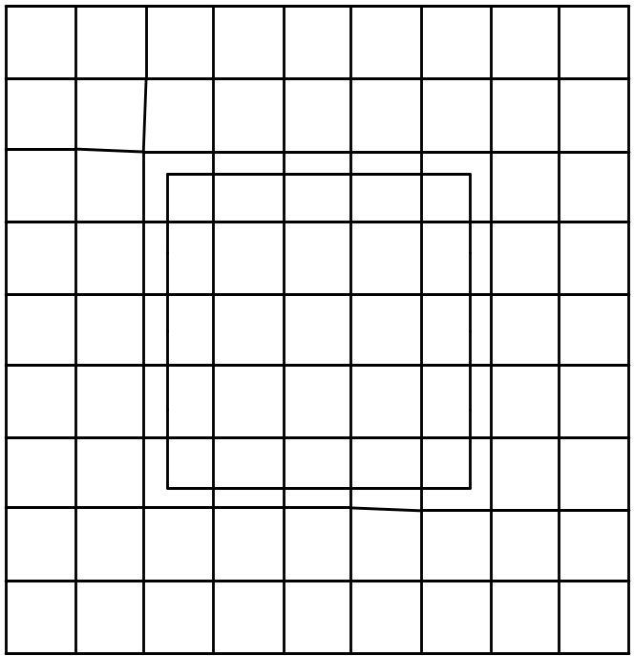
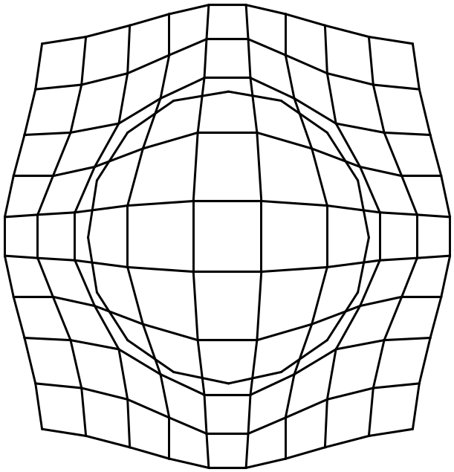
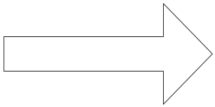
An example of warping

Slide 3
Application Area
Face recognition
Remote sensing
Medical imaging

Slide 4
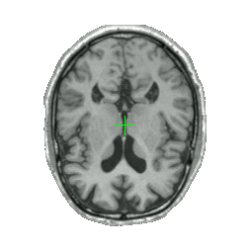
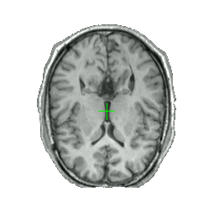
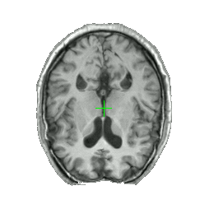
Why Warping?
Image Registration in Medical Imaging
  Aligning brain scans from different patients
Reference
(Healthy Brain)
Patient
(Not Registered)
Patient
(Registered using warping)

Slide 5
Image Warping: Our Approach
Based on radial basis functions
adopt Symmetric Bipartite Table Method (SBTM)
Parameterisable floating-point library
Fully-pipelined design

Slide 6
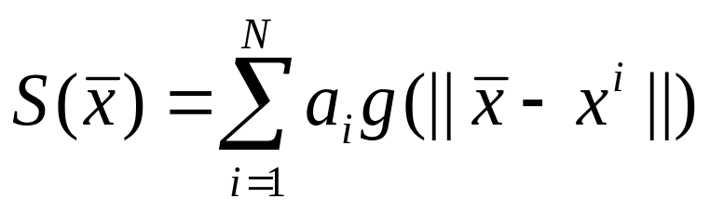
Warping Algorithm
Radial Basis Function:
  In order to interpolate image data points between control points x^{i} use:
  Problem with Pure Radial Sum:
    Poor approximation far away from control points
    Affine Transformation needed

Slide 7
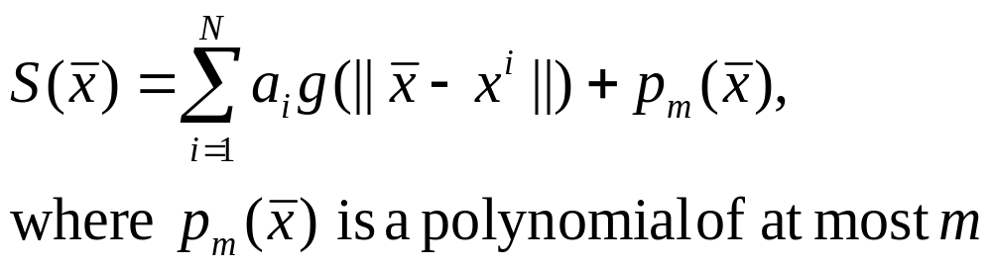
Warping Algorithm
Solution:
  Add Polynomial term to Radial Sum:
Problem:
  R² → R² mappings required, and interpolation deals with R^{d} → R

Slide 8
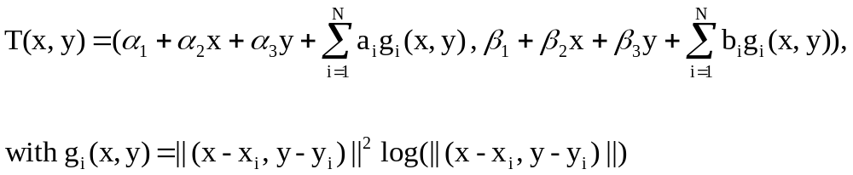
Radial Basis Function
Transformation

Slide 9
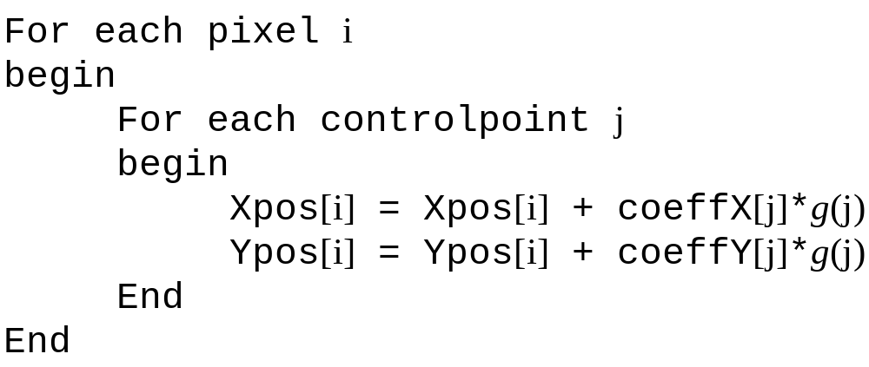
Inner loop

Slide 10
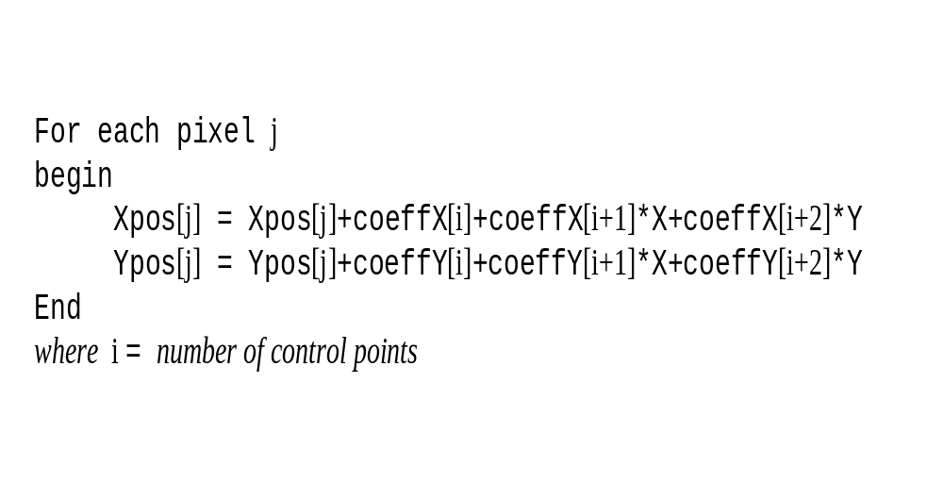
Outer loop

Slide 11
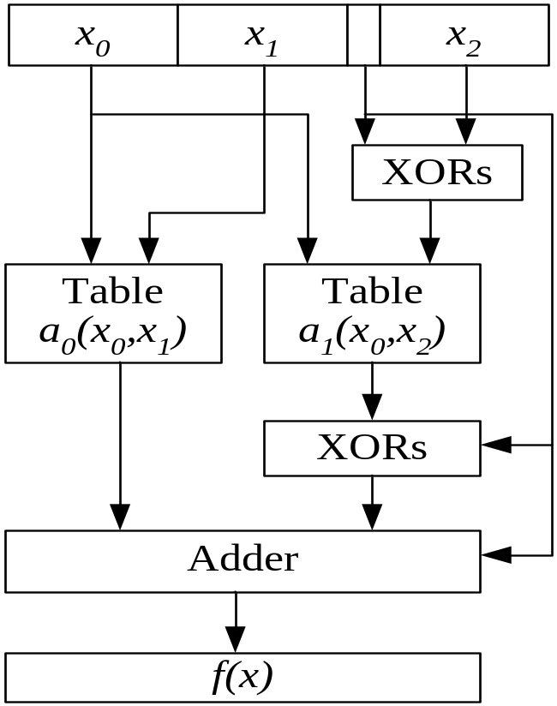
Symmetric Bipartite Table Method
Less memory
Shorter overall delays
Tighter error bound
Easy to implement
Can approximate almost any continuous function

Slide 12
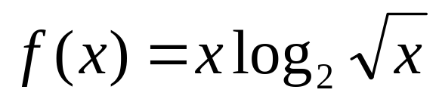
Accuracy vs Memory usage
Example:
n | n₀,n₁,n₂ | LUT size (A0) | LUT size (A1) | Norm. Area | Max. Error
26 | 9,8,9 | 128Kx28 | 128Kx11 | 4.4571 | 1.183E-8
23 | 8,7,8 | 32Kx25 | 32Kx10 | 1 | 9.275E-8
20 | 7,6,7 | 8Kx22 | 8Kx9 | 0.2214 | 7.341E-7

Slide 13
Custom number representation
Parameterisable floating-point library
Adjustable parameter in SBTM: trade off
  accuracy of the radial basis function
  memory usage of the lookup tables
Mix Integer and floating-point arithmetic

Slide 14
Parameterisable floating-point library
Mantissa and exponent can be changed at compile time
  To achieve a better performance to cost ratio
Gradual underflow, overflow protection and rounding modes are optional features
  Depending on the data to be processed, save area and faster

Slide 15
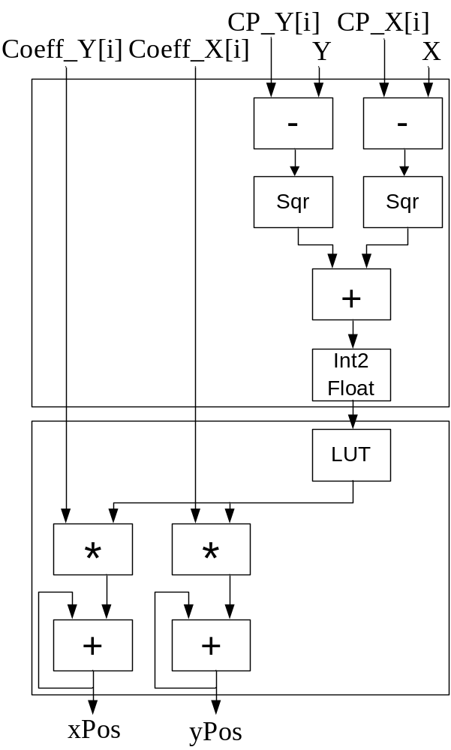
Mixing Arithmetic
Integer arithmetic
Floating-point arithmetic

Slide 16
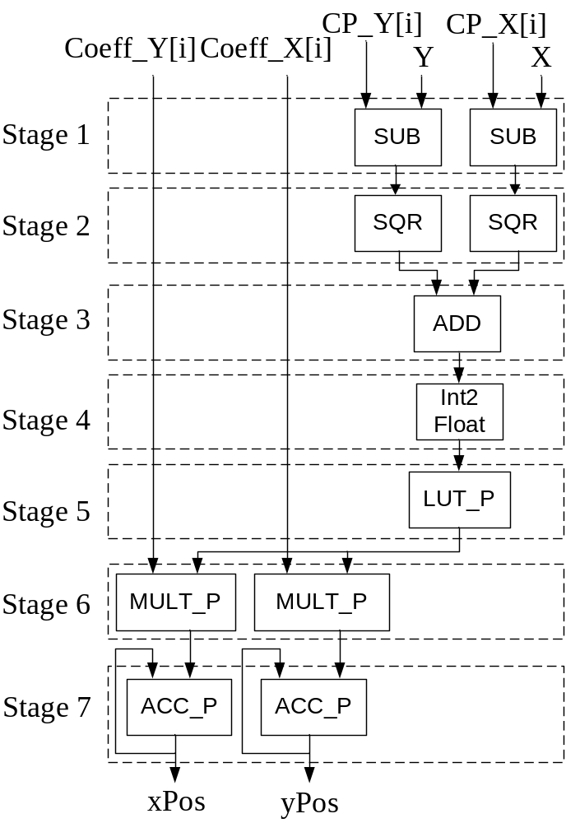
Fully pipelined design
Inner Loop

Slide 17
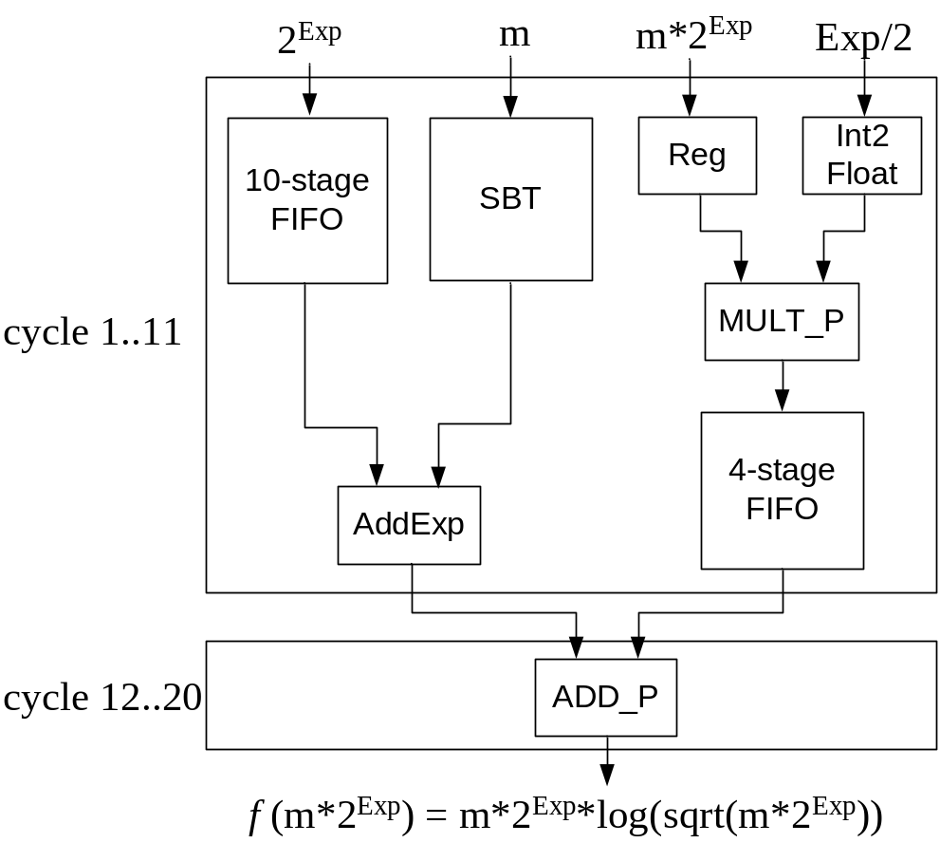
Mixing Arithmetic
Pipelined lookup table unit

Slide 18
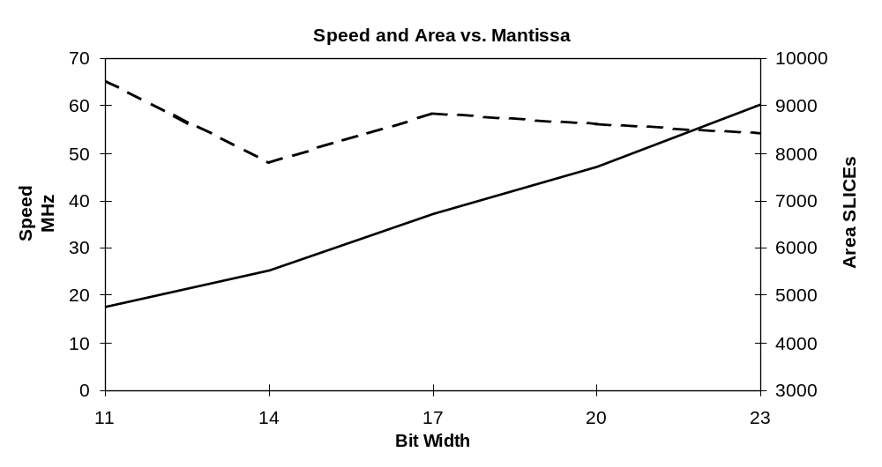
Speed and Area vs Mantissa
85% smaller in area while 104% faster

Slide 19
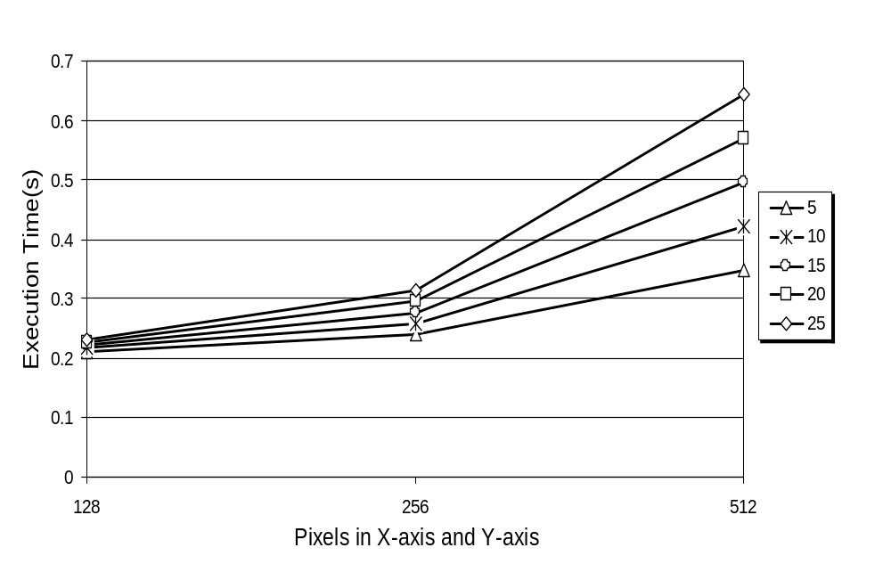
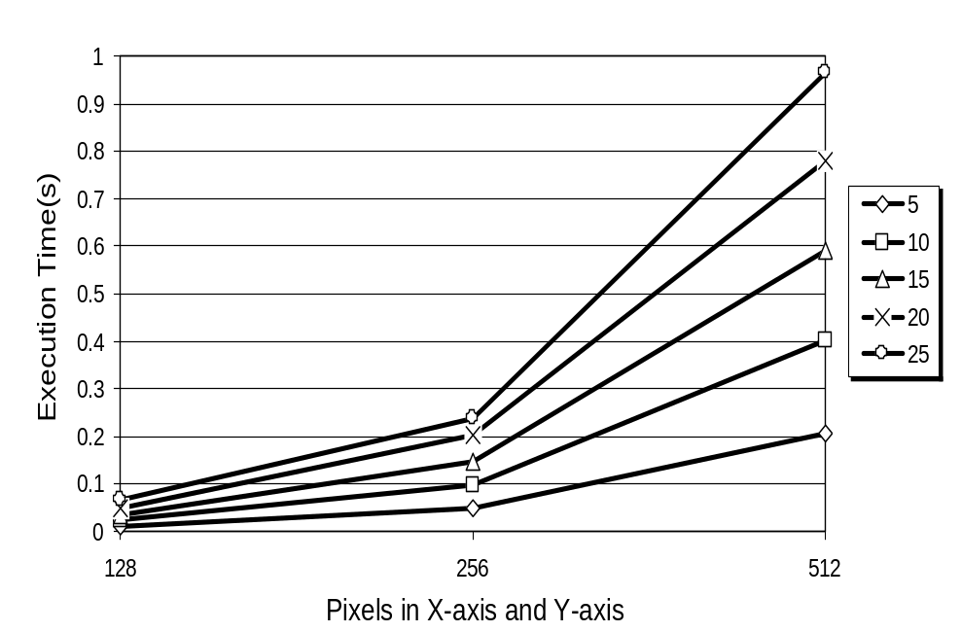
Reconfigurable device vs desktop PC
The speed of Xilinx Virtex XCV1000 is 50% faster than AMD Athlon 1.4 GHz
Real time: XC2V6000 on 256² images with 25 control points

Slide 20
Current & Future work
Exploring various function evaluation methods
Automating the precision estimation of the operators
More efficient implementation method on multi-FPGA platform

Slide 21
Summary
Based on radial basis functions
SBTM (Symmetric Bipartite Table Method) is used
Parameterisable floating-point library
Fully pipelined design
The speed of Xilinx Virtex XCV1000 is 50% faster than AMD Athlon 1.4 GHz

