Slide 1

Support Vector Machine on functional MRI data

Slide 2
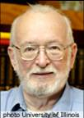
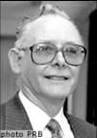
Functional MRI
2003 Nobel Prize in Physiology or Medicine
Lauterbur 和 Mansfield 因发明MRI方法获得2003年诺贝尔医学和生理学奖。

Slide 3
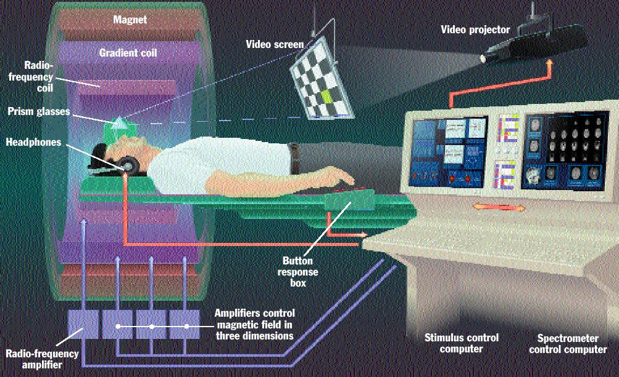
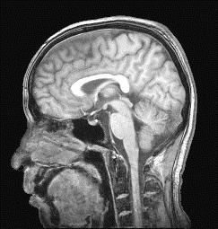
磁共振成像的设备
Slice selective

Slide 4
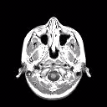
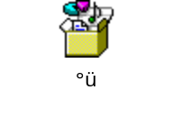
volumes
Block design

Slide 5
FLOW CHART SVM on FMRI
Train phase
FMRI volumes during rest
FMRI volumes during task
Preprocessing steps
PCA
PCA
Machine leaning Training :SVM
Discriminative volume between rest and task

Slide 6
Test Phase
FMRI volume from a new subject or block
Preprocessing steps
PCA
SVM TEST
Brain state prediction
during rest & task

Slide 7
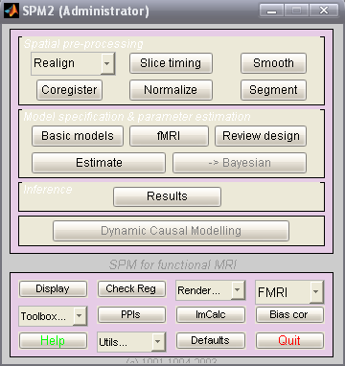
First:spatial Preprocessing
·
Using SPM2 soft transform *.dicom to*.hdr/img
1,Realign:realignment of functional time-series
2,Coregister
3,Slice timing
4,Normalize
5,Smooth
6,Segment

Slide 8
Second:
Second preprocessing:
temporal compression
Removal of the base line and low frequency components (because they’re not necessary in temporal compression) of each voxels by applying a regression model .
now we subtracted the mean volume of the previous and posterior control blocks from the mean volume of the blocks,
please look down
Previous Rest block A
Task block B
Posterior Rest block C

Slide 9
Previous Rest block A
Task block B
Posterior Rest block C
Mean:
Mean volume A
Mean volume B
Mean volume C
Set: M=(A+C)/2 then:
A=A-M
B=B-M
C=C-M

Slide 10
Third phase : Dimensionality reduction
Before this,a mask was applied to select voxels which contain brain tissue .
After this,we define a data matrix included all training data:
DM×N with one volume per column and one voxel per row D= [v1…vi…vN]
and Dc M x S being D with the mean volume of the data set subtracted
from each column. (S=number of blocks -1,because we used the
“leave-one-block-out “ approach to train and test .)
Then, We used singular value decomposition (SVD) or principal
components analysis (PCA) to reduce the raw data to its eigen-
variates (i.e. reducing the size of the problem from the number of
voxels to the number of spatial modes, i.e. scans)
[U,S,V] = SVD(Dc ) this means:Dc=U*S*V’

Slide 11
The projection of the volumes onto the principal components was
carried out as:
Dp= UTD Dp=[v1p….Vip…. Vsp]
where U is a s x s matrix containing one eigenvector or PC per
column and the superscript p means projected data or matrix. We
used Dpas training data and the test data were given by:
Dptest=UTDtest
where Dtest is the data matrix including the test data (one volume
per column, with the mean volume of the data set subtracted from
each column).
In summary, initially the data were in the voxel space (one
voxel per dimension) and after the projection the data are in the
principal component (PC) space. The classification problem is
solved in the PC space and the result (i.e. the weight vector) is
mapped back to the voxel space .

Slide 12
SVM Learning phase
Use the projected data Dp to train the classifier. The
classifier finds a hyperplane that separates the data.
H:((wp)T*vp+b)= 0
The separating hyperplane is described by a weight Vector
(wp s x 1) for each classifier;
the learning weight vector wp is orthogonal to the
hyperplane. If the input space is the voxel space (one voxel
per dimension), the weight vector will be the direction along
which the volumes of either tasks or brain states differ most.
Hence, it represents a volume with the most discriminating
regions,i.e. the discriminating volume.

Slide 13
The optimal hyperplane is the one with the largest margin
one has to minimize ½*‖wp‖2 subject to:
Yi((wp)T*vpi+b)>=1
The points with non-zero coefficients ai who are closest to the hyperplane satisfy:
yi*|(wp*vpi+b|=1 are called support vectors,
We get:
wp=ai*yi*vpi+……

Slide 14
The class label of a test example vp is computed by the
hyperplane decision function given by:
f(vp)=sgn()
And the offset b is computed by exploiting:
Ai*[]=0;
Map the weight vector (wp s x1) back to the high
dimensional or voxel space (W m x 1) by using the
principal components information. W m*1=u*wp;
In many real problems ,a separating hyperplane may not
exit,to allow for the possibility of misclassfication we need
Slack variables ei>=0,one has to minimize ½+c*ei subject
to a relaxed separation constrain,
Yi*(+)>=1-ei

Slide 15
SVM TOOLBOX
There are 4 main function for svm:
One, function net = svm(nin, kernel, kernelpar, C, use2norm, qpsolver, qpsize)
svm Create a Support Vector Machine classifier
Two , function K = svmkernel(net, X1, X2)
svmkernel - Compute Support Vector Machine kernel function
Three, function net = svmtrain(net, X, Y, alpha0, dodisplay)
svmtrain- Train a Support Vector Machine classifier
Four, function [Y, Y1] = svmfwd(net, X)
svmfwd- forward propagation through support vector machine classifier

Slide 16
Basic SVM parameters:
'type' = 'svm'
'nin' = NIN number of input dimensions
'nout' = 1 number of output dimensions
'kernel' = KERNEL kernel function
'kernelpar' = KERNELPAR parameters for the kernel function
'c' = C Upper bound for the coefficients NET.alpha during training.
'qpsolver' = QPSOLVER. QPSOLVER must be one of 'quadprog', 'loqo','qp' or empty for auto-detect. Name of the function that solves the quadratic programming problems in SVMTRAIN.Default value: empty (auto-detect).

Slide 17
'qpsize' = QPSIZE. The maximum number of points given to the QP solver. Default value: 50.
'alphatol' = Tolerance for all comparisons that involve the
coefficients NET.alpha. Default value: 1E-2.
'kkttol' = Tolerance for checking the KKT conditions (termination criterion) Default value: 5E-2. Lower this when high precision is required.
K(i,j) is the result of the kernelfunction for inputs X1(i,:)
and X2(j,:).
Currently the only valid kernel functions are:
‘Linear’ ‘poly’ ‘rbf’ ‘rbffull’

Slide 18
NET.kernel = 'linear'
inner product
NET.kernel = 'poly'
(1+inner product)^NET.kernelpar(1)
NET.kernel = 'rbf'
radial basis function, common length scale for all inputs is
NET.kernelpar(1), scaled with the number of inputs NET.nin
K = exp(-sum((X1i-X2i)^2)/(NET.kernelpar(1)*NET.nin))
NET.kernel = 'rbffull' radial basis function, different length scale for each input.
If NET.kernelpar is a vector of length NET.nin K = exp(-sum((X1i-X2i)^2*NET.kernelpar(i))/NET.nin)
If NET.kernelpar is a vector of length NET.nin+1
K = exp(NET.kernelpar(end)-sum((X1i-X2i)^2*NET.kernelpar(i))/NET.nin)
If NET.kernelpar is a matrix of size [NET.nin, NET.nin]
K = exp(-(X1-X2)*NET.kernelpar*(X1-X2)'/NET.nin)

Slide 19
Decision function:[Y, Y1] = svmfwd(net, X)
Y is a column vector with one entry for each input vector in X. Y(i) is the SVM output for input vector X(i,:), it is:
+1, if X(i,:) is classified as belonging to class 1
-1, if X(i,:) is classified as belonging to class -1
[Y, Y1] = SVMFWD(NET, X) also gives the column vector Y1 containing
the SVM output before computing the sign. Y1(i) is equivalent to the
distance of point X(i,:) from the separating hyperplane.

Slide 20
Partial code
f=fopen(‘*.img’,’r’);
a=fread(f,[64*64,inf],’integer*2’);
s16=reshape(a(:,16,:),4096,160);

Slide 21
Foreground
Multi-class SVM:
The classification problem can be extended to cases where the number of classes is more than two by using ECOC(Errorcorrecting output code)

