Slide 1
Tutorial on Neural Networks
Prévotet Jean-Christophe
University of Paris VI
FRANCE

Slide 2
Biological inspirations
Some numbers…
  The human brain contains about 10 billion nerve cells (neurons)
  Each neuron is connected to the others through 10000 synapses
Properties of the brain
  It can learn, reorganize itself from experience
  It adapts to the environment
  It is robust and fault tolerant

Slide 3
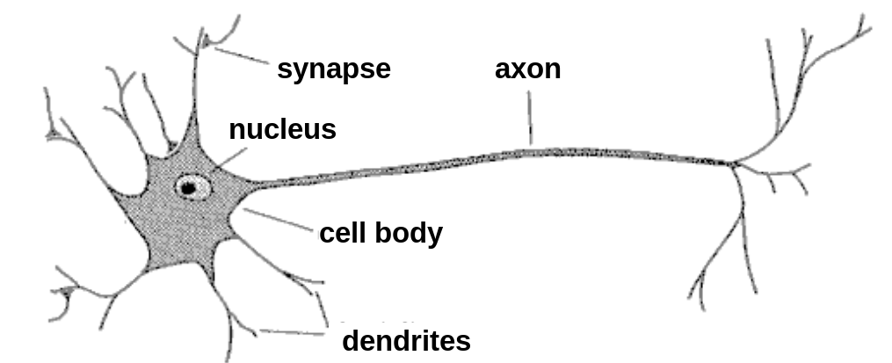
Biological neuron
A neuron has
  A branching input (dendrites)
  A branching output (the axon)
The information circulates from the dendrites to the axon via the cell body
Axon connects to dendrites via synapses
  Synapses vary in strength
  Synapses may be excitatory or inhibitory

Slide 4
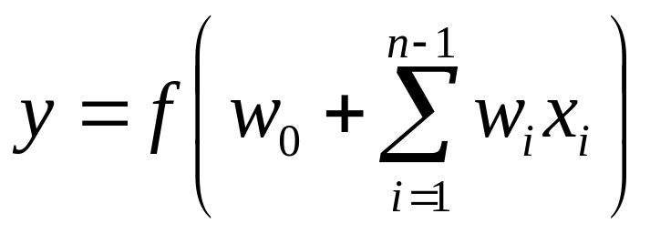
What is an artificial neuron ?
Definition : Non linear, parameterized function with restricted output range
y
w0
x1
x2
x3

Slide 5
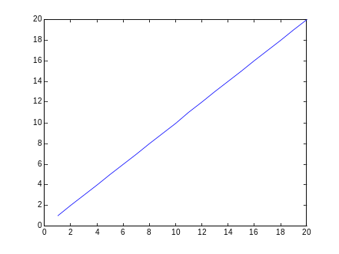

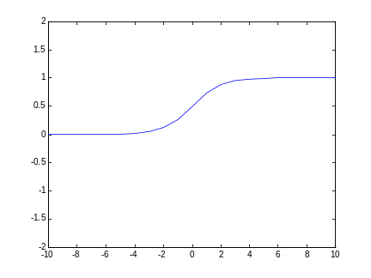
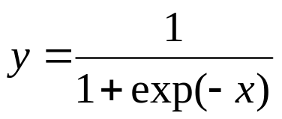
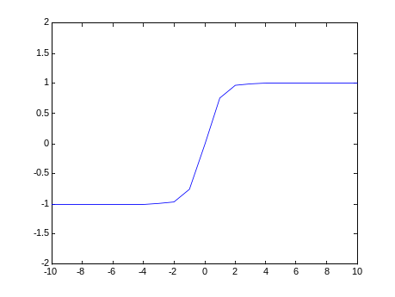
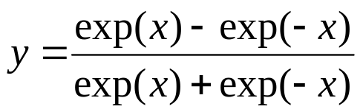
Activation functions
Linear
Logistic
Hyperbolic tangent

Slide 6
Neural Networks
A mathematical model to solve engineering problems
  Group of highly connected neurons to realize compositions of non linear functions
Tasks
  Classification
  Discrimination
  Estimation
2 types of networks
  Feed forward Neural Networks
  Recurrent Neural Networks

Slide 7
Feed Forward Neural Networks
The information is propagated from the inputs to the outputs
Computations of No non linear functions from n input variables by compositions of Nc algebraic functions
Time has no role (NO cycle between outputs and inputs)
Output layer
2nd hidden
layer
1st hidden
layer
x1
x2
…..
xn

Slide 8
Recurrent Neural Networks
Can have arbitrary topologies
Can model systems with internal states (dynamic ones)
Delays are associated to a specific weight
Training is more difficult
Performance may be problematic
  Stable Outputs may be more difficult to evaluate
  Unexpected behavior (oscillation, chaos, …)
0
1
0
0
1
0
0
1
x1
x2

Slide 9
Learning
The procedure that consists in estimating the parameters of neurons so that the whole network can perform a specific task
2 types of learning
  The supervised learning
  The unsupervised learning
The Learning process (supervised)
  Present the network a number of inputs and their corresponding outputs
  See how closely the actual outputs match the desired ones
  Modify the parameters to better approximate the desired outputs

Slide 10
Supervised learning
The desired response of the neural network in function of particular inputs is well known.
A “Professor” may provide examples and teach the neural network how to fulfill a certain task

Slide 11
Unsupervised learning
Idea : group typical input data in function of resemblance criteria un-known a priori
Data clustering
No need of a professor
  The network finds itself the correlations between the data
  Examples of such networks :
    Kohonen feature maps

Slide 12
Properties of Neural Networks
Supervised networks are universal approximators (Non recurrent networks)
Theorem : Any limited function can be approximated by a neural network with a finite number of hidden neurons to an arbitrary precision
Type of Approximators
  Linear approximators : for a given precision, the number of parameters grows exponentially with the number of variables (polynomials)
  Non-linear approximators (NN), the number of parameters grows linearly with the number of variables

Slide 13
Other properties
Adaptivity
  Adapt weights to environment and retrained easily
Generalization ability
  May provide against lack of data
Fault tolerance
  Graceful degradation of performances if damaged => The information is distributed within the entire net.

Slide 14
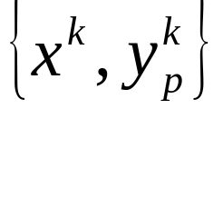
Static modeling
In practice, it is rare to approximate a known function by a uniform function
“black box” modeling : model of a process
The y output variable depends on the input variable x with k=1 to N
Goal : Express this dependency by a function, for example a neural network

Slide 15
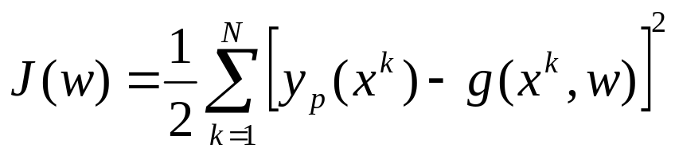
If the learning ensemble results from measures, the noise intervenes
Not an approximation but a fitting problem
Regression function
Approximation of the regression function : Estimate the more probable value of yp for a given input x
Cost function:
Goal: Minimize the cost function by determining the right function g

Slide 16
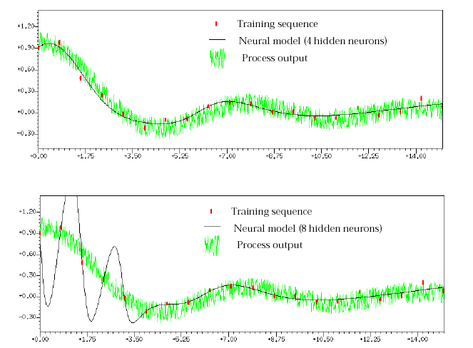
Example

Slide 17
Classification (Discrimination)
Class objects in defined categories
Rough decision OR
Estimation of the probability for a certain object to belong to a specific class
Example : Data mining
Applications : Economy, speech and patterns recognition, sociology, etc.

Slide 18
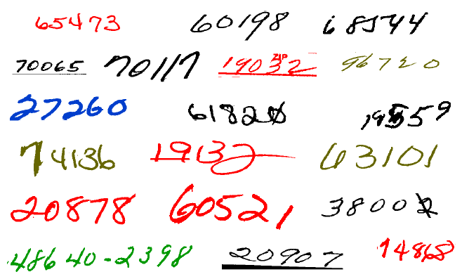
Example
Examples of handwritten postal codes
drawn from a database available from the US Postal service

Slide 19
What do we need to use NN ?
Determination of pertinent inputs
Collection of data for the learning and testing phase of the neural network
Finding the optimum number of hidden nodes
Estimate the parameters (Learning)
Evaluate the performances of the network
IF performances are not satisfactory then review all the precedent points

Slide 20
Classical neural architectures
Perceptron
Multi-Layer Perceptron
Radial Basis Function (RBF)
Kohonen Features maps
Other architectures
  An example : Shared weights neural networks

Slide 21

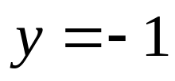

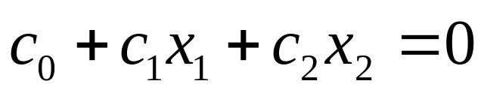

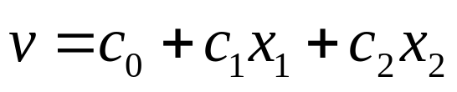






Perceptron
Rosenblatt (1962)
Linear separation
Inputs :Vector of real values
Outputs :1 or -1
+
+
+
+
+
+
+
+
+
+
+
+
+
+
+
+
+
+
+
+
+
+
+
+
+
+
+
+
+
+
+
+
+
+
+
+

Slide 22
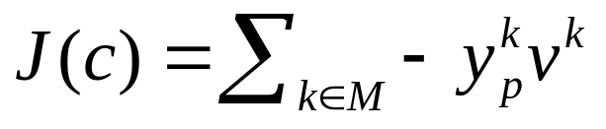




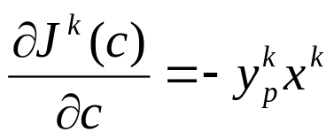
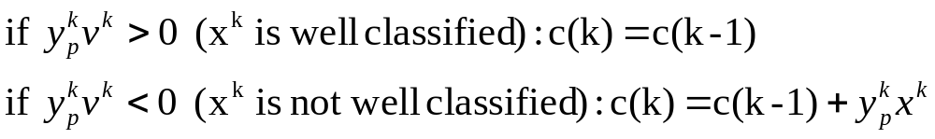
Learning (The perceptron rule)
Minimization of the cost function :
J(c) is always >= 0 (M is the ensemble of bad classified examples)
is the target value
Partial cost
  If is not well classified :
  If is well classified
Partial cost gradient
Perceptron algorithm

Slide 23
The perceptron algorithm converges if examples are linearly separable

Slide 24
Multi-Layer Perceptron
One or more hidden layers
Sigmoid activations functions
Output layer
2nd hidden
layer
1st hidden
layer
Input data

Slide 25
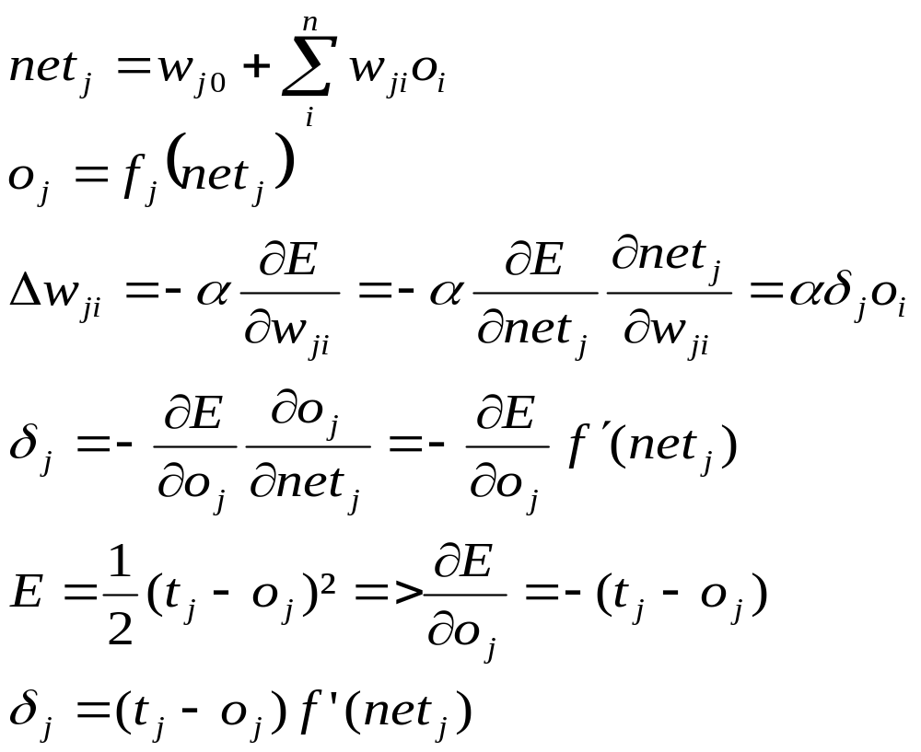
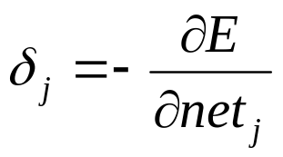
Learning
Back-propagation algorithm
Credit assignment
If the jth node is an output unit

Slide 26
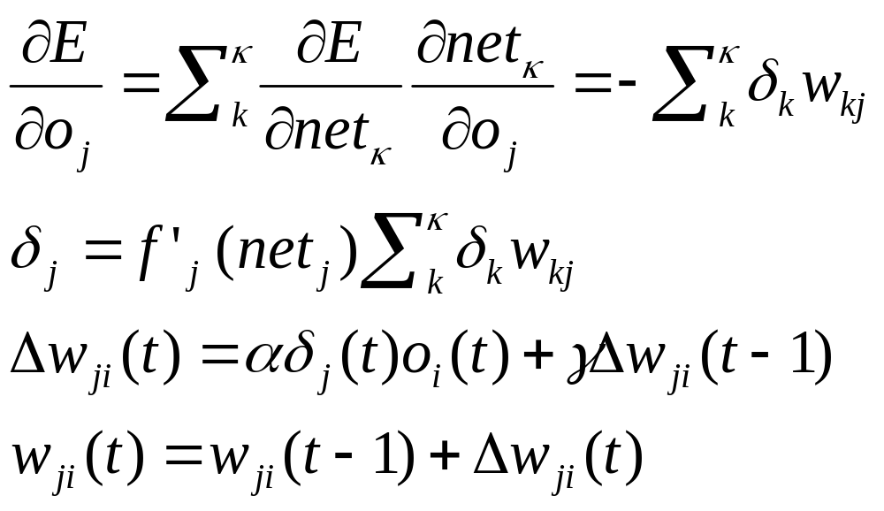
Momentum term to smooth
The weight changes over time

Slide 27
Different non linearly separable problems
Types of
Decision Regions
Exclusive-OR
Problem
Classes with
Meshed regions
Most General
Region Shapes
Structure
Single-Layer
Half Plane
Bounded By
Hyperplane
A
B
B
A
B
A
Two-Layer
Convex Open
Or
Closed Regions
A
B
B
A
B
A
Three-Layer
Abitrary
(Complexity
Limited by No.
of Nodes)
A
B
B
A
B
A
Neural Networks – An Introduction Dr. Andrew Hunter

Slide 28
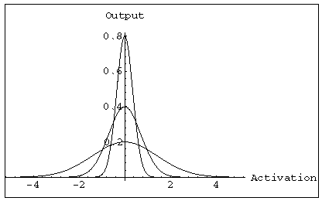
Radial Basis Functions (RBFs)
Features
  One hidden layer
  The activation of a hidden unit is determined by the distance between the input vector and a prototype vector
Outputs
Radial units
Inputs

Slide 29
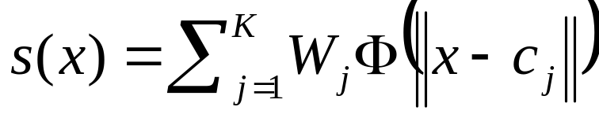
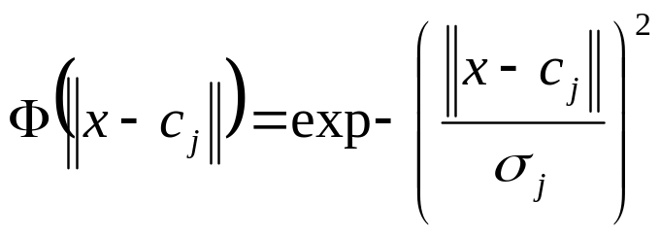
RBF hidden layer units have a receptive field which has a centre
Generally, the hidden unit function is Gaussian
The output Layer is linear
Realized function

Slide 30
Learning
The training is performed by deciding on
  How many hidden nodes there should be
  The centers and the sharpness of the Gaussians
2 steps
  In the 1st stage, the input data set is used to determine the parameters of the basis functions
  In the 2nd stage, functions are kept fixed while the second layer weights are estimated ( Simple BP algorithm like for MLPs)

Slide 31
MLPs versus RBFs
Classification
  MLPs separate classes via hyperplanes
  RBFs separate classes via hyperspheres
Learning
  MLPs use distributed learning
  RBFs use localized learning
  RBFs train faster
Structure
  MLPs have one or more hidden layers
  RBFs have only one layer
  RBFs require more hidden neurons => curse of dimensionality
X₂
MLP
X₁
X₂
RBF
X₁

Slide 32
Self organizing maps
The purpose of SOM is to map a multidimensional input space onto a topology preserving map of neurons
  Preserve a topological so that neighboring neurons respond to « similar »input patterns
  The topological structure is often a 2 or 3 dimensional space
Each neuron is assigned a weight vector with the same dimensionality of the input space
Input patterns are compared to each weight vector and the closest wins (Euclidean Distance)

Slide 33
The activation of the neuron is spread in its direct neighborhood =>neighbors become sensitive to the same input patterns
Block distance
The size of the neighborhood is initially large but reduce over time => Specialization of the network
2nd neighborhood
First neighborhood

Slide 34
Adaptation
During training, the “winner” neuron and its neighborhood adapts to make their weight vector more similar to the input pattern that caused the activation
The neurons are moved closer to the input pattern
The magnitude of the adaptation is controlled via a learning parameter which decays over time

Slide 35
Shared weights neural networks:
Time Delay Neural Networks (TDNNs)
Introduced by Waibel in 1989
Properties
  Local, shift invariant feature extraction
  Notion of receptive fields combining local information into more abstract patterns at a higher level
  Weight sharing concept (All neurons in a feature share the same weights)
    All neurons detect the same feature but in different position
Principal Applications
  Speech recognition
  Image analysis

Slide 36
TDNNs (cont’d)
Objects recognition in an image
Each hidden unit receive inputs only from a small region of the input space : receptive field
Shared weights for all receptive fields => translation invariance in the response of the network
Hidden
Layer 2
Hidden
Layer 1
Inputs

Slide 37
Advantages
  Reduced number of weights
    Require fewer examples in the training set
    Faster learning
  Invariance under time or space translation
  Faster execution of the net (in comparison of full connected MLP)

Slide 38
Neural Networks (Applications)
Face recognition
Time series prediction
Process identification
Process control
Optical character recognition
Adaptative filtering
Etc…

Slide 39
Conclusion on Neural Networks
Neural networks are utilized as statistical tools
  Adjust non linear functions to fulfill a task
  Need of multiple and representative examples but fewer than in other methods
Neural networks enable to model complex static phenomena (FF) as well as dynamic ones (RNN)
NN are good classifiers BUT
  Good representations of data have to be formulated
  Training vectors must be statistically representative of the entire input space
  Unsupervised techniques can help
The use of NN needs a good comprehension of the problem

Slide 40
Preprocessing

Slide 41
Why Preprocessing ?
The curse of Dimensionality
  The quantity of training data grows exponentially with the dimension of the input space
  In practice, we only have limited quantity of input data
    Increasing the dimensionality of the problem leads to give a poor representation of the mapping

Slide 42
Preprocessing methods
Normalization
  Translate input values so that they can be exploitable by the neural network
Component reduction
  Build new input variables in order to reduce their number
  No Lost of information about their distribution

Slide 43

Character recognition example
Image 256x256 pixels
8 bits pixels values (grey level)
Necessary to extract features

Slide 44
Normalization
Inputs of the neural net are often of different types with different orders of magnitude (E.g. Pressure, Temperature, etc.)
It is necessary to normalize the data so that they have the same impact on the model
Center and reduce the variables

Slide 45
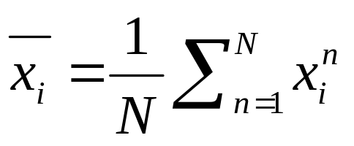
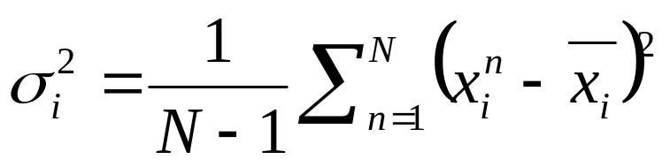
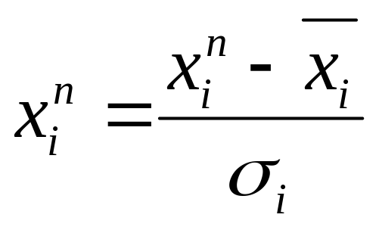
Average on all points
Variance calculation
Variables transposition

Slide 46
Components reduction
Sometimes, the number of inputs is too large to be exploited
The reduction of the input number simplifies the construction of the model
Goal : Better representation of the data in order to get a more synthetic view without losing relevant information
Reduction methods (PCA, CCA, etc.)

Slide 47
Principal Components Analysis (PCA)
Principle
  Linear projection method to reduce the number of parameters
  Transfer a set of correlated variables into a new set of uncorrelated variables
  Map the data into a space of lower dimensionality
  Form of unsupervised learning
Properties
  It can be viewed as a rotation of the existing axes to new positions in the space defined by original variables
  New axes are orthogonal and represent the directions with maximum variability

Slide 48
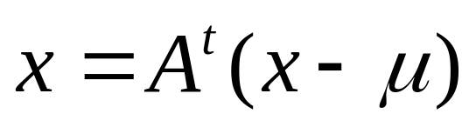
Compute d dimensional mean
Compute d*d covariance matrix
Compute eigenvectors and Eigenvalues
Choose k largest Eigenvalues
  K is the inherent dimensionality of the subspace governing the signal
Form a d*d matrix A with k columns of eigenvectors
The representation of data consists of projecting data into a k dimensional subspace by

Slide 49
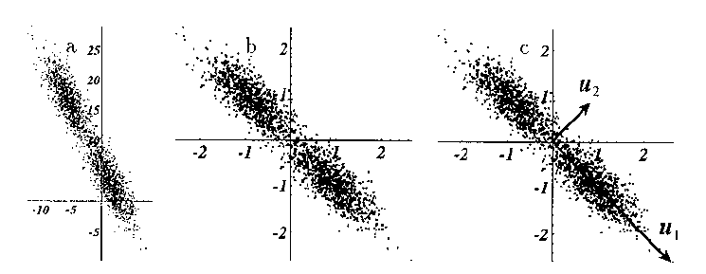
Example of data representation using PCA

Slide 50
Limitations of PCA
The reduction of dimensions for complex distributions may need non linear processing

Slide 51
Curvilinear Components Analysis
Non linear extension of the PCA
Can be seen as a self organizing neural network
Preserves the proximity between the points in the input space i.e. local topology of the distribution
Enables to unfold some varieties in the input data
Keep the local topology

Slide 52
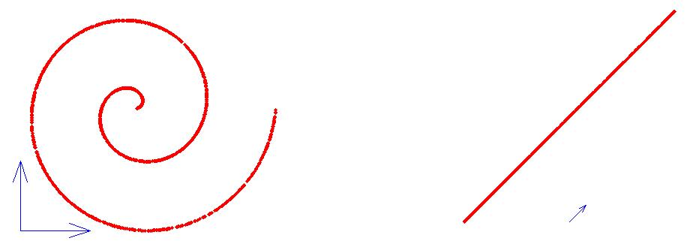
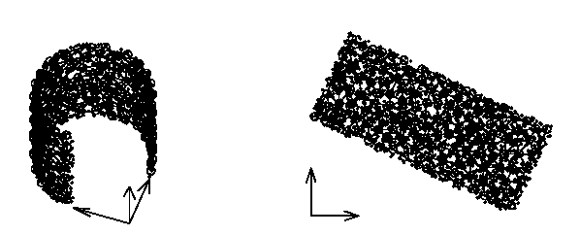
Example of data representation using CCA
Non linear projection of a spiral
Non linear projection of a horseshoe

Slide 53
Other methods
Neural pre-processing
  Use a neural network to reduce the dimensionality of the input space
  Overcomes the limitation of PCA
  Auto-associative mapping => form of unsupervised training

Slide 54
D dimensional output space
x1
x2
….
xd
Transformation of a d dimensional input space into a M dimensional output space
Non linear component analysis
The dimensionality of the sub-space must be decided in advance
M dimensional sub-space
z1
zM
x1
x2
….
xd
D dimensional input space

Slide 55
« Intelligent preprocessing »
Use an “a priori” knowledge of the problem to help the neural network in performing its task
Reduce manually the dimension of the problem by extracting the relevant features
More or less complex algorithms to process the input data

Slide 56
Example in the H1 L2 neural network trigger
Principle
  Intelligent preprocessing
    extract physical values for the neural net (impulse, energy, particle type)
  Combination of information from different sub-detectors
  Executed in 4 steps
Clustering
Post
Processing
Matching
Ordering
find regions of interest
within a given detector layer
combination of clusters
belonging to the same
object
sorting of objects
by parameter
generates
variables
for the
neural network

Slide 57
Conclusion on the preprocessing
The preprocessing has a huge impact on performances of neural networks
The distinction between the preprocessing and the neural net is not always clear
The goal of preprocessing is to reduce the number of parameters to face the challenge of “curse of dimensionality”
It exists a lot of preprocessing algorithms and methods
  Preprocessing with prior knowledge
  Preprocessing without

Slide 58
Implementation of neural networks

Slide 59
Motivations and questions
Which architectures utilizing to implement Neural Networks in real-time ?
  What are the type and complexity of the network ?
  What are the timing constraints (latency, clock frequency, etc.)
  Do we need additional features (on-line learning, etc.)?
  Must the Neural network be implemented in a particular environment ( near sensors, embedded applications requiring less consumption etc.) ?
  When do we need the circuit ?
Solutions
  Generic architectures
  Specific Neuro-Hardware
  Dedicated circuits

Slide 60
Generic hardware architectures
Conventional microprocessors
Intel Pentium, Power PC, etc …
Advantages
  High performances (clock frequency, etc)
  Cheap
  Software environment available (NN tools, etc)
Drawbacks
  Too generic, not optimized for very fast neural computations

Slide 61
Specific Neuro-hardware circuits
Commercial chips CNAPS, Synapse, etc.
Advantages
  Closer to the neural applications
  High performances in terms of speed
Drawbacks
  Not optimized to specific applications
  Availability
  Development tools
Remark
  These commercials chips tend to be out of production

Slide 62
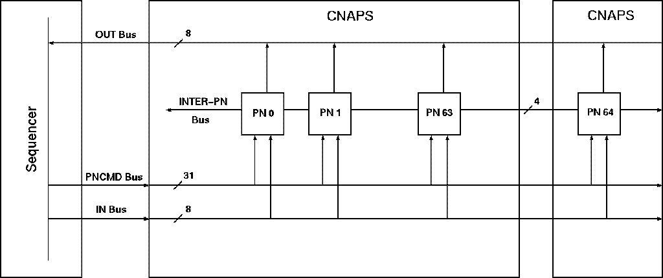
Example :CNAPS Chip
CNAPS 1064 chip
Adaptive Solutions,
Oregon
64 x 64 x 1 in 8 µs
(8 bit inputs, 16 bit weights,

Slide 63
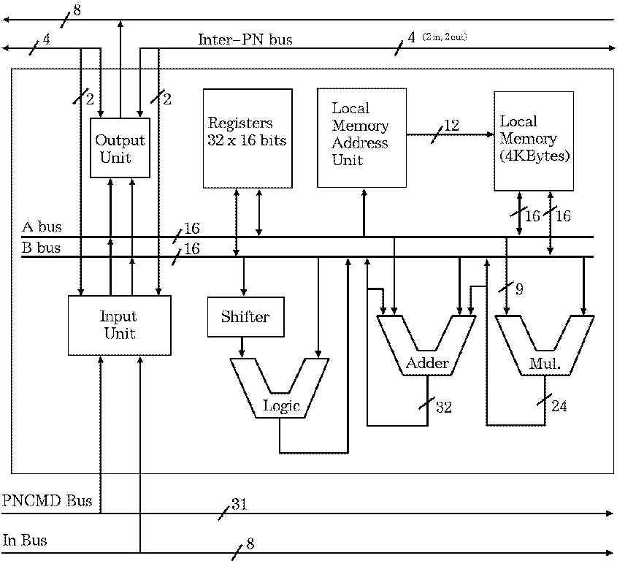

Slide 64
Dedicated circuits
A system where the functionality is once and for all tied up into the hard and soft-ware.
Advantages
  Optimized for a specific application
  Higher performances than the other systems
Drawbacks
  High development costs in terms of time and money

Slide 65
What type of hardware to be used in dedicated circuits ?
Custom circuits
  ASIC
  Necessity to have good knowledge of the hardware design
  Fixed architecture, hardly changeable
  Often expensive
Programmable logic
  Valuable to implement real time systems
  Flexibility
  Low development costs
  Fewer performances than an ASIC (Frequency, etc.)

Slide 66
Programmable logic
Field Programmable Gate Arrays (FPGAs)
  Matrix of logic cells
  Programmable interconnection
  Additional features (internal memories + embedded resources like multipliers, etc.)
  Reconfigurability
    We can change the configurations as many times as desired

Slide 67
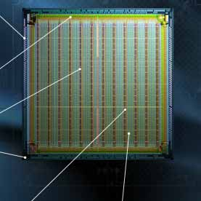
FPGA Architecture
cout
y
I/O Ports
G4
G3
G2
G1
Carry &
Control
D
Q
yq
LUT
xb
Block Rams
x
F4
F3
F2
F1
Carry &
Control
D
Q
xq
DLL
LUT
bx
Programmable
Logic
Blocks
Programmable
connections
cin
Xilinx Virtex slice

Slide 68
Real time Systems
Real-Time Systems
Execution of applications with time constraints.
hard and soft real-time systems
  digital fly-by-wire control system of an aircraft:
  No lateness is accepted Cost. The lives of people depend on the correct working of the control system of the aircraft.
  A soft real-time system can be a vending machine:
  Accept lower performance for lateness, it is not catastrophic when deadlines are not met. It will take longer to handle one client with the vending machine.

Slide 69
Typical real time processing problems
In instrumentation, diversity of real-time problems with specific constraints
Problem : Which architecture is adequate for implementation of neural networks ?
Is it worth spending time on it?

Slide 70
Some problems and dedicated architectures
ms scale real time system
  Architecture to measure raindrops size and velocity
  Connectionist retina for image processing
µs scale real time system
  Level 1 trigger in a HEP experiment

Slide 71
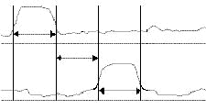
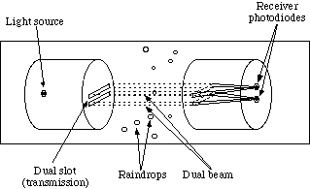
Architecture to measure raindrops size and velocity
Problematic
2 focalized beams on 2 photodiodes
Diodes deliver a signal according to the received energy
The height of the pulse depends on the radius
Tp depends on the speed of the droplet
Tp

Slide 72
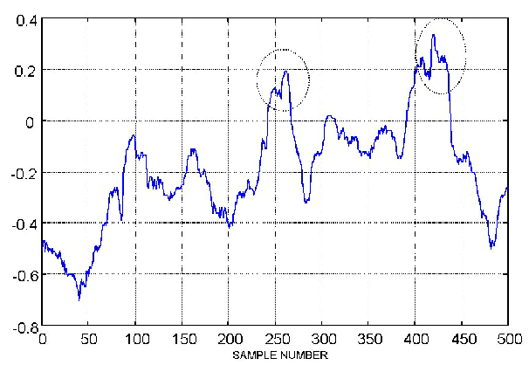
Input data
Real droplet
Noise
High level of noise
Significant variation of
The current baseline

Slide 73
Feature extractors
2
5
Input stream
10 samples
Input stream
10 samples

Slide 74
Proposed architecture
Presence of a droplet
Velocity
Size
Full interconnection
Full interconnection
Feature
extractors
20 input windows

Slide 75
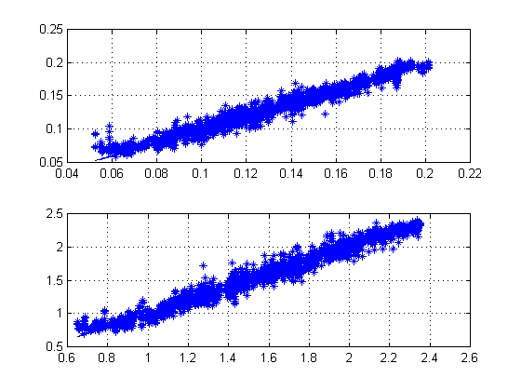
Performances
Estimated
Radii
(mm)
Actual Radii (mm)
Estimated
Velocities
(m/s)
Actual velocities (m/s)

Slide 76
Hardware implementation
10 KHz Sampling
Previous times => neuro-hardware accelerator (Totem chip from Neuricam)
Today, generic architectures are sufficient to implement the neural network in real-time

Slide 77
Connectionist Retina
Integration of a neural network in an artificial retina
Screen
  Matrix of Active Pixel sensors
CAN (8 bits converter) 256 levels of grey
Processing Architecture
  Parallel system where neural networks are implemented
I
CAN
Processing
Architecture

Slide 78
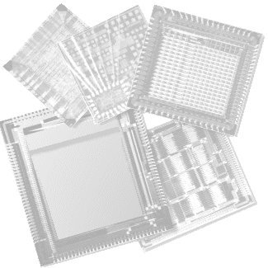
Processing architecture: “The maharaja” chip
Integrated Neural Networks :
Multilayer Perceptron [MLP]
Radial Basis function [RBF]
WEIGHTHED SUM | ∑_{i} w_{i}X_{i}
EUCLIDEAN | (A – B)²
MANHATTAN | |A – B|
MAHALANOBIS | (A – B) ∑ (A – B)

Slide 79
The “Maharaja” chip
Command bus
Micro-controller
Micro-controller
  Enable the steering of the whole circuit
Memory
  Store the network parameters
UNE
  Processors to compute the neurons outputs
Input/Output module
  Data acquisition and storage of intermediate results
M
M
M
M
UNE-0
UNE-1
UNE-2
UNE-3
Sequencer
Instruction Bus
Input/Output
unit

Slide 80
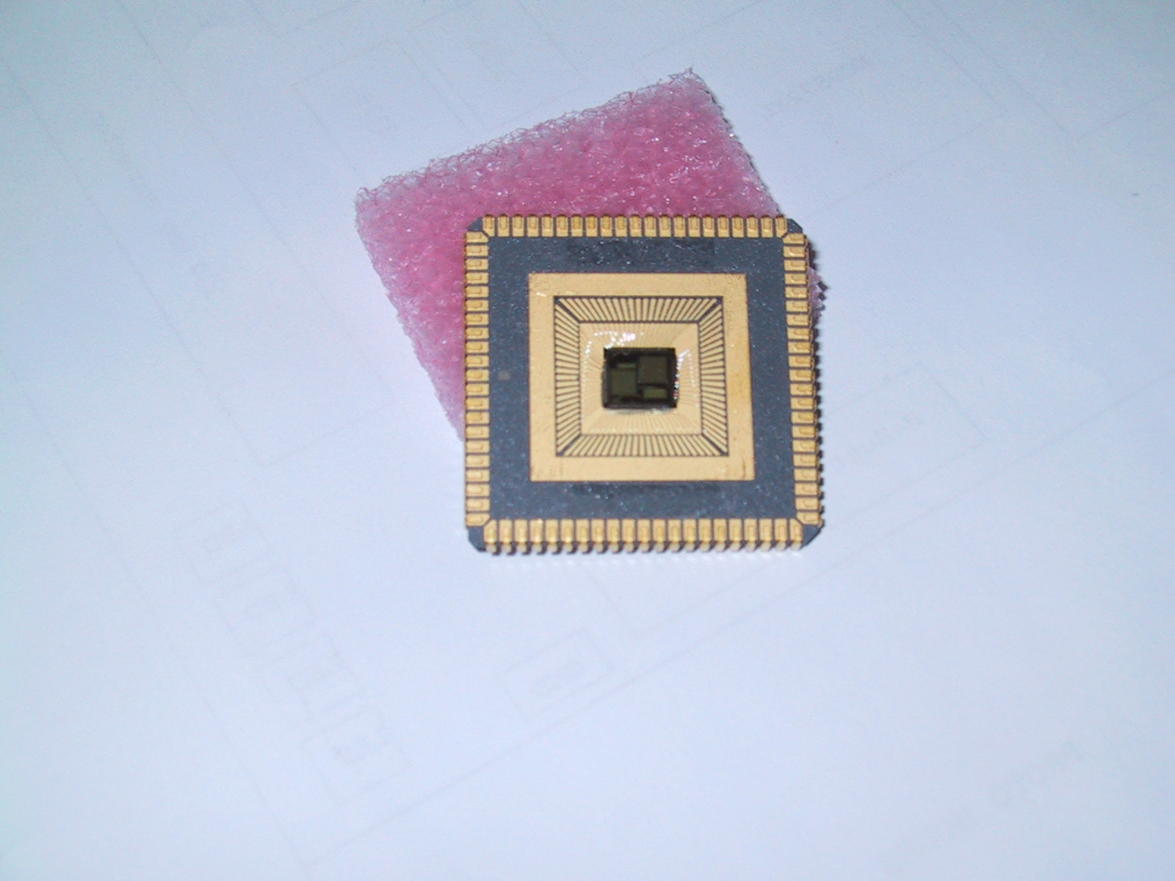
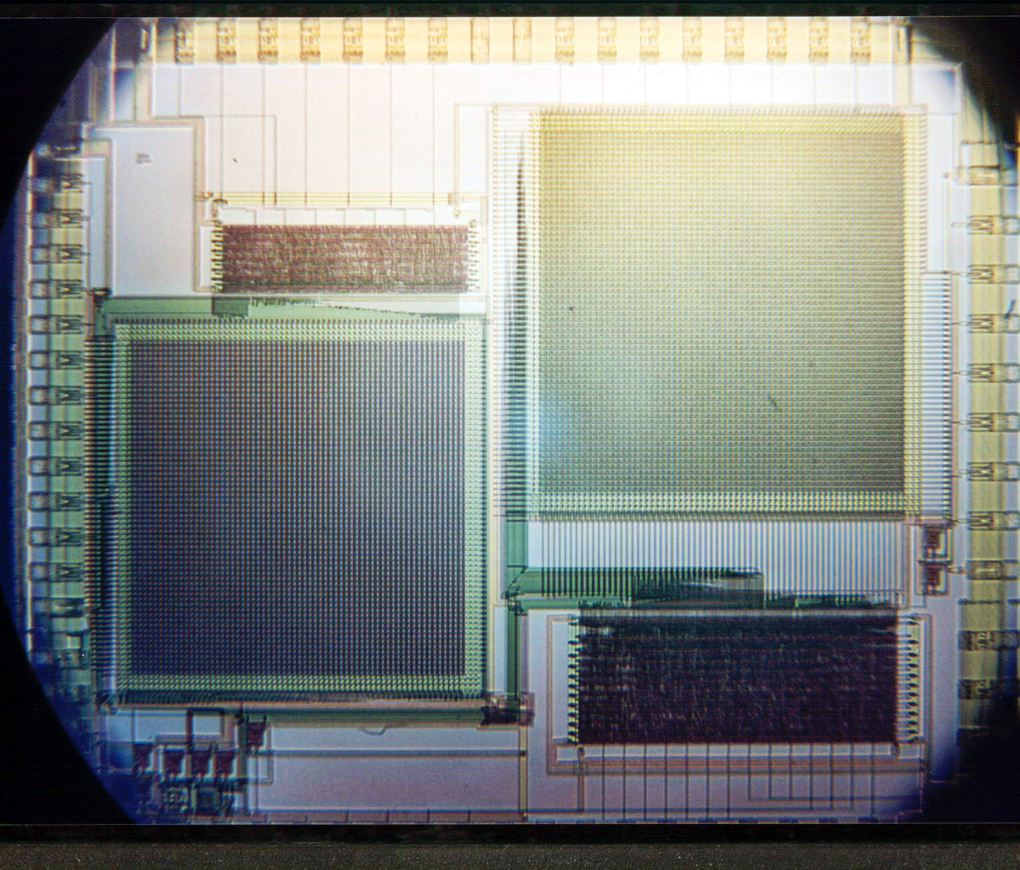
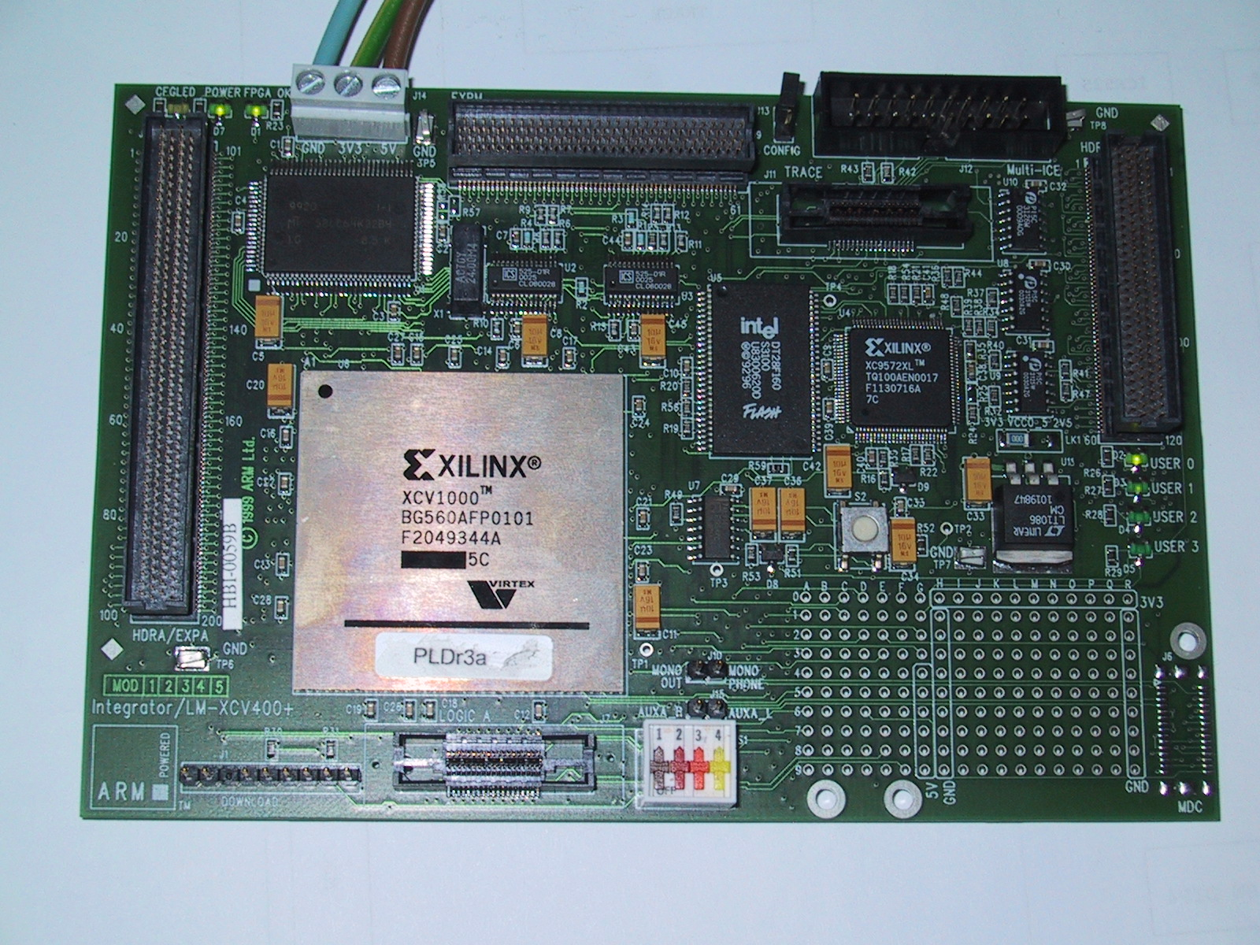
Hardware Implementation
Matrix of Active Pixel Sensors
FPGA implementing the
Processing architecture

Slide 81
Performances
Neural Networks | Performances
 | Latency (Timing constraints) | Estimated execution time
MLP (High Energy Physics) (4-8-8-4) | 10 µs | 6,5 µs
RBF (Image processing) (4-10-256) | 40 ms | 473 µs (Manhattan) 23ms (Mahalanobis)

Slide 82
Level 1 trigger in a HEP experiment
Neural networks have provided interesting results as triggers in HEP.
  Level 2 : H1 experiment
  Level 1 : Dirac experiment
Goal : Transpose the complex processing tasks of Level 2 into Level 1
High timing constraints (in terms of latency and data throughput)

Slide 83
Neural Network architecture
Electrons, tau, hadrons, jets
4
64
……..
128
……..
Execution time : ~500 ns
with data arriving every BC=25ns
Weights coded in 16 bits
States coded in 8 bits

Slide 84
Very fast architecture
Matrix of n*m matrix elements
Control unit
I/O module
TanH are stored in LUTs
1 matrix row computes a neuron
The results is back-propagated to calculate the output layer
PE
PE
PE
PE
ACC
TanH
PE
PE
PE
PE
ACC
TanH
PE
PE
PE
PE
ACC
TanH
PE
PE
PE
PE
ACC
TanH
Control unit
256 PEs for a 128x64x4 network
I/O module

Slide 85
PE architecture
Data in
Data out
Multiplier
Accumulator
Input data
8
16
X
+
Weights mem
Addr gen
Control Module
cmd bus

Slide 86
Technological Features
Inputs/Outputs
4 input buses (data are coded in 8 bits)
1 output bus (8 bits)
Processing Elements
Signed multipliers 16x8 bits
Accumulation (29 bits)
Weight memories (64x16 bits)
Look Up Tables
Addresses in 8 bits
Data in 8 bits
Internal speed
Targeted to be 120 MHz

Slide 87
Neuro-hardware today
Generic Real time applications
  Microprocessors technology is sufficient to implement most of neural applications in real-time (ms or sometimes µs scale)
    This solution is cheap
    Very easy to manage
Constrained Real time applications
  It still remains specific applications where powerful computations are needed e.g. particle physics
  It still remains applications where other constraints have to be taken into consideration (Consumption, proximity of sensors, mixed integration, etc.)

Slide 88
Hardware specific applications
Particle physics triggering (µs scale or even ns scale)
  Level 2 triggering (latency time ~10µs)
  Level 1 triggering (latency time ~0.5µs)
Data filtering (Astrophysics applications)
  Select interesting features within a set of images

Slide 89
For generic applications : trend of clustering
Idea : Combine performances of different processors to perform massive parallel computations
High speed
connection

Slide 90
Clustering(2)
Advantages
  Take advantage of the intrinsic parallelism of neural networks
  Utilization of systems already available (university, Labs, offices, etc.)
  High performances : Faster training of a neural net
  Very cheap compare to dedicated hardware

Slide 91
Clustering(3)
Drawbacks
  Communications load : Need of very fast links between computers
  Software environment for parallel processing
  Not possible for embedded applications

Slide 92
Conclusion on the Hardware Implementation
Most real-time applications do not need dedicated hardware implementation
  Conventional architectures are generally appropriate
  Clustering of generic architectures to combine performances
Some specific applications require other solutions
  Strong Timing constraints
    Technology permits to utilize FPGAs
      Flexibility
      Massive parallelism possible
  Other constraints (consumption, etc.)
    Custom or programmable circuits

