Slide 1
Functional MRI Analysis Using Self-organizing Mapping Neural Network
Liao Wei
SLST UESTC

Slide 2
Outline
Retrospect of fMRI data analysis methods
Introduction of clustering and SOM
SOM and spatio-temporal clustering
Primary results
Perspective

Slide 3
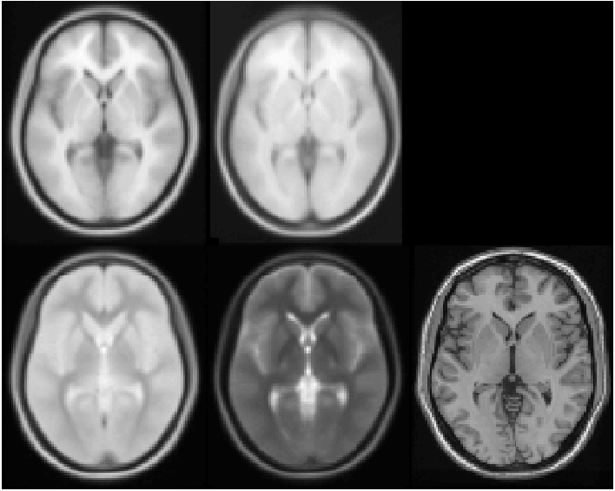
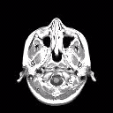
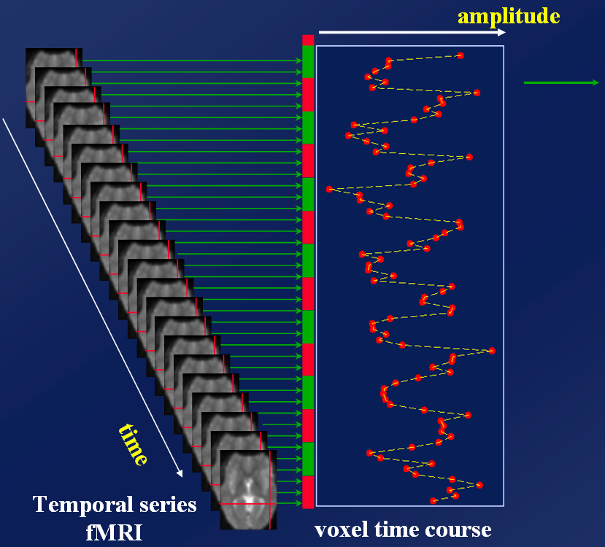
Retrospect
MRI:
T1
Time series of BOLD
responses in one voxel
fMRI:
One sssion
7 cycles of
rest and task
Each epoch 6 scans
with 2 sec TR

Slide 4
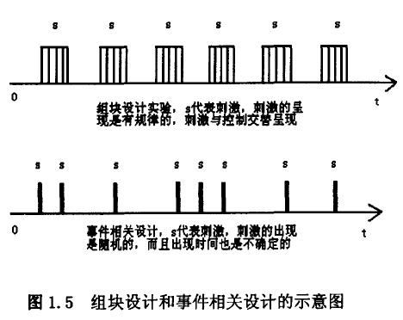
Experimental Design
Blocks of events
Delta
functions

Slide 5
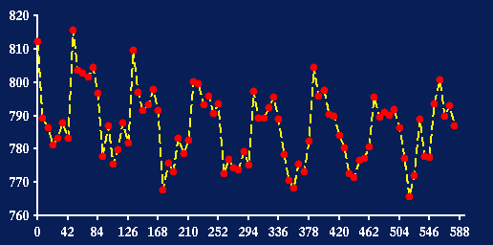
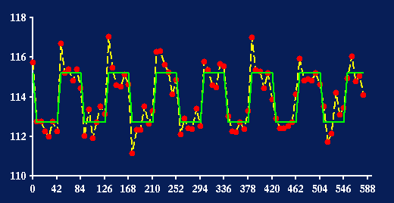
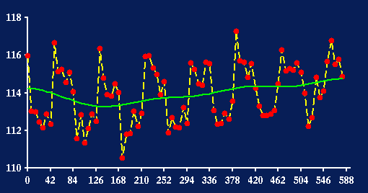
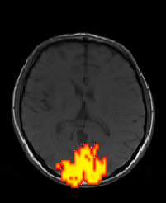
Correlation analysis
Raw fMRI timeseries
Correlation analysis
fitted box-car
highpass filtered (and scaled)
fitted high-pass filter

Slide 6
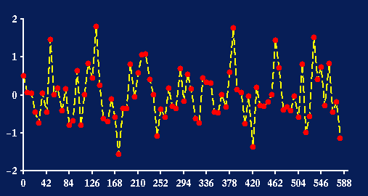
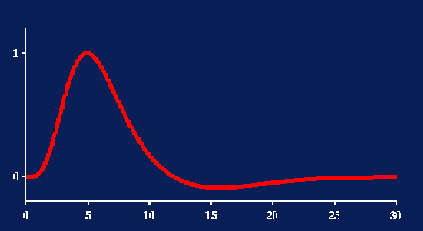

Convolution with HRF
Unconvolved fit
Residuals
⊗
Boxcar function
hæmodynamic response
convolved with HRF
Convolved fit
Residuals (less structure)

Slide 7
Summary
Hypothesis-drvien (Model-Based)
Statistical inference &
Hypothesis test
Correalation analysis
t-test analysis
General Linear Model (GLM)
……
Data-drvien (Model-free)
can do without
Component analysis
PCA
ICA ……
Clustering analysis
Sequential algorithms
Hierarchical clustering algorithms
Genetic clustering algorithms
Competitive learning algorithms

Slide 8
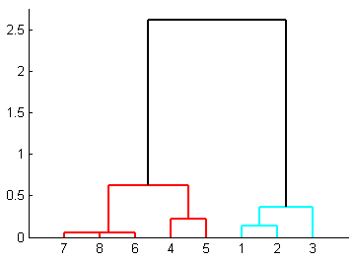
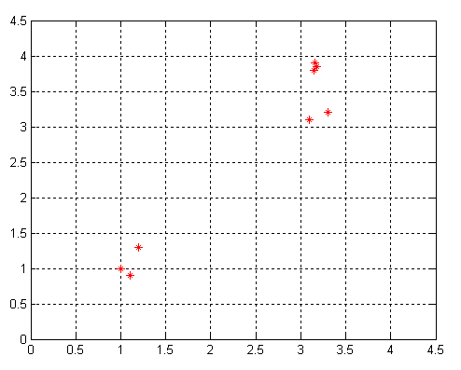
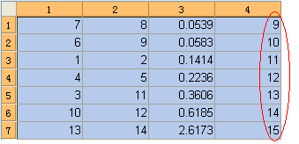
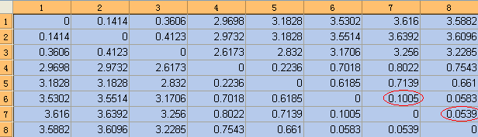
Clustering

Slide 9
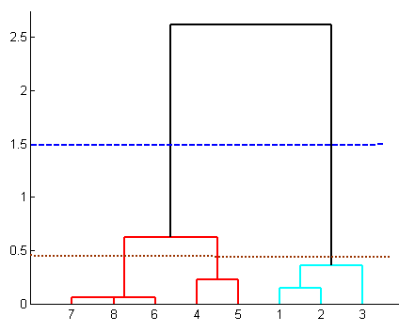
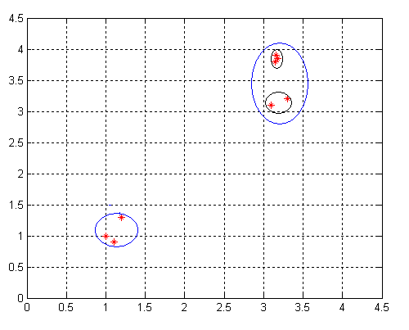


Hierarchical Agglomerative Clustering
cluster(Z,2)
cluster(Z,3)

Slide 10
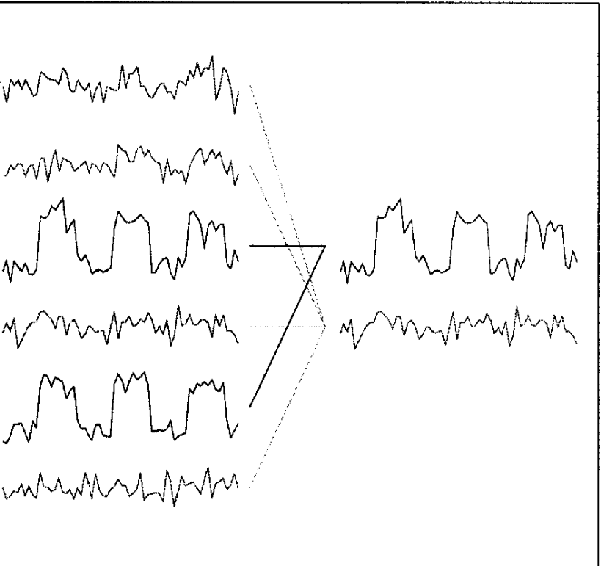
Clustering fMRI Data
using clustering methods to detect similarities in activation between voxels
The Metric:
d²(a, b) = (a - b)^{T}D(a - b)
Both clustering algorithms above rely on the use of a metric, i.e., a definition of distances between two points in P-dimensional space.
The six data vectors (left-hand side) are assigned to two cluster centers (right-hand side).

Slide 11
Self-organizing Mapping (SOM)
Self OrganisingMaps (SOM) are neural network modelsfor unsupervised learning, which combine a competitive learning principle with a topological structuring of neurons such that adjacent neurons tend to have similar weight vectors.
Neurobiological hypothesis:
–The structure self-organises based on learning rules and system interaction.
–Axons physically maintain neighborhood relationships as they grow.

Slide 12
Feature-mapping models
Principle of topographic map formation
spatial location of output neuron in a TM corresponds to a domain or feature of data drawn from input space

Slide 13
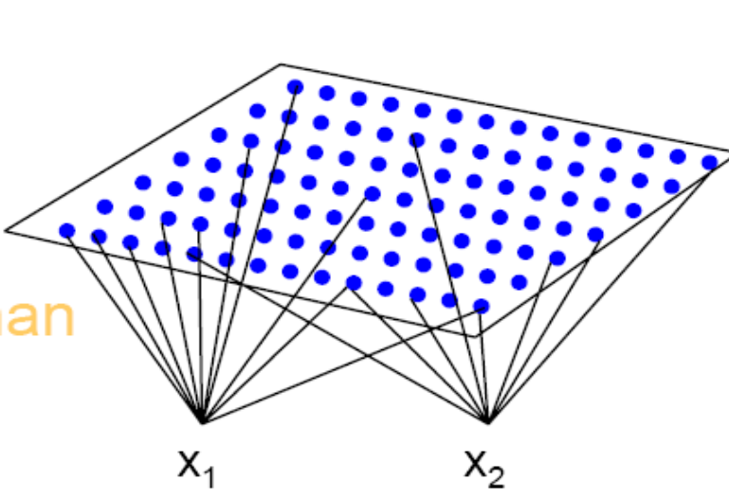
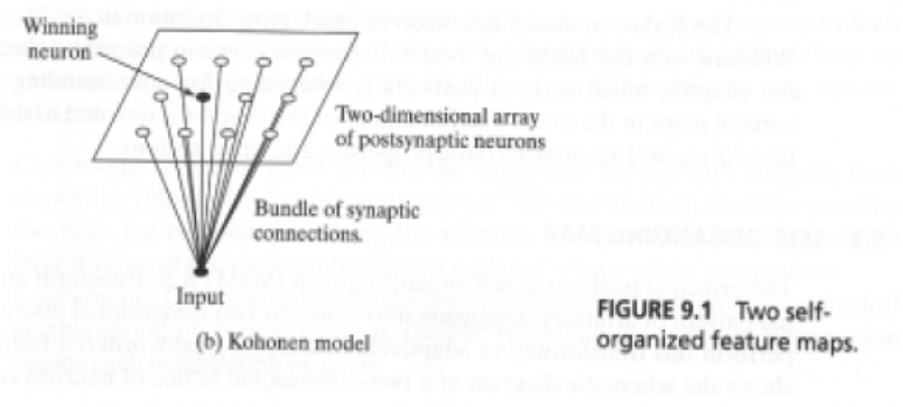
Kohonen Model
Captures essential features of computational maps in Brain
capable of dimensionality reduction

Slide 14
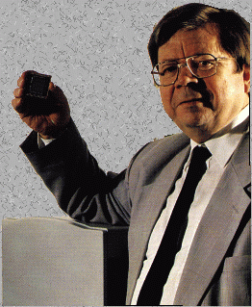
Kohonen Model
Teuvo Kohonen
Dr. Eng., Emeritus Professor of the Academy of Finland; Academician
http://www.cis.hut.fi/research/som-research/teuvo.html

Slide 15
The learning process
There are basically threeessential processes:
–competition
–cooperation
–weight adaption

Slide 16
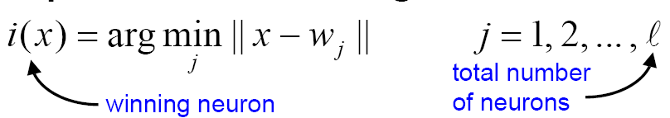
Competition:
–Competitive process: Find the best match of input vector xwith weight vectors:
–The input space of patterns is mapped onto a discrete output space of neurons by a process of competition among the neurons of the network.

Slide 17

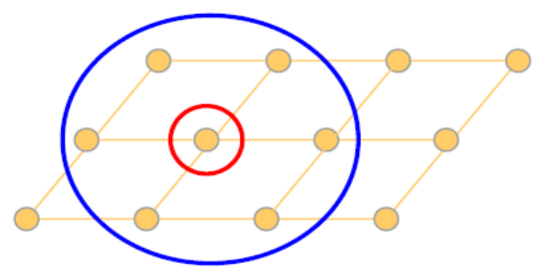
Cooperation:
–Cooperative process: The winning neuron locates the center of a topological neighbourhood of cooperating neurons.
–The topological neighbourhood depends on lateral distance d_{ji} between the winner neuron i and neuron j.
1--dimensional topology
A small neighbourhood
2--dimensional topology
Two possible neighbourhoods

Slide 18
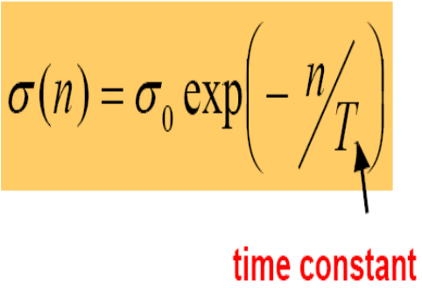
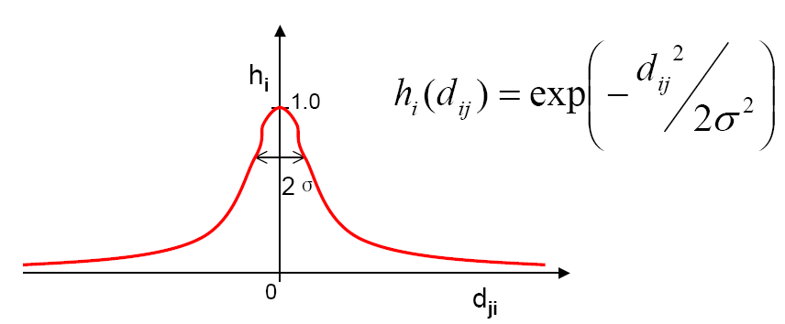
Cooperation:
-neighbourhood function
Gaussian neighbourhood function
–σ(effective width) measures degree to which excited neurons in the vicinity of the winning neuron participate to the learning process.
d_{ij}=|j-i|
1--dimensional topology

Slide 19
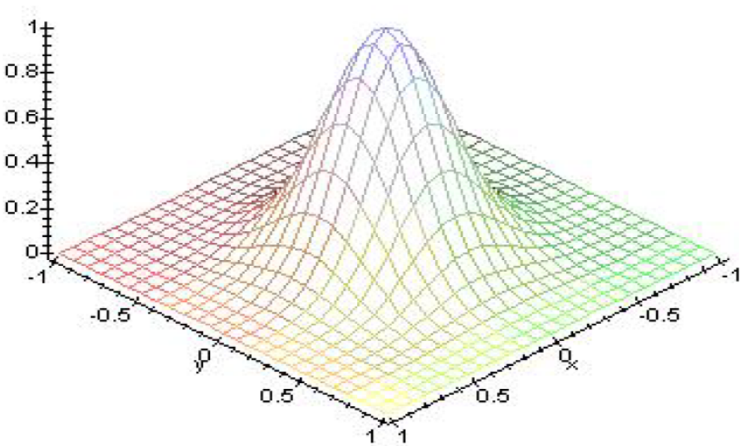
Cooperation:
-neighbourhood function
d_{ij}=|r_{j}-r_{i}|
2--dimensional topology

Slide 20
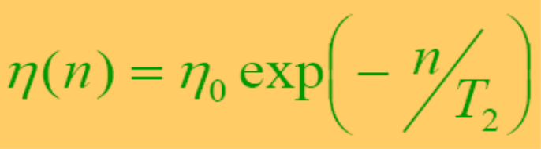
weight adaption:
Applied to all neurons inside the neighbourhoodof the winning neuron i.
exponentialdecay update:

Slide 21
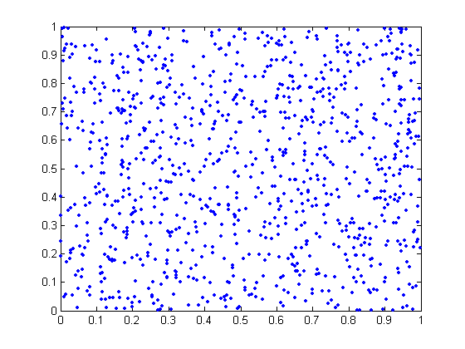
Example
1. Inputis bidimensional: x = (x1, x2) from a uniform distribution in a regiondefined by:
{ (-1 < x1< +1); (-1 < x2< +1) }
2. Weights are initialised with random values.

Slide 22
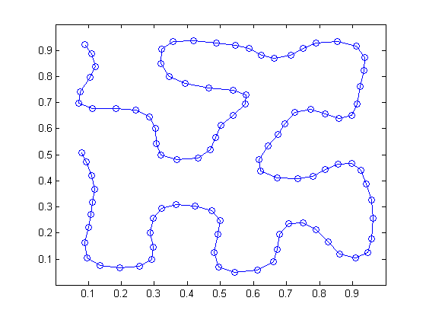
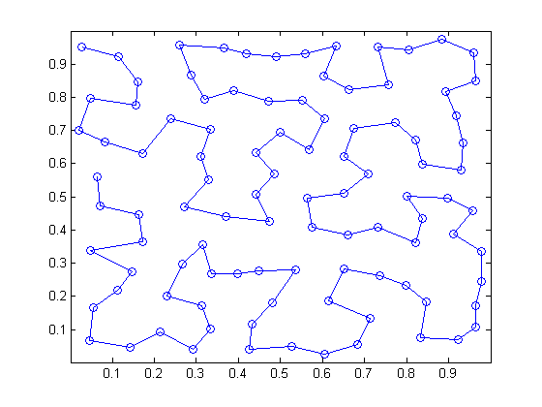
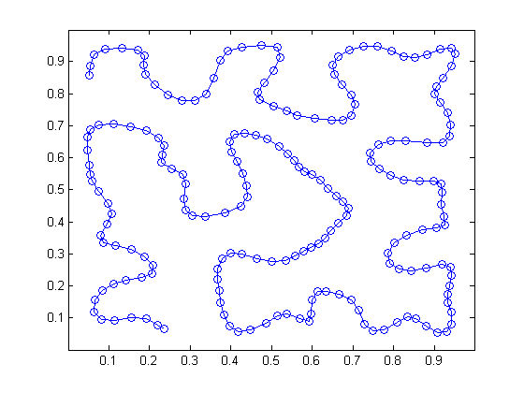
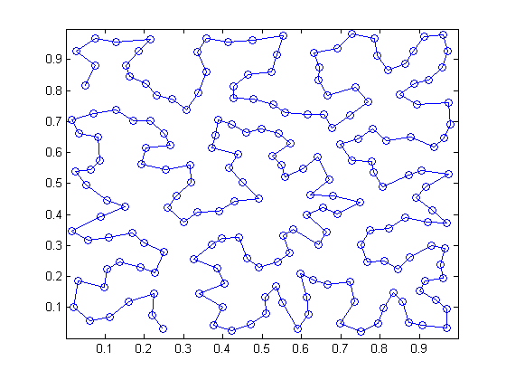
100个隐藏神经元的一维网格情况
a 排序阶段之后的网格情况
b 收敛阶段之后的网格情况
200个隐藏神经元的一维网格情况

Slide 23
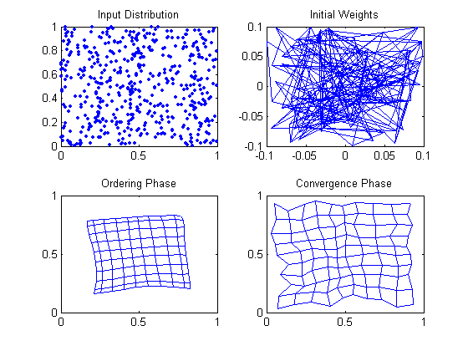
两维分布驱动的两维网格图

Slide 24
Anlysis fMRI using SOM
We employ another metric that measures the similarity between the activation stimulus and the fMRI signal
i(x)=arg max(corr(x, w_{j})) j=1,2,…N
^{j}
Where x (x₁,x₂,…x_{M}) is the time course of one voxels, and M is length of time course. N is the total number of neurons in two lattice.

Slide 25
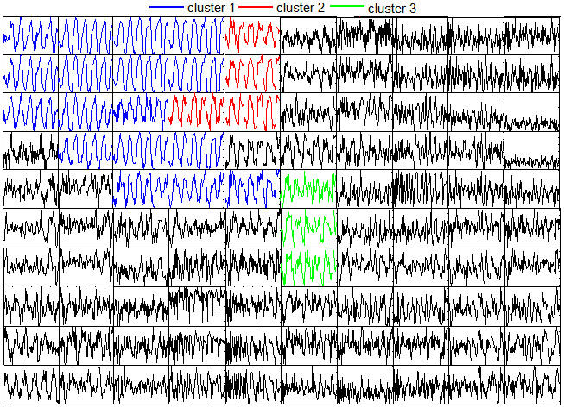
How to cluster
SOM weight?
There are total 100 neurons in the two dimensional lattice. Each neurons (weights) denotes a average time (cluster center) course of voxels in the similar cluster.

Slide 26
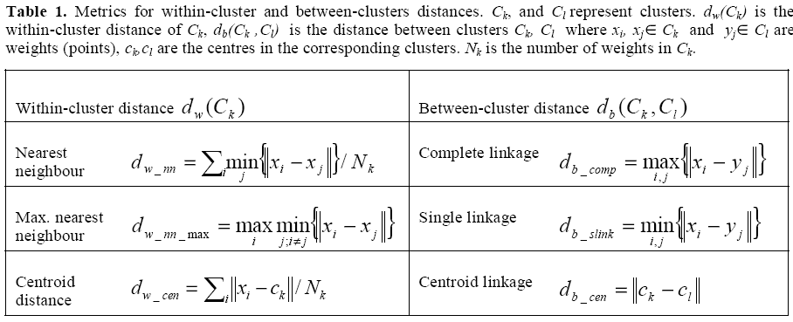
Spatio-Temporal Clustering (STC)

Slide 27
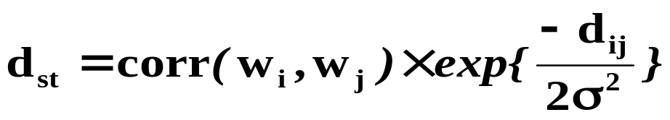
Spatio-Temporal Clustering (STC)
Define a spatio-temporal distance instead of conventional metrics for within-cluster distance.
Complete linkage distance be used in between-cluster distance

Slide 28
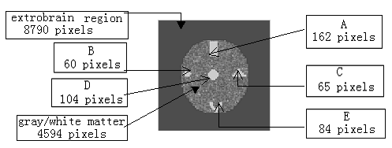
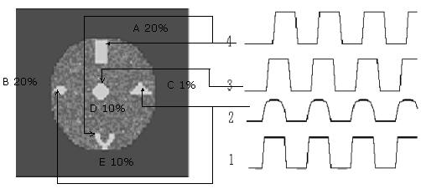
Synthetic Data
Synthetic fMRI image
(a)
Synthetic data with noise (a) Synthetic fMRI image with noise
(b) The four sorts of pattern. 1: The normal stimulation pattern with 10 times rest and 10 times task condition respectively; 2: The hypothetic pattern; 3 and 4: The 1 pattern with delay 2s and 5s.
(b)

Slide 29
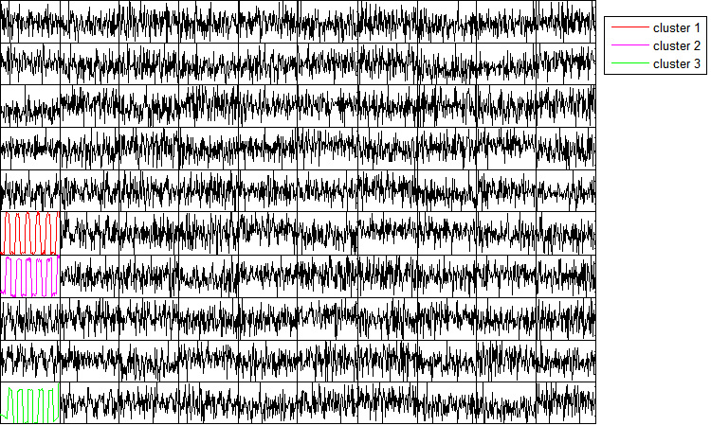
Results of Synthetic Data1
Resultant exemplar time course matrix after applying the SOM algorithm to a block-designed synthetic fMRI data.The colored time
course correspons to one supercluster.

Slide 30

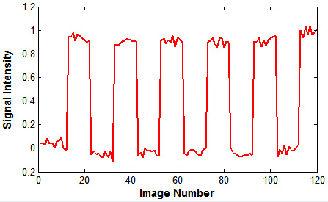

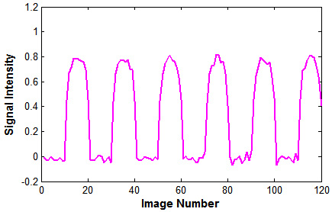
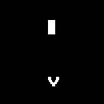
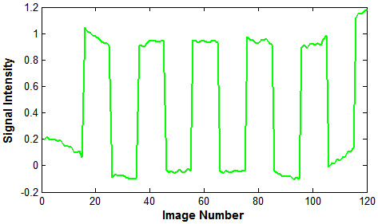
A.Voxel patterns corrresponding to the supercluster,overlaid on the corresponding
anatomic image
B1
A1
B.The averaged
weight time course
correspons the
different activation
pattern
A2
B2
A3
B3

Slide 31
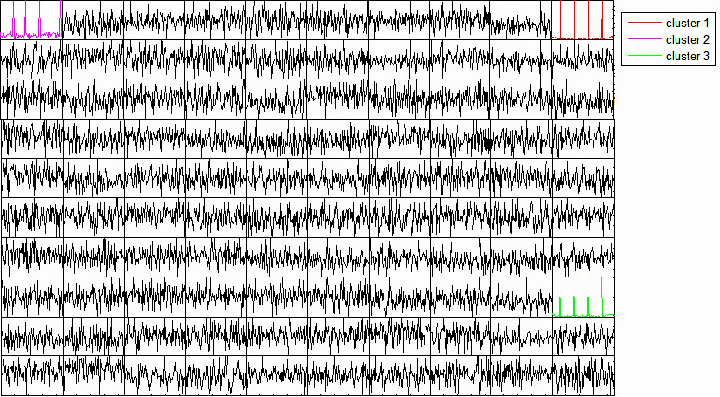
Results of Synthetic Data2
Resultant exemplar time course matrix after applying the SOM algorithm to a event-related synthetic fMRI data.The colored time
course correspons to one supercluster.

Slide 32
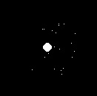
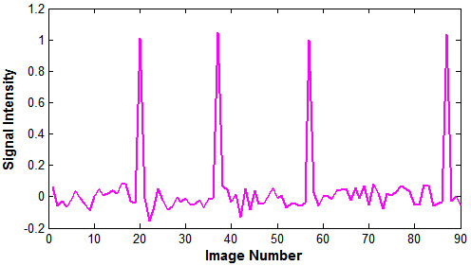

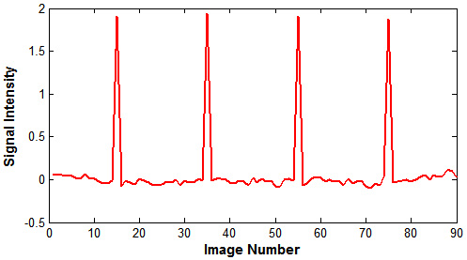
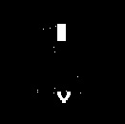
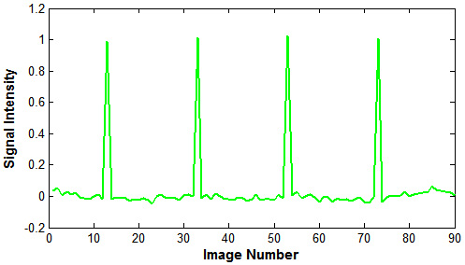
A.Voxel patterns corrresponding to the supercluster,overlaid on the corresponding
anatomic image
A1
B1
A2
B2
B.The averaged
weight time course
correspons the
different activation
pattern
A3
B3

Slide 33
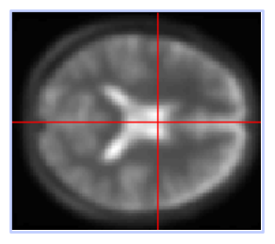
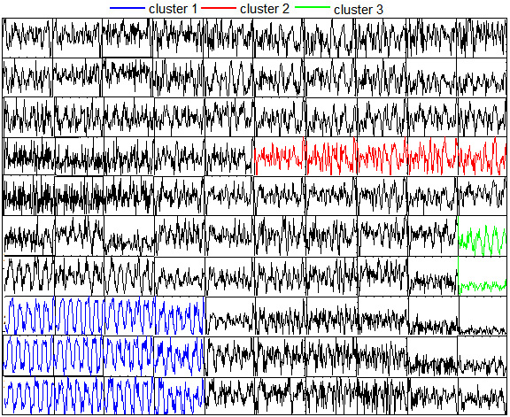




Processing of vivo fMRI Data
images
lattice
or random
initialization
  Sampling
updating
realignment &
coregistration
SOM
STC
similarity
mactching
detrend
i(x)=arg max(corr(x, w_{j})) j=1,2,…N
^{j}

Slide 34



Results of vivo fMRI Data1
C
A. Resultant exemplar time course matrix after applying the SOM algorithm to a block-designed vivo fMRI data.The colored time course correspons to one supercluster.
A
B1
B2
B3
B.Voxel patterns corrresponding to the supercluster,overlaid on the corresponding
anatomic image
C.The averaged weight time course
correspons the different activation pattern

Slide 35

Results of vivo fMRI Data2
Resultant exemplar time course matrix after applying the SOM algorithm to a event-related vivo fMRI data.The colored time
course correspons to one supercluster.

Slide 36








A1
B1
A2
B2
A3
B3
A4
B4
A.Voxel patterns corrresponding to the supercluster,overlaid on the corresponding anatomic image
B.The averaged weight time course
correspons the different activation pattern

Slide 37
Perspective
Discussion of relationship of each cluster
Decision of number of the cluster
application of the epilepsy fMRI data without prior information

Slide 38
Thanks for your attentions!!

