Slide 1

Support vector machines for classification
Radek Zíka
zikar@img.cas.cz
http://bio.img.cas.cz/zikar

Slide 2
Support vector machines for classification
History
Statistical learning
SVM principles
SVM applications
SVM implementations
Examples
References

Slide 3
History
Vapnik, V., 1979, Estimation of dependencies based on empirical data
Vapnik, V., 1995, The nature of statistical learning theory
Microarray gene expression data analysis, protein structural class. ~1999-2000

Slide 4
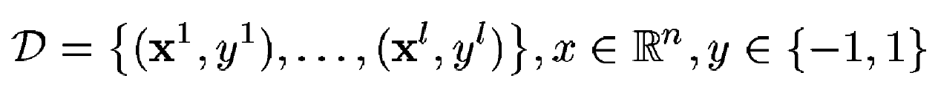
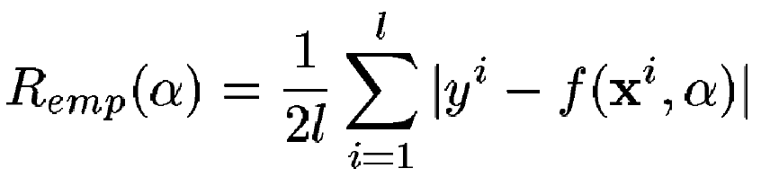
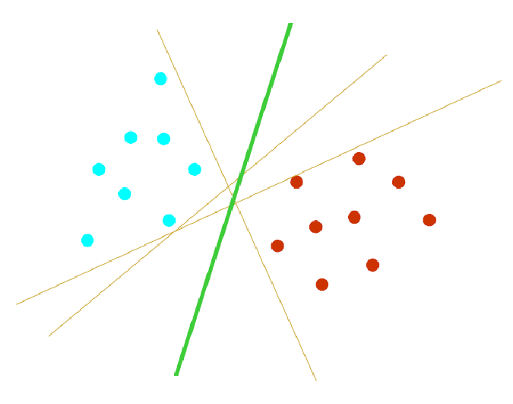
Statistical learning
Data
Hypothesis => errors
  Expectation of the test error (empirical risk)
Learning machines
  NN
  SVR ~ regression
  SVC ~ classification:

Slide 5
SVM principles (SVC) I.
Training data (vector, scalar set)
  [0.32, 0.2, 0.1], -1; [0.8, 0.9, 2.1], +1; [1.1, 3.1, 2.1]; +1, …
Model (parameters - Lagrange multipliers, hyperplane parameters)
  α₁ = 0.57, α₂ = 1.37,…, w = [0.91, 0.81, 0.74], b = 1.2
Unclassified data (vector set)
Classification using model parameters (scalars)
  y₁ = -1, y₂ = +0.9, y₃ = +1

Slide 6


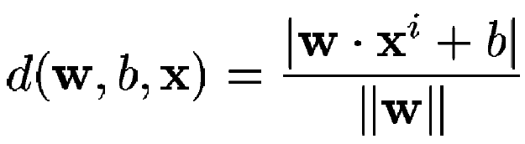
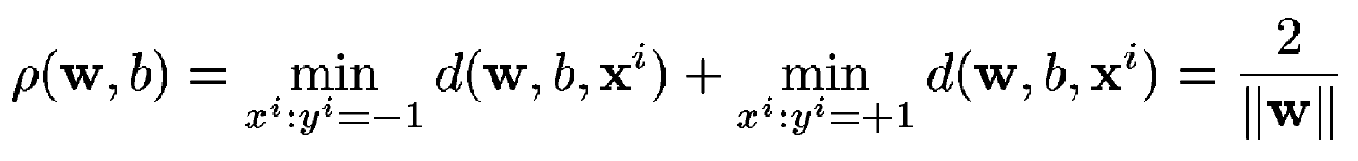
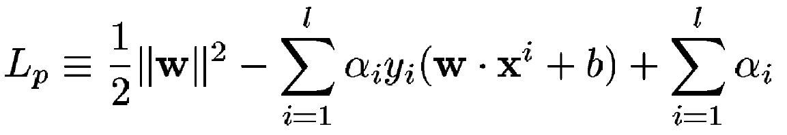
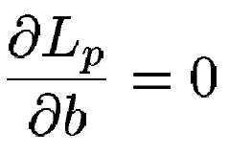
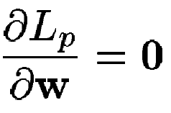
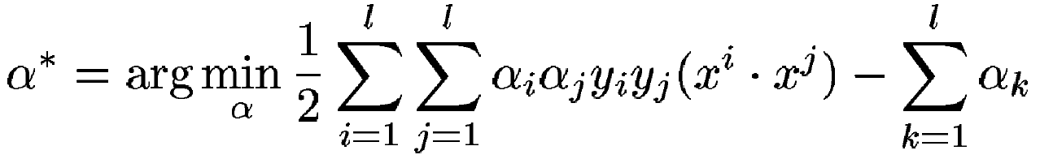

SVM principles (SVC) II.
Data
Functions
  Hyperplane
  Distance
  Margin
  Lagrangian
Params of hyperplane
Classification

Slide 7
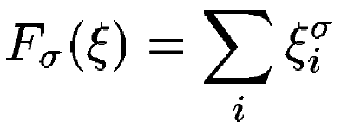

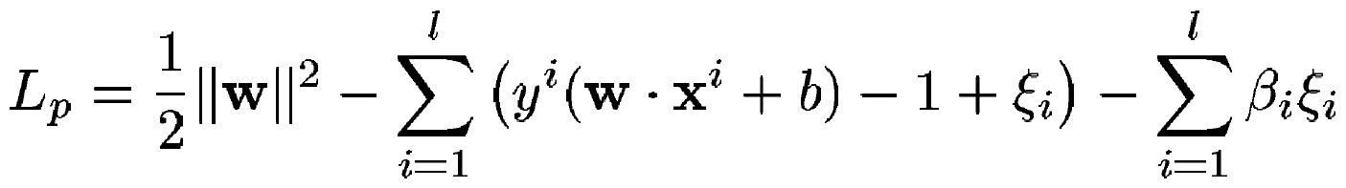
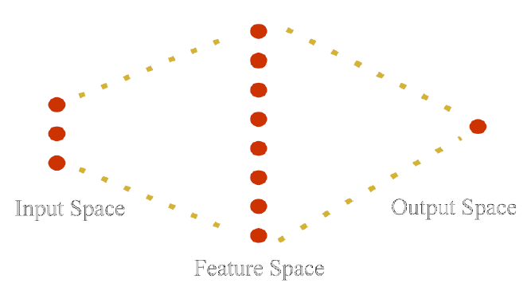
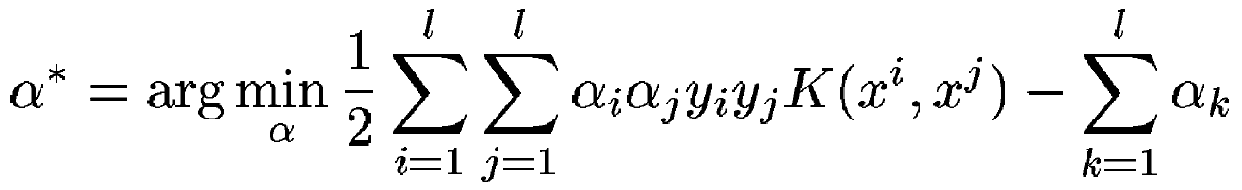


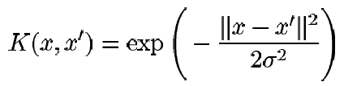
SVM principles (SVC) III.
Linearly separable data
Linearly non-separable data
  Generalized optimal separating hyperplane
  Generalisation in high dimensional space
  Kernel functions

Slide 8
SVM applications
Pattern recognition
  Features: words counts
DNA array expression data analysis
  Features: expr. levels in diff. conditions
Protein classification
  Features: AA composition

Slide 9
SVM implementations I.
SVM^{light} - satyr.net2.private:/usr/local/bin
        svm_learn, svm_classify
bsvm - satyr.net2.private:/usr/local/bin
        svm-train, svm-classify, svm-scale
libsvm - satyr.net2.private:/usr/local/bin
        svm-train, svm-predict, svm-scale, svm-toy
mySVM
MATLAB svm toolbox
Differences: available Kernel functions, optimization, multiple class., user interfaces

Slide 10
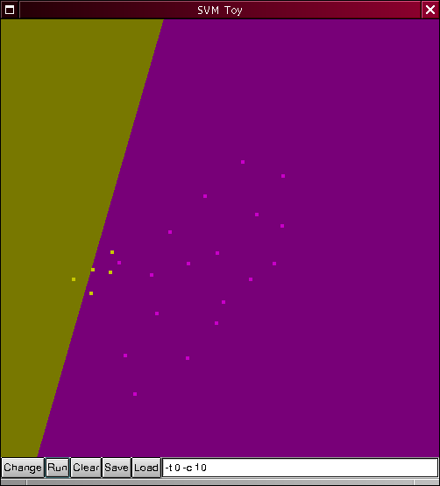
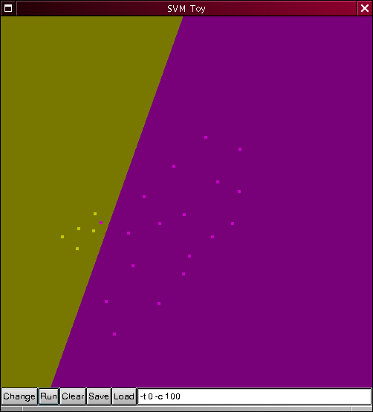
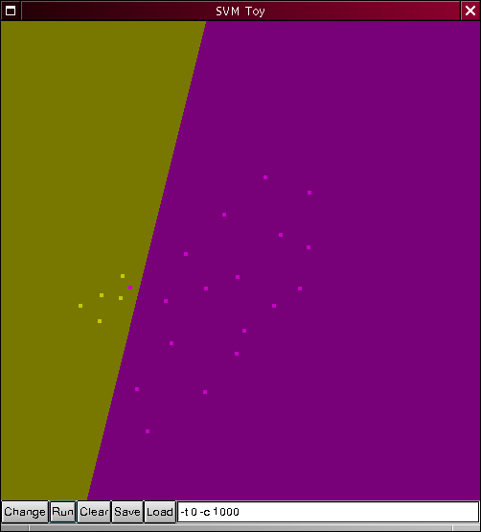
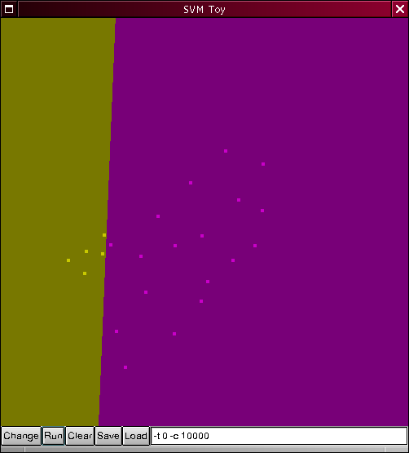


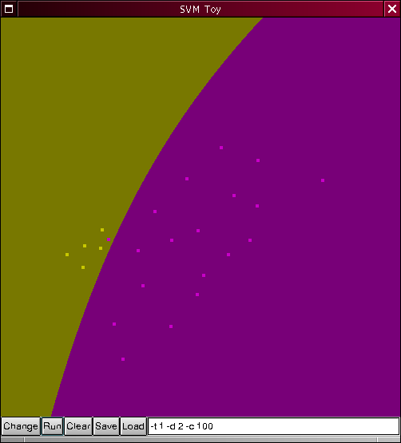
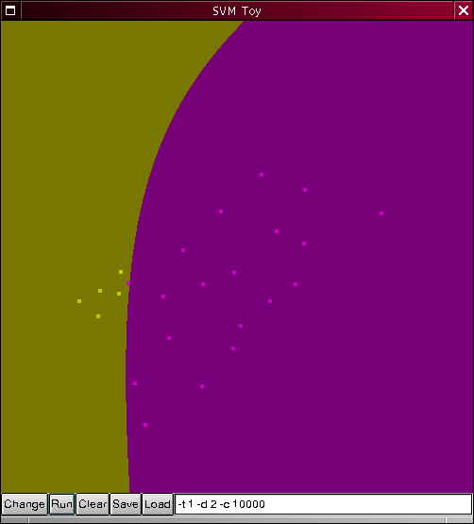
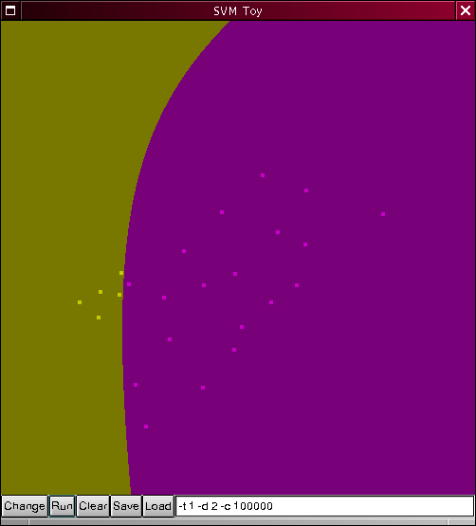
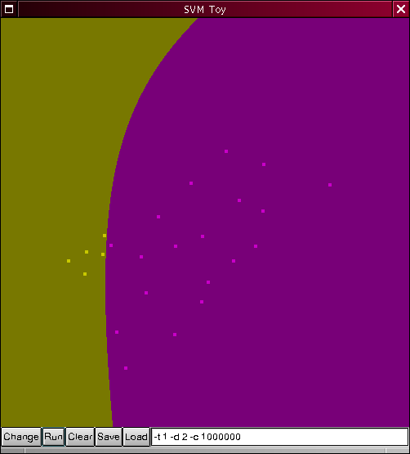
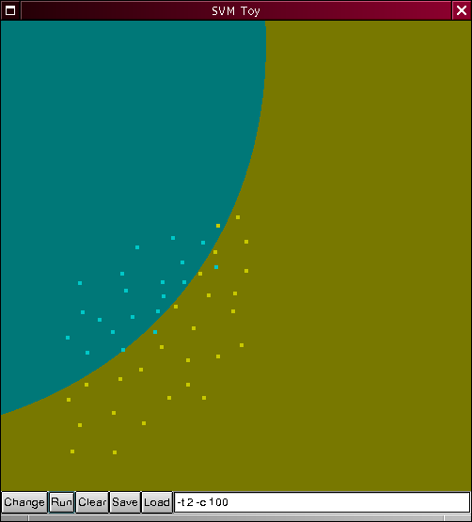
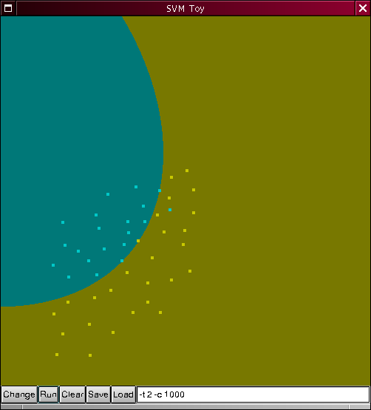
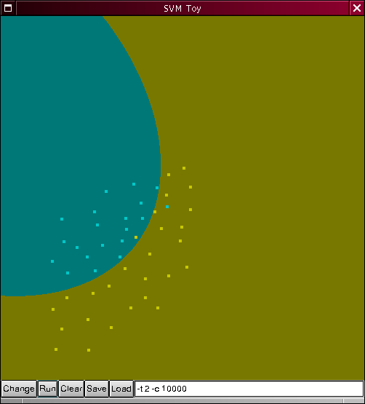
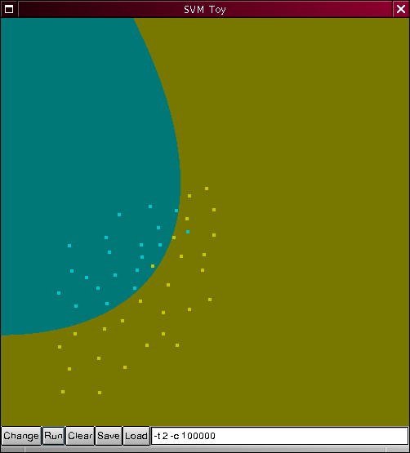
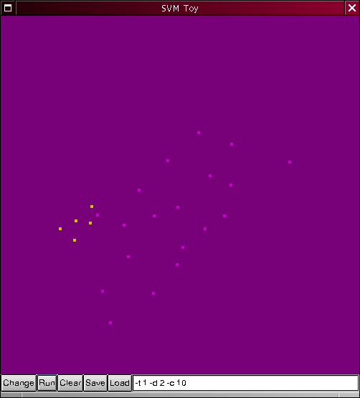
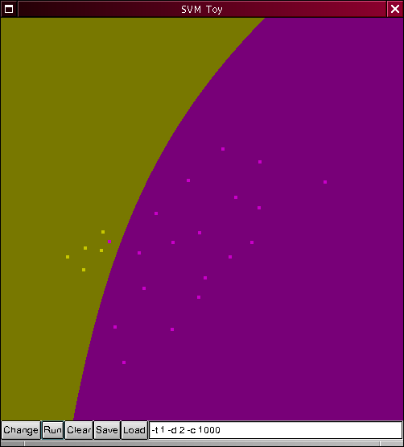
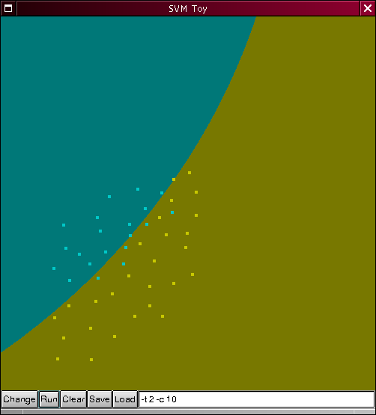
SVM implementations II.
SVM^{light}
  Simple text data format
  Fast, C routines
bsvm
  Multiple class.
LIBSVM
  GUI: svm-toy
MATLAB svm toolbox
  Graphical interface 2D

Slide 11
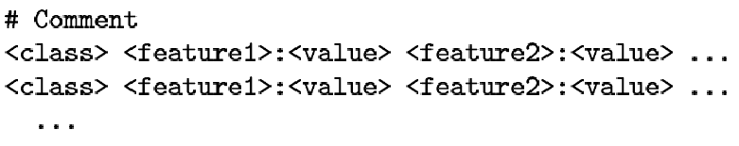
Data format
Universal, simple, human readable text
SVM^{light}
libsvm
  2D gr. interface
bsvm
  multi-class.

Slide 12
References
Steve R. Gunn: SVM for Classification and Regression (1998)
Ch. J. C. Burges: A Tutorial on SVM for Pattern Recognition (1998)
T. Evgeniou, M. Pontil, T. Poggio: Regularization Networks and SVM (2000)
SVM for predicting protein structural class, BMC Bioinformatics, (2001), 2:3
Knowledge-based analysis of microarray gene expression data by using support vector machines, PNAS, 97, 262-267
SVM classification and validation of cancer tissue samples using microarray expression data, Bioinformatics, (2000), 10(16), 906-914
http://www.kernel-machines.org/publications.html

