Slide 1
The following slides are taken from:
http://hydra.postech.ac.kr/~dkim/course/ece521/svm.ppt

Slide 2
Support Vector Machines
Trends & Controversies
May, 2002
Intelligent Multimedia lab.

Slide 3
CONTENTS
Theory of SV Learning
How to Implement SVM
SVM Applications
Conclusion

Slide 4
Theory of SV Learning
Introduction
Learning Pattern Recognition from example
Hyper plane classifier
Feature spaces & kernels
Architecture of Support Vector Machines

Slide 5
Introduction
What are benefits SV learning?
  Based on simple idea
  High performance in practical applications
Characteristics of SV method
  Can dealing with complex nonlinear problems
  (pattern recognition,regression,feature extraction)
  But working with a simple linear algorithm
  (by the use of kernels)

Slide 6


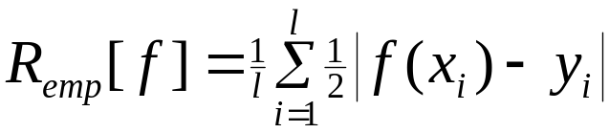

Learning Pattern Recognition from Examples(1)
Training Data
  We want to estimate a function using training data
Empirical Risk
Risk

Slide 7



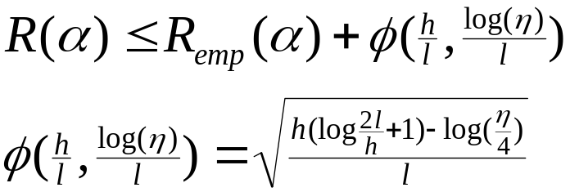
Learning Pattern Recognition from Examples(2)
Structual Risk Minimization
  VC Dimension
  - property of set of functions
  - maximum number of training points that
  can be shattered by
  Ex) ‘s VC dimension of the set of oriented lines
  VC Theory provides bounds on the test error,
  which depend on both empirical risk
  and capacity of function class

Slide 8


Hyperplane Classifiers(1)
Class of Hyperplanes
Decision functions
Maximum margin of separation
x2
x1
+1
-1
Wx+b=0

Slide 9
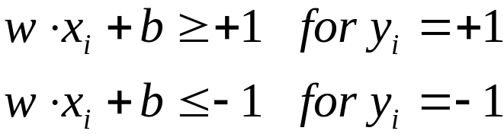
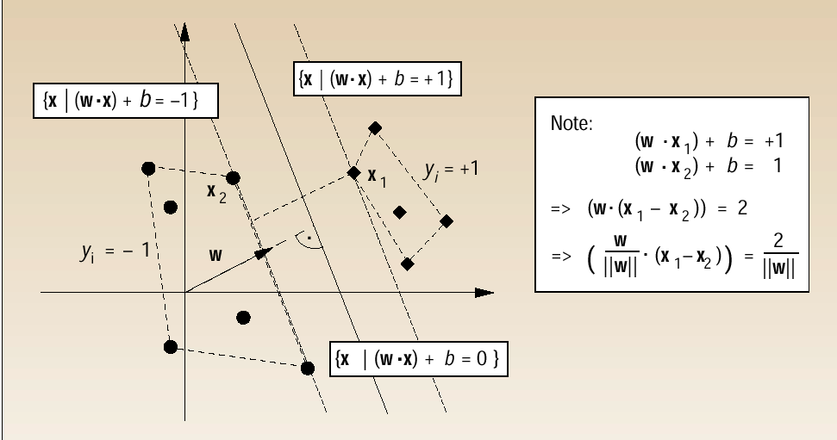
Hyperplane Classifiers(2)

Slide 10
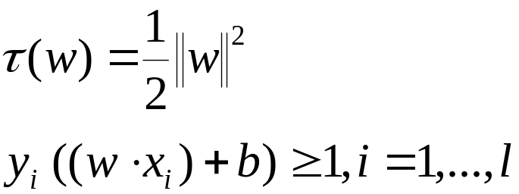
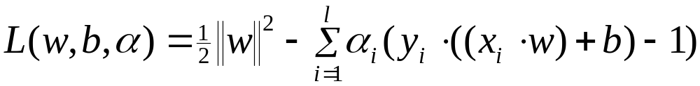
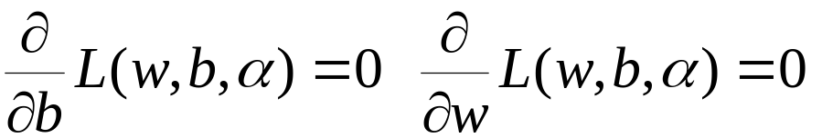
Hyperplane Classifiers(3)
To construct optimal hyperplane
  Minimize
  Subject to
Constrained Optimization problem with Lagrangian

Slide 11
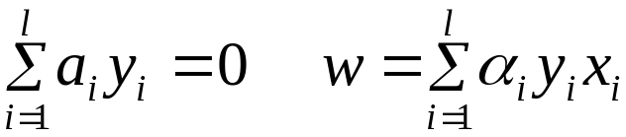

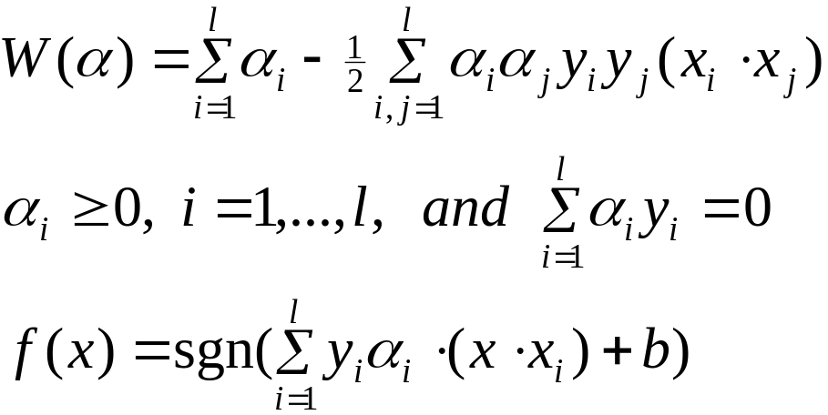
Hyperplane Classifiers(4)
  Primal variables vanish
    KKT condition
    Support Vectors whose is nonzero
  Optimization problem
    Maximize
    Subject to
    Decision function

Slide 12
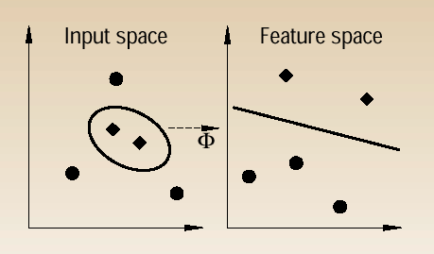



Feature Spaces and Kernels
Feature Space
    Input space map to some other
    dot product space F(feature space)
    via a nonlinear mapping
Kernels
    Evaluation of decision function require dot product
    but never the mapped pattern in explicit form
    Dot products can be evaluated by simple kernel

Slide 13


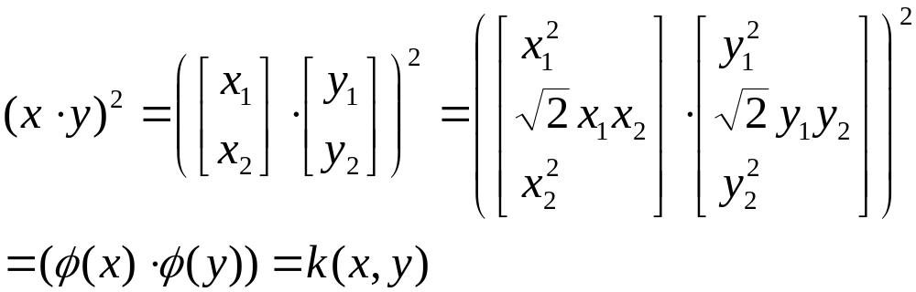
Feature Spaces and Kernels(2)
Example of Kernels
  Polynomial kernel
    If d=2 and

Slide 14
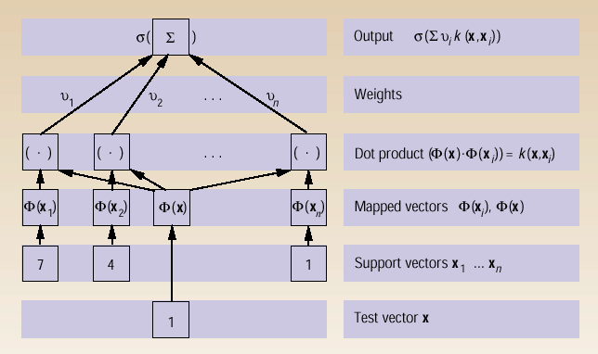
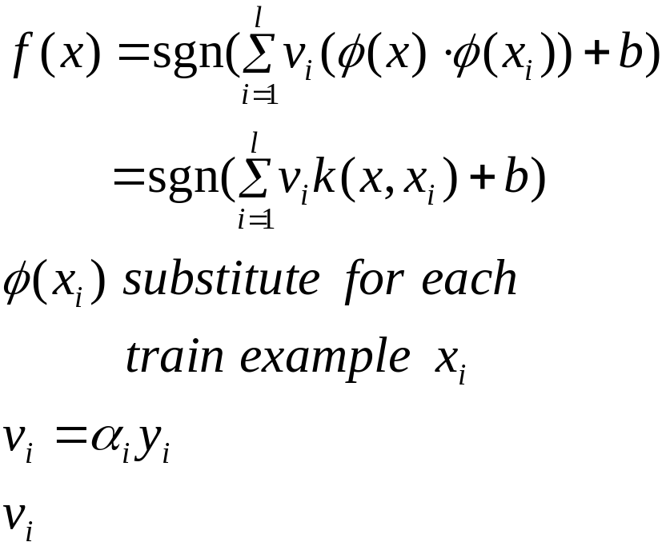
Architecture of SVMs
Nonlinear Classifier(using kernel)
  Decision function
  are computed as the
  solution of quadratic program

Slide 15
How to Implement SVM
Optimization Problem
Solving Quadratic Program

Slide 16
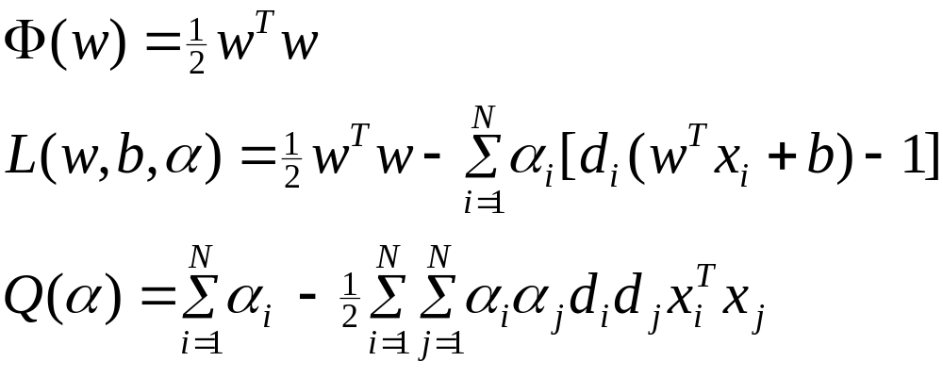
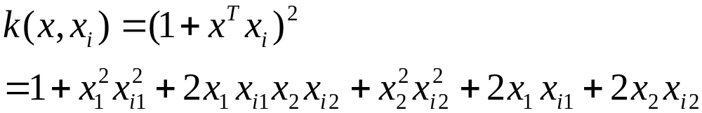
Optimization Problem(1)
Simple example (XOR problem)
Input vector d
[-1,-1] -1
[-1,+1] +1
[+1,-1] +1
[+1,+1] -1
1
0
1
1
K= | 9 1 1 1 |
| 1 9 1 1 |
| 1 1 9 1 |
| 1 1 1 9 |

Slide 17
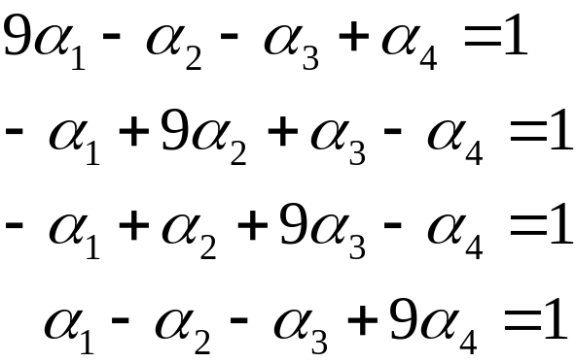
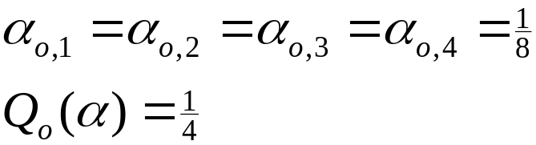
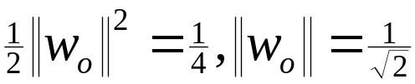
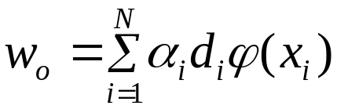
Optimisation Problem(2)
Simple example(cont.)
Four Input vectors are
All support vectors
W = [0 0 –1/sqrt(2) 0 0 0]’

Slide 18

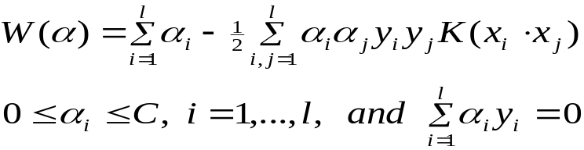
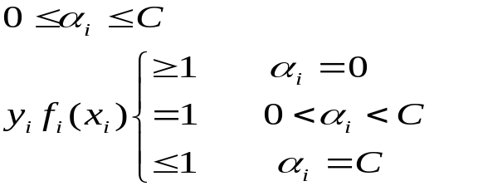
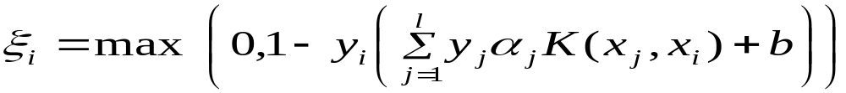
Optimization Problem(3)
We want to find
  Maximize
  Subject to
iteratively increasing the value
- Stop conditions
1.Monitoring the growth of the objective function :
fraction rate of increase of objective function W(a)
2.Monitor condition
3. Monitoring the gap vs solution

Slide 19

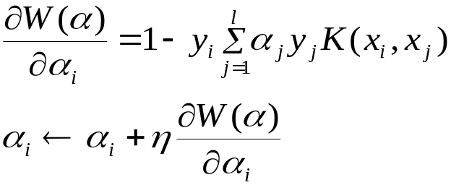





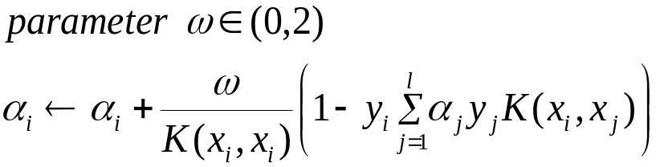
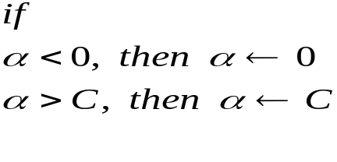
Optimisation Problem(4)
The Naive Solution : Gradient Ascent Method
I’th component of the gradient of
Given Training set S and learning rate
Repeat
for all train set
update
End for
Until stop criterion satisfied
return
= learning rate

Slide 20
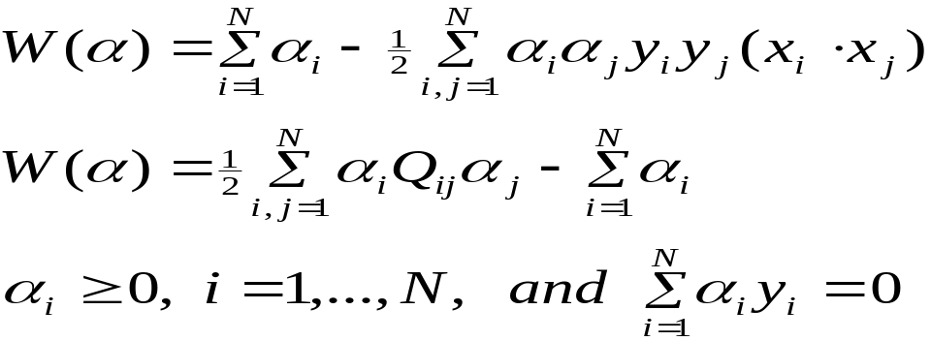



Solving Quadratic Programming(1)
Quadratic Programming
  Maximize
  Minimize
  Subject to
  - QP package (MINOS,LOQO,MATLAB toolbox etc.)
Is N*N matrix : depend on training input , label ,SVM functional form
Call this problem quadratic programming

Slide 21
Solving Quadratic Programming(2)
Solving QP problems
  Q matrix can be very large size –> limitation of memory capacity
  1.using sophisticated algorithm
  [ref] “Solving quadratic programming problem”
  ,Advanced in kernel methods – Support vector learning, Linda Kaufman,Bell Lab.
  → calculate only activate rows or cols
  2. Decompose method
  Decompose the large scale QP problem into a series of smaller QP problems
  - Chunking
  - Osuna’s algorithm
  - SMO

Slide 22




Chunking
Idea
The value of objective function is the same if removes
all rows and columns of the matrix Q correspond to zero
so large QP problem break down into series of smaller QP problem
Pseudo-code
Given training set
Select an arbitrary working set
Repeat
solve optimization problem on
select new working set from data not satisfying KKT conditions
Until stopping criterion satisfied
return

Slide 23

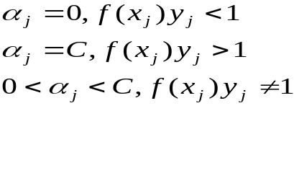


Osuna’s Method
Keeping constant size matrix for every QP sub-problem
So it allows very large size training data
Requires numerical QP Package
- Pseudo-code
Given training set
Select an arbitrary working set B of free variables
The set N of fixed variables
While KKT violated (there exists some ,such that)
select new set B -> replace any
solve optimization problem on B
return

Slide 24
SMO(Sequential minimal optimization)
-Without any extra matrix storage
-Without using numerical QP optimization step
-each step only two components modified
-needing more iterations to converge,
but it needs a few operations each step so overall speed-up
-QP decompose is similar to Osuna’s method
-each iteration,SMO chooses only two ,and find optimal value, updates
the SVM to reflect new optimal value
- 3 components to SMO
Analytic method to solve for two lagrange multiplier
Heuristic for choosing
A method for computing bias b

Slide 25
SVM Applications(1)
Applying to Face Detection
Applying to Face Recognition
Applying to Text region Detection
Other Applications

Slide 26
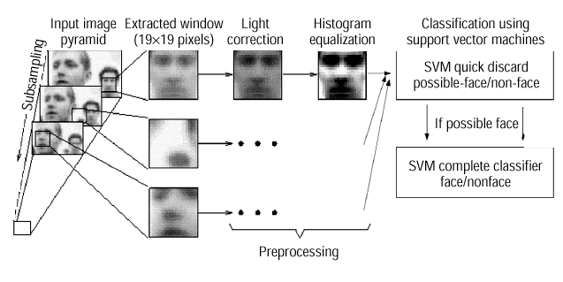
SVM Applications(2)
Applying to Face Detection
REFERENCE
  “Training Support Vector Machines: an Application to Face Detection”
  ,Edgar Osuna, MIT
  “Support Vector Machines : Training and Applications”,Edgar Osuna,MIT
Rescale Image several times
Cut 19*19 windows pattern
Preprocessing –>
light correction,
histogram equlization
4. Classify using SVM
Using Polynomial Kernel degree of 2

Slide 27
SVM Applications(3)
Applying to Face Recognition
Ref “Face Recognition under Various Lighting Conditions and Expression using Support Vector Machines”,김재진,이성환,고려대학교 인공시각연구센터,1999
Basically SVM is 2-class classifier
Face Recognition problem is usually multi class problem
Result(correct recognition rate)
Face DB : Yale Face Data base , 15 person, 11 images/person
It contains various conditions for light, expression, glasses
One/the others method
Pair-wise
Light condition : 94.7%~98.0%
Expression : 99.4%~100%

Slide 28
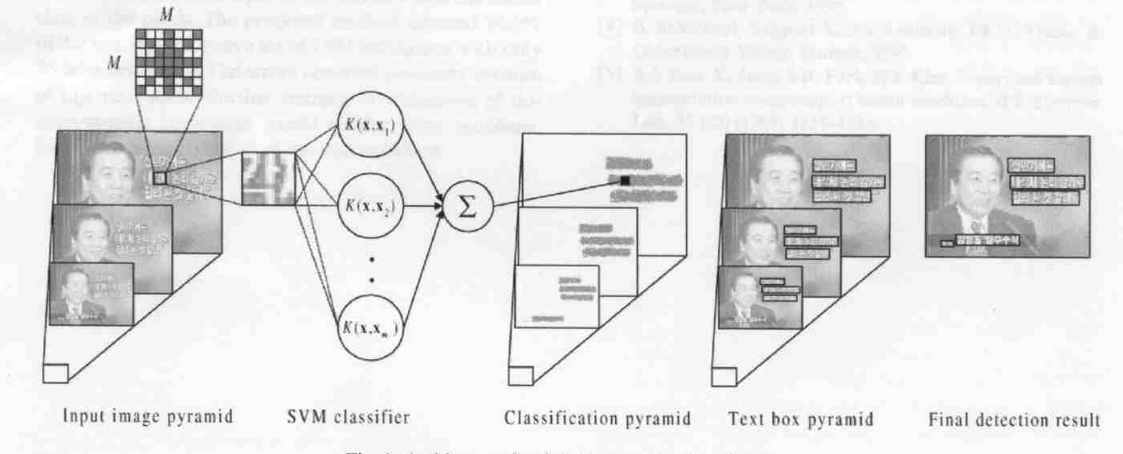
SVM Applications(4)
Applying to caption detection
Ref : “Support vector machined-based text detection in digital video”,Pattern Recognition,2001,김재진,경북대
Experimental results :
94.3% of text regions detected
86 false alarms
2000 frames korean news shot
500 were using train process
1500 were test image

Slide 29
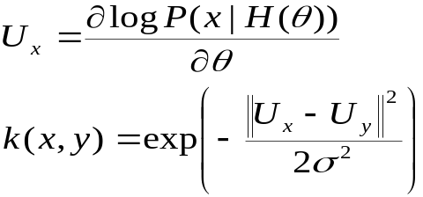
SVM Applications(5)
Other Applications
-Hand Written Digit Recognition
-Text Categorization
-3D object recognition
-Face Pose Recognition
-Color based Classification
-Bio-informatics(protein Homology Detection)
“Using SVM for text categorization”,Susan Dumais,microsoft research center
“SVM for 3D object recognition”,Pontil,MIT
Sequence x , log-likelihood, HMM model parameter

Slide 30
Conclusion
SVM assure that good performance in a variety of applications such as Pattern Recognition,regression estimation,time series prediction etc.
But it have some open issues,
1.Speed up the quadratic programming training method(both time complexity & storage capacity problem are increasing as train data increase)
2.The choice of kernel function : there are no guidelines
Other Kernel method
Kernel PCA performs nonlinear PCA by carrying out linear PCA in feature space
its architecture is nearly the same as SVM

